Slide 1
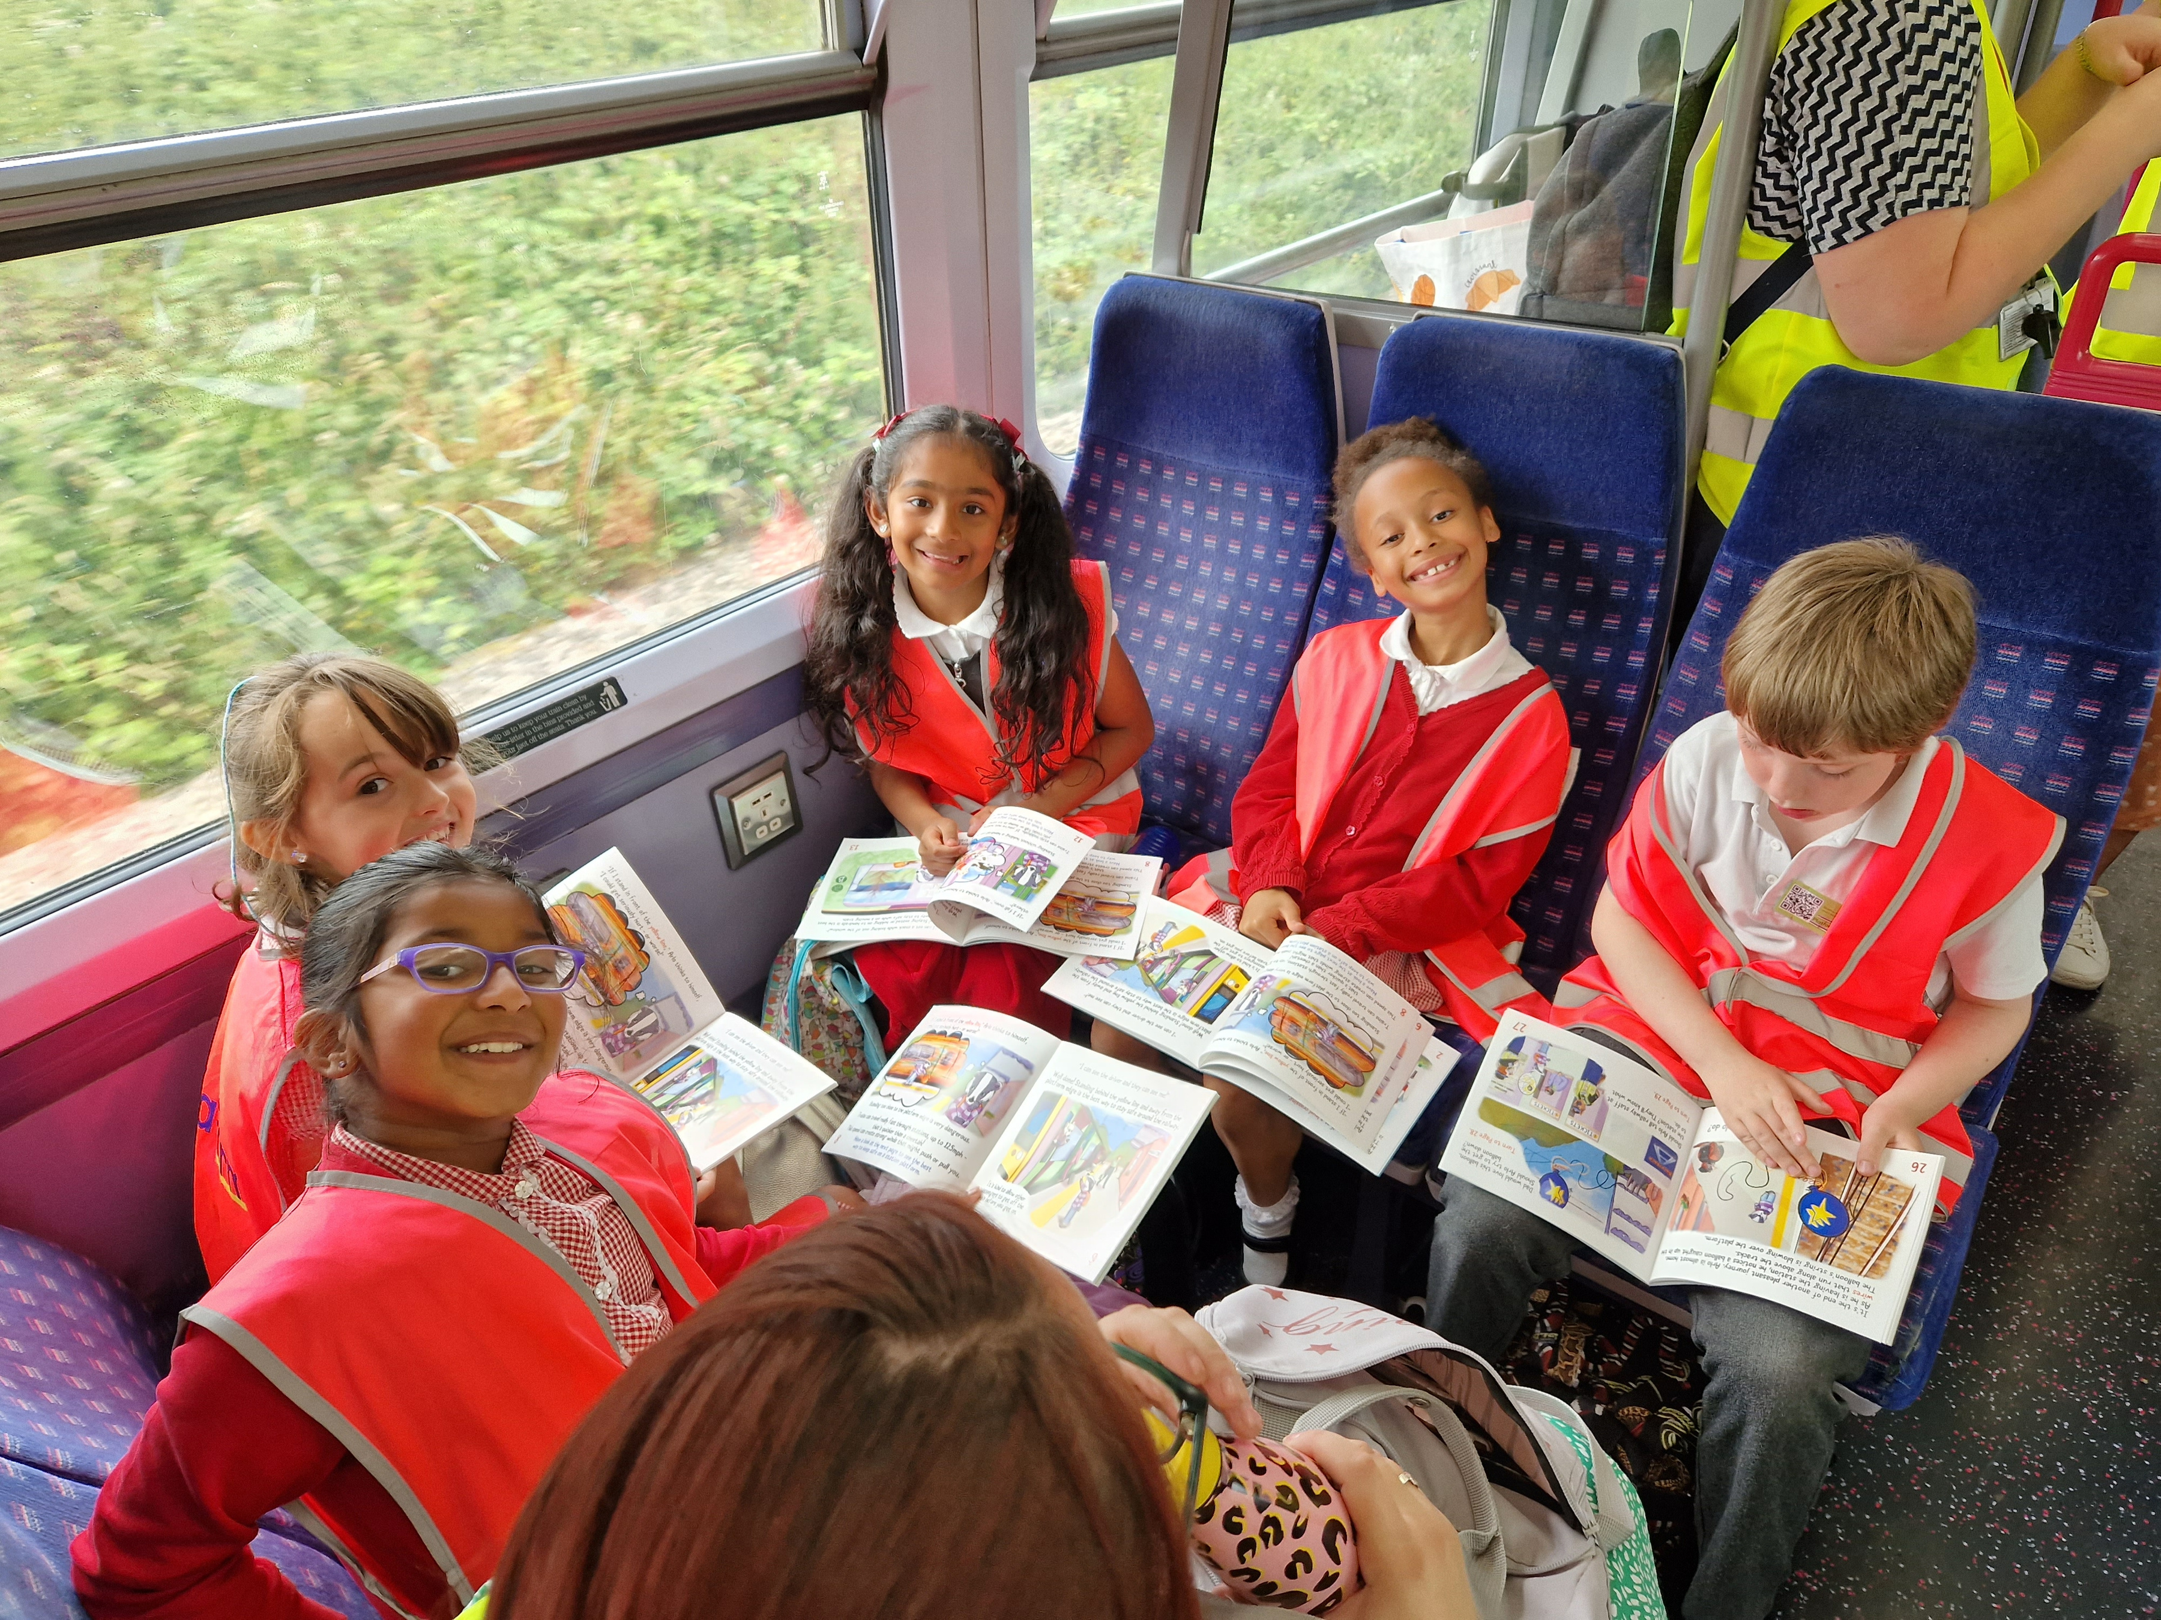
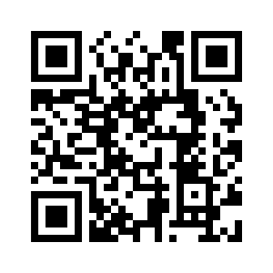


We're proud to be part of community rail
Add your own images here and above to help showcase your work
A growing grassroots movement, of 76 community rail partnerships and 1,200 station volunteer groups across Britain, helping communities get the most from their railways.
You can create your own QR code to direct people to your website using this website for free: www.qr-code-generator.com or alternatively you can keep this QR code that links back to CommunityRail.org.uk
Scan me
Add your logo here
Find out more at communityrail.org.uk

