Slide 1
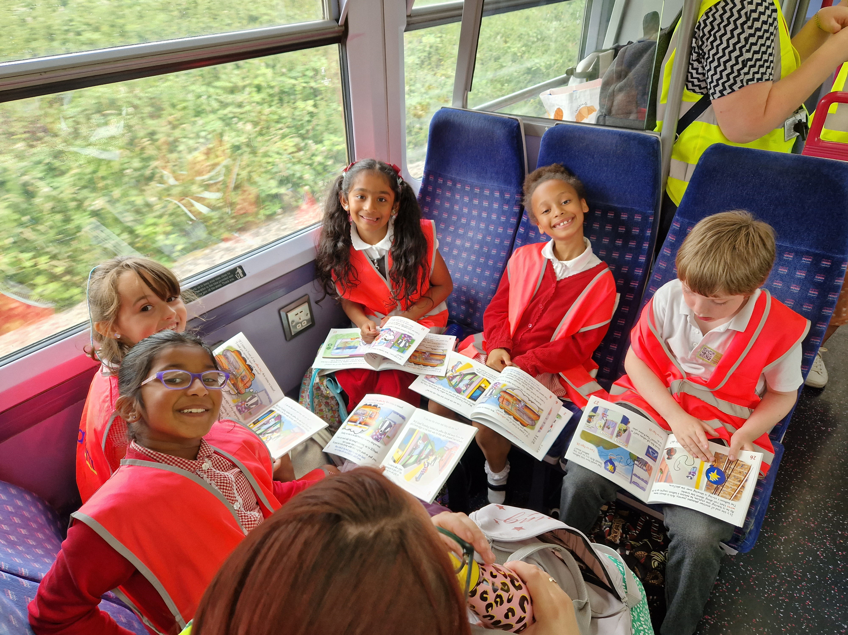

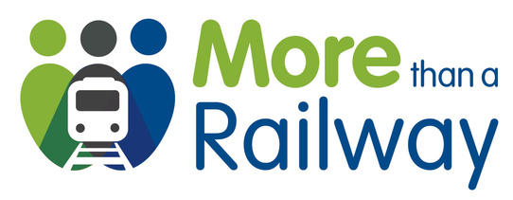

Add text here and replace the image below as needed
Community Rail Week is sponsored by:

