Slide 1

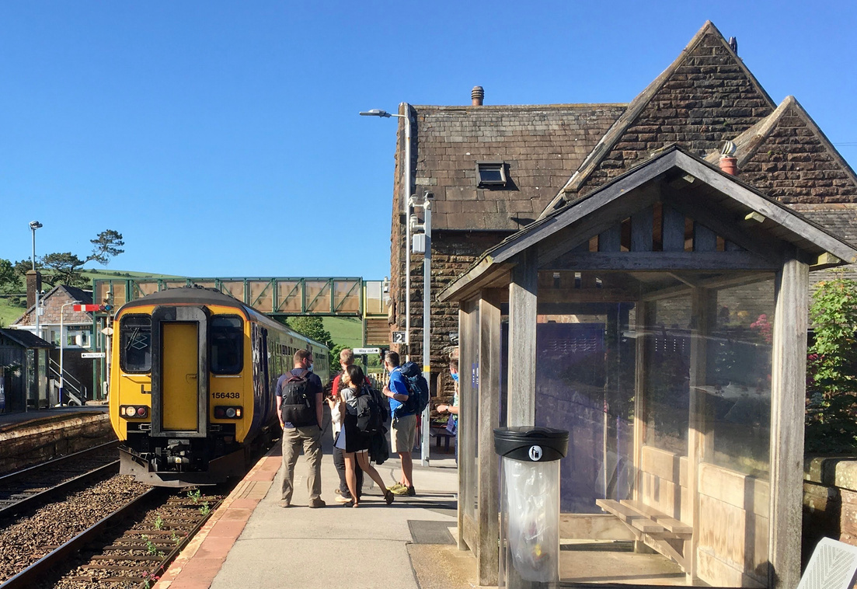

We’re celebrating
200 years of the modern railway

Slide 2
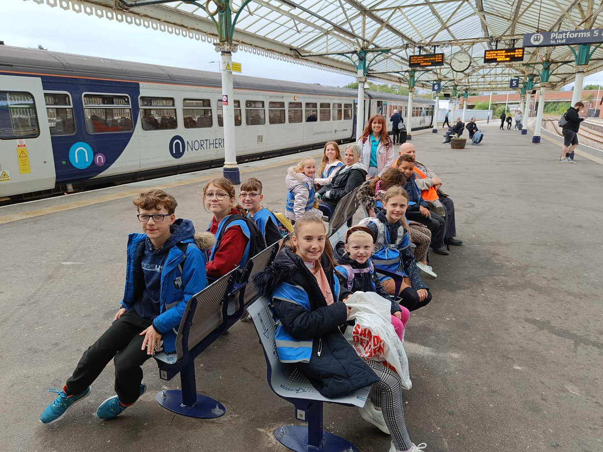
Education and skills
[Use this text to pick out a couple of highlights around the theme above that will entice people to visit your website to find out more]

Slide 3
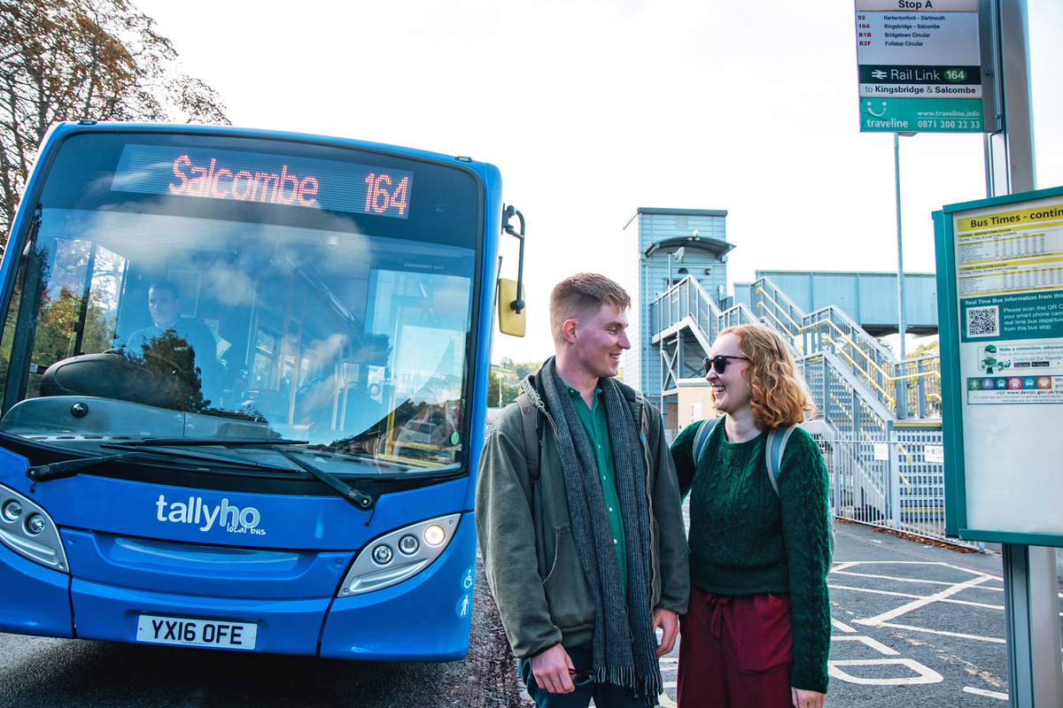
Innovation, technology and environment
[Use this text to pick out a couple of highlights around the theme above that will entice people to visit your website to find out more]

Slide 4
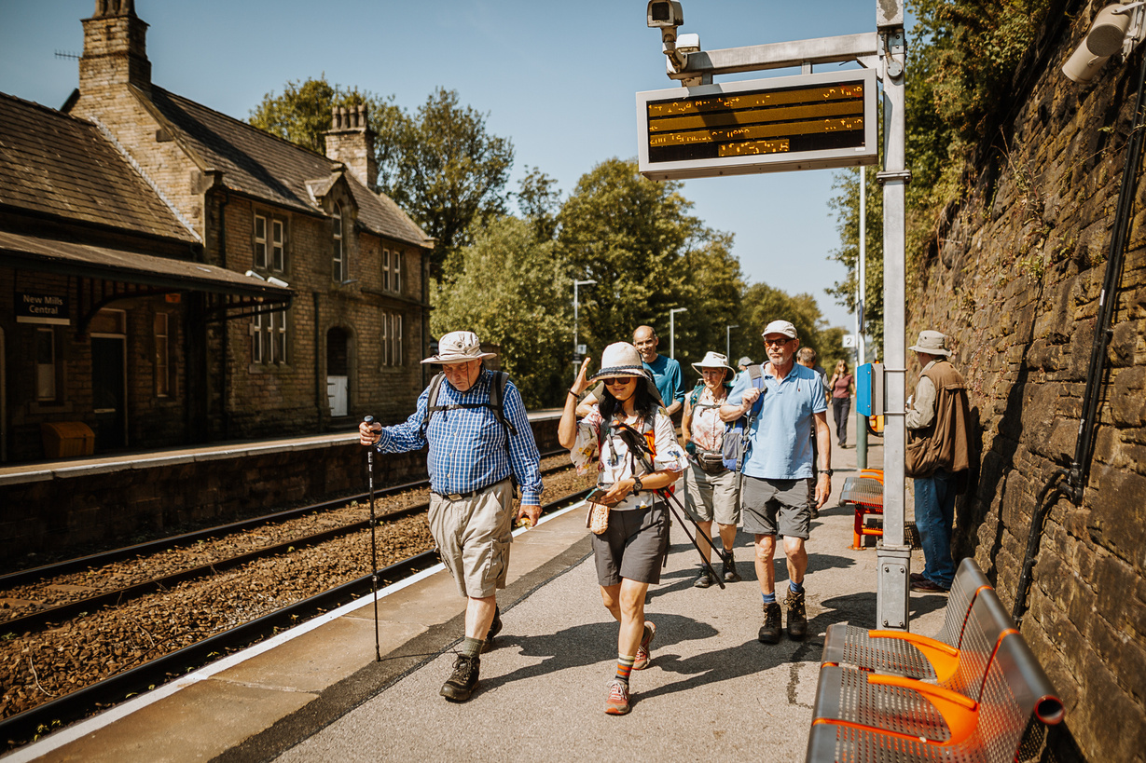
Culture, heritage
and tourism
[Use this text to pick out a couple of highlights around the theme above that will entice people to visit your website to find out more]

Slide 5
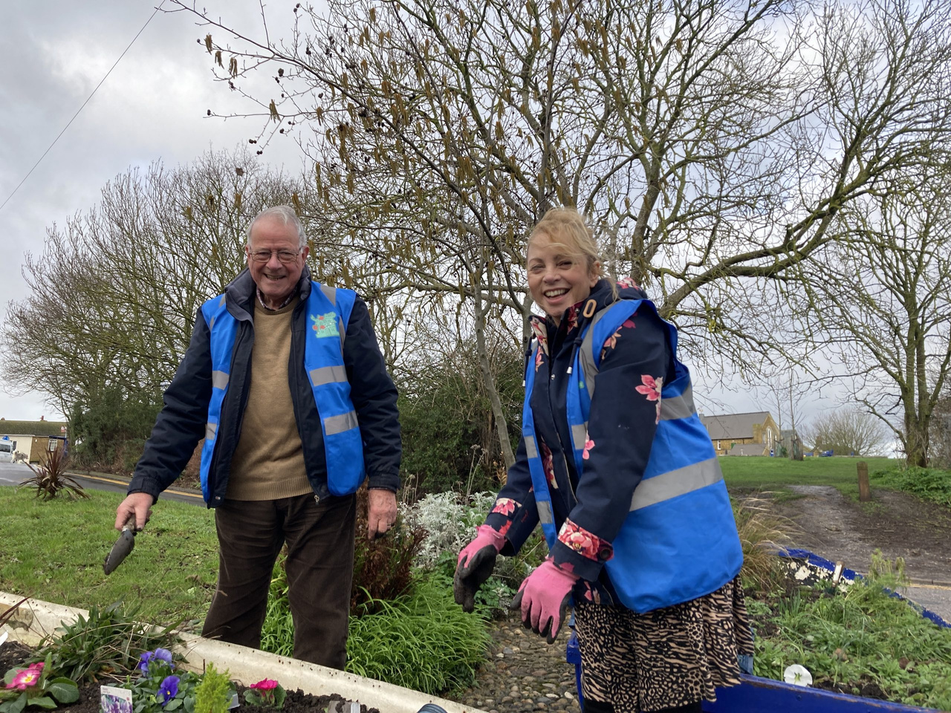
Celebrating rail people
[Use this text to pick out a couple of highlights around the theme above that will entice people to visit your website to find out more]

