Slide 1
A quick-start guide for community groups: Joining up transport modes and helping people move sustainably
For community rail partnerships, volunteer-led station groups, and any community organisation with an interest in developing and promoting sustainable, inclusive transport.
2025 version

Slide 2
Community Rail Network is the membership body for over 75 community rail partnerships and 1,300 station adoption groups. We support our members to be effective in connecting communities with their railways, delivering social, environmental and economic benefit. For more information on community rail and its work and insights, visit communityrail.org.uk.
Development of this guide was kindly supported by the Foundation for Integrated Transport. Thank you to Community Rail Network members and partners who provided feedback on the original draft.

Slide 3
About this guide
This practical guide has been developed to help community groups take action to improve sustainable, inclusive travel opportunities in their local area. It takes a step-by-step approach to the planning, delivery and review of activities to integrate different forms of public transport, active travel, and community and shared mobility, to help people travel in more sustainable ways and access the opportunities they want.
We recommend first reviewing this resource using the ‘talk through’ presentation available in the member resources section of the Community Rail Network website. This will help to explain the approach and how the different sections fit together. The resource itself is best viewed as a 'slide show' due to the inclusion of animations and links within and outside of the document.
We recognise that for some, aspects of our advice may currently be out of reach - perhaps due to a lack of time or resources, or because local connections do not yet exist. We still hope there will be ideas and principles of immediate use, whilst you build the networks and resources to help you achieve more.
Our aspiration is to review and update the resource annually, including adding examples of successful projects delivered by community groups. To provide feedback, case studies, suggested links and ideas for future development, please email integrated@communityrail.org.uk.

Slide 4
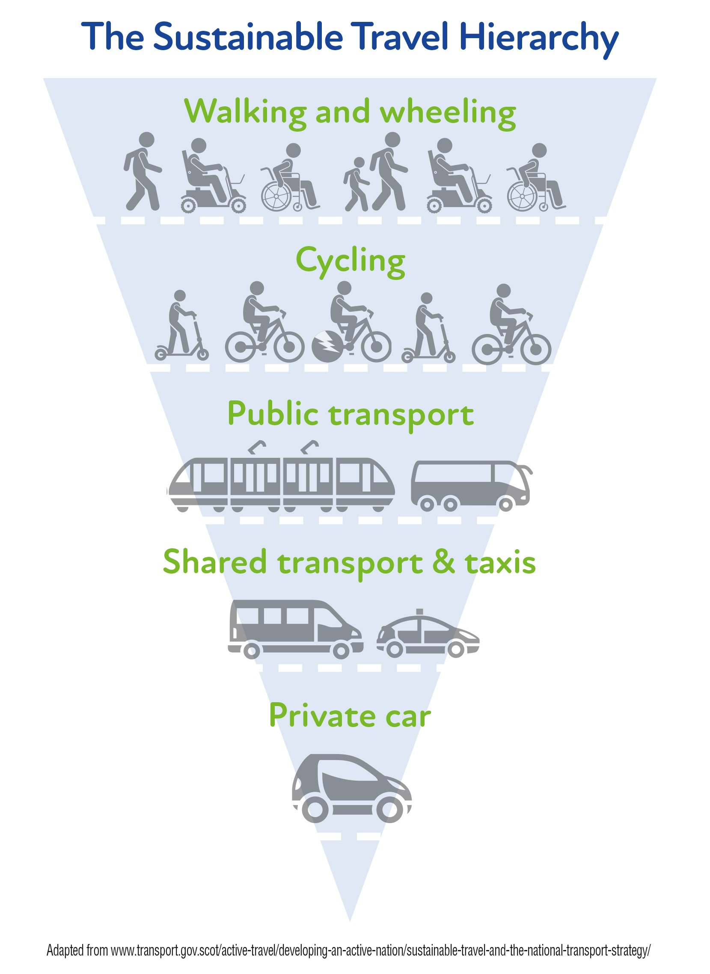
Contents
Why integrated transport matters
The integrated transport jigsaw
Community is key
Understanding behaviour change
A model for designing your activities
Ten steps to better integrated transport
Useful links
The further up the sustainable travel hierarchy, the greener, cleaner and healthier way it is to travel.

Slide 5
Why integrated transport matters
More than one fifth of UK households do not have access to a car (National Travel Survey, 2023). Millions of people across the country live in poorly connected areas, causing transport-related social exclusion. Without viable alternative transport options and the confidence and knowledge to use them, people and communities are prevented from accessing services and life opportunities. In addition, a large proportion of car owners are in poverty due to the high costs of running a private vehicle and would prefer to use alternative transport more, but a lack of integration is preventing them from doing so.
Good integrated sustainable transport is when people have access to reliable, affordable and convenient options for making everyday ‘door to door’ journeys without having to rely on a private vehicle. Through improving connections between buses, trains, community and shared transport, walking, wheeling and cycling, and by working with people and communities to develop the skills and confidence to use them, we can make the alternatives to car dependency accessible and appealing for everyone.
Providing more equitable access to sustainable transport benefits people, places and the environment by:
Widening access to employment, education, training, health and leisure opportunities;
Supporting social connections and helping to tackle loneliness and isolation;
Reducing carbon emissions and pollution.
Back to contents

Slide 6
The integrated transport jigsaw
Places and people are unique, so a ‘one size fits all’ approach to integrating different sustainable transport options will never have the same impact as an approach that is locally designed and nuanced.
It can be helpful to think about the task as being similar to a jigsaw puzzle:
The difficulty of a jigsaw depends on the complexity of the picture, and the number and shape of the pieces. The more complex the picture and the more pieces involved, the more challenging it is to complete;
With a jigsaw, it is common to start with the easier bits (the edges, corners and obvious objects) and leave the trickier bits until later. However, until all sections are finished, the picture will have holes in;
A jigsaw is often quicker to complete when more people are involved, as long as everyone knows which section is their responsibility and how it joins with the neighbouring sections.
Different places = Different picture
Different challenges = More or less pieces
Different communities = Different resources available
Aim for a completed integrated transport picture for the local context.
Back to contents

Slide 7
Community is key
Your work to improve sustainable transport must be underpinned by community engagement at all stages. Designing activities with rather than for communities means they are more likely to succeed in benefitting the people they are intended for.
When communities are empowered to influence and drive changes in their local areas, these changes will not only work better for local people, but there will also be awareness and ownership that will help to ensure improvements are best utilised. Empowering people to play a role in improving their local area also sees the additional benefits of fostering local pride, ownership and social cohesion.
Whatever role you already play in the community, a crucial step is to identify other local groups and organisations that may be interested in, or can contribute to, your work to improve transport integration. This must include reaching out to those that can help to engage and hear from marginalised and less-heard groups, to understand the mobility barriers they face.
There are many examples where communities themselves have innovated in order to fill gaps. By engaging widely from the start, you may well discover activities that are already taking place or identify enthusiasm that you can tap into to support your own work.
Back to contents

Slide 8
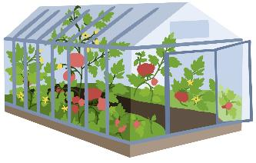
Understanding behaviour change
Understanding the basics of behaviour change theory will help to make sure your work to improve integration addresses the individual barriers preventing people trying different ways of getting around.
Seed
CAPABILITY
OPPORTUNITY
MOTIVATION
BEHAVIOUR
Building a team to work together, having money to spend, and a way of measuring success so you can update your plans, will help SUSTAIN AND GROW the crop.
In addition, by providing the right FOUNDATIONS you increase the chances that the seed will grow.
Click here for further information about the COM-B Model for Behaviour Change
Back to contents

Slide 9
A model for designing your activities
This theory of behaviour change, alongside the key principle of community engagement to bring people together and inspire collective change, is the basis for our recommended approach. This is illustrated below and will be explained further through our ten steps to better integrated transport.
SUSTAIN AND GROW
Ongoing improvement
BEHAVIOUR
More people, more often
OPPORTUNITY
Having the chance
CAPABILITY
Being able to
MOTIVATION
Wanting to
FOUNDATIONS
Supported and encouraged
COMMUNITY ENGAGEMENT
Back to contents

Slide 10
Ten steps to better integrated transport
Keeping in mind the concept of the integrated travel ‘puzzle’, the importance of community engagement and the theory of behaviour change, we can now introduce our ten-step approach:
1 - What’s already out there? – people, plans, data and resources
2 - Get a team together – working on your puzzle collectively
3 - Engage the community – they have the knowledge
4 - Design your picture together – everyone on the same page
5 - Agree where to start – who and what to target
6 - Make things happen – helping behaviours change
7 - Measure impact – finding out what’s worked
8 - Celebrate your achievements – showing progress and inspiring others
9 - Widening your reach – lesser seen groups and influencing policy
10 - Keeping going – plan, do, review, repeat
Back to contents

Slide 11
Step 1 - What’s already out there?
People, plans, data and resources
Chances are that someone, somewhere, will already have done or be doing work that you can build on. This could be looking at ideas and best practice from somewhere else or finding activities already taking place locally to you. Time spent identifying key people, plans, data and resources now can help identify key allies to work with as well as preventing you from ‘reinventing the wheel’. Below are some examples of what to look for:
People Individuals/groups actively involved in campaigning Community groups and charities wanting to improve access for their service users Education and healthcare providers Transport operators and interested businesses | Plans Station Travel Plans (Train Operators) School and Hospital Travel Plans Local Transport Plan, Local Cycling & Walking Infrastructure Plan (Highways Authority) Bus Service Improvement Plan (Local Authority)
Data Census and station usage data (available online) Resident surveys (ask your Parish/Town Council) Station or local transport audits | Resources Funding or time allocated within an existing project that your work could dovetail with Planned work that you could bolster
Back to contents

Slide 12
Step 2 – Get a team together
Working on your puzzle collectively
Through prior knowledge and further research, you should have a good idea about who may have an interest in working with you. Different groups, organisations and people will bring a diversity of knowledge, viewpoints, experience and contacts, which should help to widen the impact of your work. Below are some of the groups who you might consider approaching to help with your integrated transport ‘puzzle’.
Existing and potential funders
Passenger representatives
Large employers
Voluntary organisations / groups / clubs
Local destinations and attractions
Local service
providers (health, wellbeing, recreation)
Local authorities and national parks
Town and parish councils
Education providers
Bus, train, community and shared transport operators
Representatives from disability / inclusion groups
Local businesses, chambers of commerce, etc
Back to contents

Slide 13
Step 3 – Engage the community
They have the knowledge
As we know, community engagement is a key principle that should run through every stage. Proactive collaboration throughout planning, delivery and evaluation, alongside ongoing, two-way communication, will enable the wider community to see what is happening, and get involved in ways that suit them. It will help ensure that improvements are inclusive and appropriate to local needs, ensure ‘buy in’, and support behaviour change. Some ideas of community engagement techniques where you might gather and understand people’s views and enable people to interact, discuss and develop ideas together include:
Engage as wide a cross-section of people as possible to ensure a diverse spectrum of perspectives, including but also going beyond existing sustainable transport users. The connections you’ve developed in the earlier steps should help you reach different people and groups, including those who may be marginalised and who may face barriers to transport that you want to understand and overcome. By working with such partners, you can reach the ‘lesser heard’ voices by going to where they are, using the trust and expertise of their leaders/service providers to effectively engage with them.
Participatory mapping
Surveys and questionnaires
Community meetings
Walkabout or site visits
Pop up
events
Workshops
Back to contents

Slide 14
Common barriers to using sustainable transport
Through these engagement activities, you will start to develop a detailed understanding of the barriers to using sustainable transport experienced by people in your community. Some commonly cited barriers are listed below, grouped into internal and external factors and those which could be viewed as an interaction between the two. Some barriers will have greater impact on certain individuals or groups and may be experienced temporarily or longer term.
INTERNAL |  | EXTERNAL
Confidence Awareness of opportunities Lack of knowledge, experience or skills Perceptions of status | Socio-cultural factors Fear of personal safety Concerns about reliability Cost/affordability Parenting or caring duties Physical and mental health condition or disability | Distance to services Physical infrastructure and accessibility Lack of reliable services at the right time for their needs
Back to contents

Slide 15
Step 4 – Design your picture together
Everyone on the same page
Armed with knowledge of what has gone before, alongside insights from your community engagement activities, your team can now start to set out what the shared vision looks like – the picture that adorns your puzzle.
Your vision should be a positive, inspirational picture of the future that people can get behind. You might support this with examples from elsewhere that you intend to replicate. Add to this details such as a timeline, responsibilities, risks and dependencies, to help everyone to be clear and realistic about what to expect and the part they are playing.
Your proposed vision can then be shared back through your routes into the community so that you can check your proposals align with the people you are hoping to benefit. At this stage you should have confidence in the benefits and outcomes you are hoping to achieve, so any follow up consultation is about the specifics that you hope to deliver, rather than having to re-justify the need.
This shared vision is the masterplan for what your team is hoping to achieve. Continue to invite ongoing contributions to allow more people the opportunity to engage with and influence your plans.
Back to contents

Slide 16
Step 5 – Agree where to start
Who and what to target
Now you are ready to start planning your activities, you need to decide on your priorities and who you are hoping to benefit first.
Your engagement activities will have identified some of the common barriers experienced by people and groups in your community. For some, the barriers faced may be fewer and they may be enthusiastic for the opportunities you are hoping to provide, whilst for other the barriers may be more significant or their motivation to take up the opportunities may be less.
Some people may have a degree of dependency that means any improvements you make will have a more profound impact on their life opportunities and so may be a higher priority for you.
The images on the next page offer an illustration of these points.
Top Tip - When helping people try something new, create opportunities to do so with low stress and maximum enjoyment. This could be part of a social activity with a group of people already known to them. Travelling to an interview or starting a new job is not the right time to try something for the first time.
Back to contents

Slide 17
Few barriers
Reliant
‘Lower hanging fruit’
Biggest impact on life opportunities
Fewer resources
Previous experience, confidence or concerns
Health, finance, disability or personal choices
Reluctant
Enthusiastic
Temporary
Longer term
‘Slow burner’
Resource intensive
Less impact
Many barriers
Independent/Flexible
Being clear about where your priorities lie will help you focus on activities that will have the most impact for your target group. It will also help set expectations for how quickly the benefits may be realised as well as the resources you might need to achieve the change you are hoping for.
Back to contents

Slide 18
Step 6 – Make things happen
Helping behaviours change
From the COM-B model described earlier, we know that for people to make use of sustainable travel options, they need the personal capability, opportunity and motivation to do so. In turn, they will be supported further if the right foundations are in place and are more likely to stick with this new behaviour if efforts are made to sustain and grow participation. A well-rounded programme will include activities which address each of these elements to help overcome the specific barriers faced by your community.
The next slide suggests activities to consider under each of the five headings. The list is by no means exhaustive, and many activities cross over between two or more headings. Information for community rail groups on how to access funding to support these activities can be found on our website.
It may be that some activities will be of most benefit to a particular group or individuals. How much of a priority these people are for you should influence the order in which you plan your activities. You might decide to achieve some ‘quick-wins’ to build momentum and demonstrate your intent, before making headway with more challenging plans that may require complex partnership working, larger amounts of funding, or further engagement with the community.
Click here for guidance on adopting an ‘outcomes-based approach’ to help your activities to be as impactful, inclusive and successful as possible.
Back to contents

Slide 19
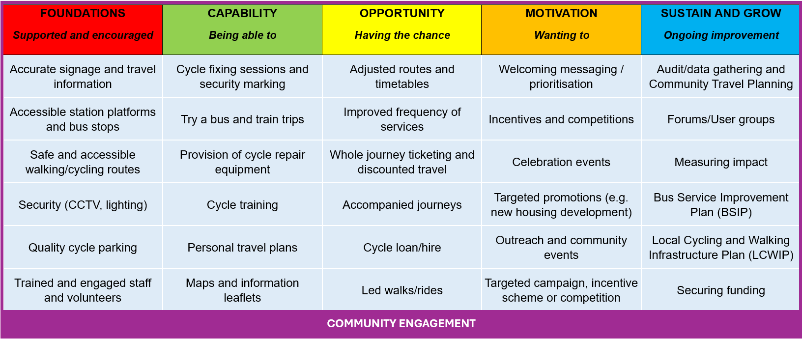
For examples of these activities within community rail see our Guide to Community-led Station Travel Planning, our reports on Encouraging and Enabling Modal Shift, Youth Engagement and Accessibility and Inclusion, and some of our case studies.
Back to contents

Slide 20
Step 7 – Measure impact
Finding out what’s worked
Collecting evidence of impact creates a positive feedback loop, helping motivate your team, providing publicity opportunities and inspiring others to get involved. Often, funding partners will have an expectation about evaluation and evidence required for the projects they support.
Ideally, you will already have considered at the planning stage how you will go about assessing the impact and success of your activities. Having ‘baseline’ information of the situation before you started your activities is particularly useful if you are planning to use quantitative data (numbers-based information) for measuring impact. This will enable you to compare the situation before and after your activities to consider how effective they have been in achieving the impact you are looking for. Qualitative data adds richness and is more about understanding the ‘why’, ‘how’ and what’ of a person’s behaviour. This sort of information is helpful for telling more of the individual’s own story and can draw out potential case studies about the benefit of your work.
The Community Rail Impact tool is an easy-to-use way to record, assess, demonstrate and evidence outcomes that can be used in lots of different ways – for individual projects, or certain aspects of your work, or for recording all your activities to help you report to funders.
Back to contents

Slide 21
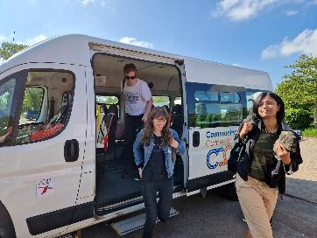
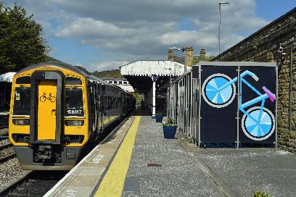
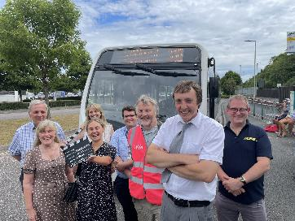
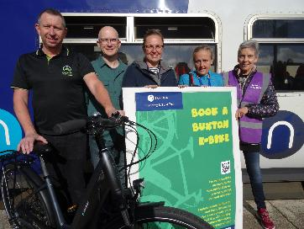
Step 8 – Celebrate your achievements
Showing progress and inspiring others
Throughout each step of your work, you will have been keeping the community informed of the activities that have been taking place, including those targeted at certain individuals and groups. Now, with evidence about your successes to hand, you can focus on celebrating what has been achieved to date.
This stage is about demonstrating to the community and your team the progress that has been made, reinforcing your collective commitment to the shared vision, and inspiring more and more people to get involved. It is also an opportunity to thank funders and partners, which may help encourage future support.
Our guide to engaging local media provides advice for community groups on how to secure positive coverage to help raise profile and awareness. It offers guidance on developing working relationships with journalists and media outlets and tips on identifying and writing eye-catching stories and content.
Pic – Gloucestershire CRP
Pic – Community Rail Network
Pic – Devon & Cornwall Rail Partnership
Pic – Friends of Buxton Station
Back to contents

Slide 22
Step 9 – Widening your reach
Lesser seen groups and influencing policy
Through your efforts to measure the impact of your work, you might identify groups or individuals that aren’t engaging with your activities or benefitting from the improvements you have made. Use the community links you have established to actively reach out to these people to discover more about the barriers they are facing and whether there is more that you can do to include them. This may not be a quick fix where groups have become particularly disenfranchised, and as mentioned previously, there are decisions to be made about how best to use the resources available to you.
Our report on accessibility and inclusion offers insights into how community rail is breaking down barriers for those who might otherwise feel excluded or marginalised, opening up rail travel to more people.
By this stage, you will likely have identified what is within your project team’s control, gift or ability to make happen, and what might require wider policy/structural changes. With the support and voice of your networks, your team may need to consider how to collectively engage key decision makers to secure their ‘higher level’ support in delivering your vision. This may be through contributing to formal planning or transport consultations, or by seeking to influence in other ways. These sorts of activities may take a while to bear fruit but could be essential in laying the foundations for longer term investment.
Back to contents

Slide 23
Step 10 – Keeping going
Plan, do, review, repeat
Step 6 – Make things happen
Foundations
Capability
Opportunity
Motivation
Sustain and grow
Step 1 - What’s already out there?
Step 2 - Get a team together
Step 3 - Engage the community
Step 4 - Design your picture together
Step 5 - Agree where to start
Step 7 - Measure impact
Step 8 - Celebrate your achievements
Step 9 - Widening your reach
PLAN
DO
REVIEW
REPEAT
To further the impact of your work, start over again at step one and repeat the plan, do, review cycle.
Back to contents

Slide 24
Useful links
Resources, webinar recordings, future events and training opportunities available at communityrail.org.uk
Sustainable Transport Alliance member websites:
Bus Users UK
Campaign for Better Transport
Community Rail Network
Community Transport Association
COMO UK
Cycling UK
Living Streets
Sustrans
Other useful links and resources:
Active Travel England
Cycle Rail Toolkit
Sustainable Travel to Stations (Scotland’s Railways)
Bus Centre of Excellence
Back to contents

