Slide 1
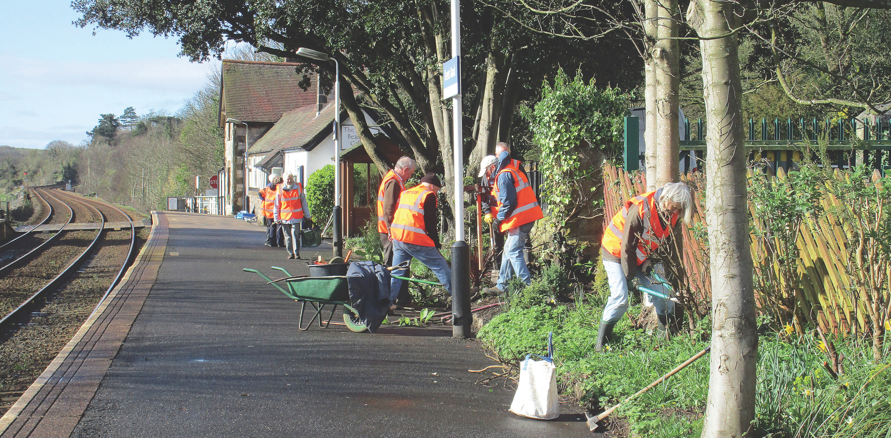


Add your messaging here and replace the image below with one specific to your work
Add your logo here
Community Rail Week is sponsored by:

