Slide 1
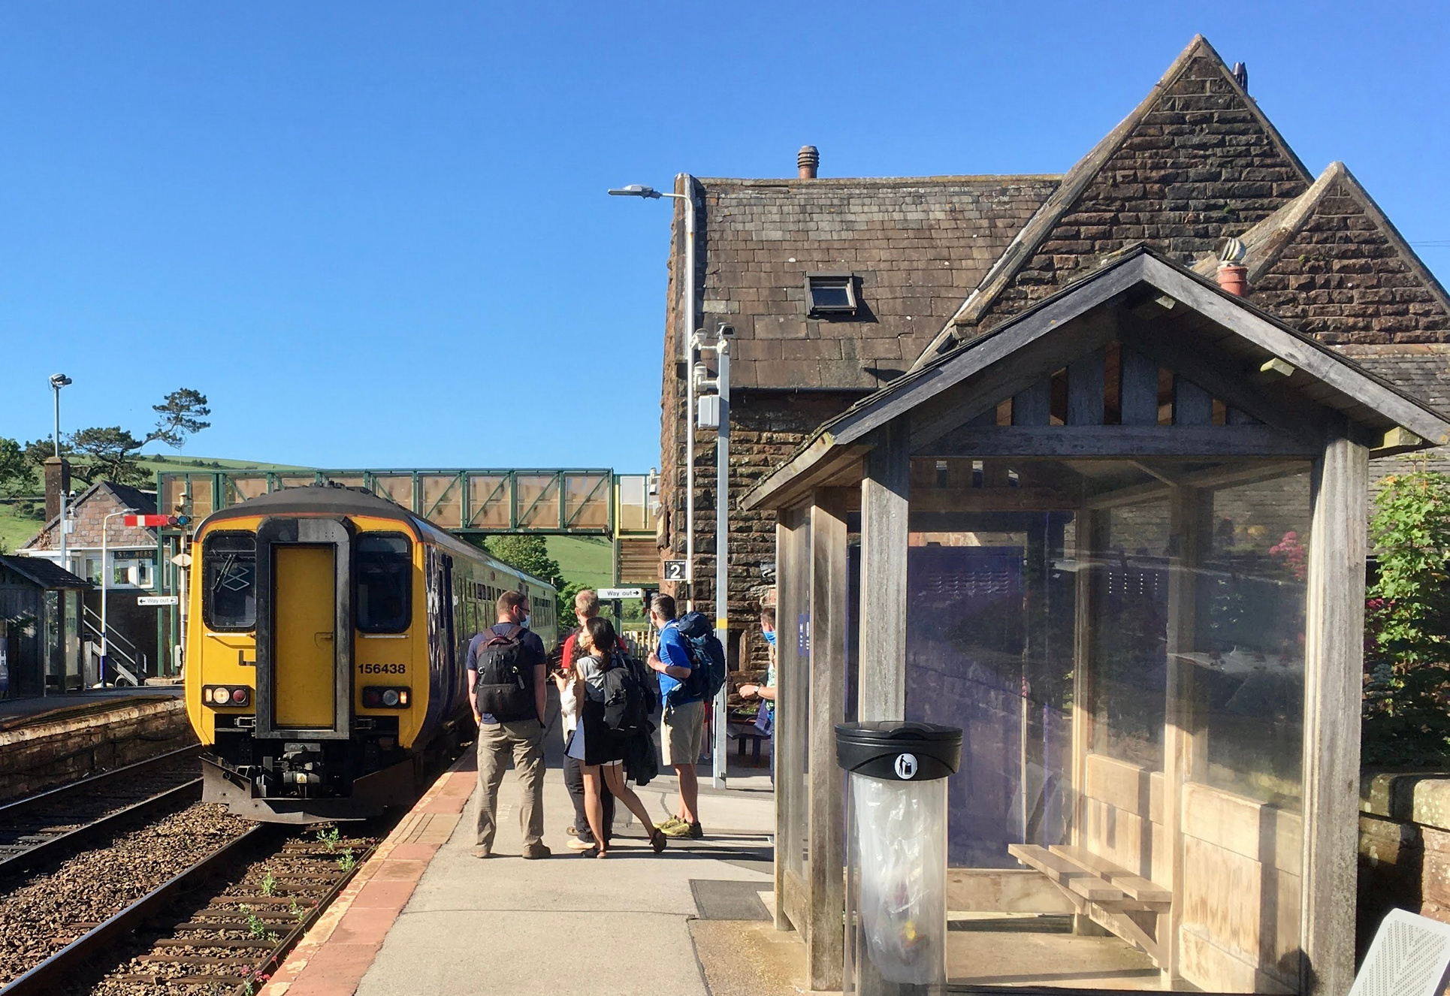

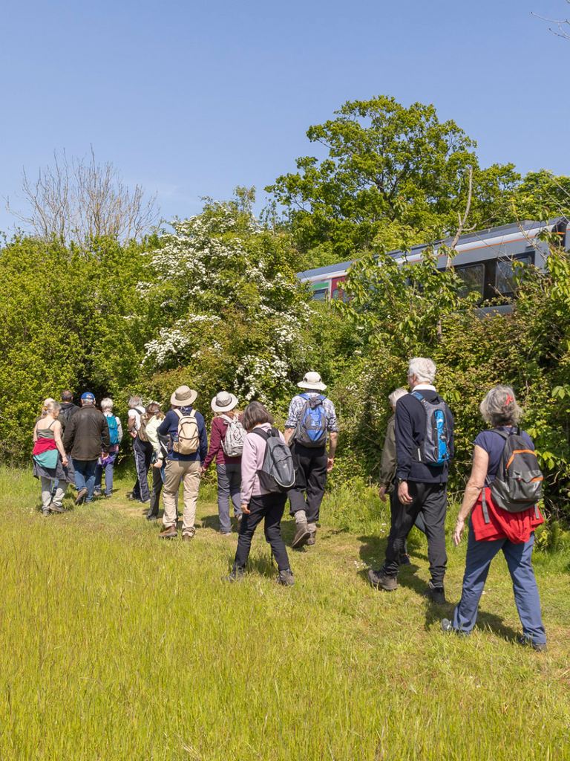





Days Out
Use this QR code linking to ScenicRailBritain.com or replace with your own
BY TRAIN
Take a greener day out and
explore [insert station/line name] by rail for
spectacular views, wonderful walks and hidden gems
Scan me for ideas
Insert your logo

