Slide 1
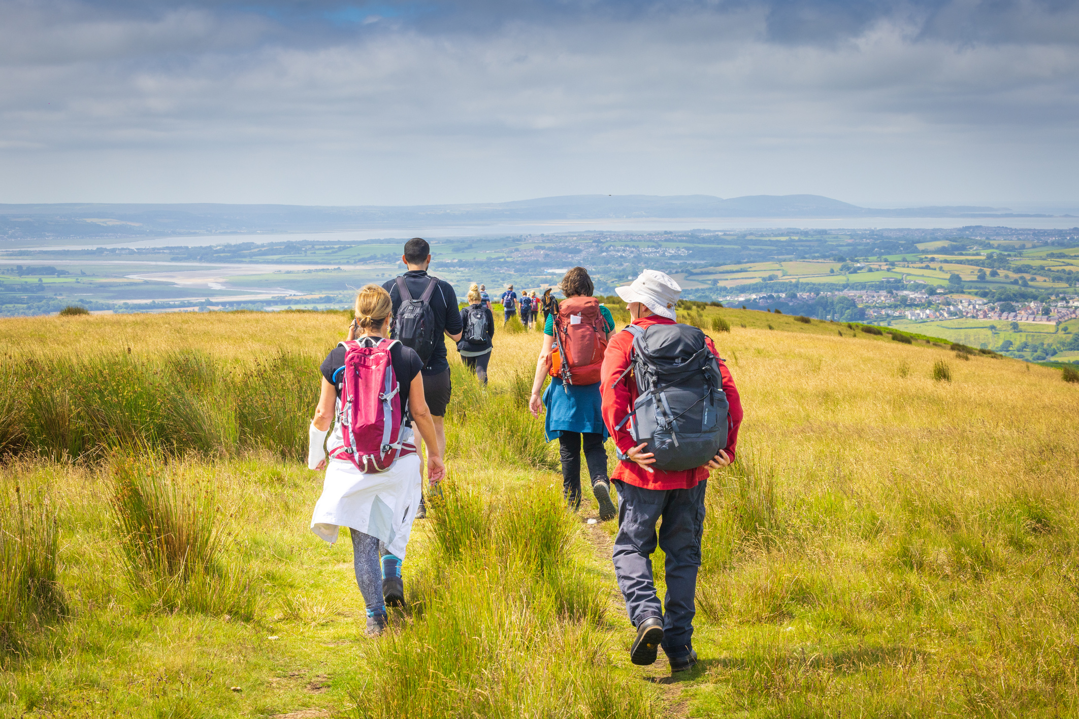








From vibrant city streets to peaceful countryside paths - this October discover walking, wheeling, and cycling routes that start right at the station.
Insert your logo

