Slide 1
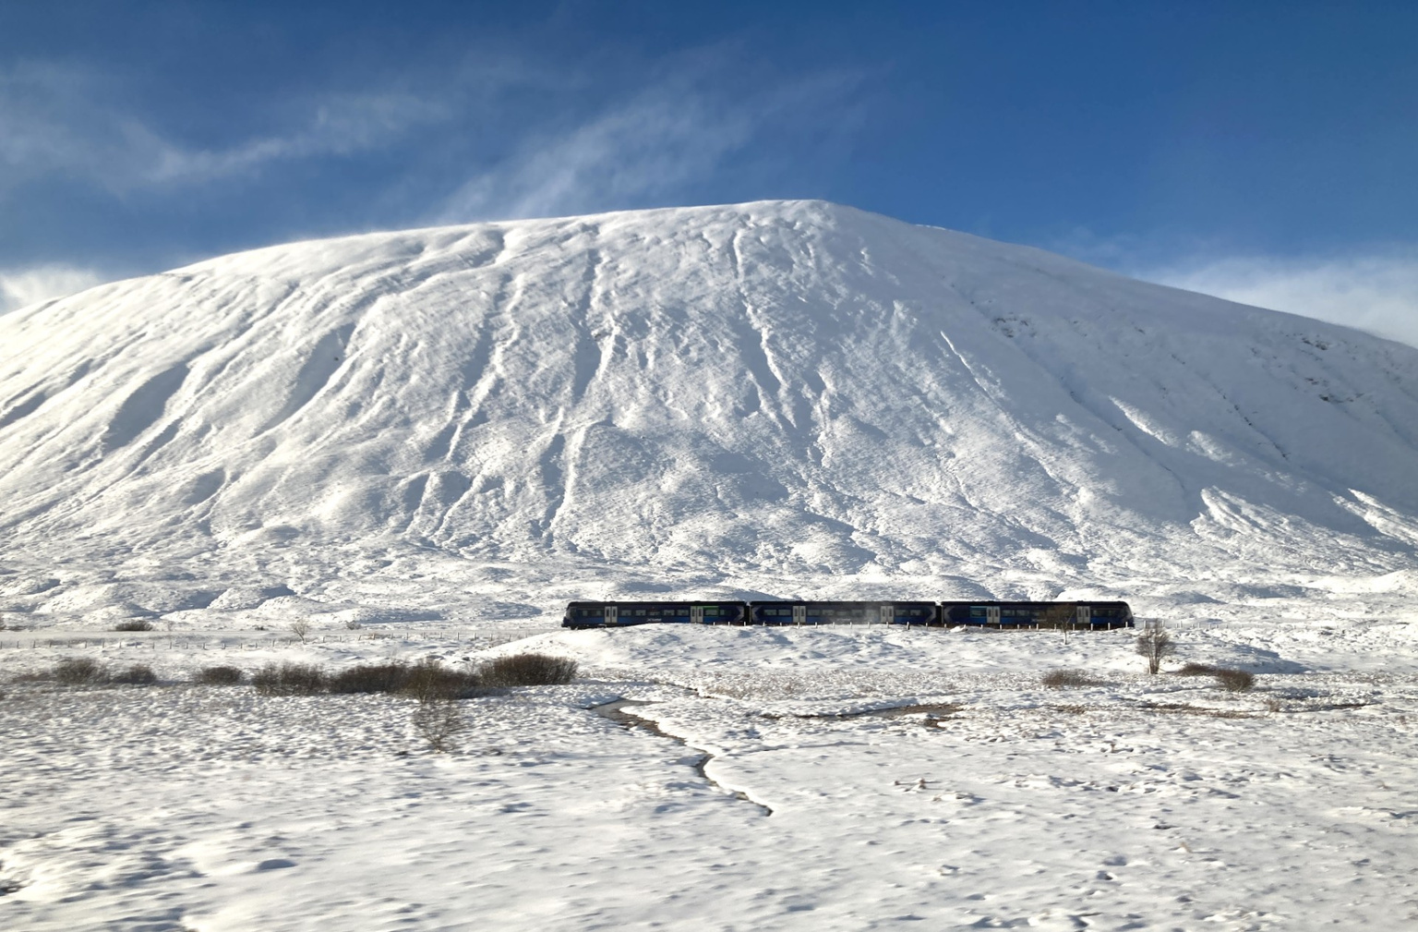


Explore frosty views, rainy-day escapes, and scenic winter moments. Find your inspiration this December here...
#ScenicRailWinter
ScenicRailBritain.com/Winter

