Slide 1
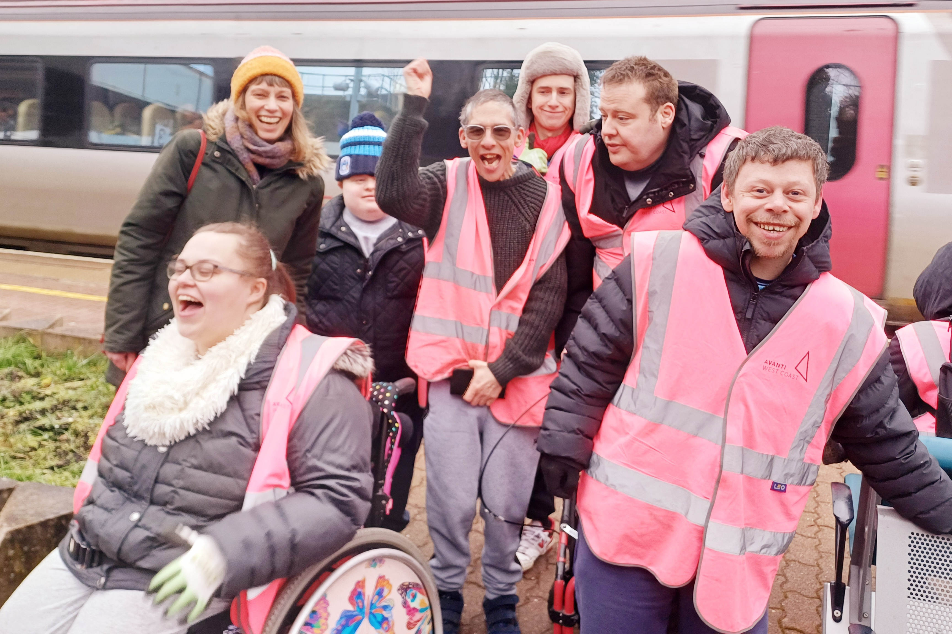
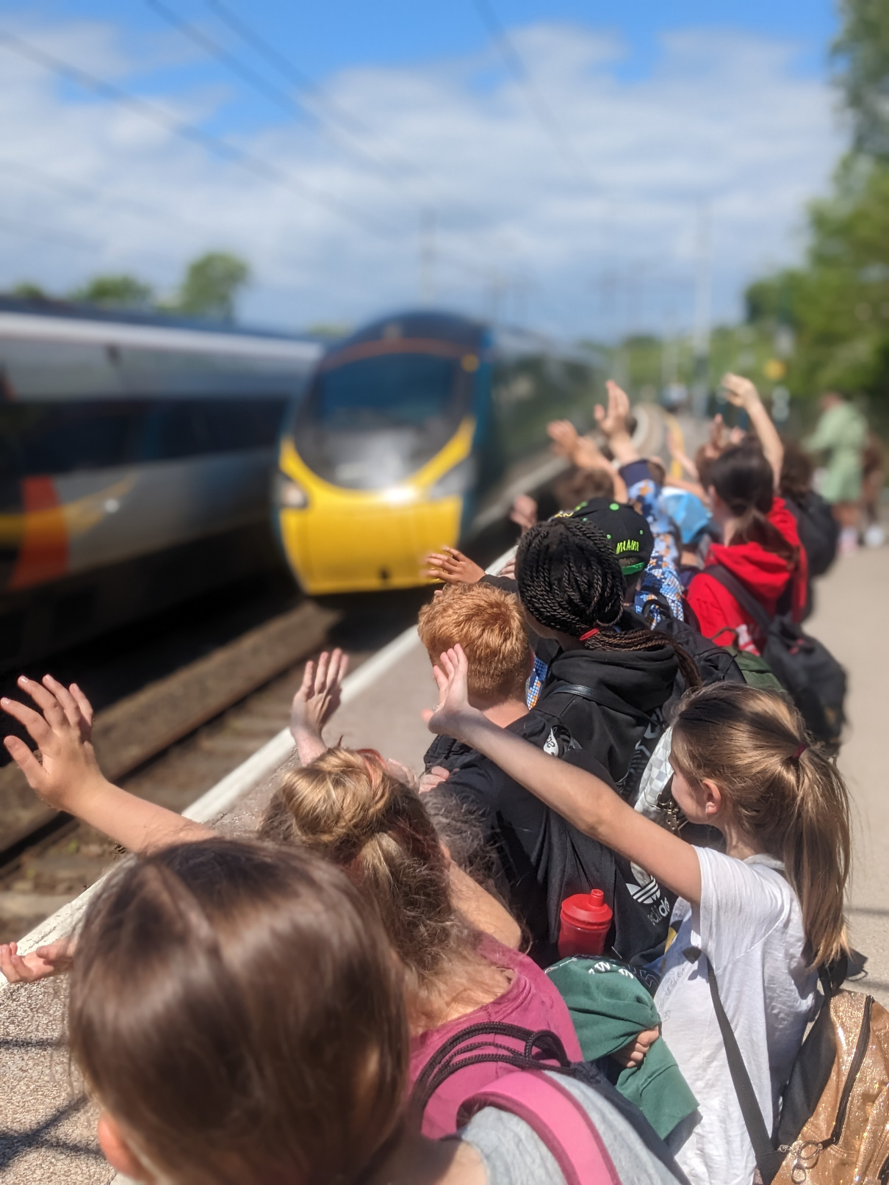




Photo: Heart of England Community Rail Partnership & Life Path Trust
We're proud to be part of community rail
Photo: Community Rail Lancashire
A growing grassroots movement, of 77 community rail partnerships and 1,300 station volunteer groups across Britain, helping communities get the most from their railways.
Scan me
Find out more at communityrail.org.uk

