Slide 1
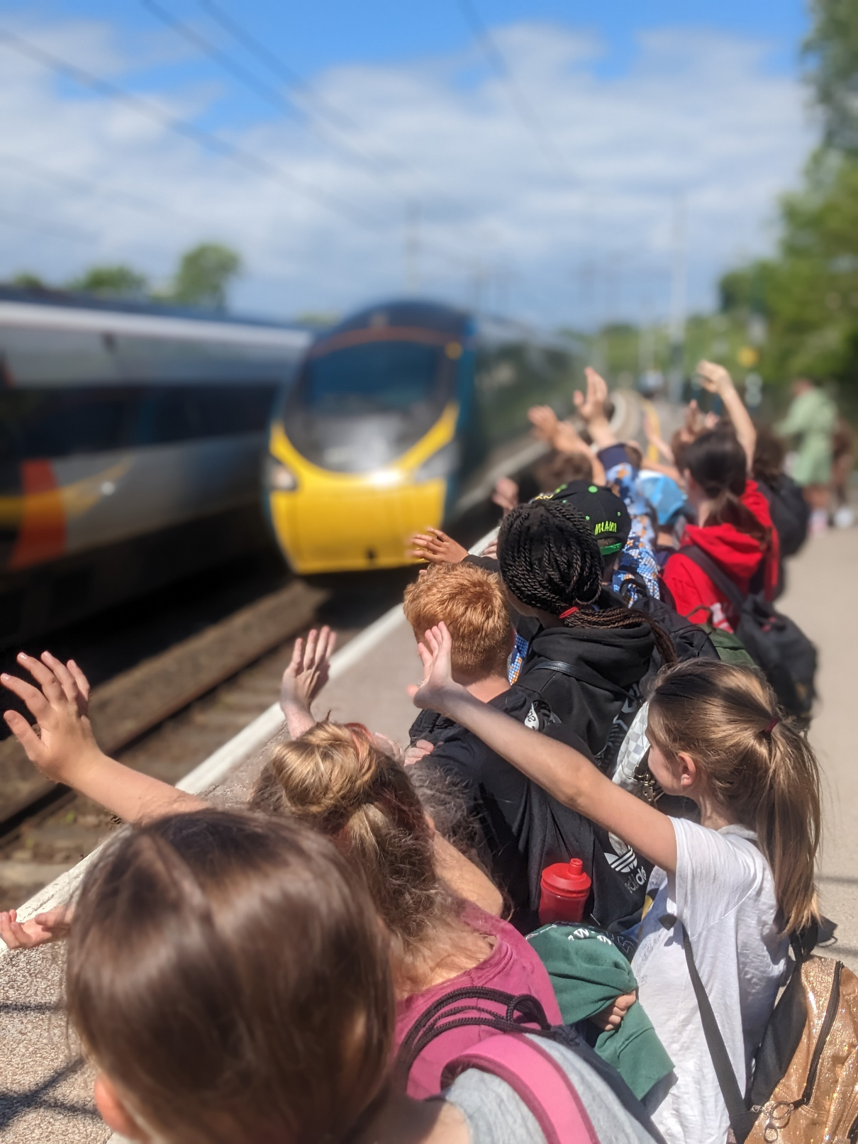



Photo: Community Rail Lancashire
Community rail brings people together through rail
#CommunityRailWeek

