Slide 1

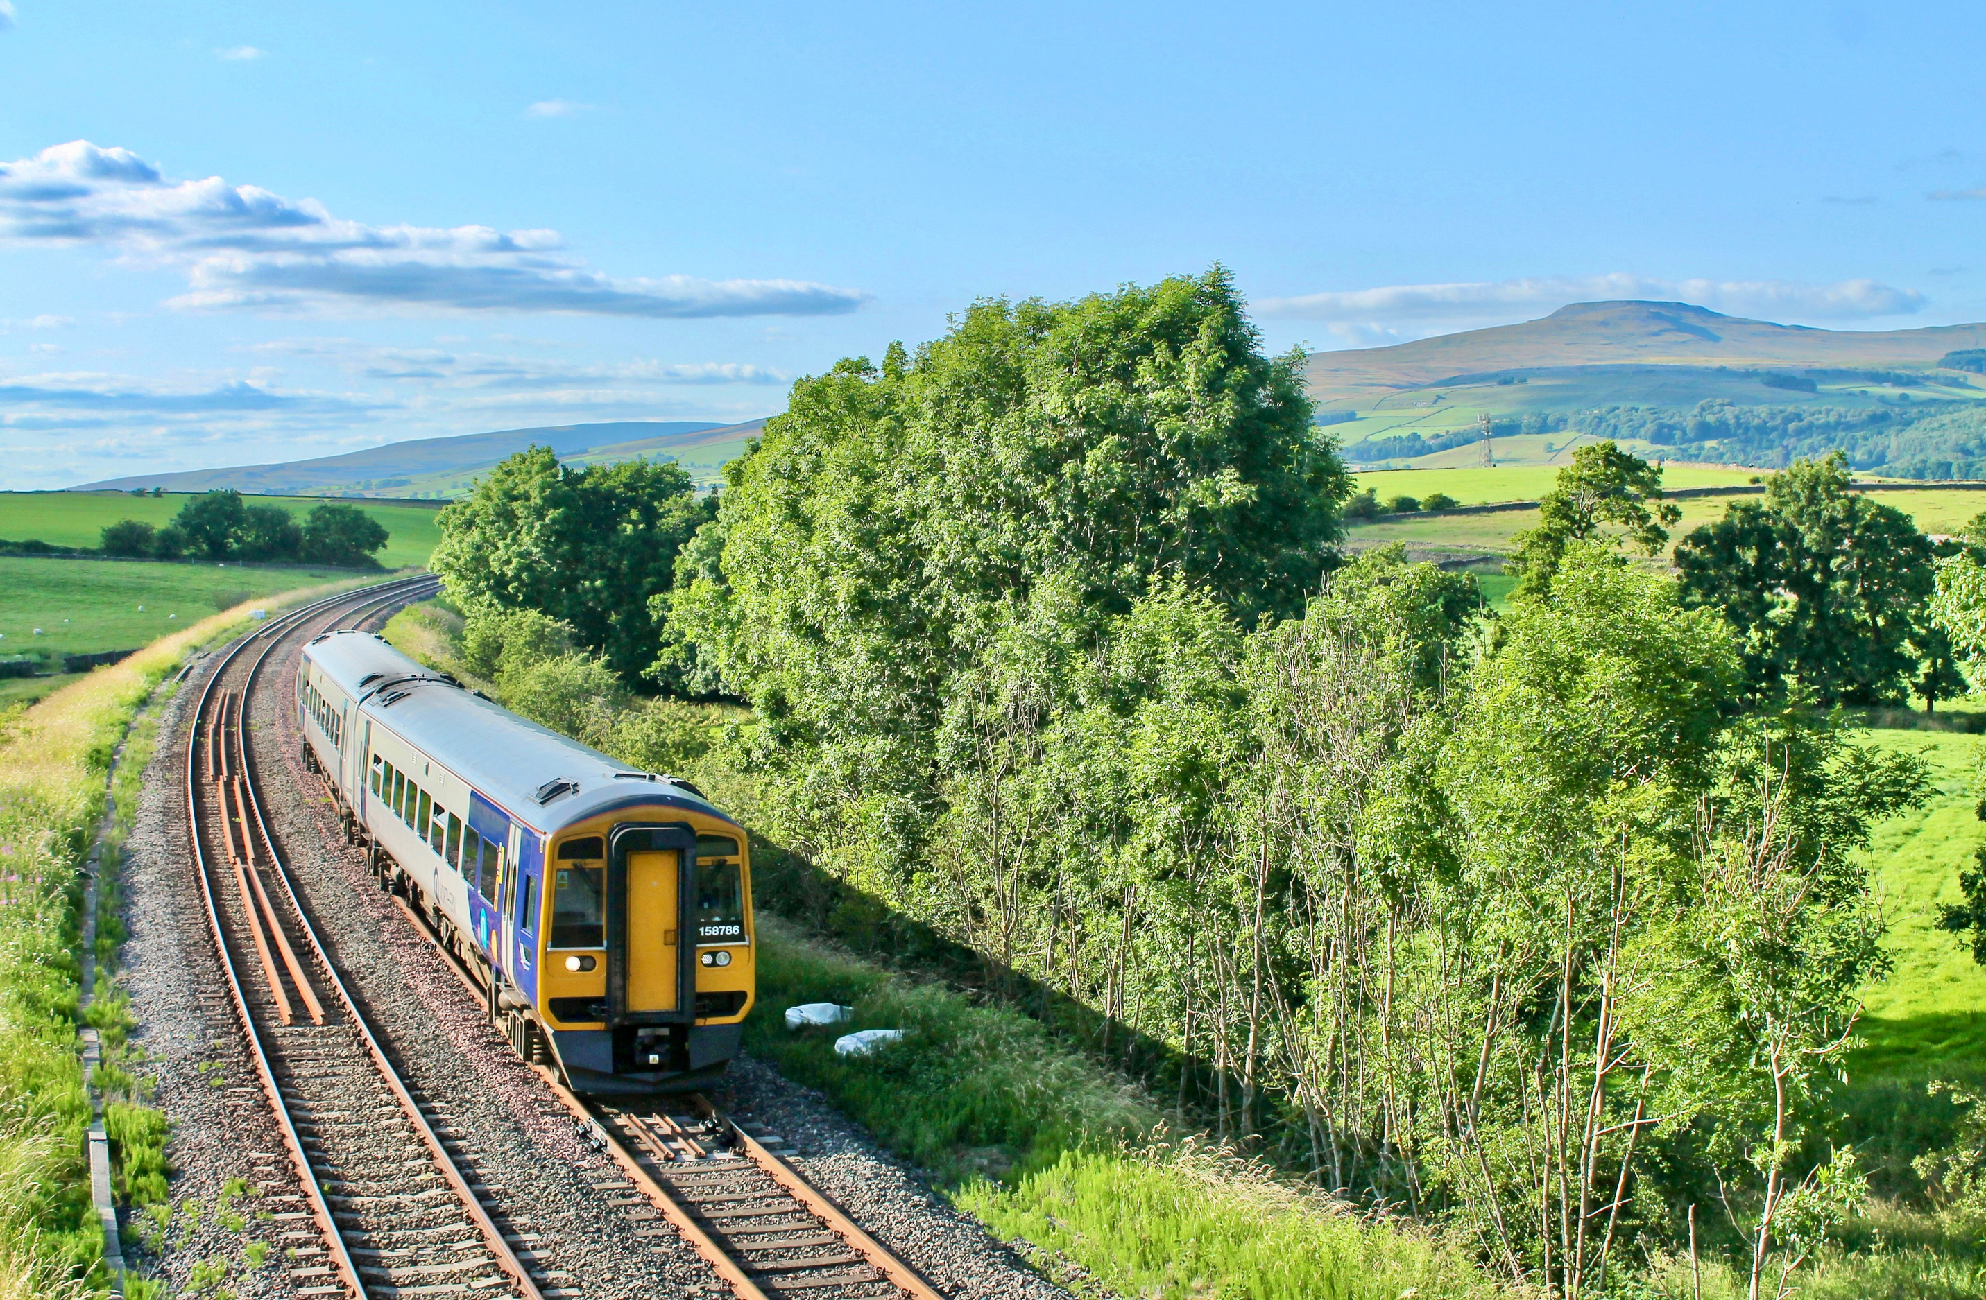



Great days
start by train
Discover hidden gems, make new memories and travel greener this summer with community rail.
Scan me for inspiration
Local gems
Car-free
Memorable
Add your website & logos

