Slide 1

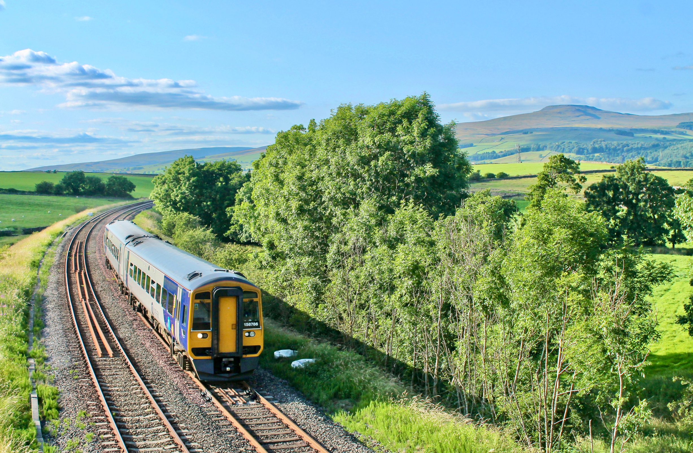



Great days
start by train
Discover hidden gems, make new memories and travel greener this summer.
Local gems
Car-free
Memorable
ScenicRailBritain.com

