Slide 1
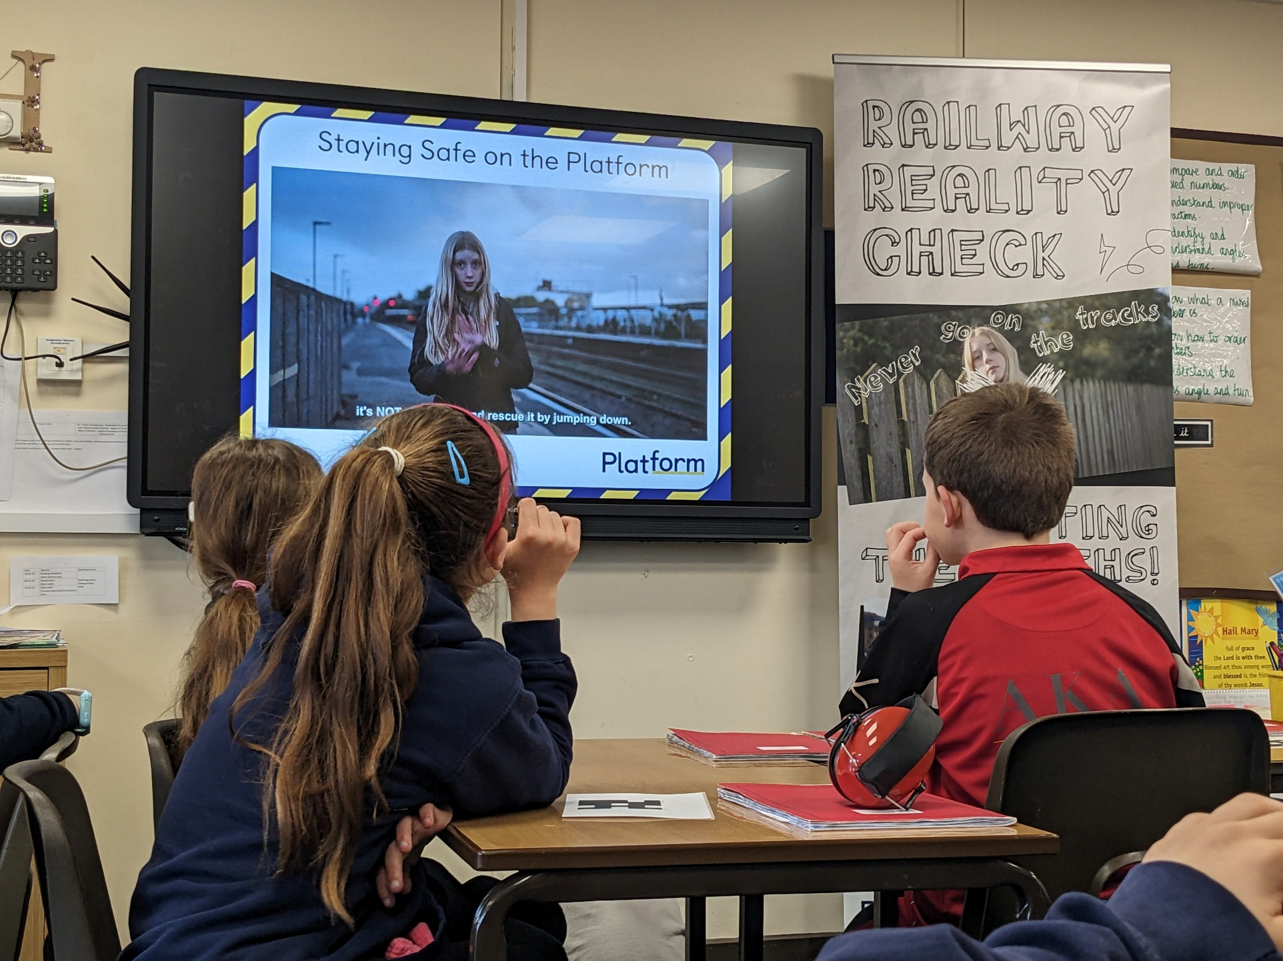

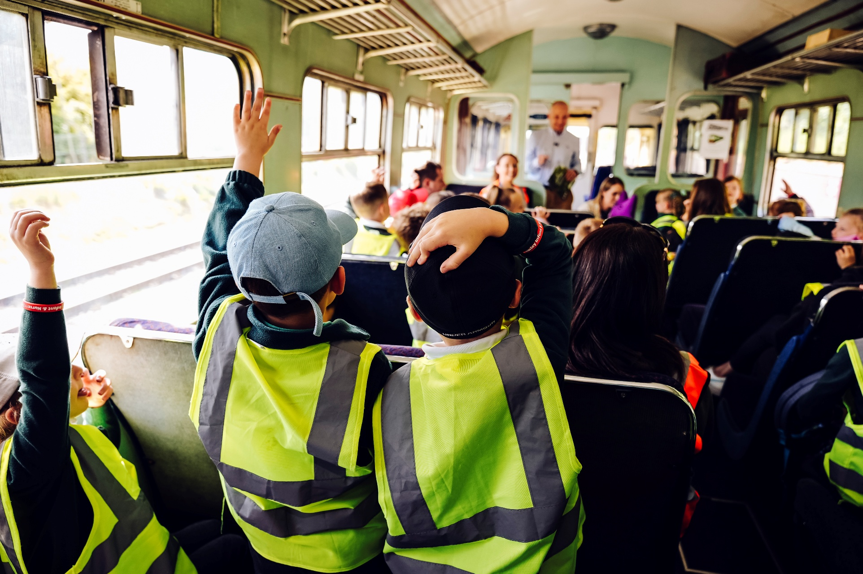
Community Rail Education Network
Wednesday 16 September 2026

Slide 2
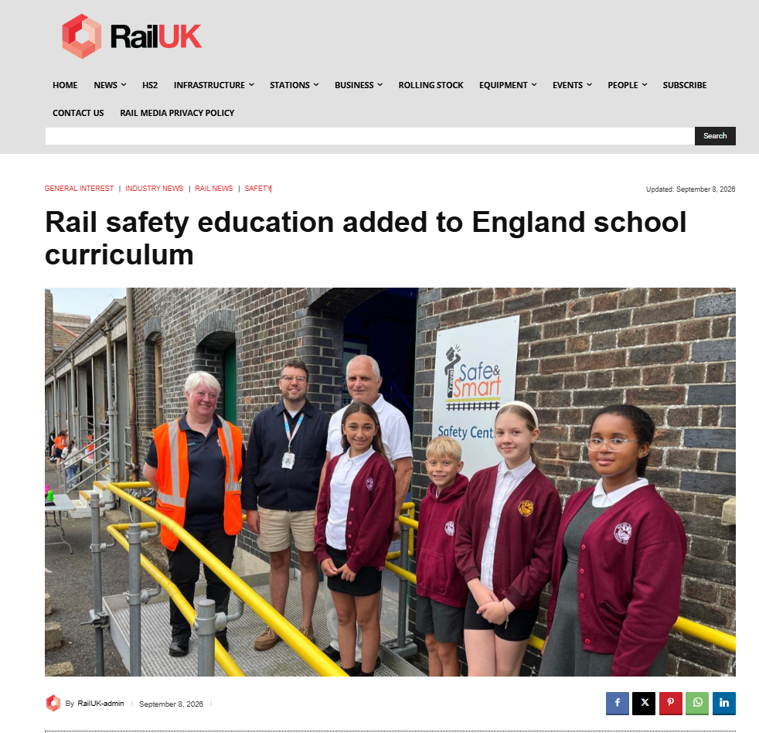


Slide 3
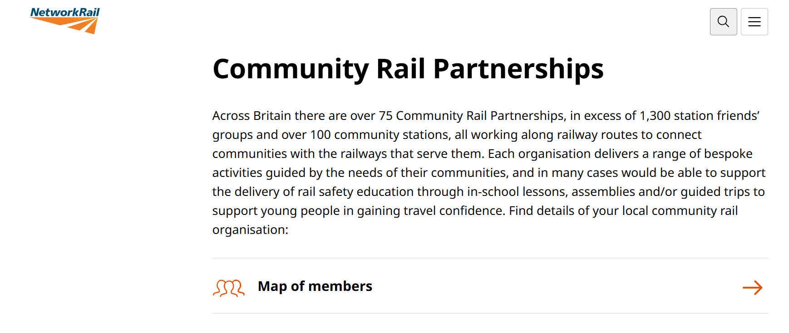
Network Rail Link

Slide 4
PSHE Curriculum Sept 2026
Primary
There’s a greater focus on online safety and wellbeing. For example, pupils will learn about online financial harms such as gaming, video game monetisation, scams and fraud – as well as the reasons for age restrictions on online content such as gambling websites and social media.
Within health education, there’s still an emphasis on helping pupils understand their bodies and the changes they might experience — and now, this includes learning the correct names for body parts (including genitalia). This reflects established best practice when it comes to giving children the knowledge and understanding they need to stay safe, including the ability to identify and report signs of abuse, while reducing stigma.
Addition of ‘personal safety’ to the statutory content, with an emphasis on recognising and reducing risk, in the context of fire and travel safety — for example around water, roads and railways.
There’s new learning around change and loss, including bereavement; recognising that this can cause a range of feelings, and that everyone grieves differently.
Within relationships education there’s new learning around communicating effectively, and developing the ability to be assertive and to express needs and boundaries.
Programme of Study for PSHE education (KS1-5)

Slide 5
PSHE Curriculum Sept 2026
Secondary
PSHE is about children’s real lives and to keep up with new and emerging issues young people are exposed to. This includes several references to 'AI literacy' and 'deepfake images' specifically at secondary.
There’s also a much greater focus on tackling misogyny, incel culture and their influence on attitudes towards women and girls and how they negatively affect boys and young men, as well as the harmful nature of pornography.
For both primary and secondary, we see the inclusion of personal safety, which now includes fire safety and travel safety — for example around water, roads and railways. At secondary, young people will also have the opportunity to learn about knife crime and conflict resolution.
At secondary level, pupils will learn more about menstrual and gynaecological health, including endometriosis and menopause. And there is greater emphasis on building skills to access healthcare services and professionals.
A more considered language around mental health, and there’s also a recognition of financial exploitation and its impact on safeguarding — including a requirement to cover scams, fraud, extortion and ‘sextortion’.
Programme of Study for PSHE education (KS1-5)

Slide 6
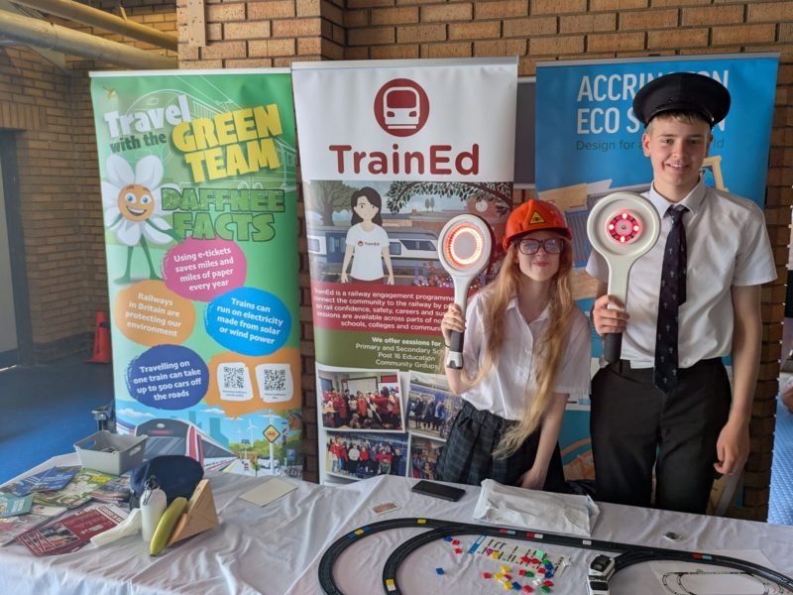
The wider benefit to CRPs
Schools have contact with a very large proportion of the community, working with a school also connects you to this community (e.g. Newsletters, parents’ evening, social media)
Anti-social behaviour at stations – visiting a school gives the station a face
Other Community Rail engagement – eg rail confidence trips, art projects

Slide 7
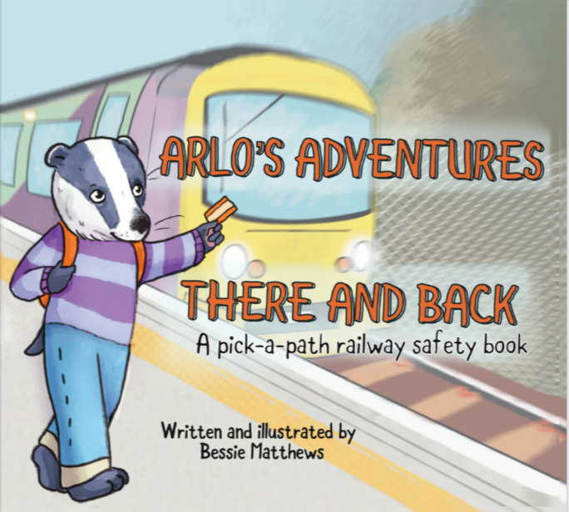
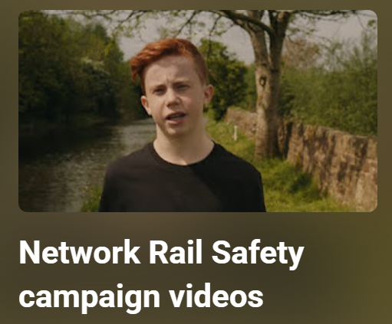
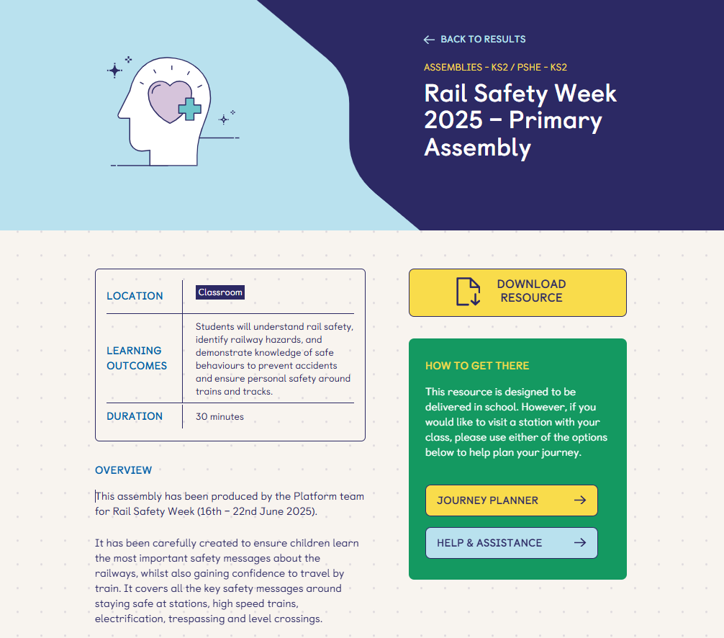
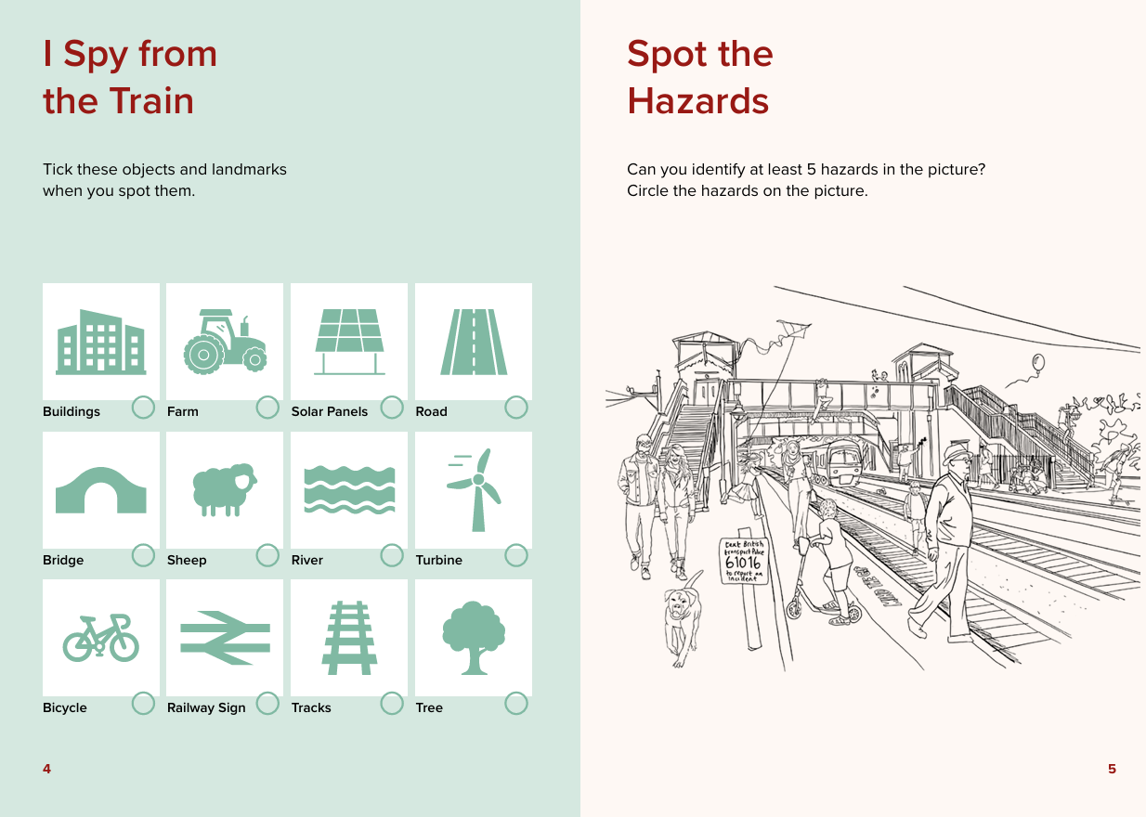
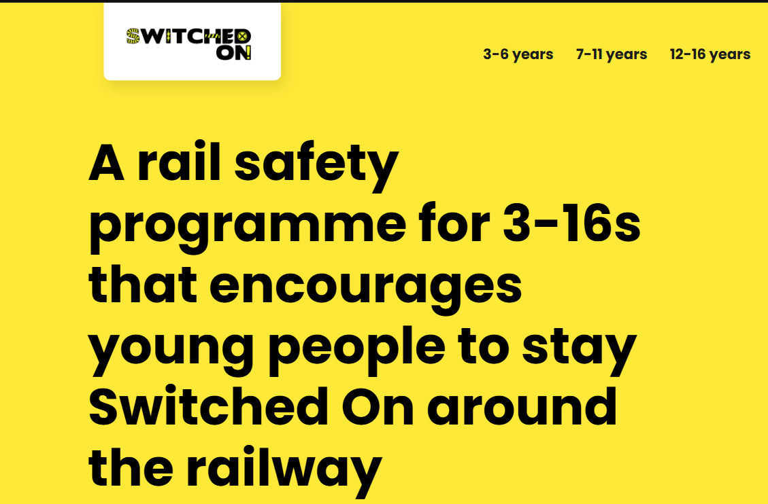
Resources
Arlo's Adventures - There and Back
Network Rail Safety campaign videos - YouTube
Rail Safety Week 2025 - Primary Assembly - Platform
Home New - Switched On!
All-Aboard-Booklet.pdf

Slide 8
Top Tips for reaching out to schools
When emailing schools – write who the email is for in the subject header – eg “FAO Year 5 teacher” or “FAO PSHE co-ordinator”
Don’t just use one method to communicate – Email, call, send a letter, drop into the school reception in person.
Mention if the engagement is free in the subject header or in the first sentence – schools have a lot of correspondence to sift through.
Follow all your local schools from your organisation’s social media accounts – find out when events are and make sure they know when your events are too!
Find the person responsible at your local authority who has all school email addresses and can send mailshots to all in the area.
Find out when the local cluster headteacher networking event is – you could get an invite to it and talk abut what you can offer.
18th May - Engaging with Schools - TrainEd

Slide 9
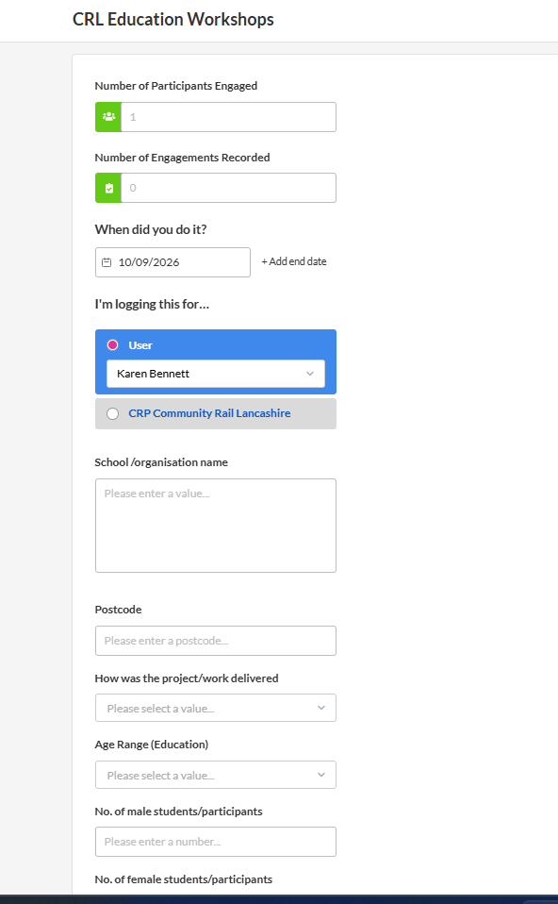
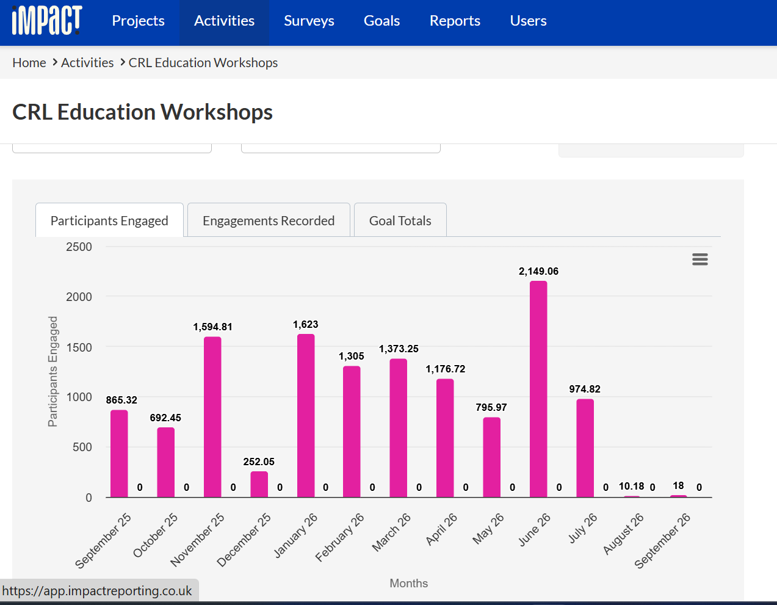
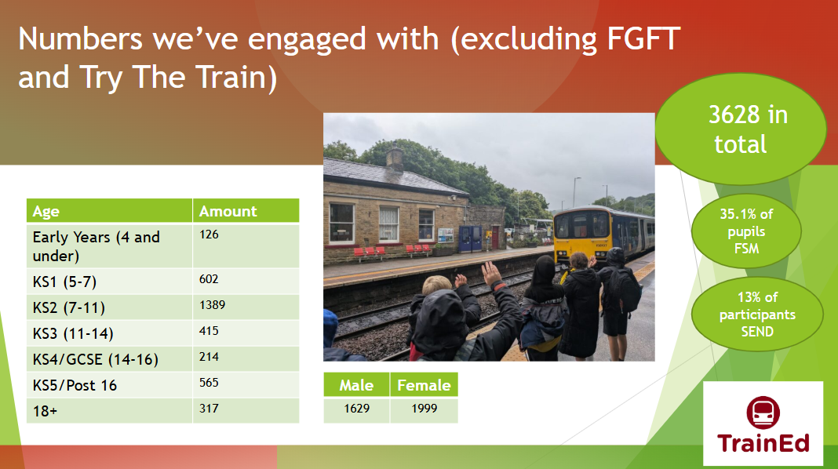
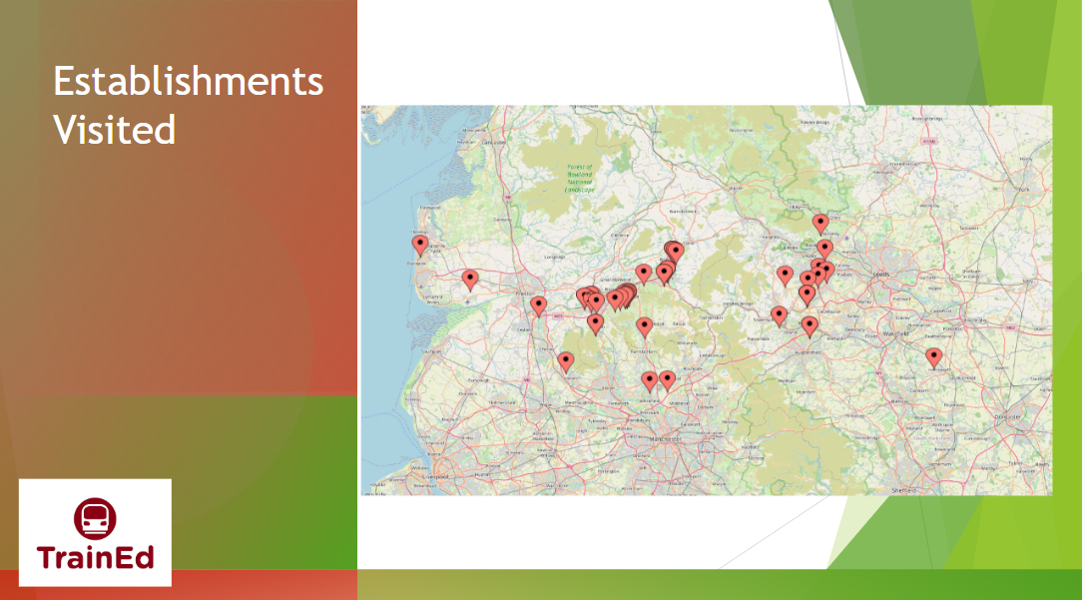
Collecting data
To set up Impact for your CRP/group: a.hughes@communityrail.org.uk

Slide 10
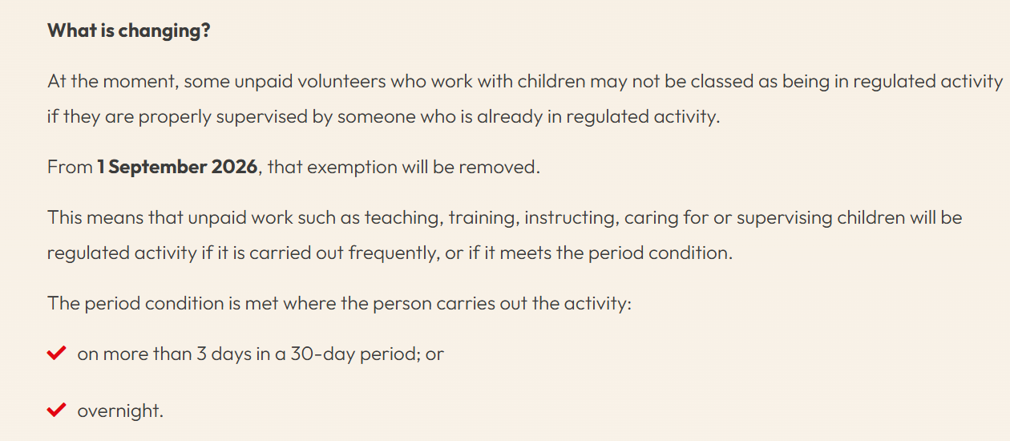
DBS – an update
Change to the definition of regulated activity with children from 1 September 2026 - GOV.UK

Slide 11
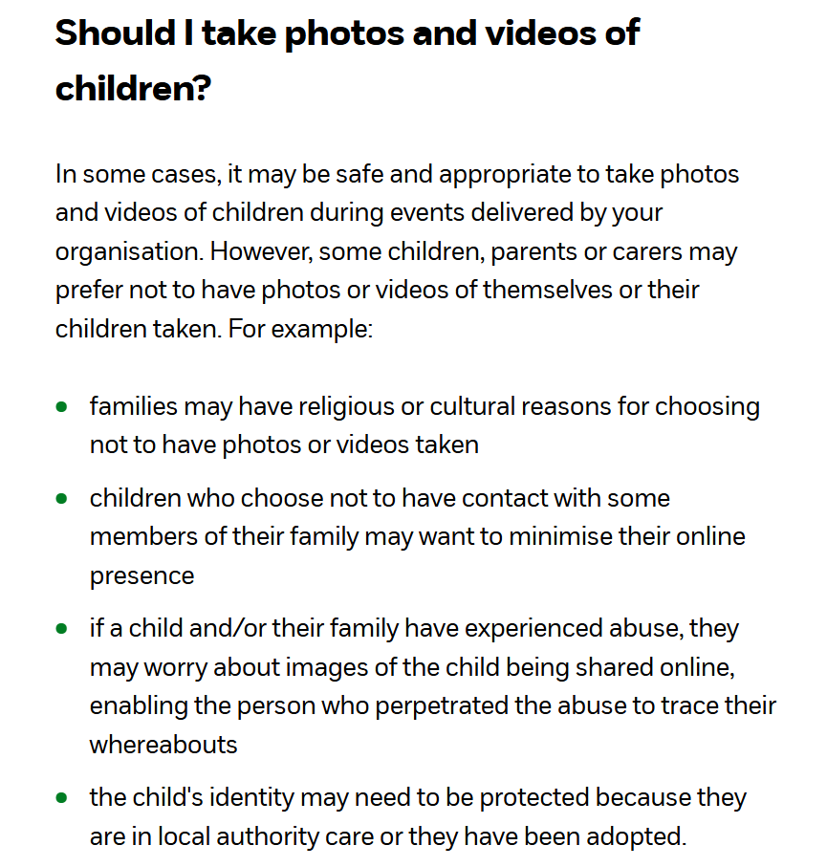
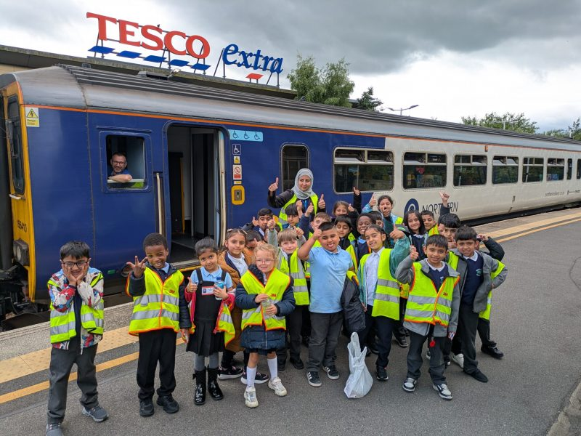
Photographs
Photographing and filming children | Images guidance | NSPCC Learning

Slide 12
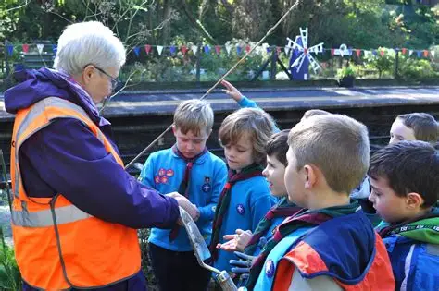
Sheila Davidson
(2) Friends of Hindley Station - The Official Site | Facebook

Slide 13
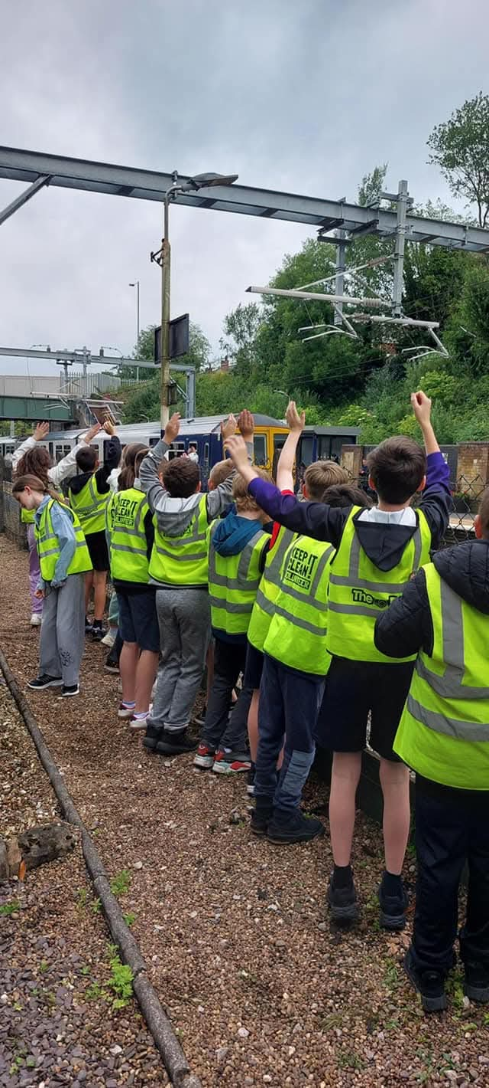
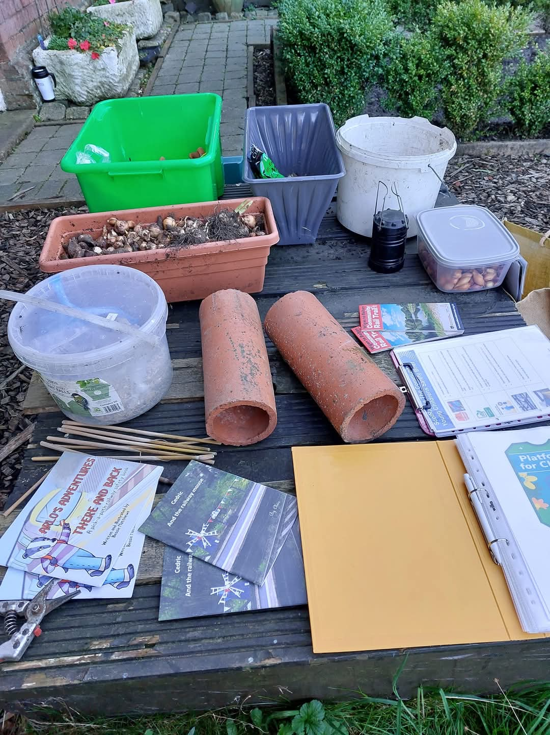
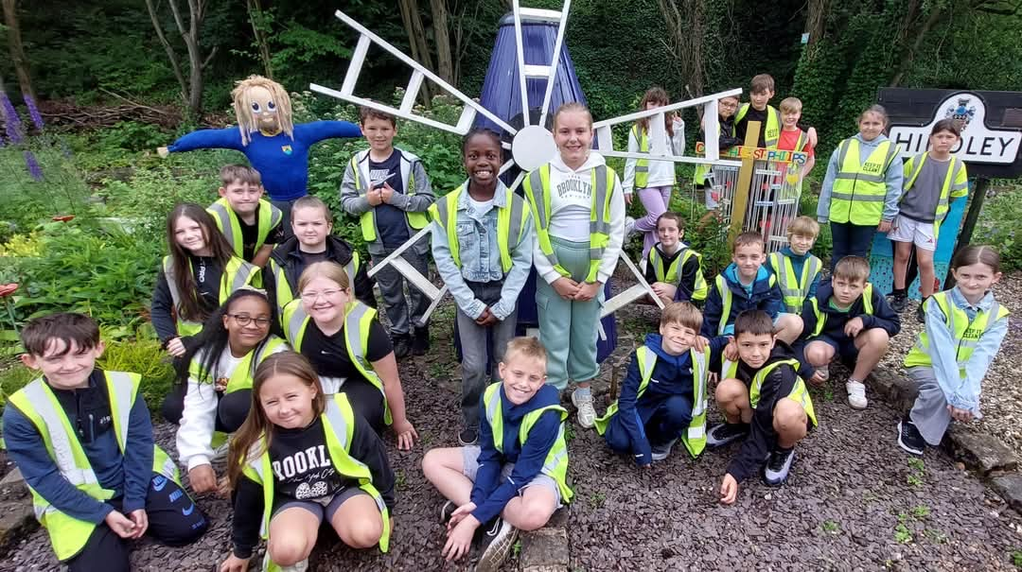
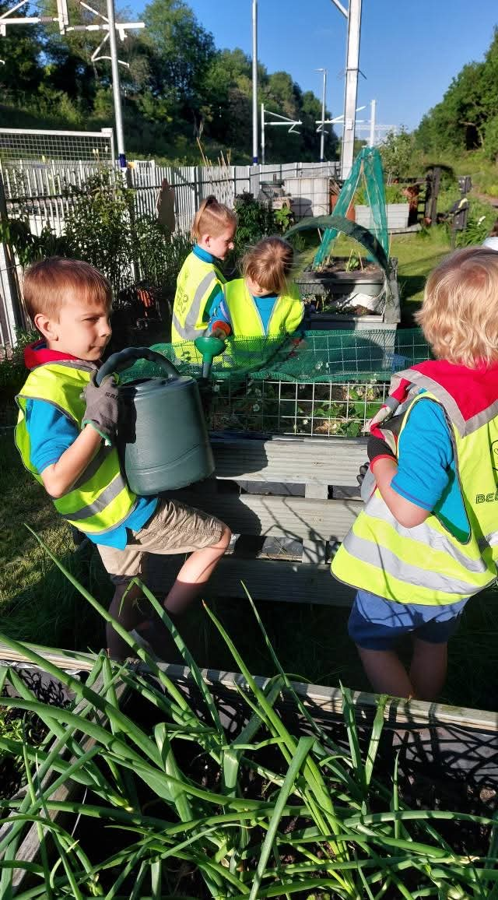
At the station

Slide 14
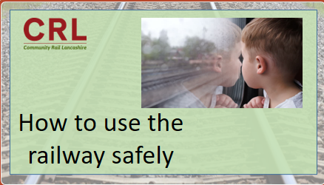
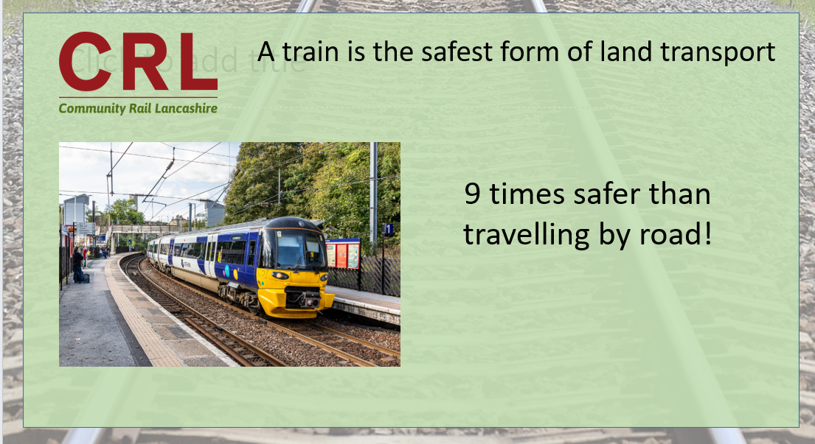
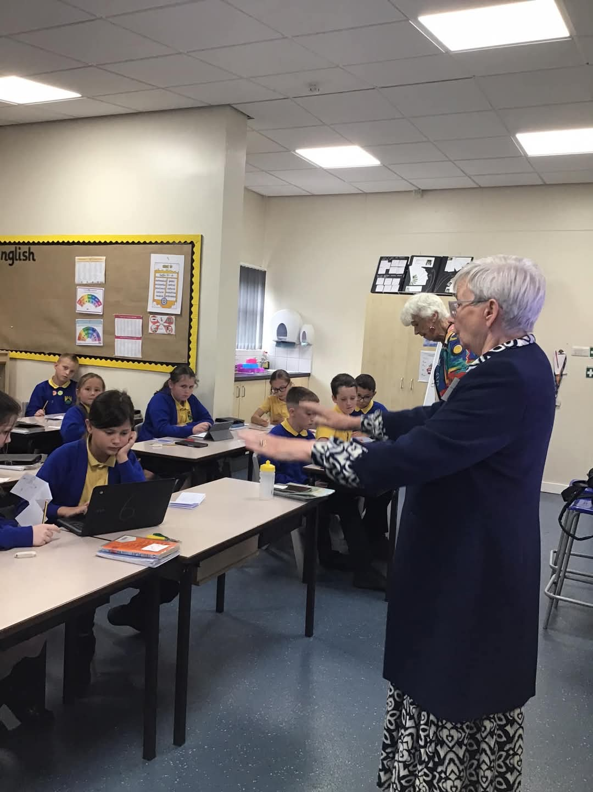
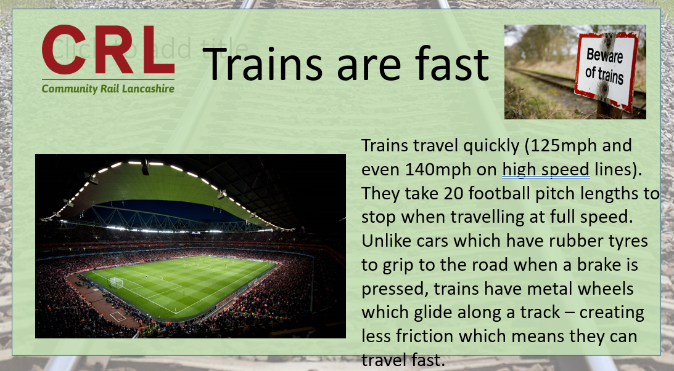
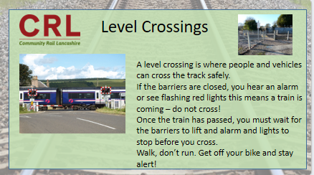
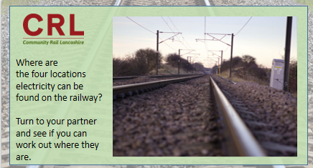
School engagement

Slide 15
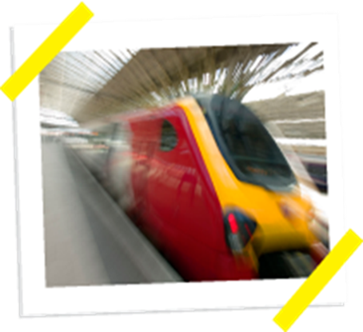

Early Years and KS1
Jess Young
Education Officer

Slide 16

Engagement Top Tips
Specific staff contact.

Slide 17
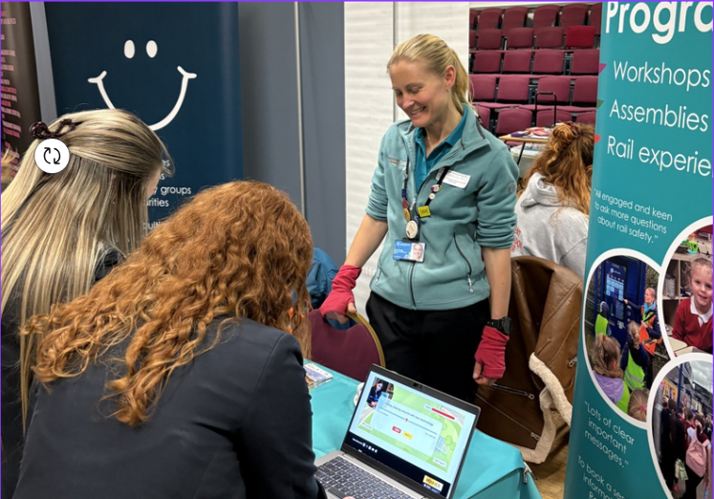
Engagement Top Tips
2. Careers Fairs – Gatsby Bench Marks
Gatsby Benchmark 5 “Every year, from the age of 11, pupils should participate in at least one meaningful encounter with an employer.”

Slide 18

Engagement Top Tips
2. Careers Fairs

Slide 19
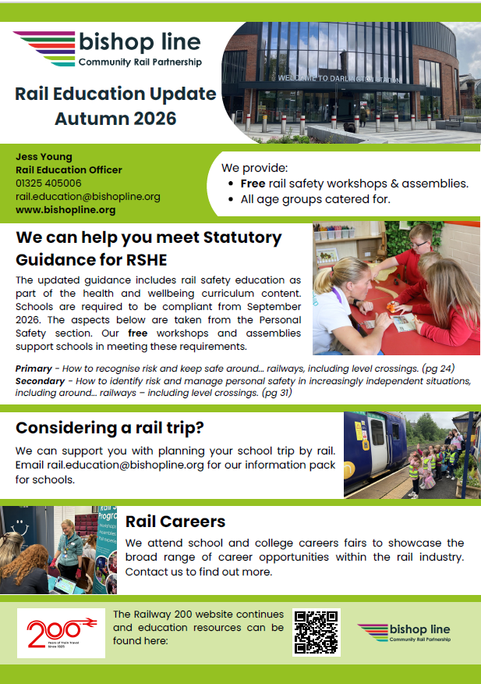
Engagement Top Tips
3. Local Authority Communications

Slide 20
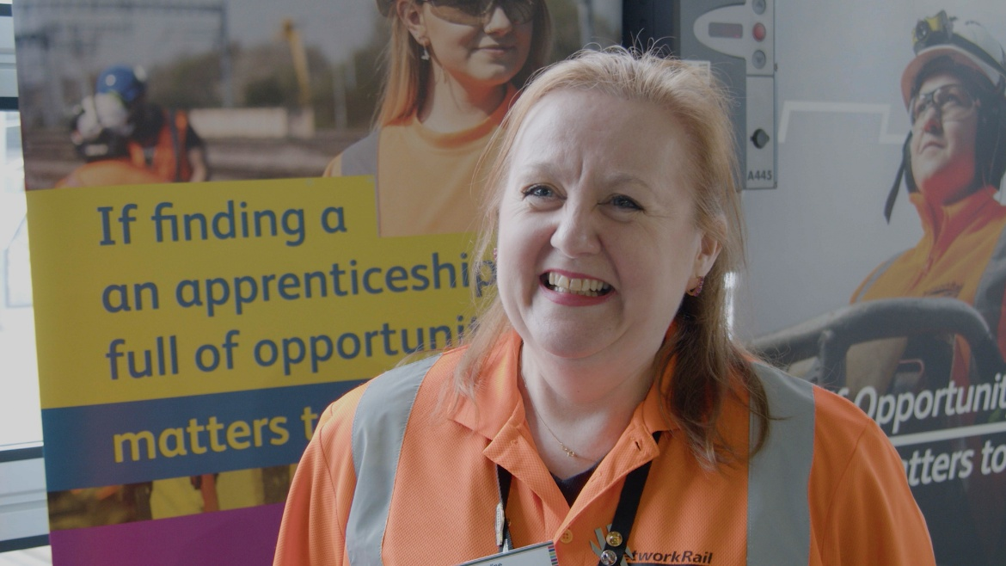
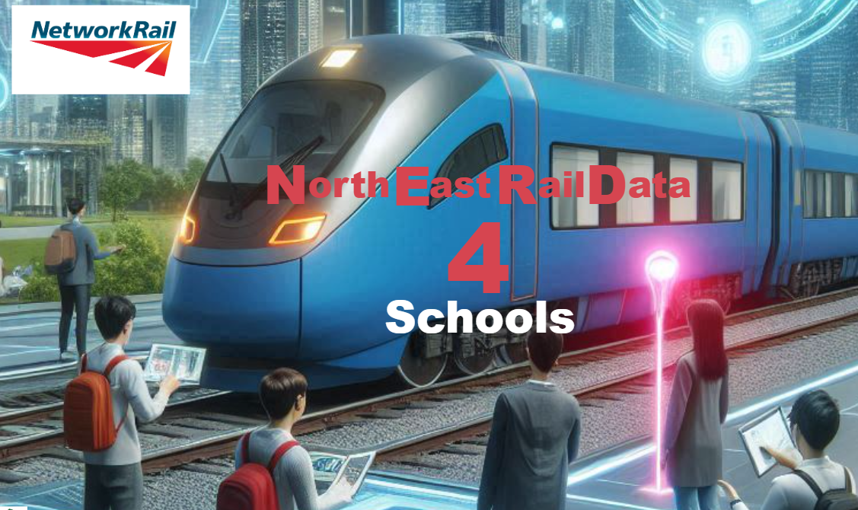
Engagement Top Tips
4. Network Rail Community Safety Manager

Slide 21
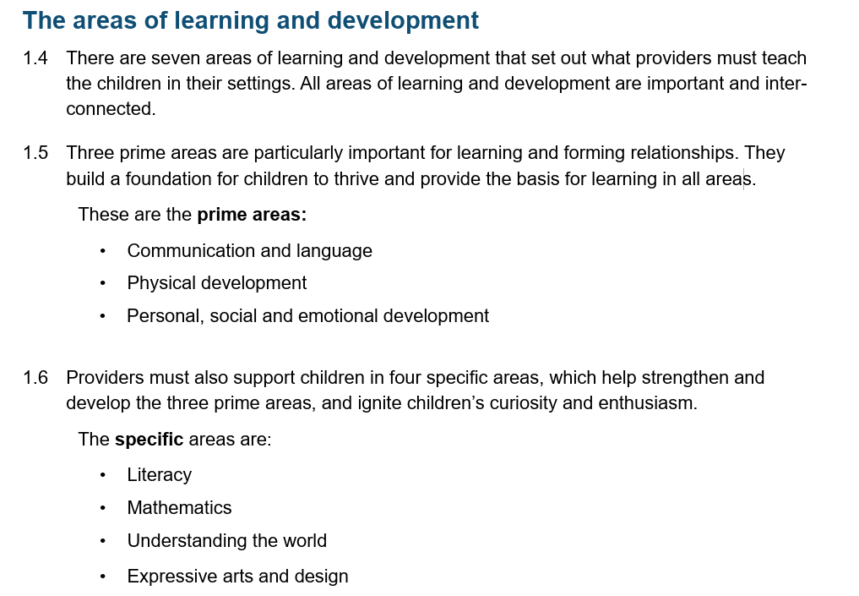
Early Years Foundation Stage Framework – All children up to end of Reception
https://www.gov.uk/government/publications/early-years-foundation-stage-framework--2

Slide 22
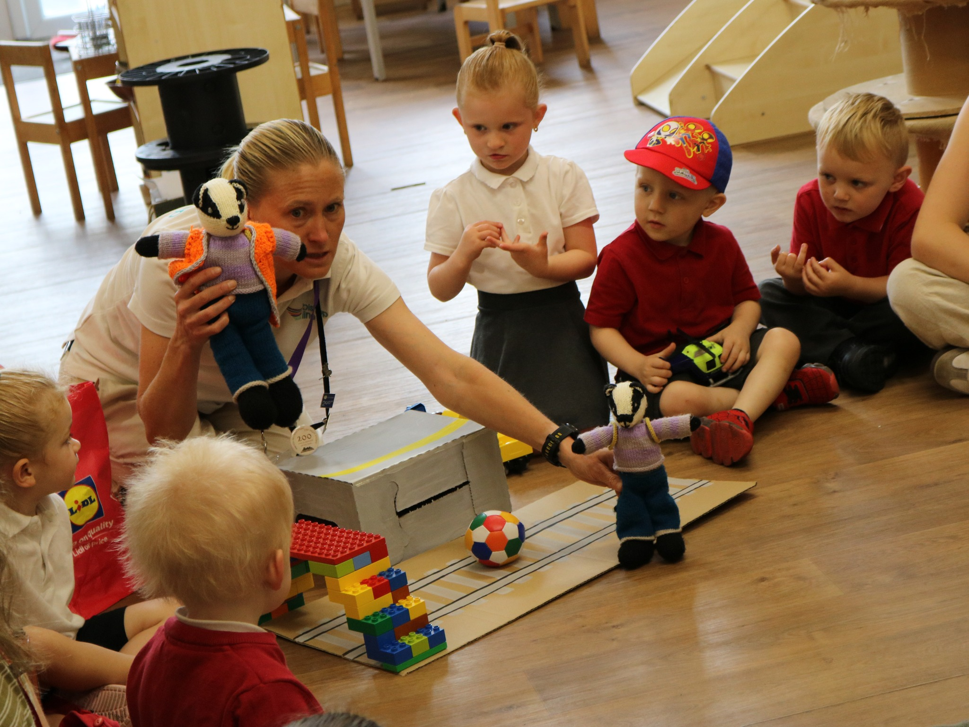
Personal, Social and Emotional Development: (3 ELGS)
ELG: Managing Self
Children at the expected level of development will:
Be confident to try new activities and show independence, resilience and perseverance in the face of challenge.
Explain the reasons for rules, know right from wrong and try to behave accordingly.

Slide 23
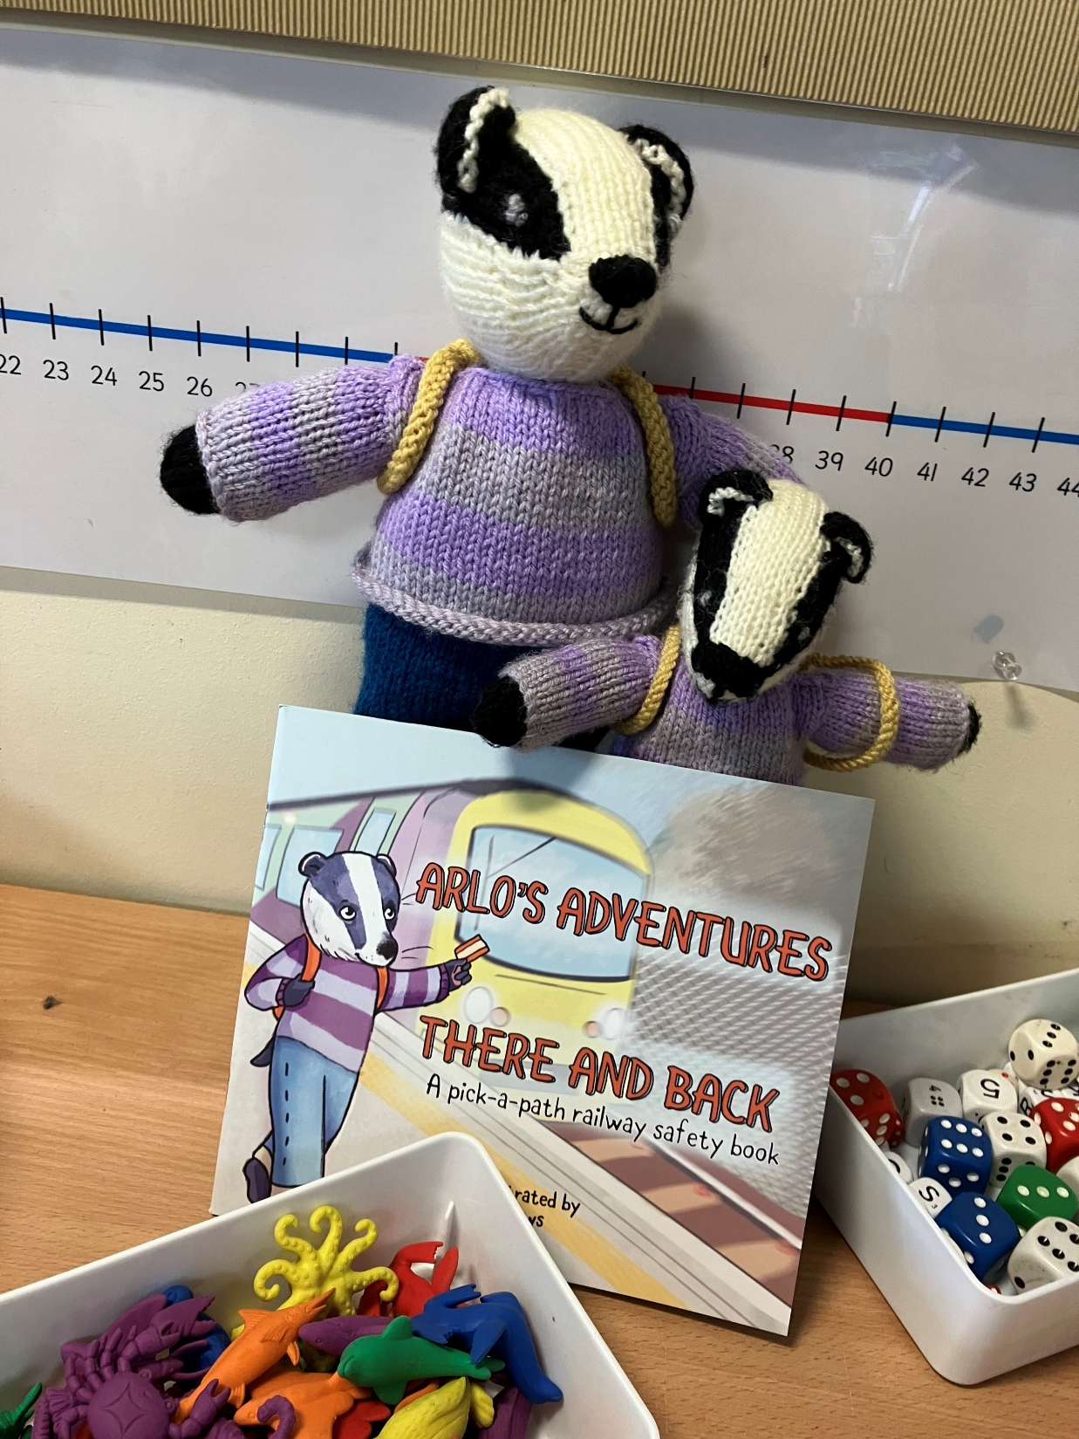

Slide 24
Key Stage 1 (5-7 years old)
Statutory Guidance for RSHE
The updated guidance includes rail safety education as part of the health and wellbeing curriculum content. Schools are required to be compliant from September 2026. The aspects below are taken from the Personal Safety section.
Primary - How to recognise risk and keep safe around... railways, including level crossings. (pg 24)
Secondary - How to identify risk and manage personal safety in increasingly independent situations, including around... railways – including level crossings. (pg 31)

Slide 25
Learning Objectives | To know how to keep myself safe when near or using the railway.
Success Criteria | I know that stations and level crossings can be dangerous places. I can talk about some of the dangers around the railway. I can explain how to keep myself safe in a station or at a level crossing.
Primary - How to recognise risk and keep safe around... railways, including level crossings. (pg 24)

Slide 26
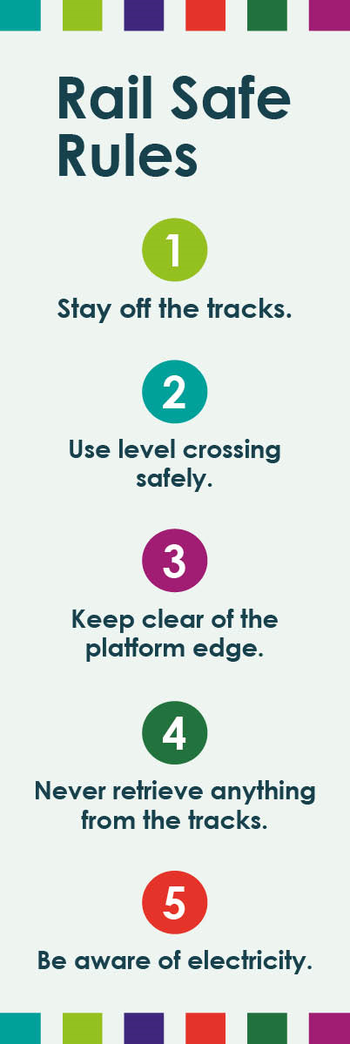

Slide 27
Clackety Clack, Stay off the track!
You’ll be fine, behind the yellow line!

Slide 28
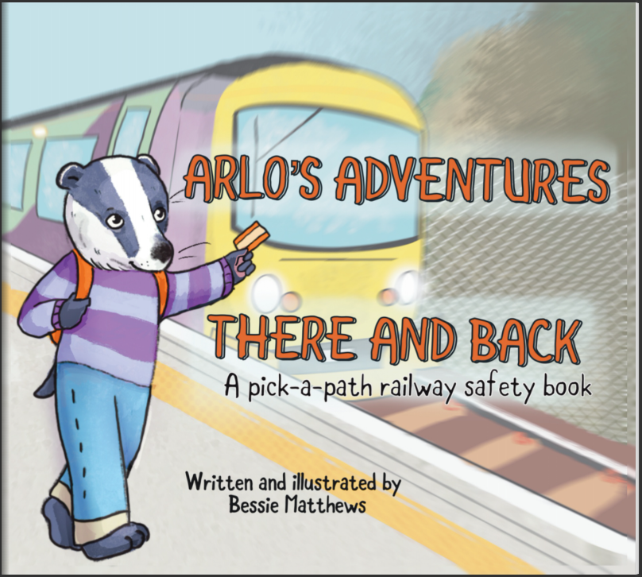
Arlo's Adventures - There and Back (fliphtml5.com)
Notes:
Arlo's Adventures - There and Back (fliphtml5.com)

Slide 29
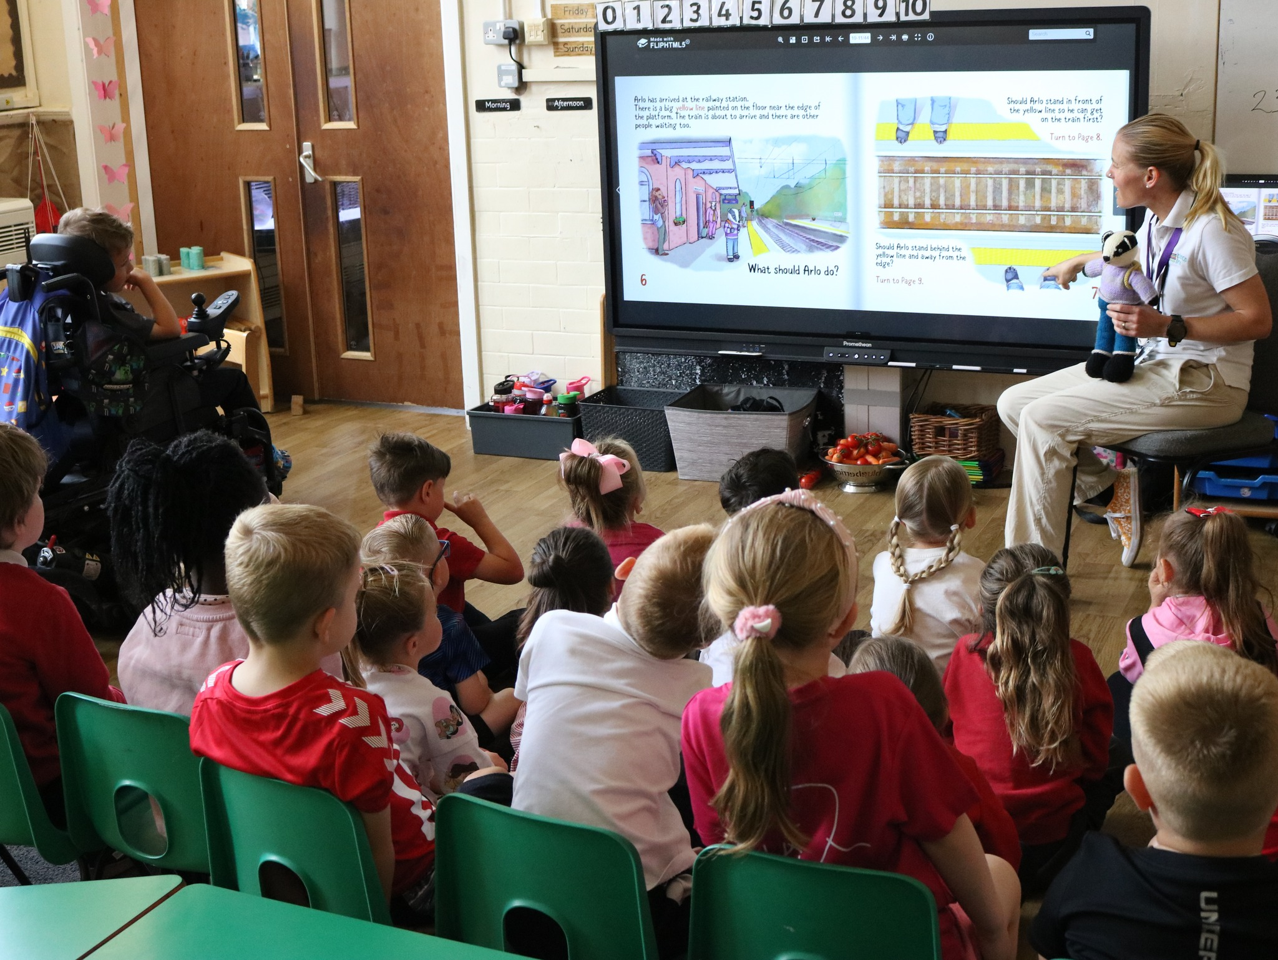
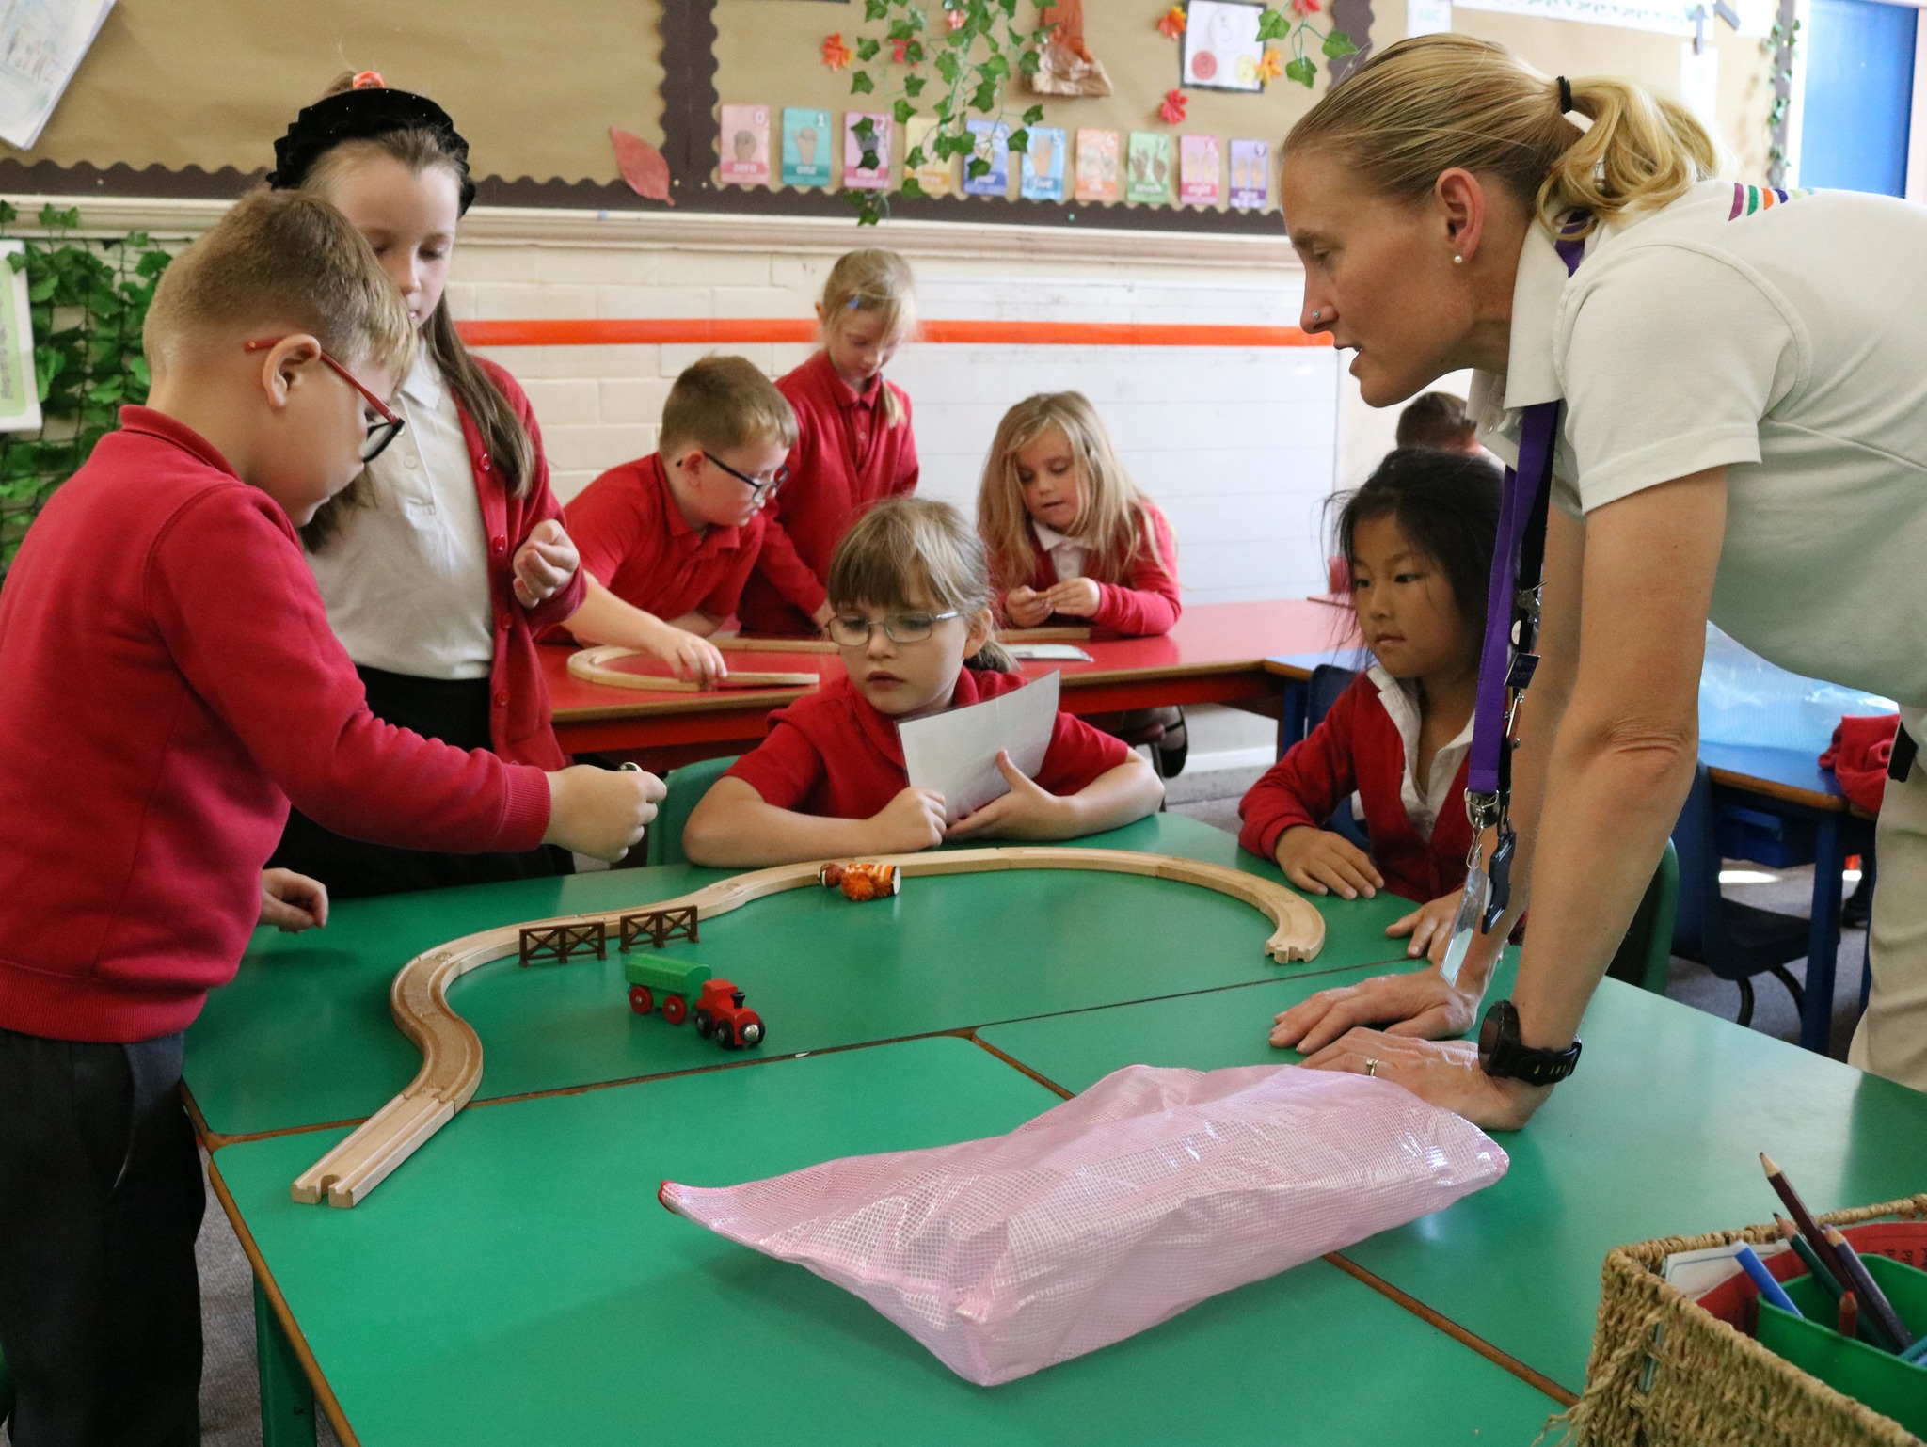

Slide 30
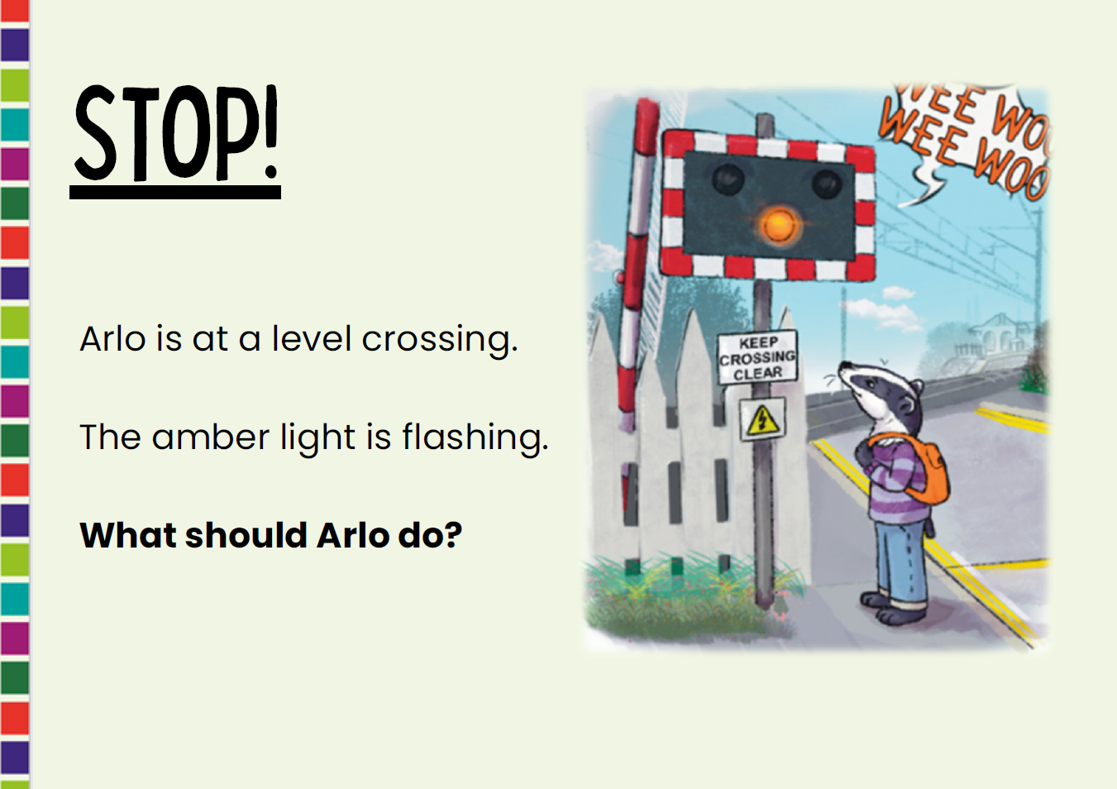

Slide 31
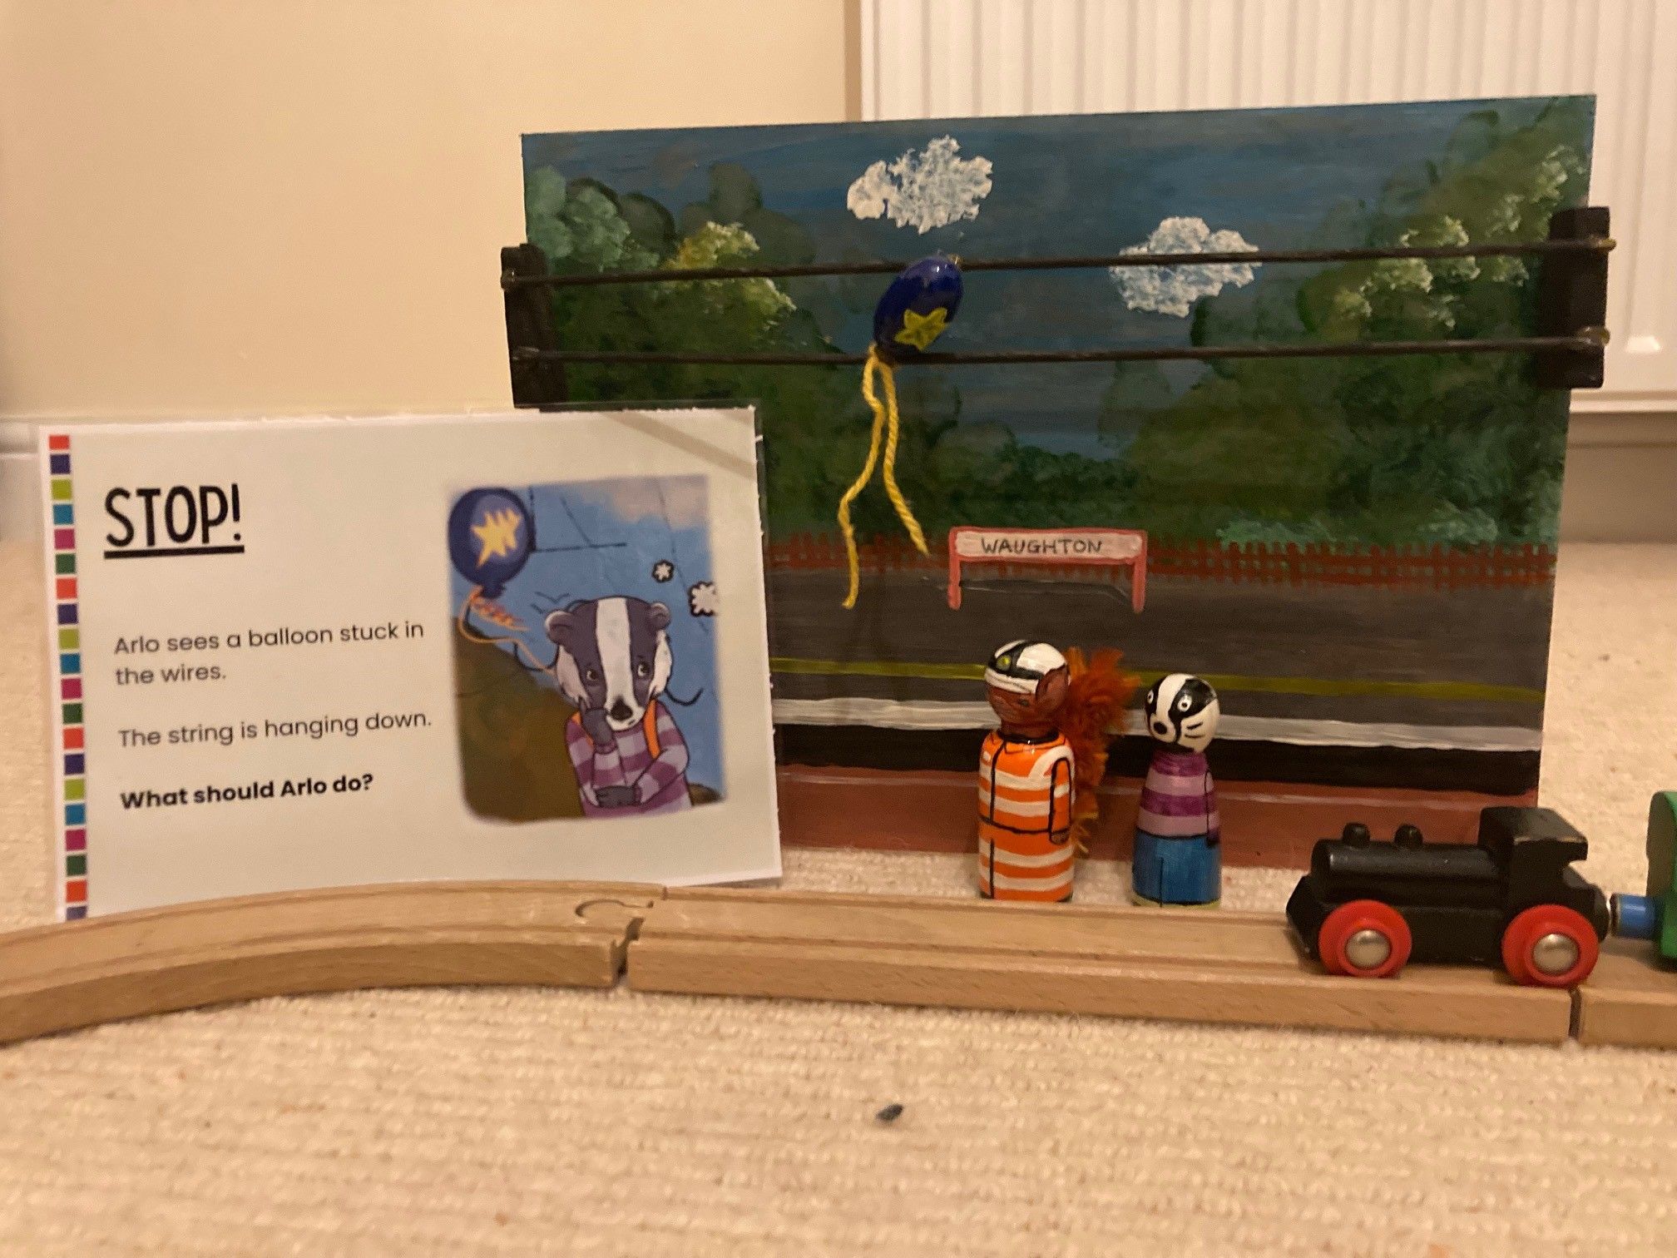

Slide 32
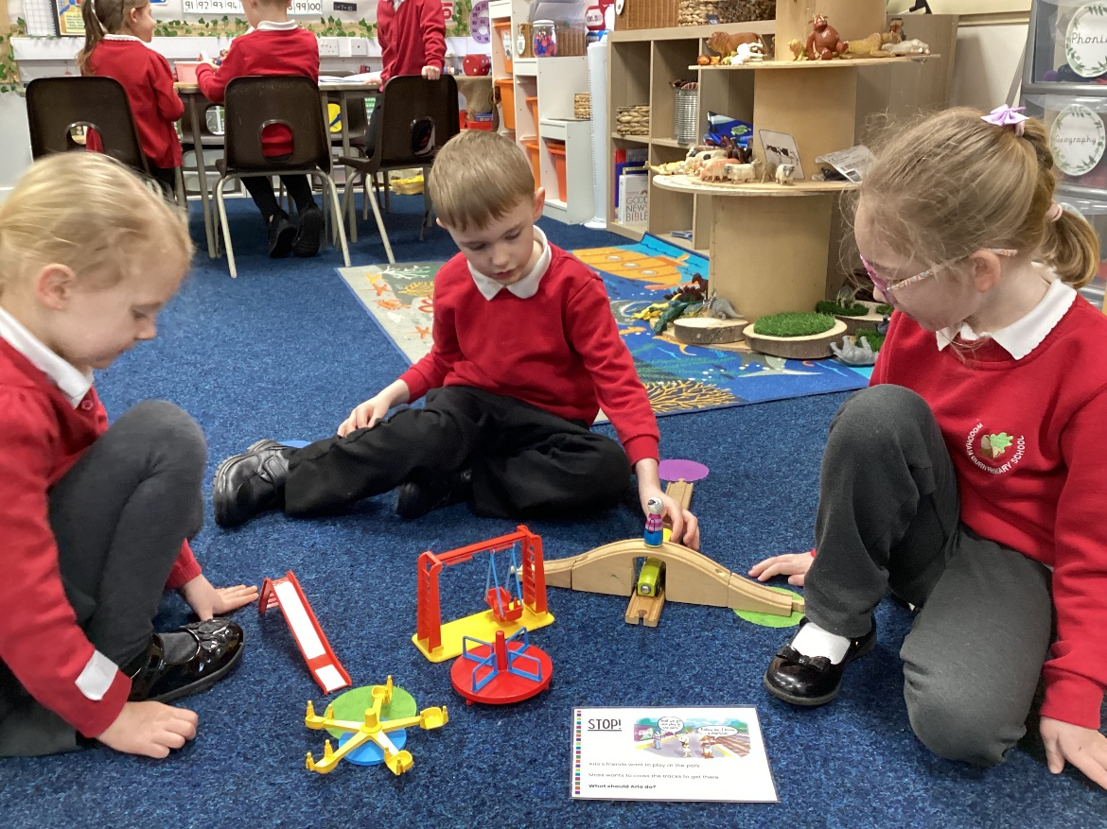
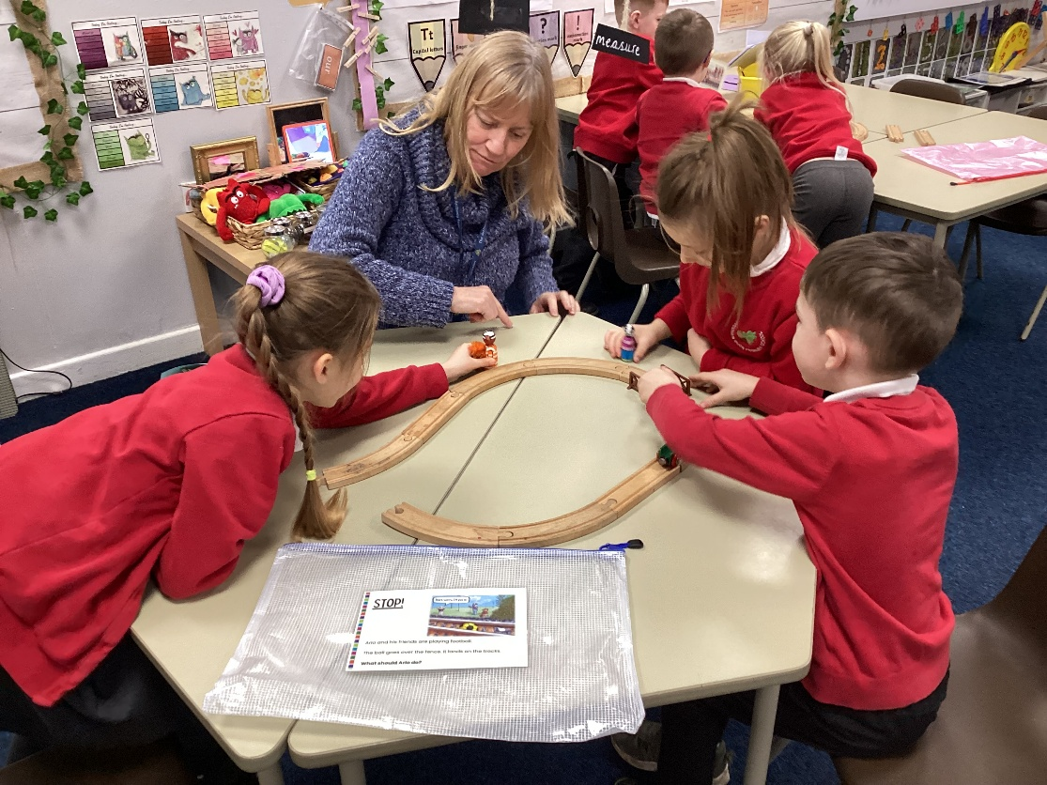
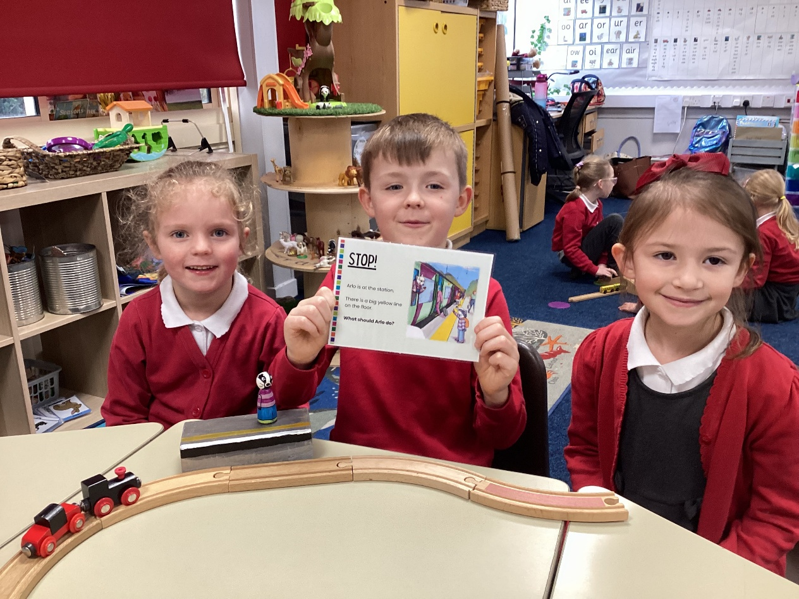
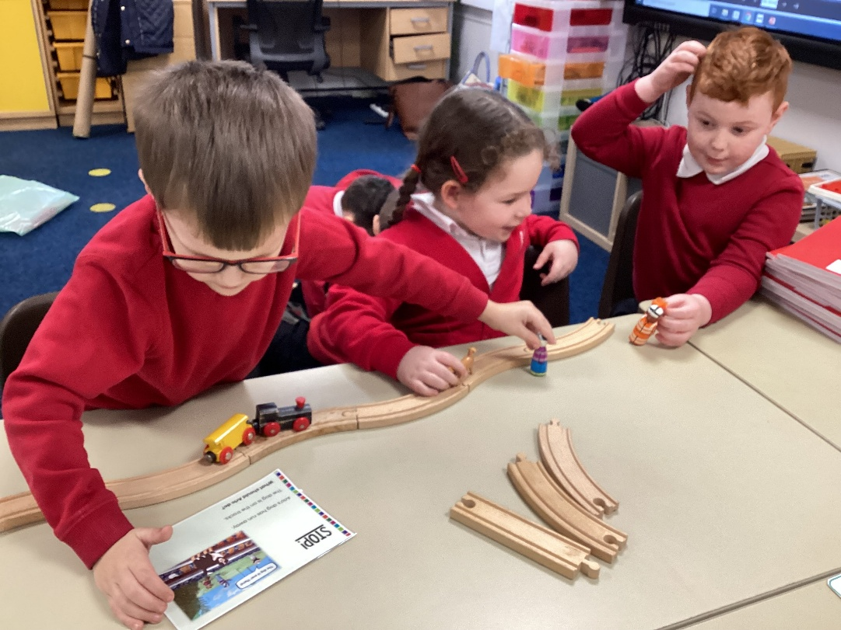

Slide 33
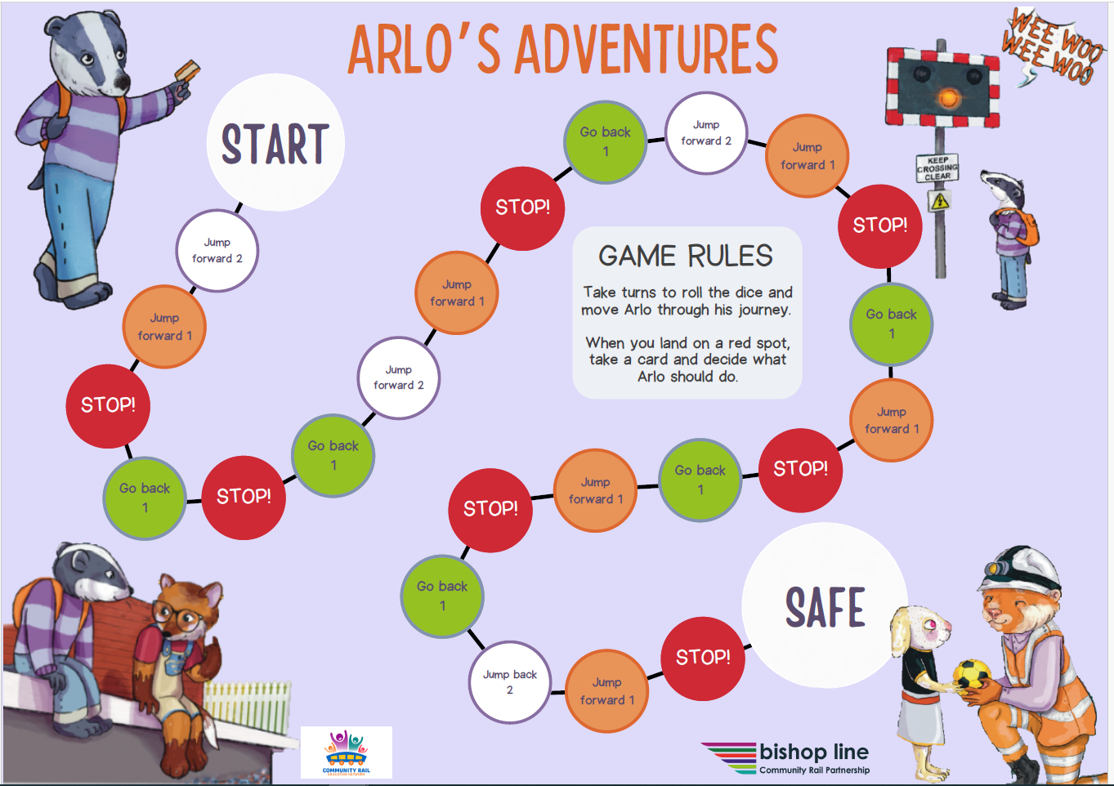

Slide 34
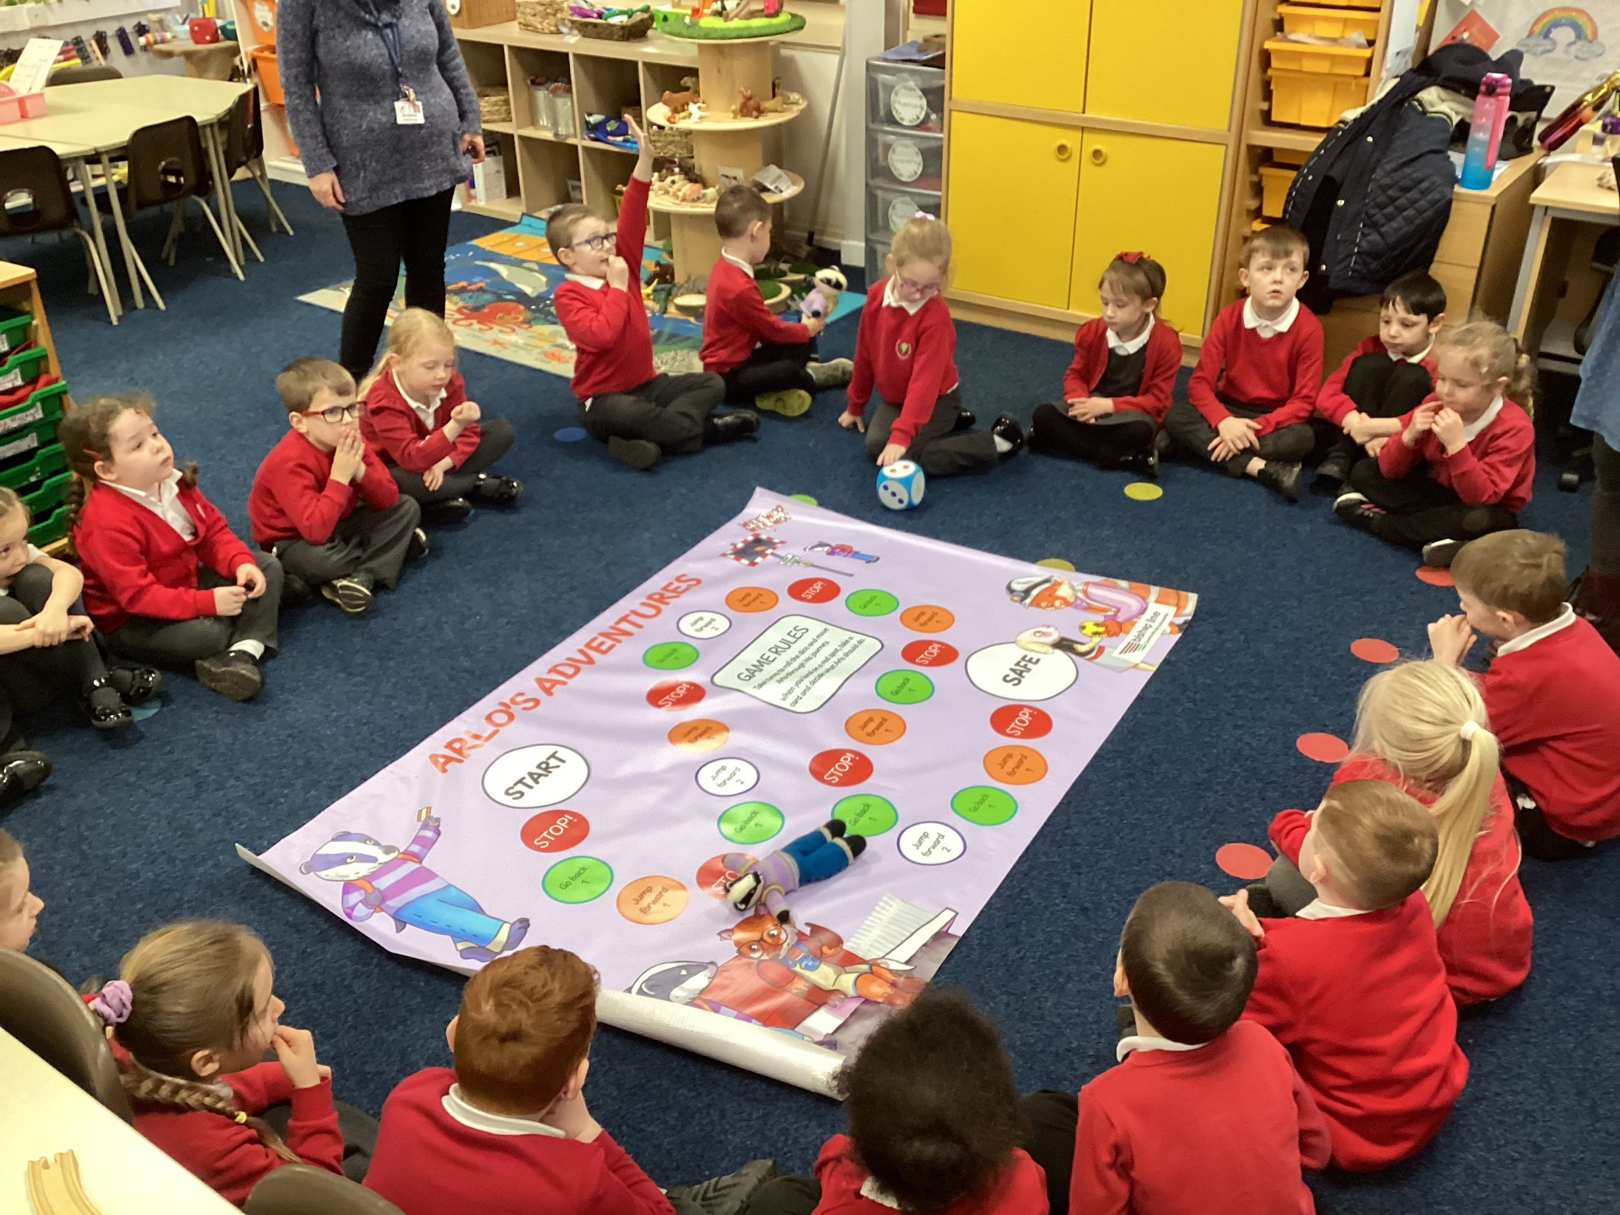

Slide 35
Top Tips for working with young children
Keep it simple – focus on a few key learning points.
Over-learn – practical/play activities to reinforce the learning. (simple songs and poems, actions, drama)
Not too long! – as a rule of thumb young children can focus their concentration for 1 minute for every year they’ve been alive!
Small Groups! – can the school tell you how many before you arrive?

