Slide 1

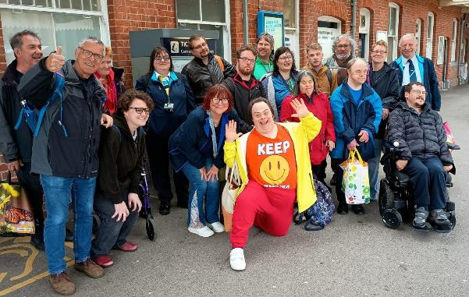
On Track for Inclusive
Train Travel
Making rail travel more accessible
Notes:
Webinar purpose is to tell CRPs about the outcomes from the On Track for Inclusive Train Travel project and to encourage the conversation to keep going
There were a variety of outcomes from this work which have already been shared out across our networks and directly with TOCs and a variety rail organisations.
CRPs have a crucial and valuable role to play in but supporting and lobbying the rail industry to improve accessibility across all stages of train travel.

Slide 2




Project partners
Notes:
This work was funded by Motability Foundation. RNIB were the lead partner and worked closely with the other main partner CRN.
The work was supported and carried out by CRL & GOCRP. The CRPs in this partnership brought valuable connections and networks with local disabled people’s groups and residents, as well as some established connections with EDI leads in local TOCs.
Although RNIB were lead partner, this project held a pan-disability focus.
Also had support from Evaluation Consultant Dr Miriam Ricci.

Slide 3
Why now?
National rail sector strategy is increasingly focused on outcomes-based accessibility and inclusion.
Passenger expectations/needs for accessible and inclusive travel continue to grow.
There is growing recognition that training alone will not resolve accessibility challenges.
The industry has an opportunity to move from reactive fixes to systemic change
Stronger partnerships between communities, operators and disabled passengers can drive lasting improvements.
Notes:
Disabled people have been calling out for more accessible travel forever, so this project was not expecting to highlight completely new and unheard information. But, disabled passengers continue to face predictable and recurring barriers when travelling by rail and these accessibility challenges occur across the whole journey, not just at stations or on trains (from planning a journey to booking and right through to feedback, complaints, or claiming refunds).
National expectations for rail accessibility and inclusion are no longer limited to regulatory compliance or training delivery quotas. For example:
The Accessible Railways Roadmap establishes that accessibility must be directly informed and shaped through meaningful engagement with disabled people. It also identifies cultural change, improved monitoring and lived-experience-led decision-making as core priorities for the rail industry
The Department for Transport’s Better Connected strategy reinforces the shift towards putting people at the centre of transport systems, strengthening local partnerships and engagement, improving feedback and accountability.
The rail industry is moving towards a model where accessibility and inclusion are not delivered through isolated interventions or as a tick-box exercise, but are embedded in governance, operations and decision-making. Rail reform and the transition to Great British Railways (GBR) create an important opportunity to build this approach into the future structure and culture of the railway from the outset.
At the same time, accessible and inclusive travel has become an increasingly central tenet across Britain’s community rail movement, with a growing range of initiatives to build rail confidence, co-produce projects and solutions with disabled and marginalised people, and support the rail industry to better understand local needs and lived experience. This existing community-based engagement offers significant untapped potential for wider rail industry learning, collaboration and the development of more inclusive services.

Slide 4
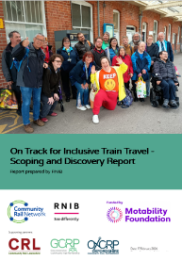
Discovery
Identified that barriers are systemic, predictable and often embedded within operational processes.
Highlighted challenges created by fragmented systems, staffing pressures and operational constraints.
Found that staff often want to help but are limited by existing systems and processes.
Demonstrated the value of placing lived experience at the centre of service improvement.
Provided a strong evidence base for future industry action and collaboration.
Notes:
The purpose of Discovery was to review, collect and assess evidence to better understand what influences disabled people’s experiences of staff support when travelling by rail in the UK. As part of this, we:
Talked with disabled people, rail professionals and key stakeholders through focus groups, interviews and surveys.
Set up an advisory group bringing together lived experience and industry expertise.
Gathered evidence, insights and feedback to identify opportunities for system-wide improvements.
Desk-based research – including literature review of relevant academic texts
We found that:
barriers are systemic, predictable and often embedded within operational processes.
Accessibility and inclusion challenges are created by fragmented systems, staffing pressures and operational constraints
staff often want to help but are limited by existing systems and processes
There is a mixed understanding of the value of placing lived experience at the centre of service improvement
a strong evidence base for future industry action and collaboration
The biggest barriers to accessible and inclusive rail travel are not caused by lack of training, but by the systems, environments and operational conditions within which staff work, affecting how training is applied and the experiences and barriers faced by disabled people. Hence the On Track project sought to explore and understand this better.
On Track showed that while disability awareness and inclusion training is well established across the sector, its impact is limited by:
staffing pressures and gaps
inconsistent handovers between operators
inaccessible or fragmented information systems
rigid operational processes
lack of clear accountability across complex journeys
These factors significantly shape whether staff are able to deliver inclusive support in practice.
Evidence from the On Track discovery phase indicates that around four in five disabled respondents reported difficulties when travelling by train. Nearly a third said they avoid travelling by train altogether due to unmet accessibility needs. These challenges are not isolated or incidental - they are systemic and predictable. Improving accessibility outcomes requires changes to systems, operations and culture not just improvements in training.
On Track’s evidence shows that many of the right components already exist across train operators, but they are not yet connected or embedded in a way that delivers consistent outcomes. Progress is limited by a set of common constraints:
Lived experience is not consistently embedded into decisions
Engagement happens but does not reliably shape operational or strategic choices.
Feedback does not consistently drive improvement
Insight is collected but not systematically shared, tracked or translated into action.
Journeys are not managed as a single, coordinated system
Responsibility breaks down at handovers, particularly across locations and operators.
Staff are constrained by operational realities
Time pressure, staffing levels and rigid processes limit the ability to apply inclusive practice.
Accessibility is not fully embedded in core operations
It is often treated as a requirement to meet, rather than a principle shaping how services are designed and delivered.

Slide 5
Core insights
  1. Moving from compliance to performance and outcomes
  2. Enabling trained staff to act within operational reality
  3. Strengthening coordination across operators, modes and journey elements
  4. Embedding engagement and co‑design as ongoing practice
  5. Improving feedback, data and learning loops
  6. Designing a more consistent, lived experience informed training offer for all roles
Notes:
1. reframing success around performance and passenger outcomes, rather than training completion alone. This includes exploring how behavioural expectations, operational metrics and passenger experience indicators might be better aligned, and how evidence of “what good looks like in practice” can be generated, tested and refined within real-world rail contexts
2. An important opportunity for further work is therefore to explore the operational conditions that enable or inhibit inclusive practice, rather than focusing solely on individual capability
3. to focus on journey-level reliability rather than isolated interactions, exploring how handovers, shared accountability and information flows can be strengthened across organisational boundaries. Further work in this area would help fill gaps in evidence about how coordination failures arise in practice and which interventions are most effective in reducing them
4. Discovery confirms strong evidence that involving disabled people improves the relevance, credibility and legitimacy of training and other interventions. opportunity lies in exploring how co-design and lived experience input can be embedded more systematically across multiple aspects of delivery, including reviewing standard operating procedures, piloting and evaluating new initiatives, and informing feedback processes
5. clear opportunity to explore how feedback and data can be better integrated into learning loops, enabling organisations to identify recurring failure patterns, test changes and monitor their effects. Addressing these gaps would help build a stronger evidence base for understanding what interventions are most effective, and for supporting continuous improvement across the sector.
6. Strengthening training for all roles can also help contribute to wider cultural change, ensuring that accessibility and inclusion are understood not only as frontline responsibilities but as organisational values shaping policies, decision-making and everyday practice.

Slide 6

What needs to be done

Slide 7
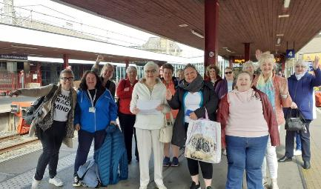
Strengthening co-production in rail
Move from one-off consultation to ongoing co-production with disabled people.
Build stronger relationships between disabled passengers, frontline staff and decision-makers
Use accessibility panels and local community partnerships as active channels for shaping services
Develop practical frameworks and tools that help organisations embed lived experience into everyday decision-making
Ensure accessibility improvements are designed with disabled people, not just for them.
Notes:
This is about shifting from occasional consultation to genuine, ongoing co‑production with disabled people.
We know from Discovery that when lived experience is embedded early, services become more usable, more consistent and more resilient. So, we’re encouraging operators to build stronger relationships between disabled passengers, frontline staff and decision‑makers.
Accessibility panels and community partnerships shouldn’t be passive - they should be active channels for shaping services. And importantly, we need practical frameworks that help teams bring lived experience into everyday decisions, not just major projects.
The goal is simple: accessibility improvements designed with disabled people, not just for them.

Slide 8

Creating better feedback loops
Strengthen mechanisms that connect passenger experiences with operational and leadership decisions
Move beyond complaints data to capture learning from everyday experiences
Create clearer “You Said, We Did" approaches that demonstrate action and accountability
Use frontline staff insights alongside passenger feedback to identify systemic barriers earlier
Build organisational learning processes that support continuous improvement.
Notes:
We also need to strengthen the way feedback flows through the system. Right now, learning seems to be focused on complaints data, which only captures a fraction of real experiences.
We want operators to build clearer ‘You Said, We Did’ (or even better we said, we did) approaches that show action and accountability.
Frontline staff insights should sit alongside passenger feedback because staff often spot systemic barriers long before they become incidents.
By improving organisational learning processes, we can move from reactive fixes to continuous improvement, where everyday experiences genuinely shape operational and leadership decisions

Slide 9
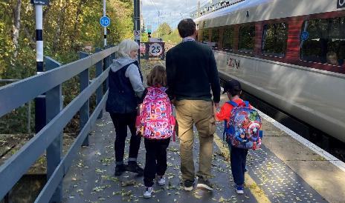
Supporting inclusive practice in the frontline
Create opportunities for shared learning between disabled people and rail staff.
Use co-designed campaigns, prompts and real-life stories to reinforce inclusive behaviours
Help staff understand lived experience within the realities of day-to-day rail operations
Focus on creating the conditions that enable inclusive practice, not just additional training.
Support managers and leaders to take greater ownership of accessibility outcomes.
Notes:
Inclusive practice doesn’t come from more training alone, it comes from creating the right conditions for staff to act inclusively.
Shared learning between disabled people and rail staff is key. Co‑designed campaigns, prompts and real stories help reinforce behaviours that make a real difference day‑to‑day.
We also need to help staff understand lived experience within the realities of rail operations like tight schedules, busy platforms, fragmented systems.
Managers have a crucial role here: supporting teams, modelling inclusive practice and taking ownership of accessibility outcomes. When frontline staff feel equipped and supported, inclusive practice becomes part of everyday operations, not an add‑on.

Slide 10

Call to action

Slide 11
What TOCs can do
Move beyond training-focused solutions and tackle systemic barriers.
Commit to embedding accessibility within everyday operations and decision-making.
Involve disabled people from the outset when designing services and improvements.
Strengthen collaboration across organisations to improve end-to-end journeys.
Speak to your local Community Rail Partnership to build on the learning from On Track to deliver lasting industry change
Notes:
Train operators, Network Rail, GBR leaders and wider rail partners all have a critical role in shaping a more accessible railway. But this is not about adding more activity, it is about changing how decisions are made, how systems operate, and how insight is used.
We invite rail partners to:
engage with the findings of the On Track project
reflect with us on current approaches and opportunities for development
explore opportunities to pilot and apply co-production approaches alongside Community Rail Network and our members
work collaboratively with the community rail movement to strengthen, scale and better connect existing community-based accessibility and inclusion activity
help shape future rail reform and GBR structures in ways that embed accessibility, inclusion and lived experience across the railway.

Slide 12
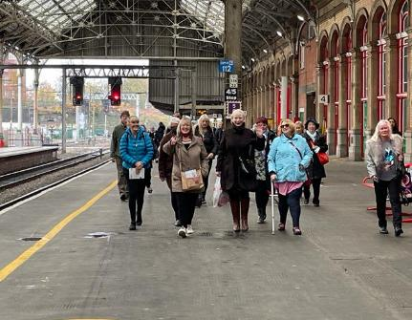
How Community Rail can support
Act as a bridge between communities, disabled passengers and the rail industry.
Facilitate meaningful engagement and co-production activities.
Gather and share local insight.
Help rail partners understand lived experience and identify practical improvements.
Share learning, evidence and best practice from the On Track project.
Notes:
CRPs have significant experience in community engagement, co-production and supporting the involvement of lived experience voices in the rail industry. To further the work that On Track started, the Community Rail movement can support rail organisations by:
Acting as a bridge between communities, disabled passengers and the rail industry.
Facilitating meaningful engagement and co-production activities.
Gathering and sharing local insight.
Helping rail partners understand lived experience and identify practical improvements.
Sharing learning, evidence and best practice from the On Track project.

Slide 13
CRPs next steps
Read the Discovery Report and Rail Industry Briefing
Send them out to your contacts at local rail organisations and partners
Ask rail partners direct questions about their progress in this area
Lean on CRL and GOCRP who have been working on this already
Keep CRN in the loop
Tell CRN what you need
Notes:
CRPs are in a unique position to influence rail partners and this work provides a spring board for conversations about accessibility/inclusion relate systemic change, particularly around co-production.
Read the Discovery Report and Rail Industry Briefing
Send them out to your contacts at local rail organisations and partners
Press rail partners for what they are doing and offer your support
Lean on CRL & GOCRP who have been working on this already
Keep CRN in the loop! We want this work to continue and will do what we can to support it
Tell CRN what you need – more holistic training across the board on co-production in practice for example.

Slide 14
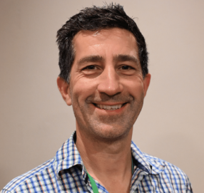
Contact us
Let's work together to make rail more accessible for everyone.
Download the On Track for Inclusive Train Travel Discovery Report.
For further information or conversations about the On Tack for Inclusive Trian Travel project contact:
Gary Shipp – Project Development Manager
Email: g.shipp@communityrail.org.uk

