Slide 1


Community rail and the journey to GBR
Carolyn Watson
Director of Stakeholder and Community Engagement

Slide 2
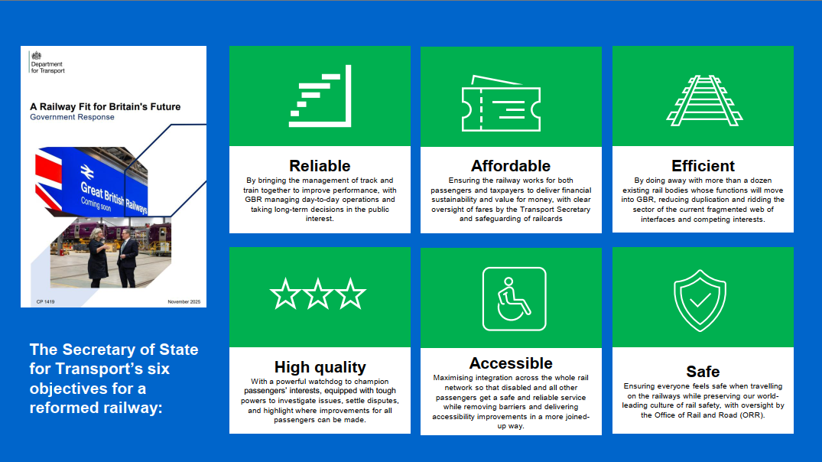
A Railway Fit for Britain's Future
Reliable
Affordable
Efficient
High quality
Accessible
Safe
Notes:
Secretary of State for Transport's Six Objectives for a Reformed Railway
The proposed reforms aim to create a railway that is more reliable, affordable, efficient, high-quality, accessible and safe, delivering better outcomes for passengers, communities and taxpayers.
Reliable
By bringing the management of track and train together to improve performance, with GBR managing day-to-day operations and taking long-term decisions in the public interest.
Affordable
Ensuring the railway works for both passengers and taxpayers to deliver financial sustainability and value for money, with clear oversight of fares by the Transport Secretary and safeguarding of railcards.
Efficient
By doing away with more than a dozen existing rail bodies whose functions will move into GBR, reducing duplication and ridding the sector of the current fragmented web of interfaces and competing interests.
High quality
With a powerful watchdog to champion passengers' interests, equipped with tough powers to investigate issues, settle disputes, and highlight where improvements for all passengers can be made.
Accessible
Maximising integration across the whole rail network so that disabled and all other passengers get a safe and reliable service while removing barriers and delivering accessibility improvements in a more joined-up way.
Safe
Ensuring everyone feels safe when travelling on the railways while preserving our world-leading culture of rail safety, with oversight by the Office of Rail and Road (ORR).
Summarised:
Reliable – Integrated management of track and train to improve performance and support long-term decision-making.
Affordable – Better value for passengers and taxpayers through a financially sustainable railway and clearer fares oversight.
Efficient – Simpler industry structure, reduced duplication, and more streamlined decision-making.
High Quality – Stronger passenger advocacy and scrutiny to drive service improvements.
Accessible – A more joined-up network with improved accessibility and fewer barriers to travel.
Safe – Maintaining world-leading safety standards while ensuring passengers feel safe when using the railway.

Slide 3
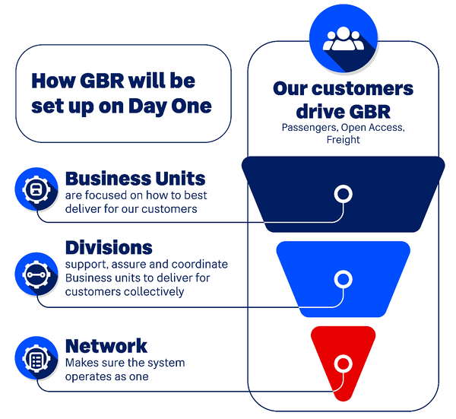
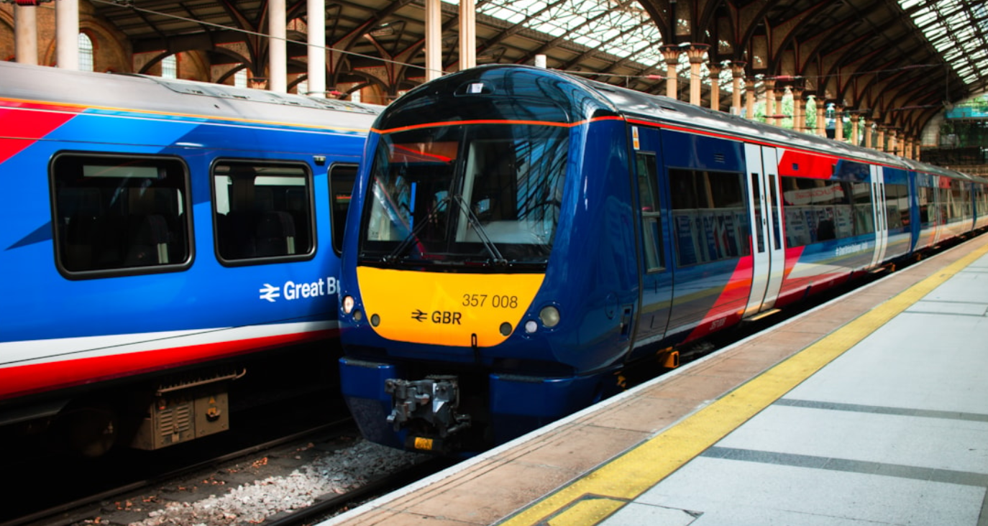
Journey to GBR
Notes:
Approx 3 mins
As we move closer to the creation of GBR, with legislation expected to bring track and train together under one organisation in late 2027, we're already taking important steps to work differently. Rather than waiting for formal change, we're focused on delivering the benefits of a more integrated railway now.​ At its heart, GBR is about creating a simpler, more joined-up railway by bringing together the work of the many organisations that currently make up our industry.
Integration of track and train will create a single, simpler system focused on delivering for customers, communities and local economies. ​
Some of you may have heard how it’s progressing, and some of you may not. If you can look at the slide, on the right-hand side it shows a pyramid, in organisations, people often start at the centre. The design principle of GBR has inverted the pyramid – very purposefully.
At the top are the business units that bring track and train together and serve customers and communities. This is about moving from infrastructure and centrally focused to being far more place based and customer focused. That is a huge culture shift for the whole railway.
Business units will be responsible for customer service, safety and delivery of local services.
They will be supported by divisions who will look after largely the longer-term infrastructure and things that can’t be delivered locally. So, you might get some economies of scale.
Supported by a very small network team who are looking at policy.
New structure results in very clear accountability for customers, no finger pointing, one integrated leader responsible and accountable for services in a local area, forces a different way of working.
For partners, the rail industry aims to be easier to do business with, reducing the need to navigate multiple complex organisations. We are committed to providing clarity on accountability and action. The operating model will give clear leadership for local areas and put decision making as close to possible as customers. It will also foster greater collaboration with partners to support their ambitions. ​

Slide 4
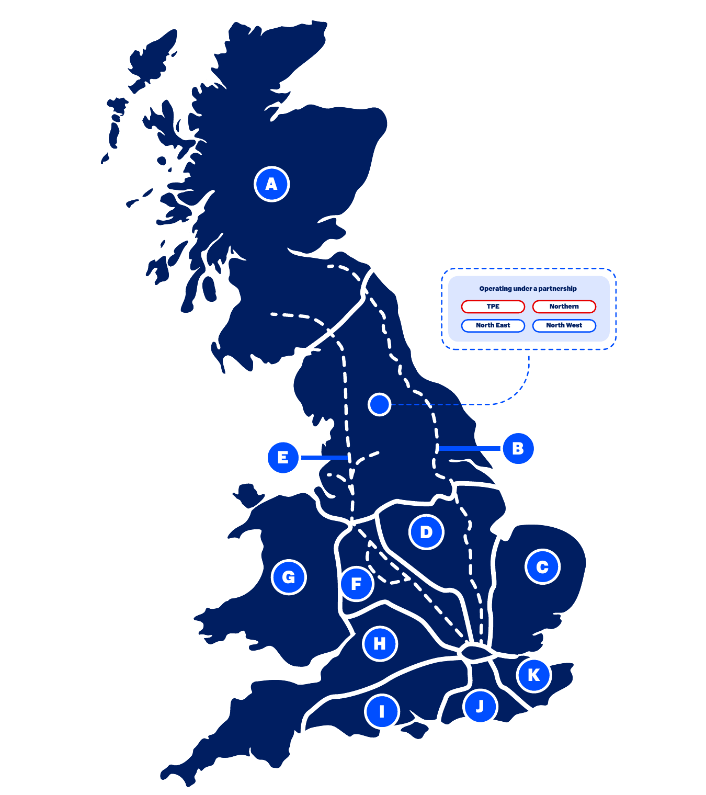
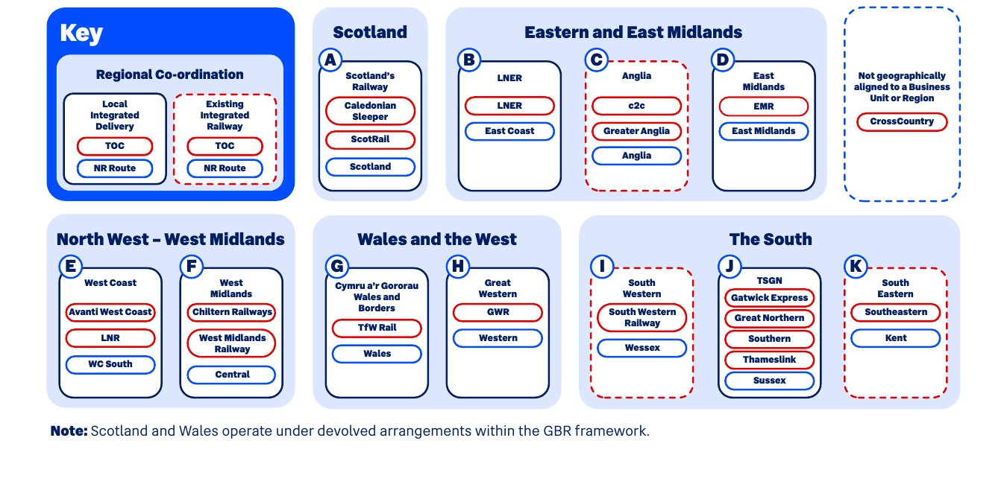
GBR Day One
Notes:
Approx 3 mins
What I want to touch on is how we are going to see that across the geography of the UK, at the moment you have train operating companies, some of which are publicly owned. About 10 of us now, public ownership programme is progressing:
Chiltern, latest to join us at the end of September
GWR end of the year
Avanti in March 2027
What will happen under GBR is the train operating company will be integrated together with a route from a Network Rail point of view. In the south, this structure is already working well where they have already got a route and a train operating company working underneath, one integrated leader.
For the North, we are really taking our time to really understand the design and what it means for the North, these decisions can’t be made in just a couple of round tables, it’s vital we get this right. EG: Northern and TPE travel across the Pennines whereas the Network Rail Routes go either side of the Pennines. As we progress, there’s a huge sense of all Train operating companies and routes coming together across the country. It’s really important to note that we are already working together to act culturally in a way that is integrated while we’re working out what the organisation structure looks like.
Collaboration in action: The North’s Railway - Tricia Williams NTL, Chris Jackson TPE, James Richardson TRU, Chris Wright NW Route, Jason Hamilton E Route. Tricia is sponsoring the work on the organisation design but colleagues from TPE are doing the design work. As well as working with the Mayoral Authorities, it’s really important that we co-create what the organisation structure looks like with those who represent the communities.

Slide 5

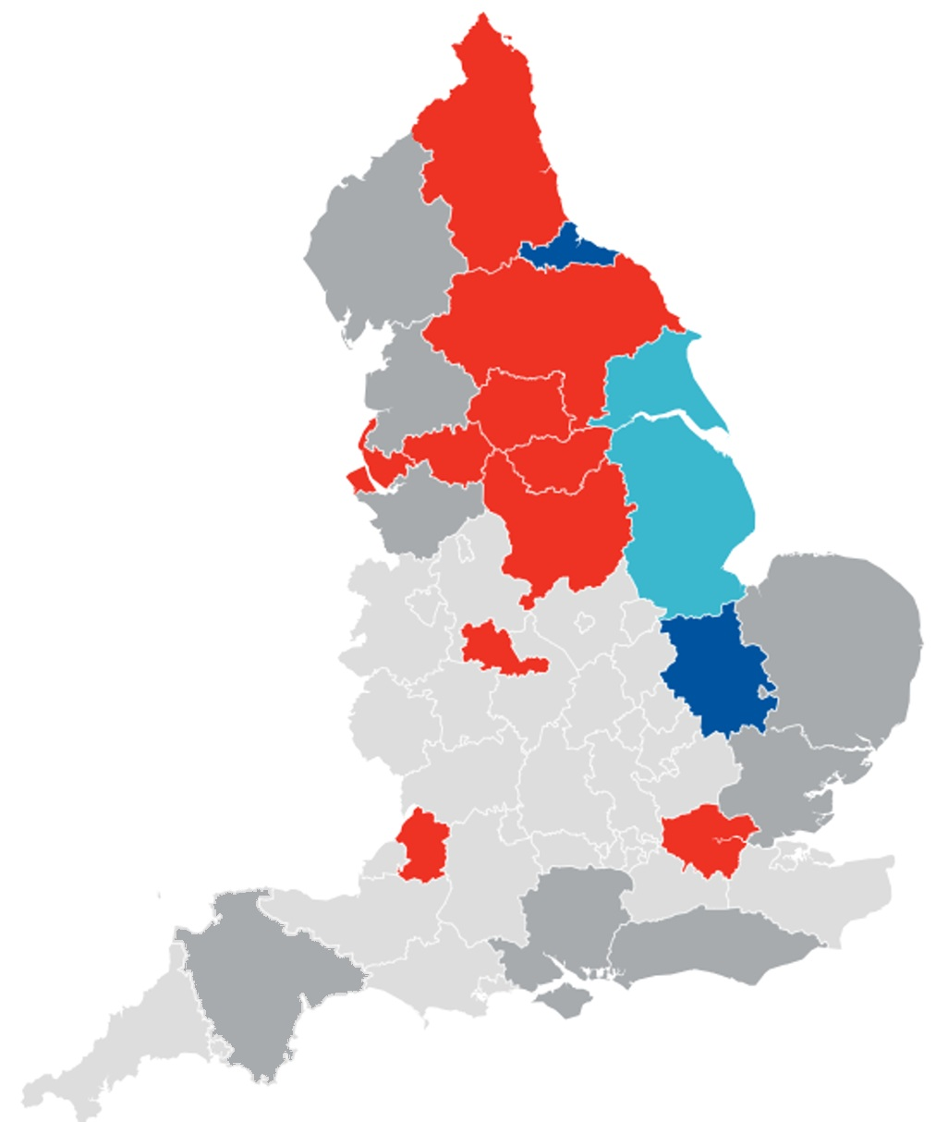
Geography of MSAs in England
North East
Next election 2028
Cumbria
Mayor due in 2027
Tees Valley
Next election 2028
Lancashire SA
Foundation
(Non-mayoral)
York and North Yorkshire
Next election 2028
West Yorkshire
Next election 2028
Greater Manchester
Next election 2028
Hull and East Yorkshire
Next election 2029
Liverpool City Region
Next election 2028
South Yorkshire
Next election 2028
Cheshire and Warrington
Mayor due in 2027
Greater Lincolnshire
Next election 2029
East Midlands
Next election 2028
Norfolk and Suffolk
Mayor due in 2028
West Midlands
Next election 2028
Cambridge and Peterborough
Next election 2029
Greater Essex
Mayor due in 2028
West of England
Next election 2029
Greater London
Next election 2028
Devon and Torbay SA
Foundation
(Non-mayoral)
Hampshire and the Solent
Mayor due in 2028
Sussex and Brighton
Mayor due in 2028
Image source: Institute for Government
Notes:
Approx 2 min
This is the current map of existing and emerging mayoral strategic authorities (updated February 2026)
Strategic Authorities (SAs) defined in English Devolution and Community Empowerment Act 2026, Mayoral SAs have additional powers and funding, with statutory economic, growth and local transport roles. Mayors elected for four-year term.
New ambition is for every part of England to have a Strategic Authority (SA) by end of 2028.
The North is on course for full mayoral authority coverage, save for Lancashire – although Lancashire has now established a non-mayoral combined authority covering Lancashire Country Council, Blackpool Council and Blackburn with Darwen, which is taking on local transport functions.
These reforms are leading to a gradual consolidation of the number of local partners that the railway will need to do business with
Key roles and responsibilities for MSAs
Local growth plan – long-term vision for growth in the region over the next decade and how this can be achieved.
Spatial Development Strategy – a plan identifying strategic locations for development, and the infrastructure required.
Local Transport plan – transport outcomes to deliver on mayoral strategies, comprising a strategy and delivery plan
Proposed statutory roles in rail:
-GBR regard to LTPs in decisions
-Statutory basis for partnership agreements
-Formal consultation on significant decisions

Slide 6
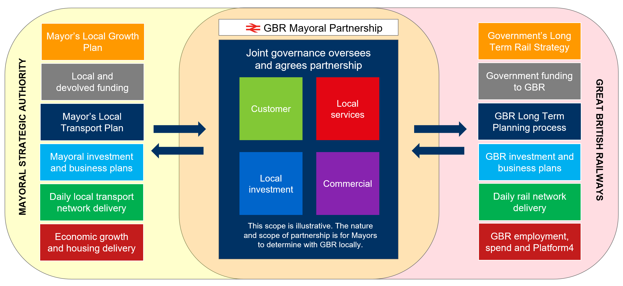
GBR and Mayors collaborating as partners to develop and agree outcomes
GBR and MSAs each have their own objectives, funding and powers. Each are accountable for these. Partnerships provide a process to agree local objectives and advance mutual interests based on what is right for each place.
Notes:
Approx 4 mins
Simply, partnership is not about telling each other what to do or getting involved in each other’s governance – it is important for both sides that they are each accountable for the decisions they take. GBR needs to be accountable for its activity, just as the MSA and Mayor need to be accountable for their activity. For mayoral authorities, partnership with GBR should be seen as the tool for delivery of mayoral growth plans, securing the delivery of local rail services as an integrated part of local transport networks.
MSAs are responsible for substantial funding, their strategy and their delivery plans. The mayoral authority needs to be accountable for these, just as the railway needs to be accountable for its funding, strategies and delivery plans.
This creates a rich partnership space where the railway and local partners must come together and jointly develop, agree, and where necessary fund joint responses. Each party needs to be confident they can stand behind what is jointly agreed, driving early collaboration and alignment. Joint local investment planning is a valuable way to ensure the best is made on both sides of the significant investment already being made in the local railway.
Transport remains at the heart of mayoral authority powers and budgets, with a substantial multi-modal public transport delivery role
Mayors’ Local Transport Plans (LTPs) set policies and drive implementation of the transport outcomes needed to deliver mayoral priorities
Mayoral Partnerships secure collaboration to inform LTP strategies and are the channel for implementing the required rail outcomes and outputs
In the places that want it, it will secure delivery of local rail as an integrated part of mayoral multi-modal transport networks
Stakeholders are becoming Partners:
Stakeholders have now evolved as part of the GBR journey to be partners
Officers have been heavily involved in rail decisions for some time, wide regular consultation on a wide range of operational and strategic matters/decisions
service development, station development, fares changes, Mayoral schemes (e.g. Bee Network)

Slide 7
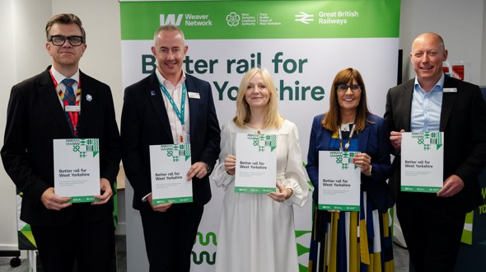
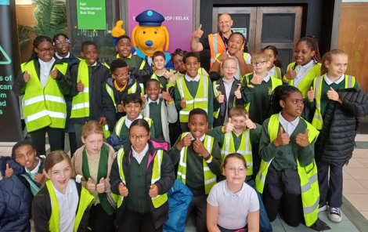
In summary … it’s all about people, places and opportunities
Notes:
Approx 3 mins
Rail reform and mayoral devolution present great opportunities for stronger links with community rail
Shared priorities and ambitions around people and place
Encourage continued engagement with rail partners and with mayoral authorities – if you don’t already have links CRN and railway contacts can help

