Slide 1
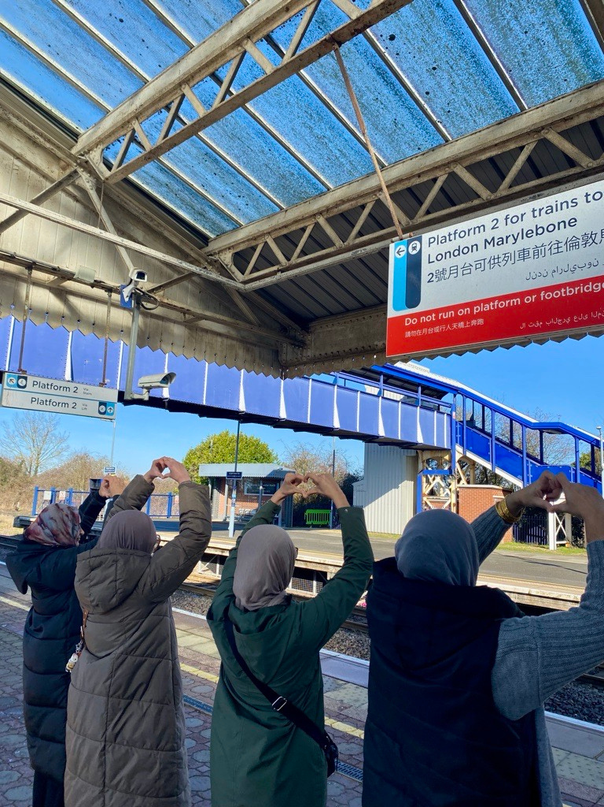
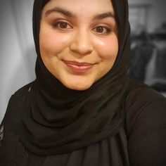
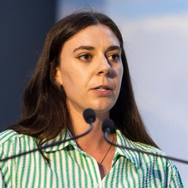


From Lived Experience to Industry Change
Community rail’s role in tackling violence and intimidation against women and girls (VIAWG)
Faatimah Bham
Community Rail Development Manager
Alayne McDonald
Community Rail Development Manager

Slide 2
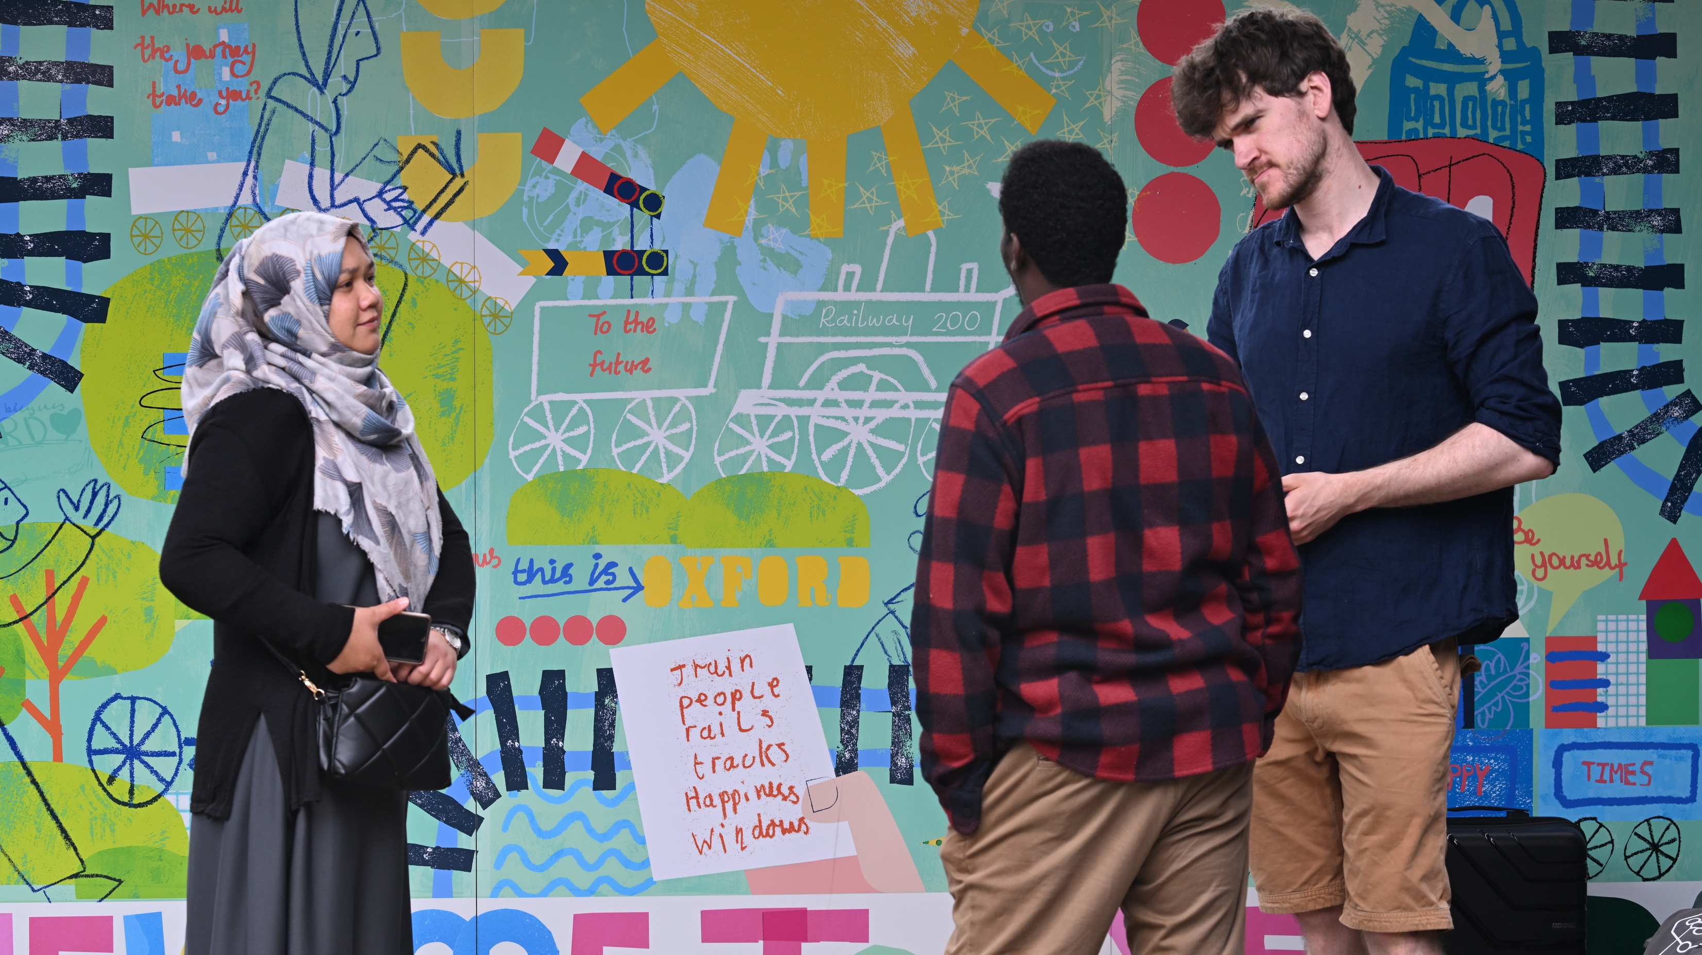
Why this matters to community rail
  Safety affects whether, when and how women travel
  Being safe and feeling safe are not always the same
  Community rail connects lived experience with industry action

Slide 3
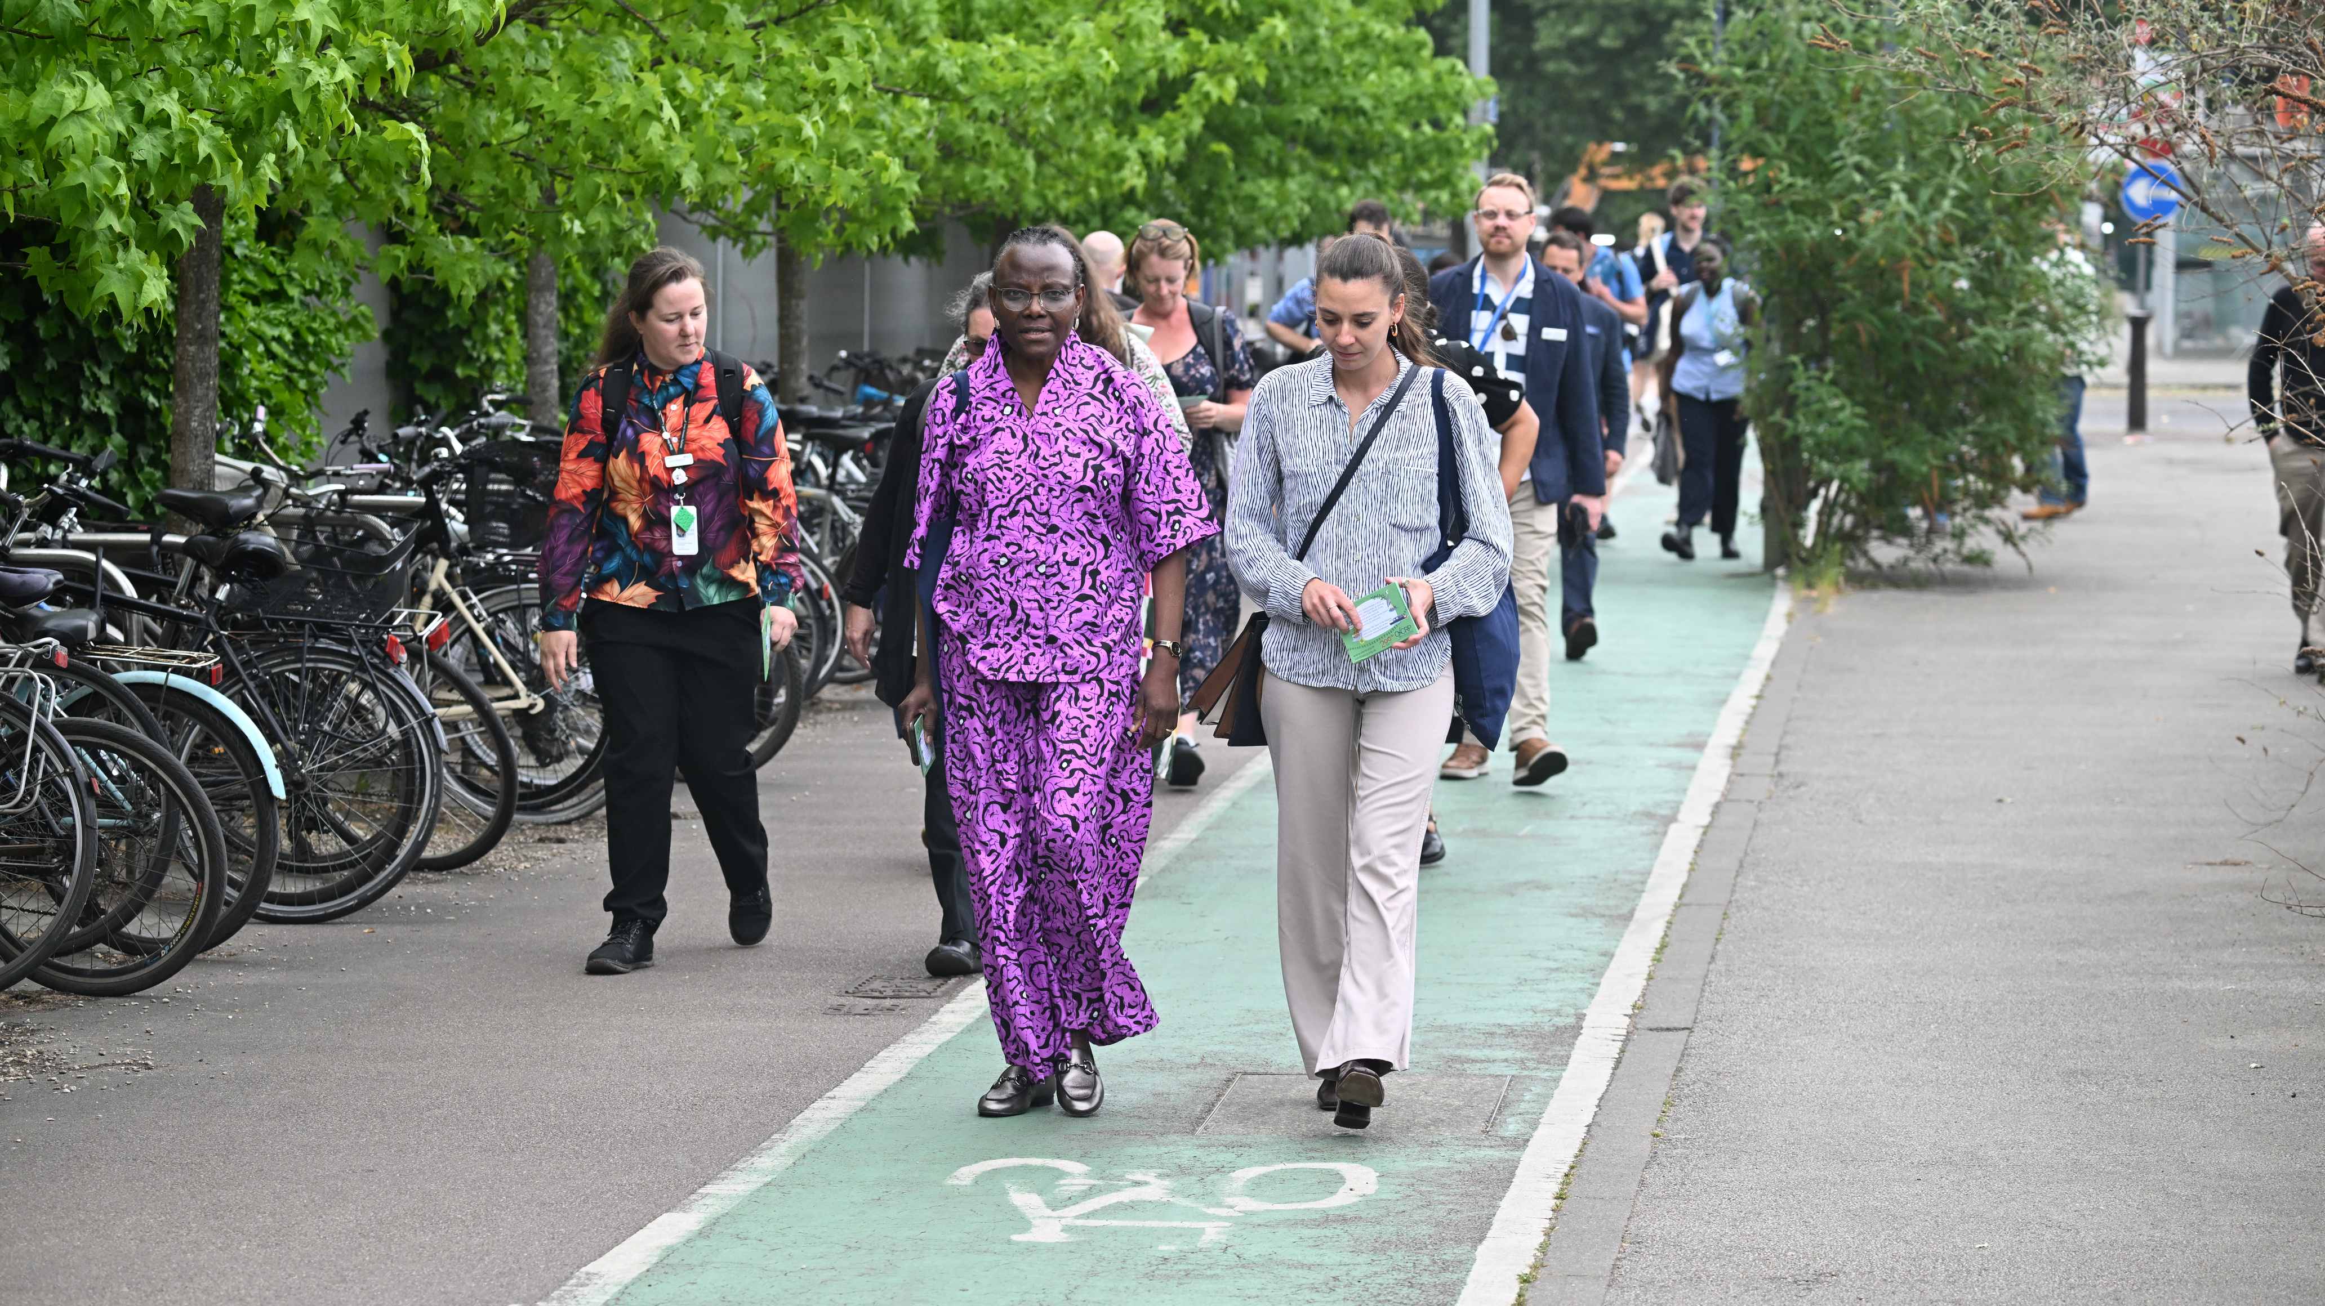
>Listen >Understand >Influence
  Trusted, inclusive community engagement
  Research shaped by lived experience
  Evidence turned into practical recommendations
GCRP

Slide 4


Gloucestershire VIAWG Survey
  235 women surveyed
  79% changed their travel behaviour because of perceived risk
  Under-35s experienced higher rates across every category
197,455
54
73%
campaign impressions
organisations
engaged
new to community rail

Slide 5
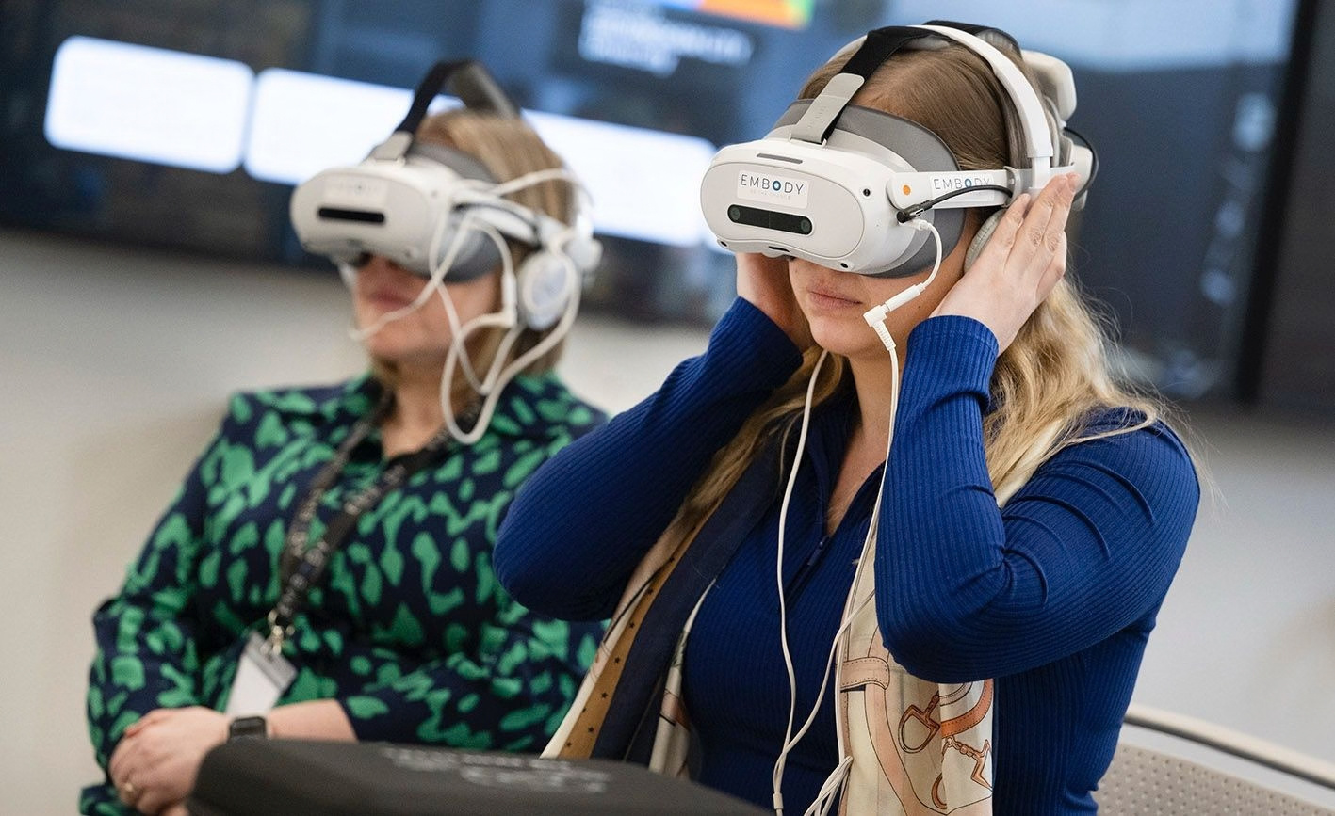
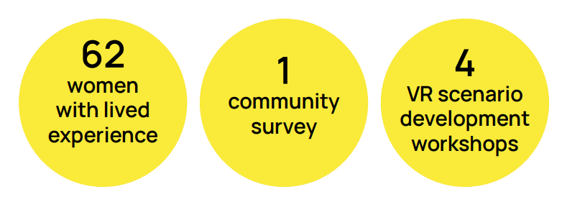

Embody: Be the Change
Oxfordshire
  First-of-a-kind immersive VR training
  Designed for frontline rail staff
  Recognise, respond to and report VIAWG
  Community voices shaped training scenarios
  Grounded in lived-experience

Slide 6
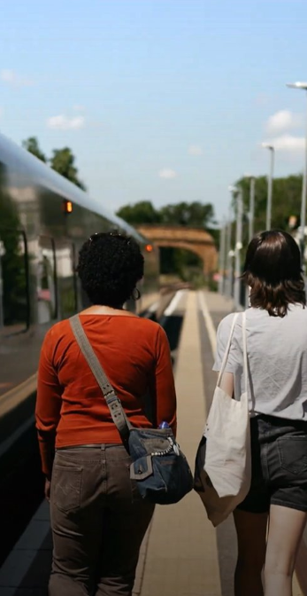
What We Can Do
  Be bold, brave and confident
  Build trust, listen safely and inclusively
  Build on what already exists
  Translate experience into evidence and action
  Start local, think scalable
  Bridge community and industry
  You don’t need all the answers
Notes:
Be bold, brave and confident – VAWG is everyone’s business, and transport spaces are a legitimate place to act
Build on what already exists – use national strategies, legislation and policy commitments to strengthen your funding case
Use the evidence – draw on research, data and lived experience to justify new, locally-led interventions
Start local, think scalable – small, place-based projects can test ideas and demonstrate impact
Use your insight to shape policy – CRPs are trusted voices; feed local learning back into regional and national conversations
You don’t need all the answers – partnership, co-design and iteration are part of doing this work well

