Slide 1

Making data collection more accessible
Heather Cullimore
and
Faye Keane

Slide 2
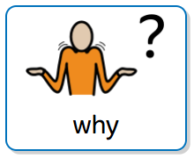
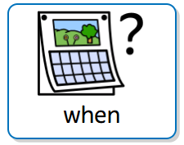
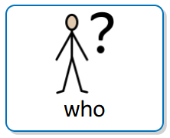
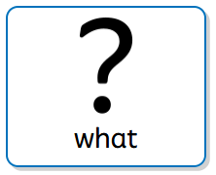

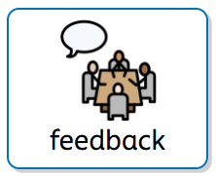
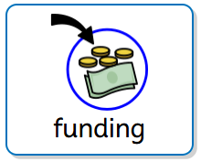
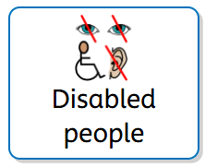
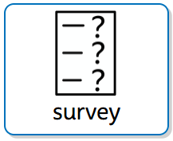


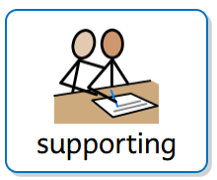
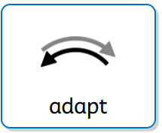
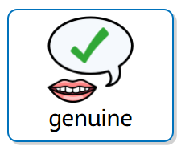
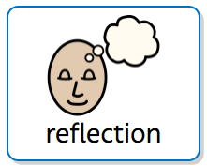

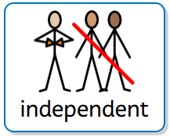
Collecting the data
Accessible Surveys

Slide 3
Benefits and Barriers
What works and what doesn’t…
Contemporary
Adaptable
Self build
Saves time
Independent and genuine
Self build
Choosing the settings
One size does not fit all
Emerging software
Technology and connectivity

Slide 4
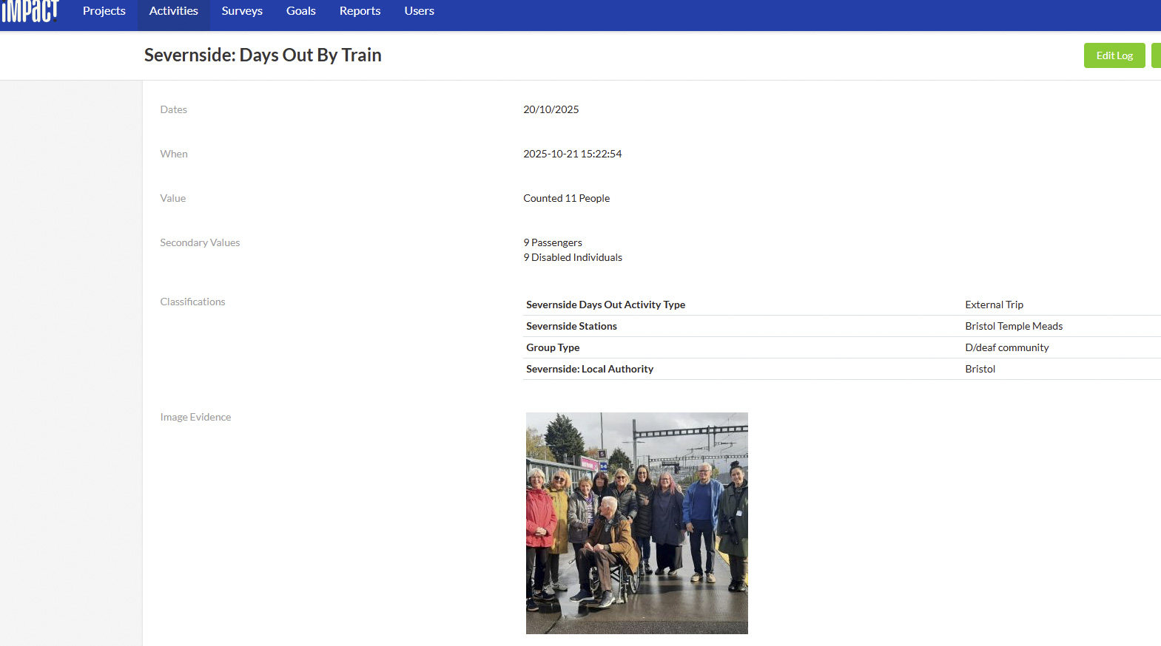
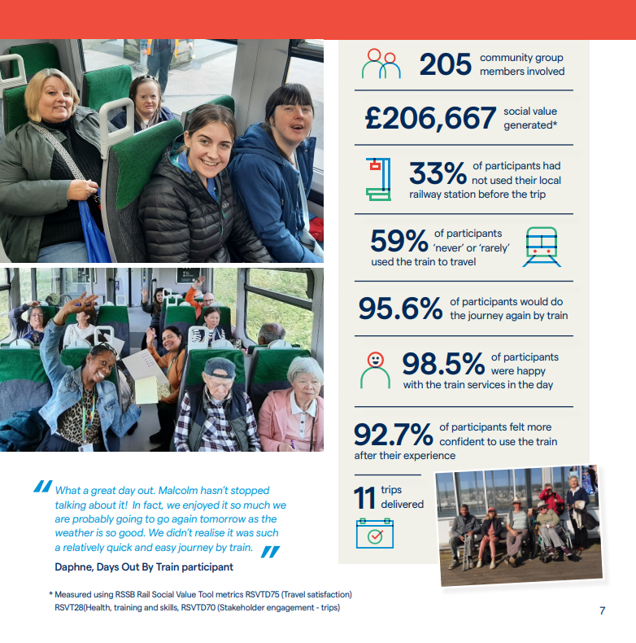
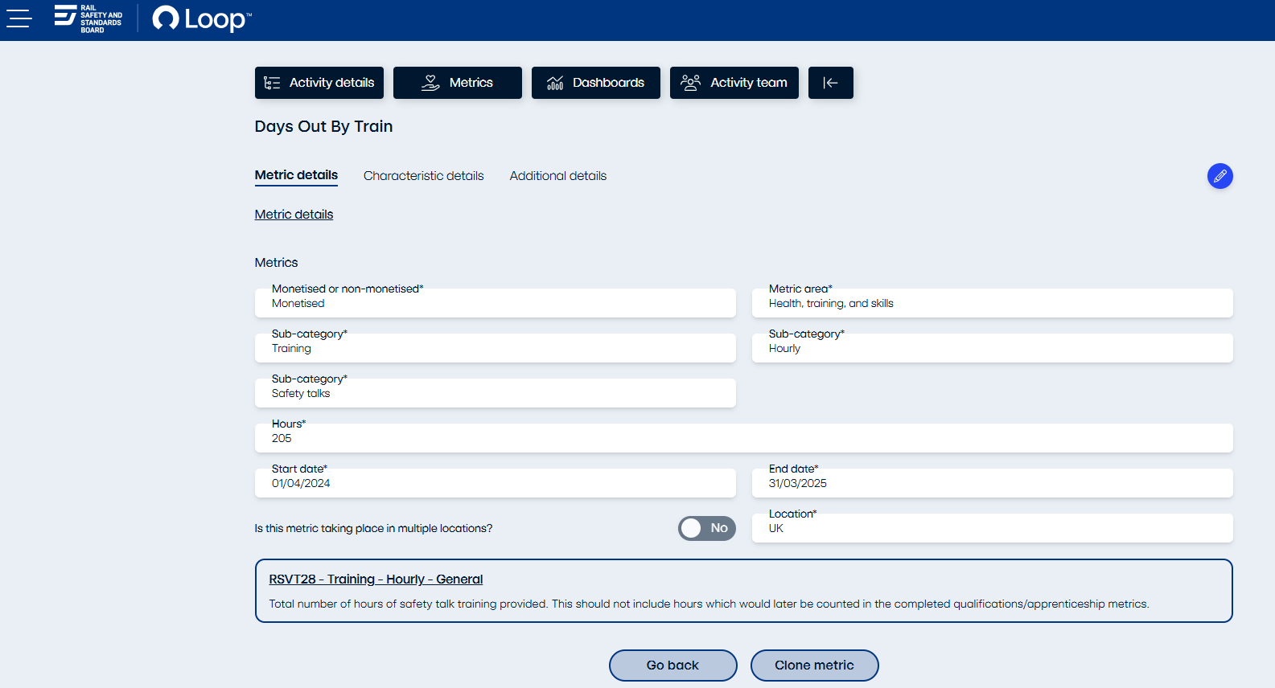
Using the data
1 Accessible survey
2 Impact
Collect feedback
and export
to Excel
What is your age? | How did you arrive at the first train station? | Did you have any problems getting to the train station? | What prevents you from travelling by train? | Has the scheme helped to address what prevents you from using the train? | Have you found it beneficial to take part? | Do you feel more confident to plan a journey by train? | Do you feel more confident to make a journey by train? | Would you know what to do if things go wrong on a journey? | Have you got more knowledge about how to get assistance? | Which stations did you visit today?
51 - 60 | Taxi/Car | No | Not easy in my wheelchair | Yes | Yes | Yes | Yes | Help point and staff | I used the ramp | Bath spa, bristol temple meads, Weston super mare
19 - 29 | Walk/Wheeled | not really | I use the bus and taxis | yes | Yes | Yes | Yes | yes | yes but I don't need it | Ashley Down and Bristol Temple Meads
51 - 60 | Bus | None | Anxiety | Yes definitely | Yes | Yes | Yes | Phone up? | Yes | Bath spa, temple meads, WSM
30 - 40 | Taxi/Car | Taxi instead of bus | i need help to get the train | yes | Yes | Yes | Yes | yes | yes but i will have my support worker with me | Bath Spa and Bristol Temple Meads
19 - 29 | Walk/Wheeled | we were in a rush | buses are easier | yes but buses are still easier | Yes | I don't know | Yes | yes | yes | Ashley Down and Bristol Temple Meads
19 - 29 | Bus | None | I need a carer | Not really but would go with my carer | Yes | No | Yes | Yes | A little | Bath spa, Bristol Temple Meads, weston Super mare
19 - 29 | Walk/Wheeled | no | money, I get lots of lifts | yes, railcards | Yes | Yes | Yes |  | yes | Ashley Down, Filton Abbey Wood and Bristol Parkway
41 - 50 | Taxi/Car | no | I can't walk far and use a wheelchair | yes i tried the ramps | Yes | Yes | Yes | ask for help from GWR staff | yes | Bath Spa and Bristol Temple Meads
19 - 29 | Walk/Wheeled | no | habit | n/a | Yes | Yes | Yes | yes | yes | Ashley Down, Bristol Temple Meads
Record project
activity
3 Loop
4 Reports
Capture data
for social value
modelling
Share results
and participant
stories
Notes:
Overview of the four source sections: accessible survey responses exported to Excel, Impact project records, Loop model inputs, and the results report. The screenshots and full response table are retained as source examples. Present the large headings and purpose statements rather than reading the small interface text. The detailed source slide remains on slide 10.

Slide 5


What questions do you have?
info@severnside-rail.org.uk
www.severnside-rail.org.uk
where

