Slide 1
“A railway station is something that can generate a city.”
Santiago Calatrava

Slide 2
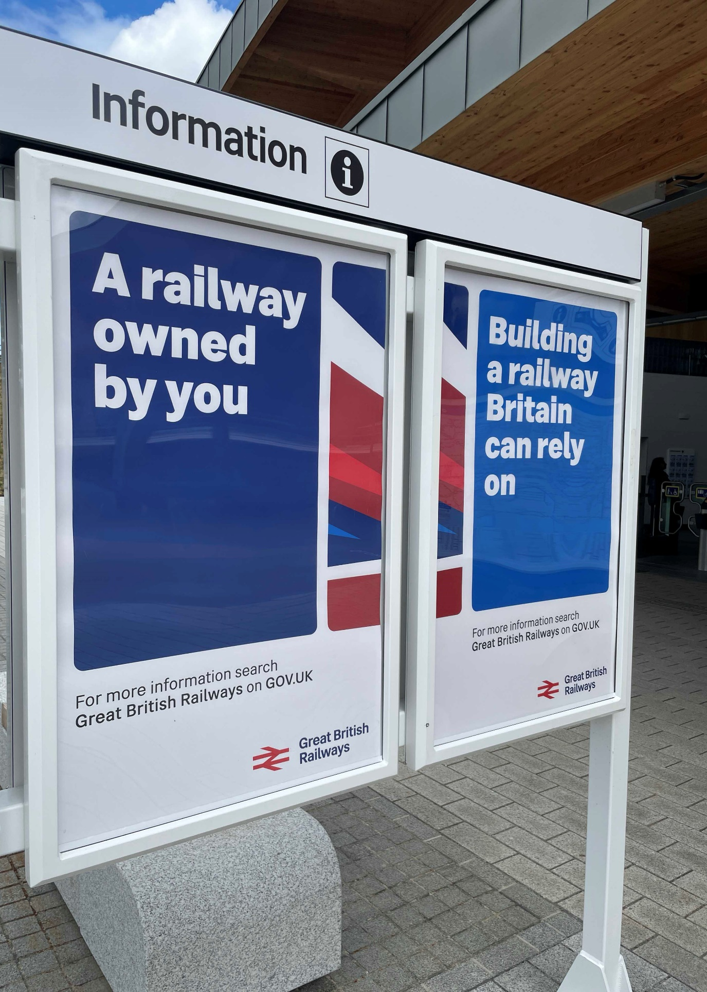
The Department for Transport Operator and Community Rail
Why me, why now, and what next?

Slide 3
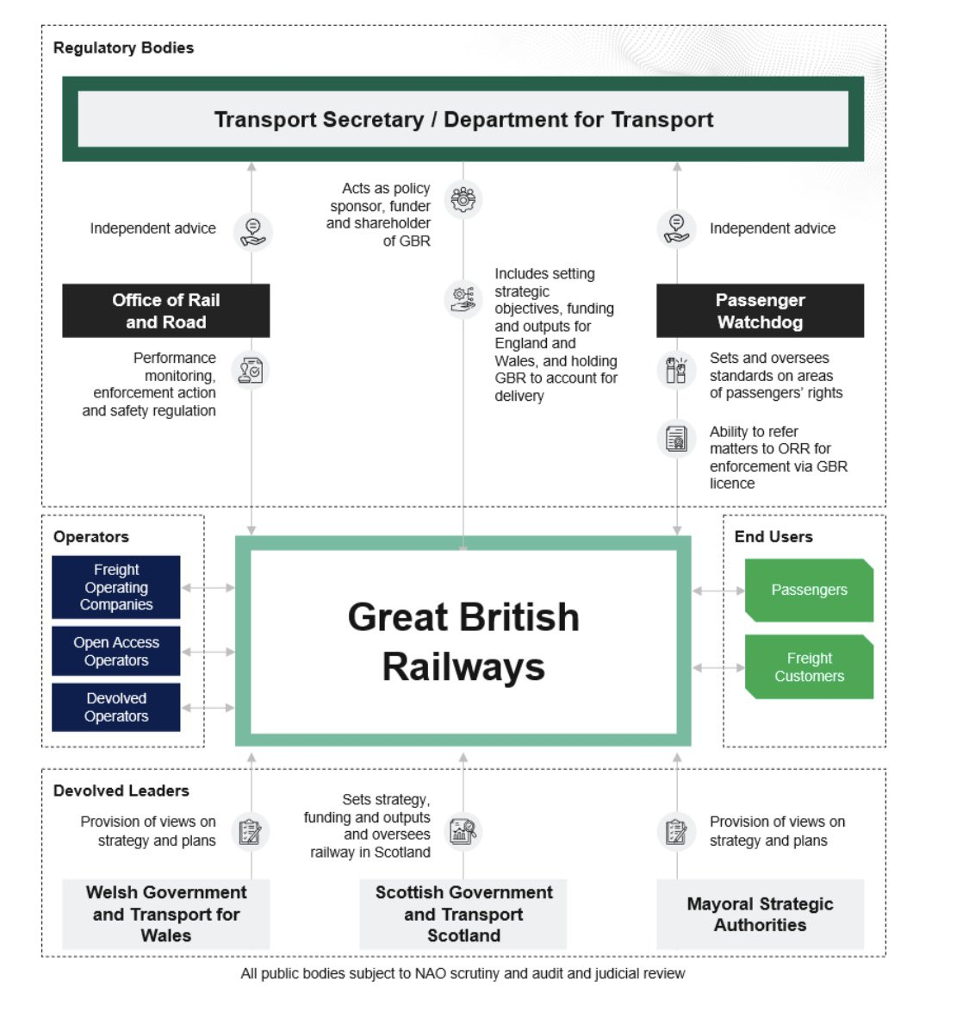
The Future of Rail
Image from: gov.uk - Holding Great British Railways to account: House of Commons Railway Bill factsheet

Slide 4
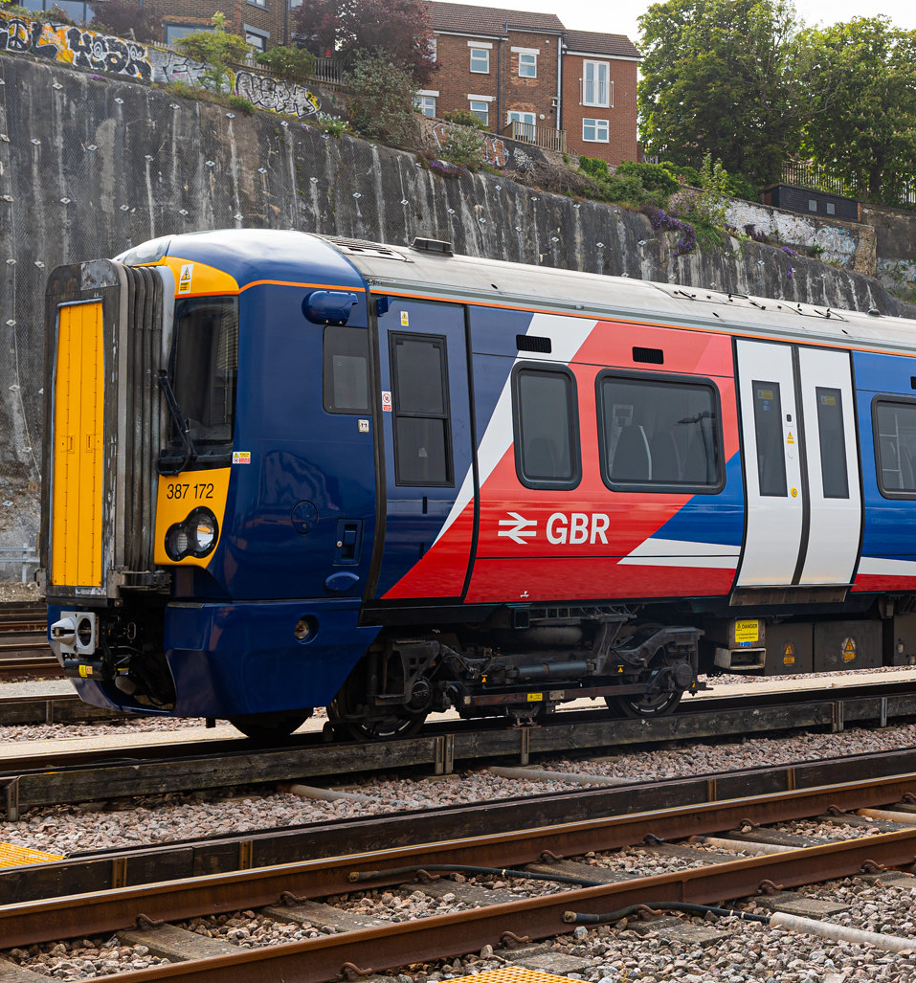
What will DfTO seek to do for Community Rail?
What could we ask Community Rail to do for DfTO and the future of rail?

Slide 5
Supporting local economies, boosting leisure and tourism travel and spending
Reducing vandalism, antisocial behaviour, making stations feel safe and welcoming
Achievement of common goals and operator KPIs/targets e.g. customer satisfaction, accessibility, safety of women and girls, and beyond
Reduces trespass and risk to life, as well as reducing time lost and delays
Generates approximately £129m of annual social value from £7.2m of funding
Lines with CRPs annually exceed non-CRP line pax growth between 1% and 2.8%
CRP lines had between 3% and 16% faster passenger number COVID recovery than non-CRP lines (2020-23)
Enables asset and incident reporting, supports Service Quality (saving £ms)
Engaging hard-to-reach communities, boosting future workforce agenda
Building confidence in rail use for more than 125,000 people per annum
Bringing joy, passion, and good news stories to rail

Slide 6

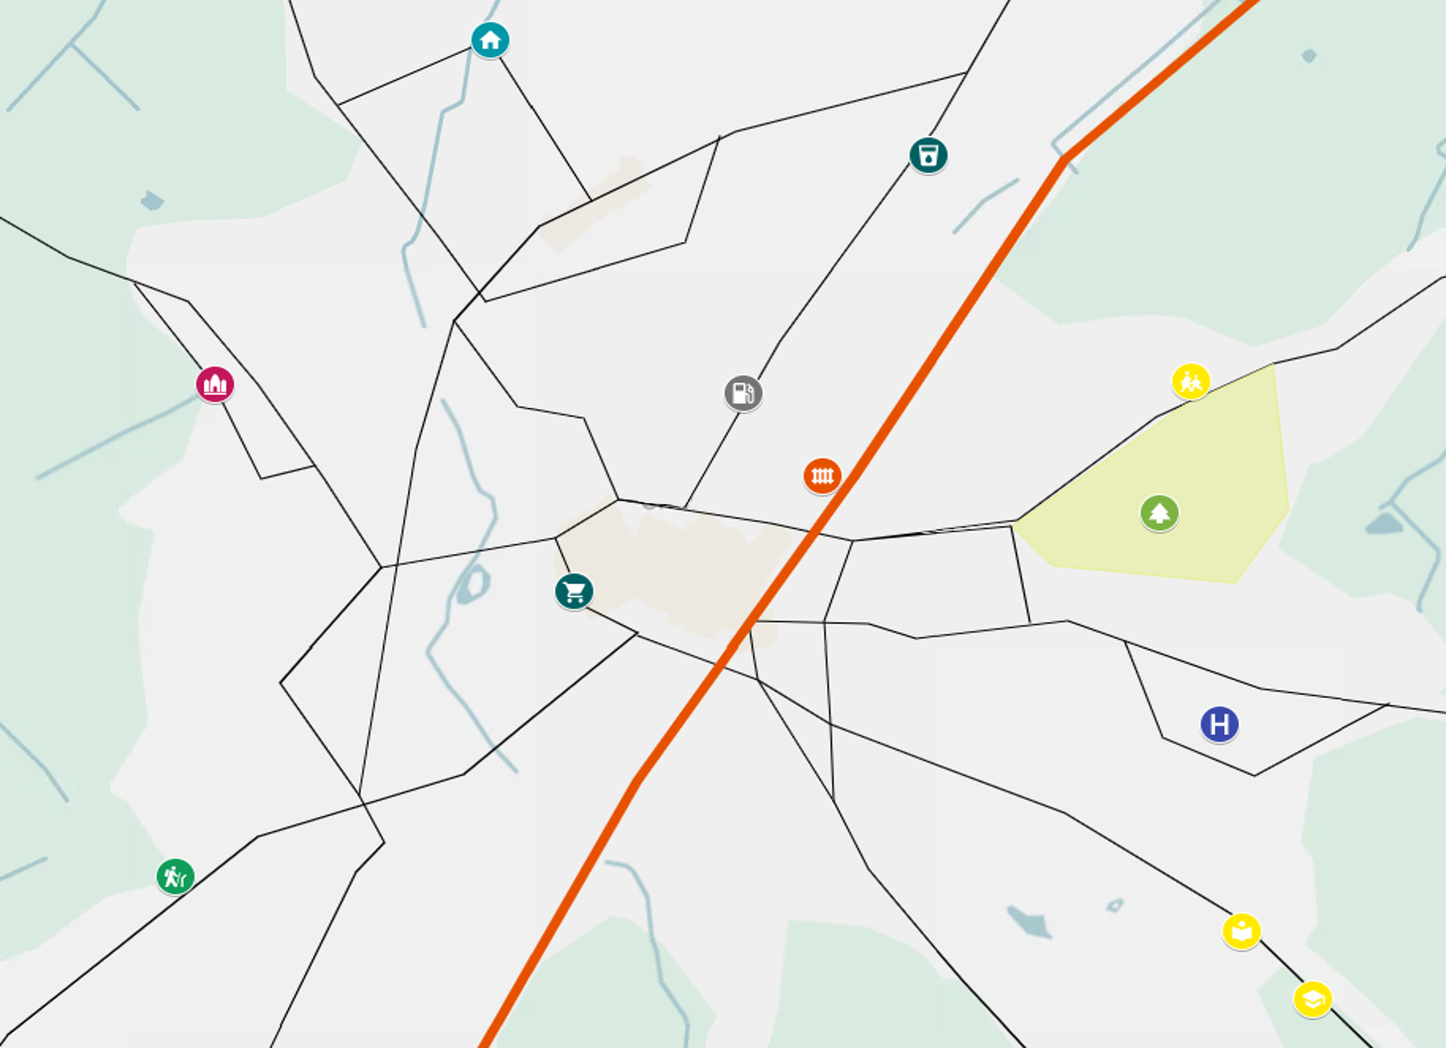

Slide 7
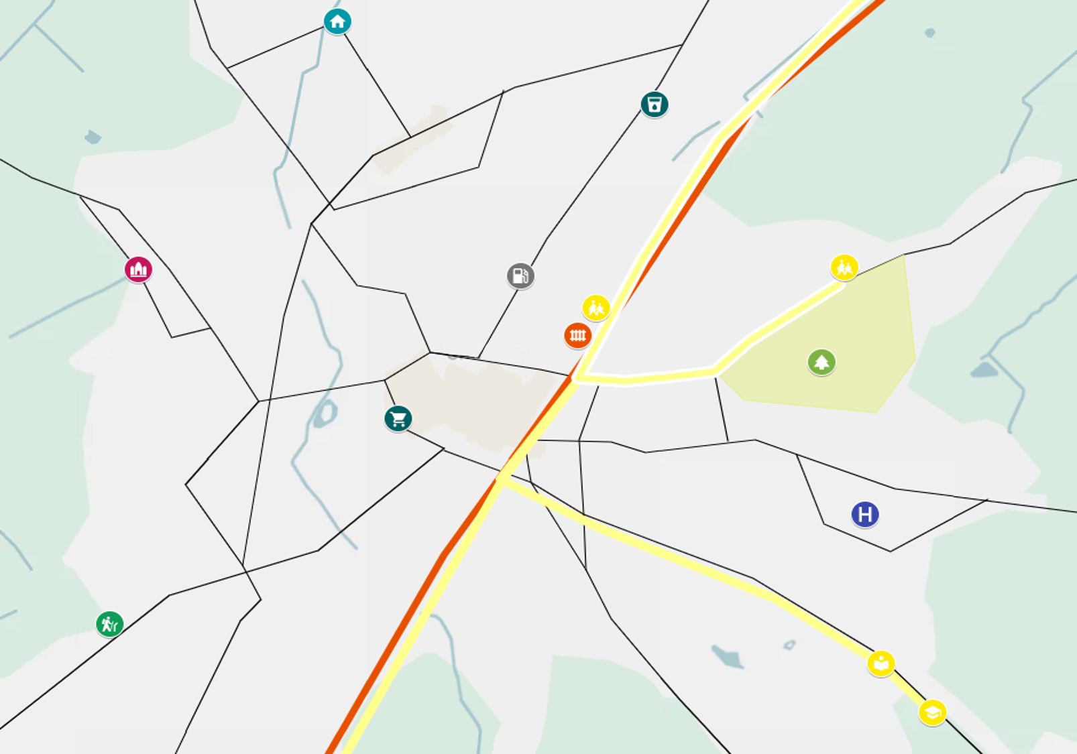

Slide 8
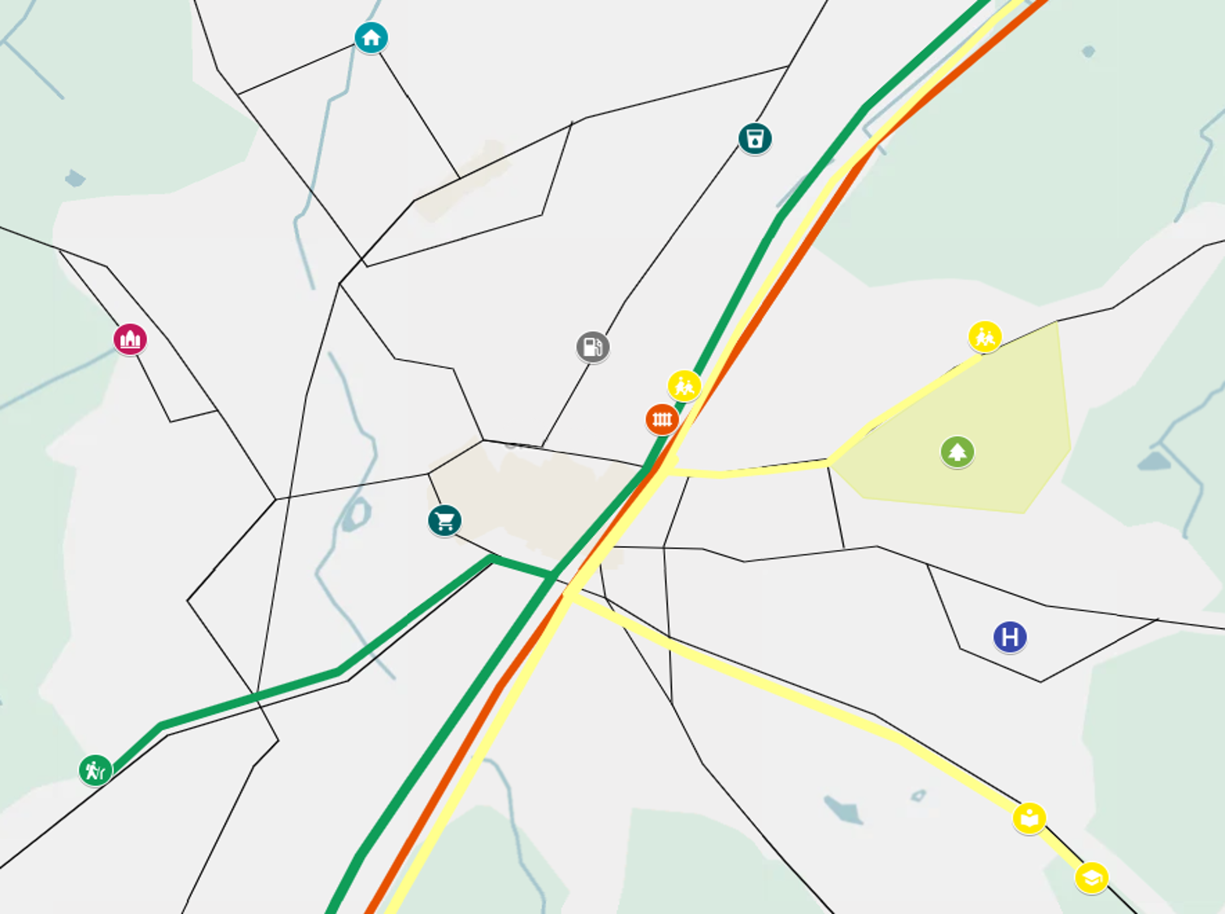

Slide 9
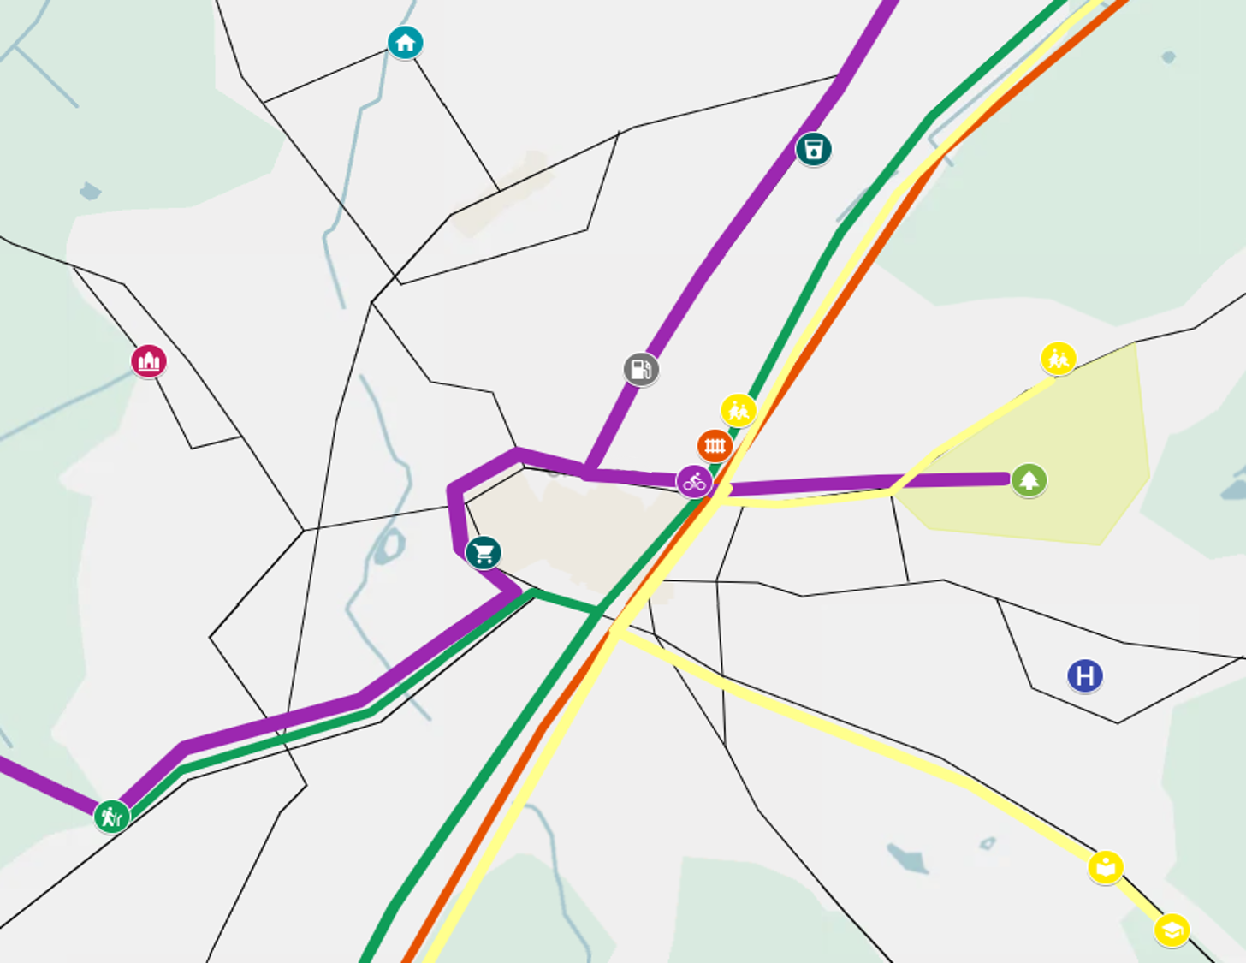

Slide 10
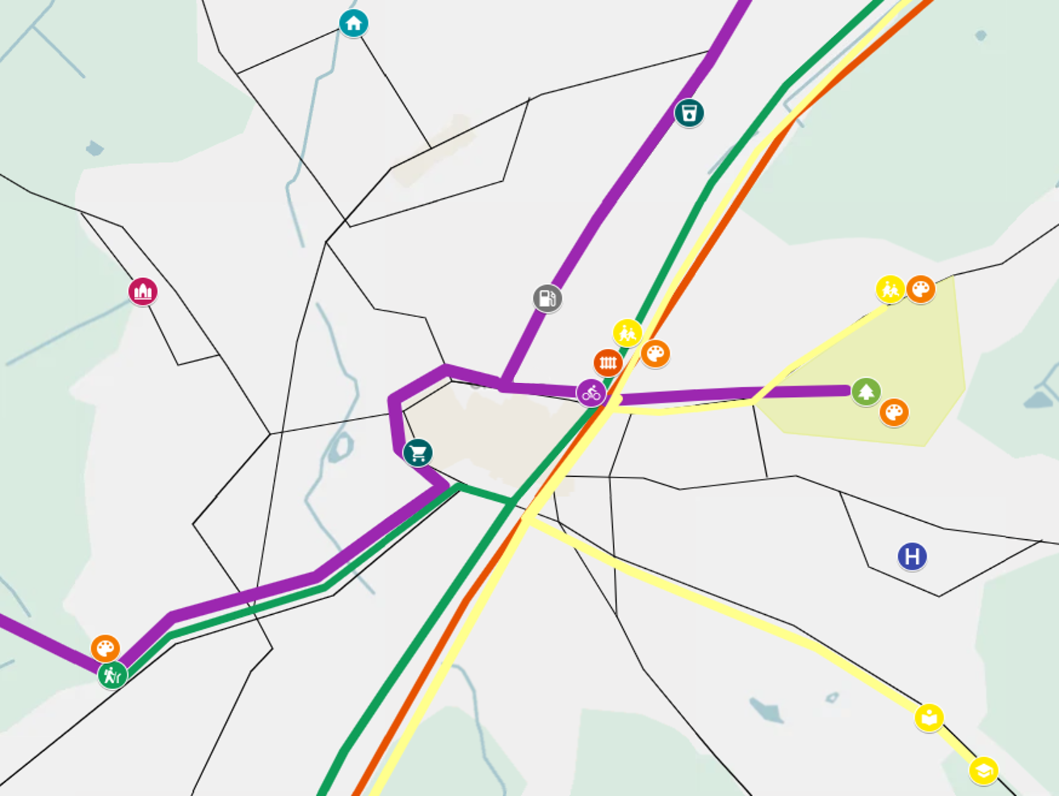

Slide 11
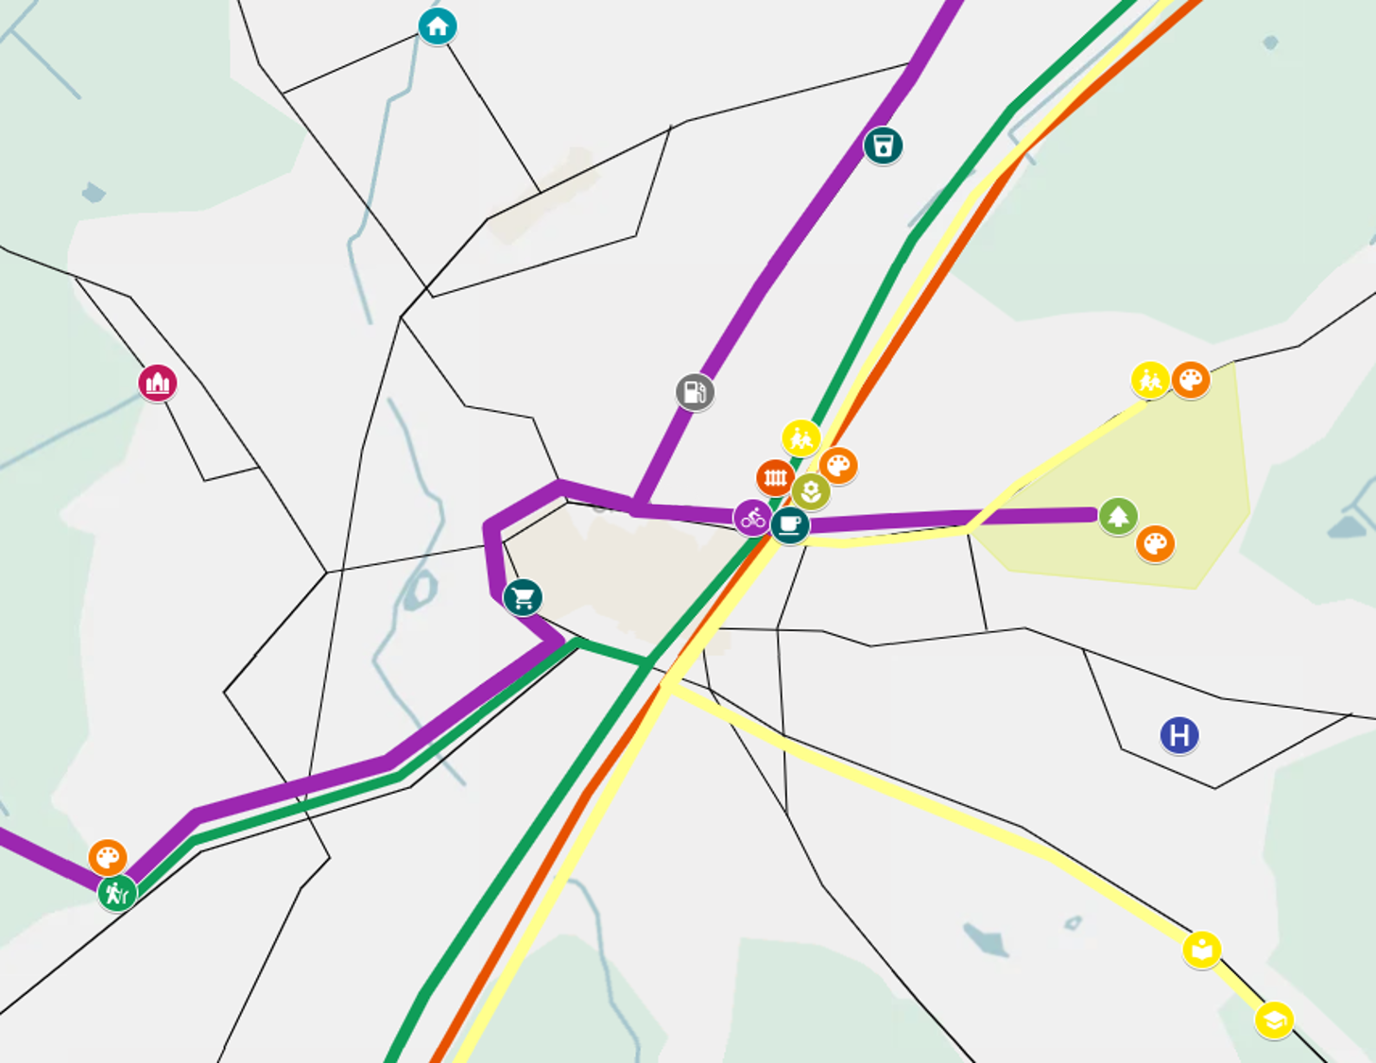

Slide 12
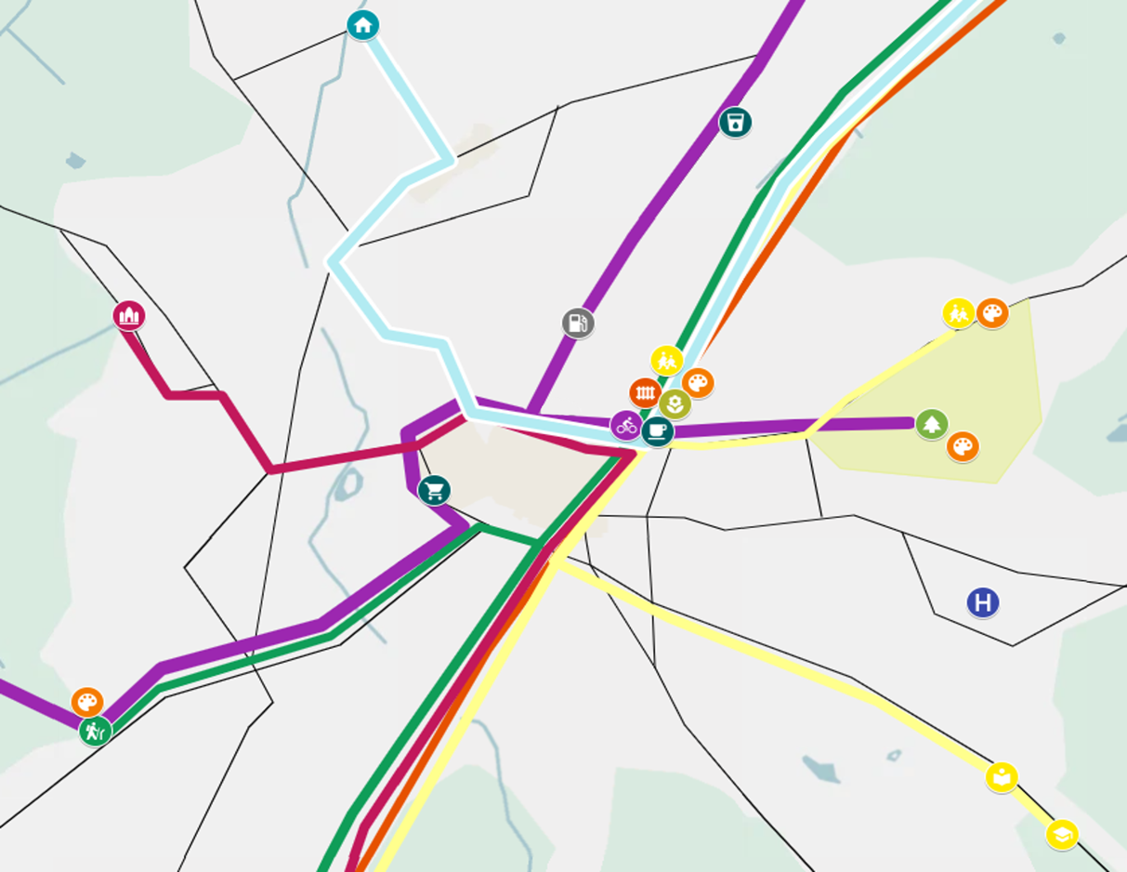


Slide 13
Thank you
Daisy.ChapmanChamberlain@dftoperator.co.uk
LinkedIn: Daisy Chapman-Chamberlain

