Slide 1

Settle Carlisle Railway Development Company
Community Rail Partnership
Community Rail Network Conference 2026
Susie Smith
Operations Manager
Karen Morley-Chesworth
CRP Officer
Notes:
The Settle Carlisle Railway is celebrating it’s 150th anniversary of passenger transport this year. An iconic line, but those involved are looking to the future. Our aim is to make our CRP sustainable in the next 150 years through enterprise.

Slide 2
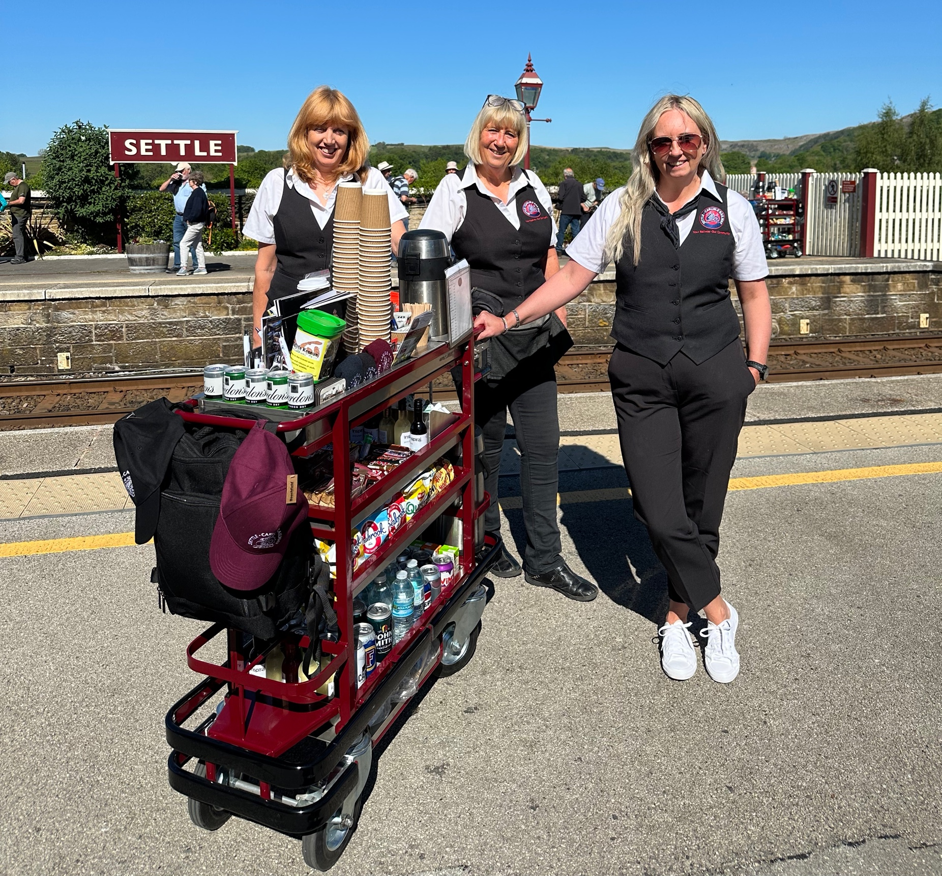
FROM TROLLEY TO TRANSFORMATION
Creating a sustainable future for Community Rail
Notes:
We all know the value Community Rail brings to our railways and our communities. But there is a question we increasingly need to ask: how do we make sure that work is sustainable?
On the Settle–Carlisle, part of our answer is commercial.
Not commercial activity for its own sake, but commercial activity with a social purpose – generating income, creating local employment, supporting local businesses and helping us continue investing in our communities.

Slide 3
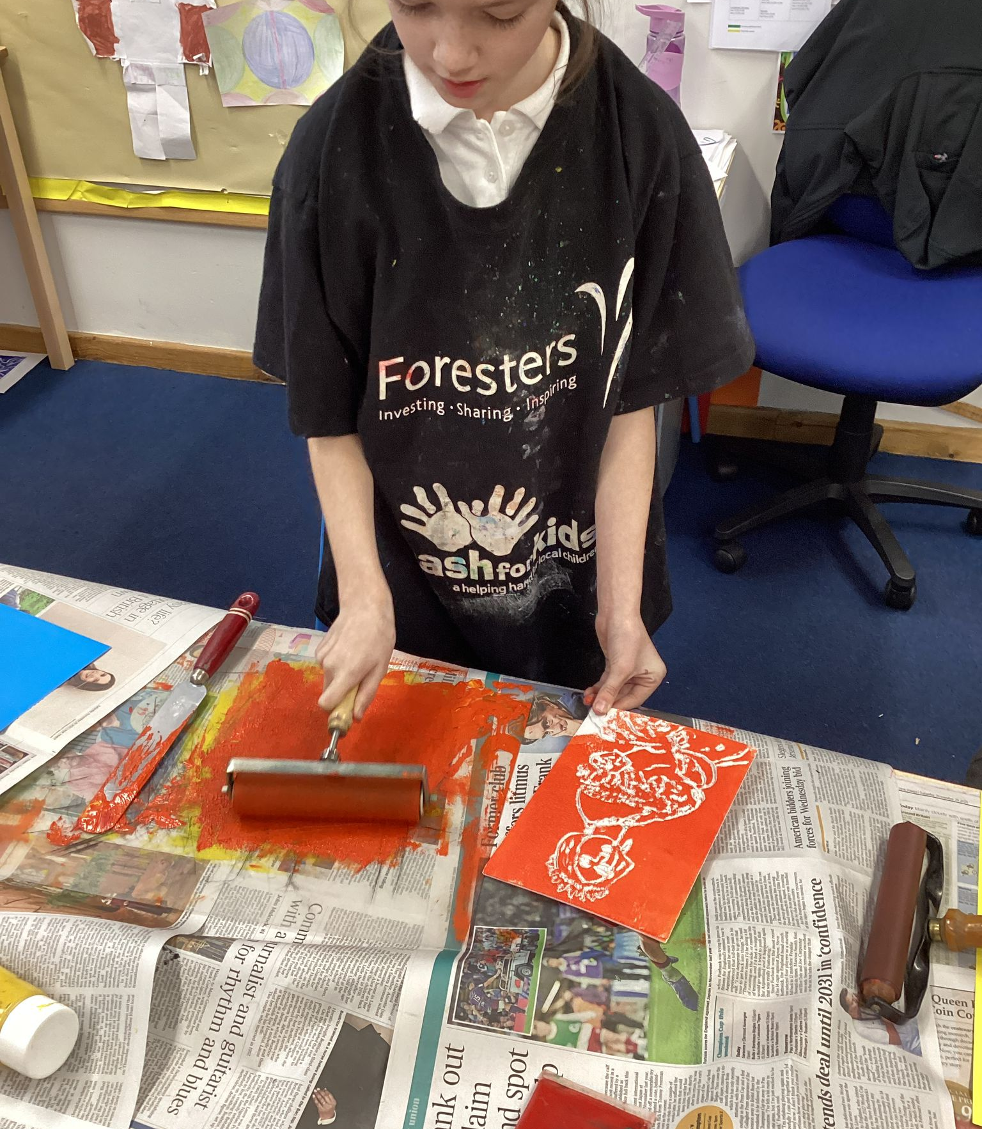
THE CHALLENGE
We can't take tomorrow's funding for granted.
Partner funding
+
Earned income
=
Greater resilience
Not replacing partnership funding – strengthening it.
Notes:
We rely greatly on our train operator partners, Community Rail Network and other organisations to fund projects, and we are enormously grateful for that support.
It allows us to innovate and to deliver projects that simply wouldn't happen otherwise.
But we also recognise that funding priorities change. With uncertainty about how Community Rail Partnerships will be funded in the future, we believe we have a responsibility to build greater resilience ourselves.
So our question is not, ‘How do we replace our partners?’
It is: ‘What can we do to help secure our own future?’”
The Settle Carlisle Railway Development Company is an accredited CRP for 2026–27, with its work encompassing inclusive travel, schools, sustainable tourism and station communities.

Slide 4
THINK DIFFERENTLY ABOUT COMMUNITY RAIL
Social Purpose: Reinvesting in communities
Community Rail Connecting: people and places
Enterprise: Generating income
Notes:
The Settle Carlisle Railway Development Company has an unusual model.
We are an accredited Community Rail Partnership, but alongside our community activity we deliver commercial services.
That includes our onboard trolley service, catering and retail, group travel, Dales Railcard administration, station staffing, merchandise, tourism promotion and other activities.
The important point is that we don't see these as two separate worlds.
The commercial activity supports the social purpose.
The Development Company works with Northern on promotion of the route, station staffing at Settle and Appleby and operation of the onboard trolley service; it also has retail and catering activities including Skipton Station Cafe Express.

Slide 5
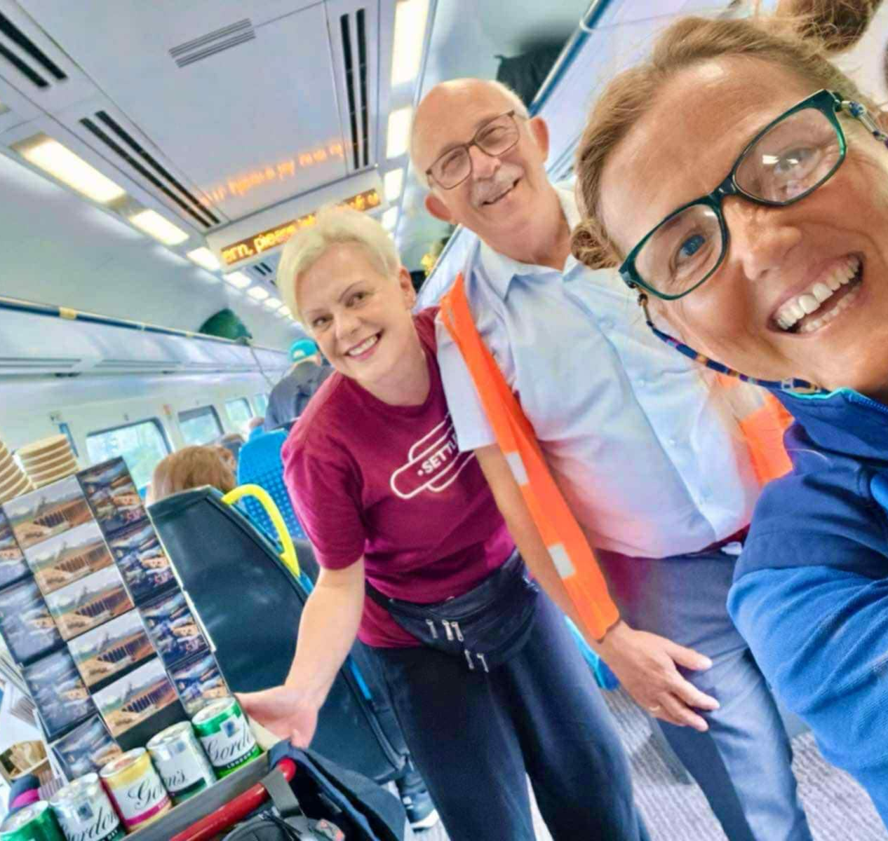
MORE THAN A CUP OF TEA
21 years of the Settle–Carlisle trolley
Local jobs • Local suppliers • Local produce • Passenger experience • Income
Every sale creates a little more community value.
Notes:
Take our trolley.
At first sight, we're selling tea, coffee, snacks and souvenirs on selected Northern services.
But look at what sits behind that cup of tea.
We employ local people.
We buy stock from local businesses.
We promote local food and drink.
We provide something increasingly unusual on the modern railway – a friendly onboard buffet service.
Our team become ambassadors for the line. They talk to visitors, answer questions and help make the journey memorable.
And the activity generates income that supports the wider work of the Development Company.”
The trolley service is now in its 21st year and specifically focuses on locally sourced produce.

Slide 6
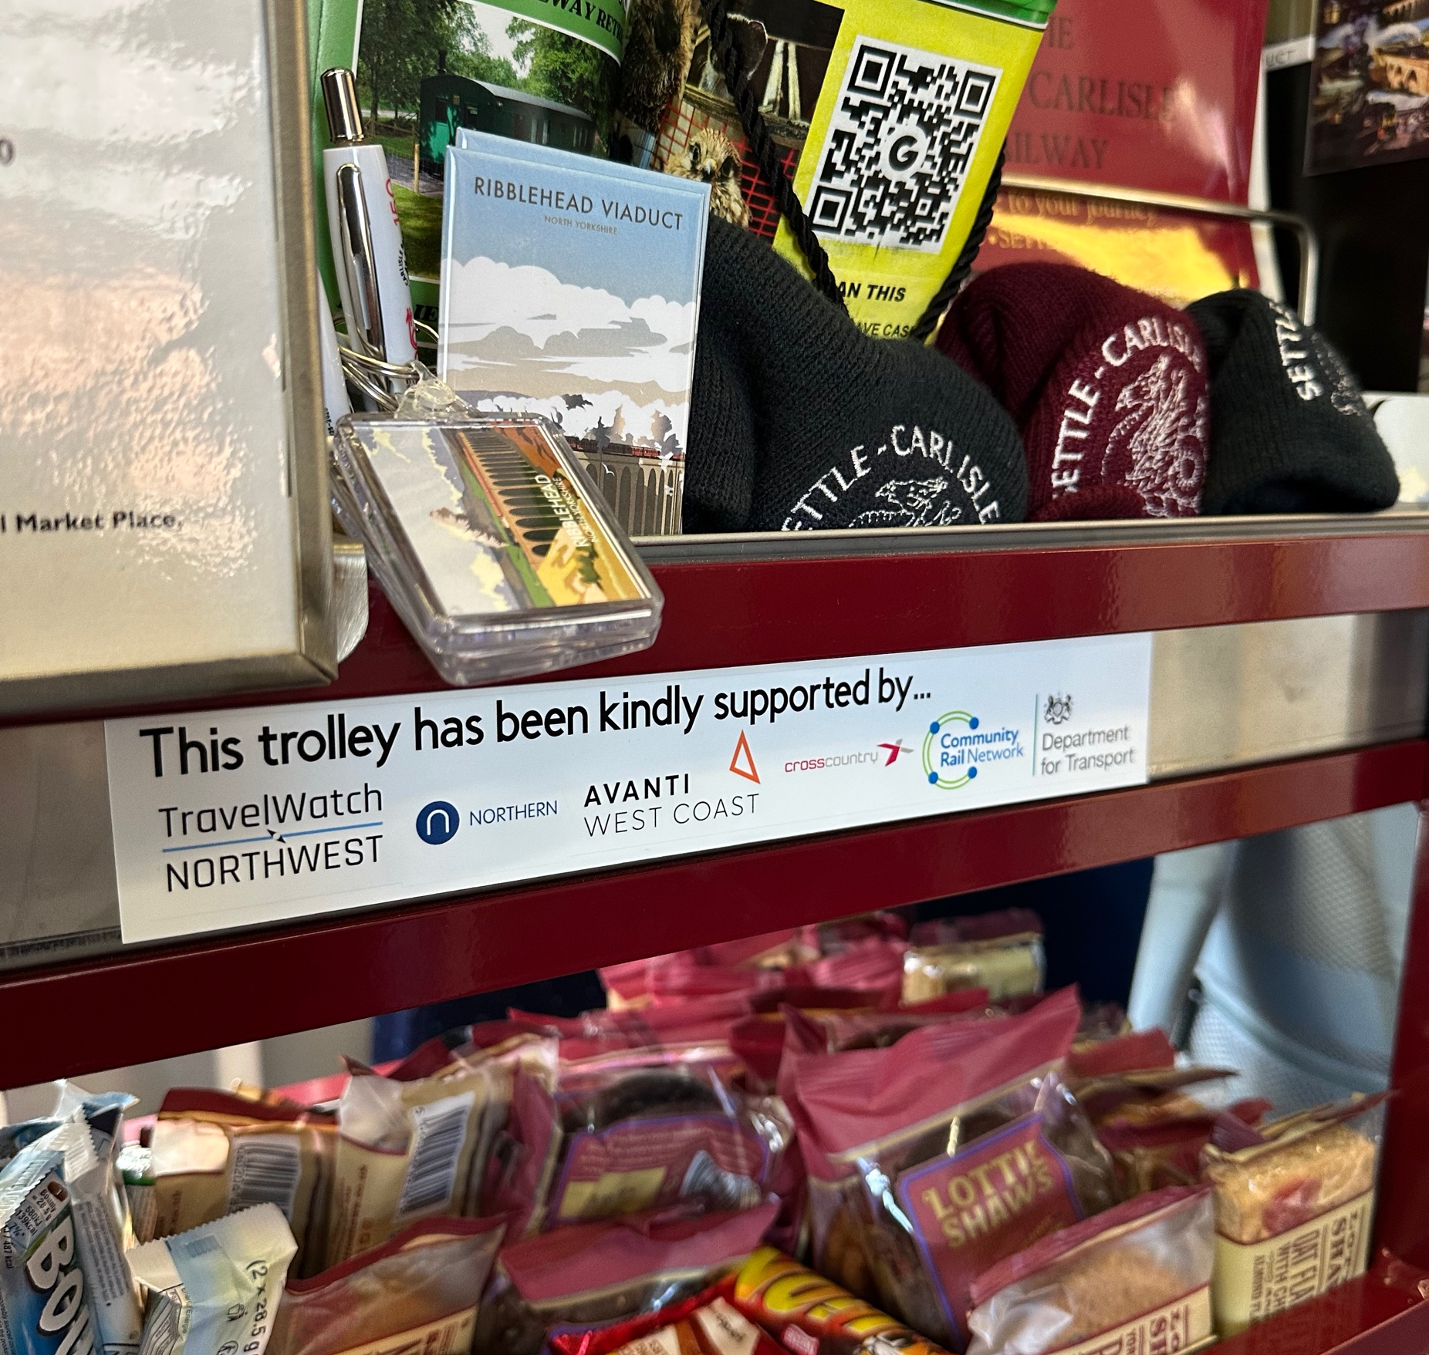
KEEPING THE £ LOCAL
ONE PURCHASE.
MULTIPLE BENEFITS.
PASSENGER
↓
☕ BUYS FROM TROLLEY
↓
🏪 WE BUY LOCALLY
Notes:
It's a small circular economy travelling up and down the Settle–Carlisle line.
Money spent by a passenger doesn't simply disappear into a catering operation.
Some of it goes back into local businesses through our purchasing. It supports employment. It gives local producers access to railway passengers. It improves the passenger experience.

Slide 7
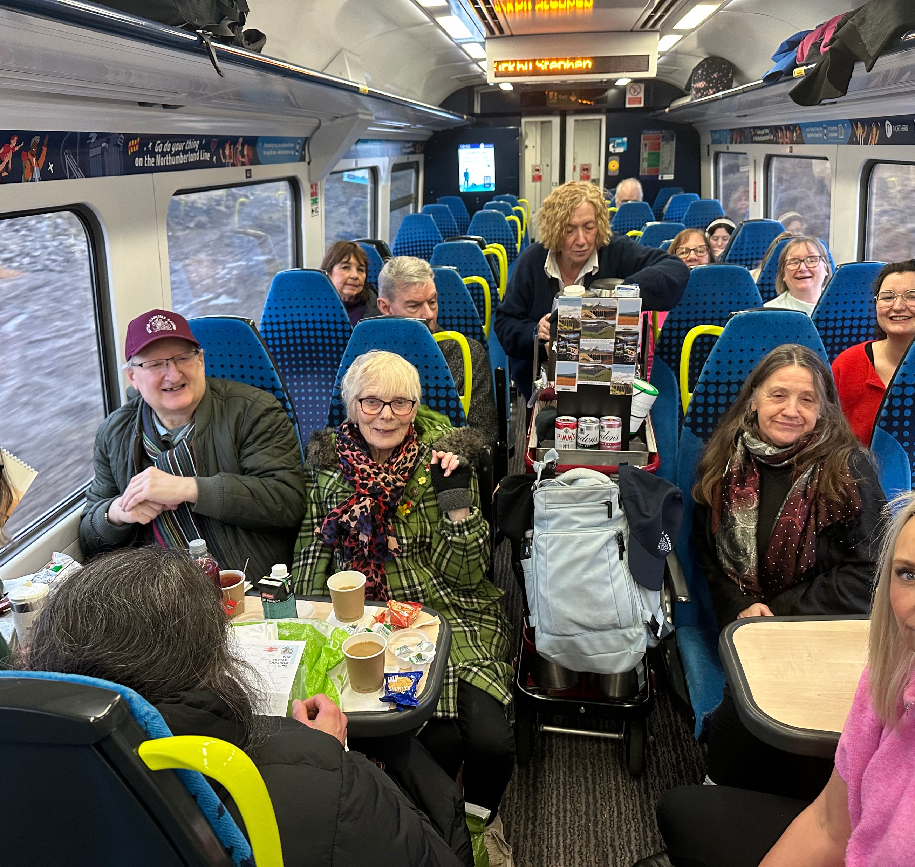
KEEPING THE £ LOCAL
👥 LOCAL JOBS
↓
📍 LOCAL PRODUCTS PROMOTED
↓
🚆 BETTER JOURNEY
↓
£ INCOME GENERATED
↓
❤️ COMMUNITY RAIL
Notes:
And the commercial return helps make our organisation more resilient.
So the value of that £2 or £3 purchase is actually much greater than the transaction itself.
The Development Company describes the trolley's purpose in precisely these wider terms: supporting local producers and the local economy, providing employment and enhancing journeys for both residents and tourists.

Slide 8
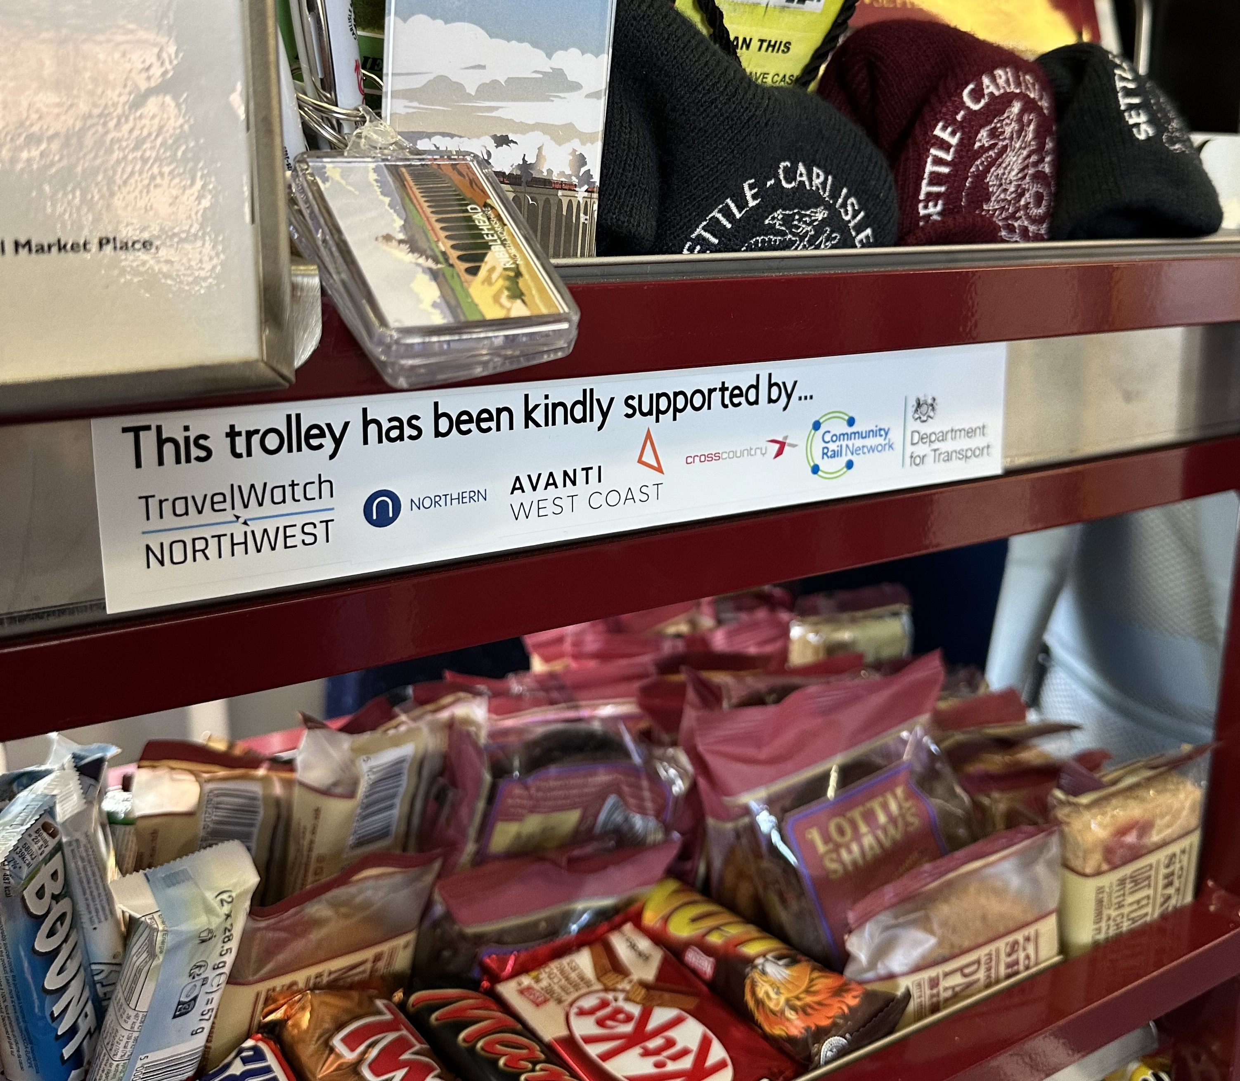
INVEST ONCE
CREATE VALUE AGAIN AND AGAIN
Our new trolley fleet
thanks to the support
    Northern
    Avanti West Coast
    CrossCountry
    TravelWatch NorthWest
Designed and manufactured with a local engineering business
Notes:
And this shows why partnership funding remains so important.
After 20 years, our trolley fleet was reaching the end of its life.
Northern, Avanti West Coast, CrossCountry and TravelWatch NorthWest helped fund replacements.
But we didn't simply buy an off-the-shelf product.
We worked with local engineering company J Mortimer Fabrications near Kirkby Lonsdale to develop our own trolley.
So partner investment helped us improve passenger experience, support a local business and protect an income-generating service for the future.
External investment helped create longer-term sustainability.

Slide 9
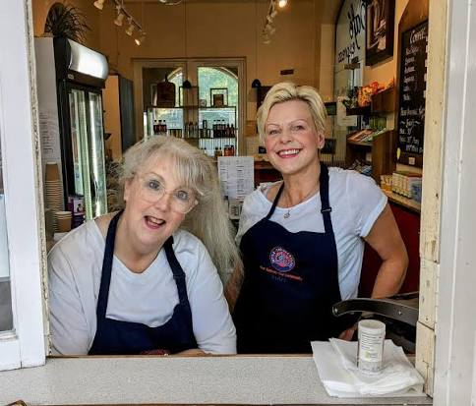
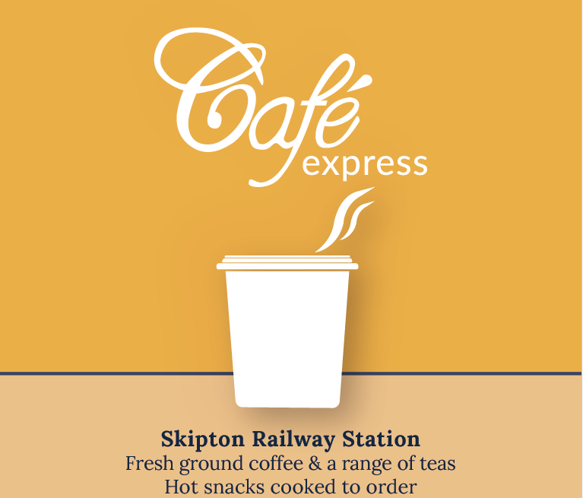
Settle Carlisle Railway Development Company Projects
Our Station Cafe at Skipton
Group Travel
Notes:
It’s not just onboard catering services
Settle Carlisle Railway Development Company also runs the Station Café at Skipton, which opened in 2008 - still going strong (This is a subsidiary company)- and, until this yearranun the Ribblehead Station café in season
We also manage group travel bookings for Northern

Slide 10
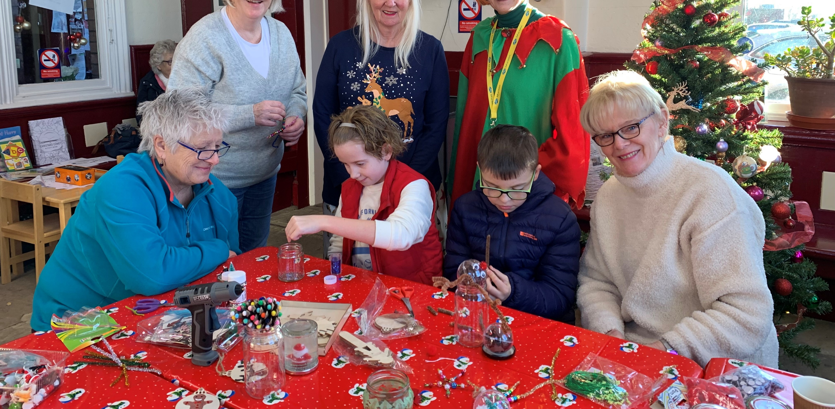
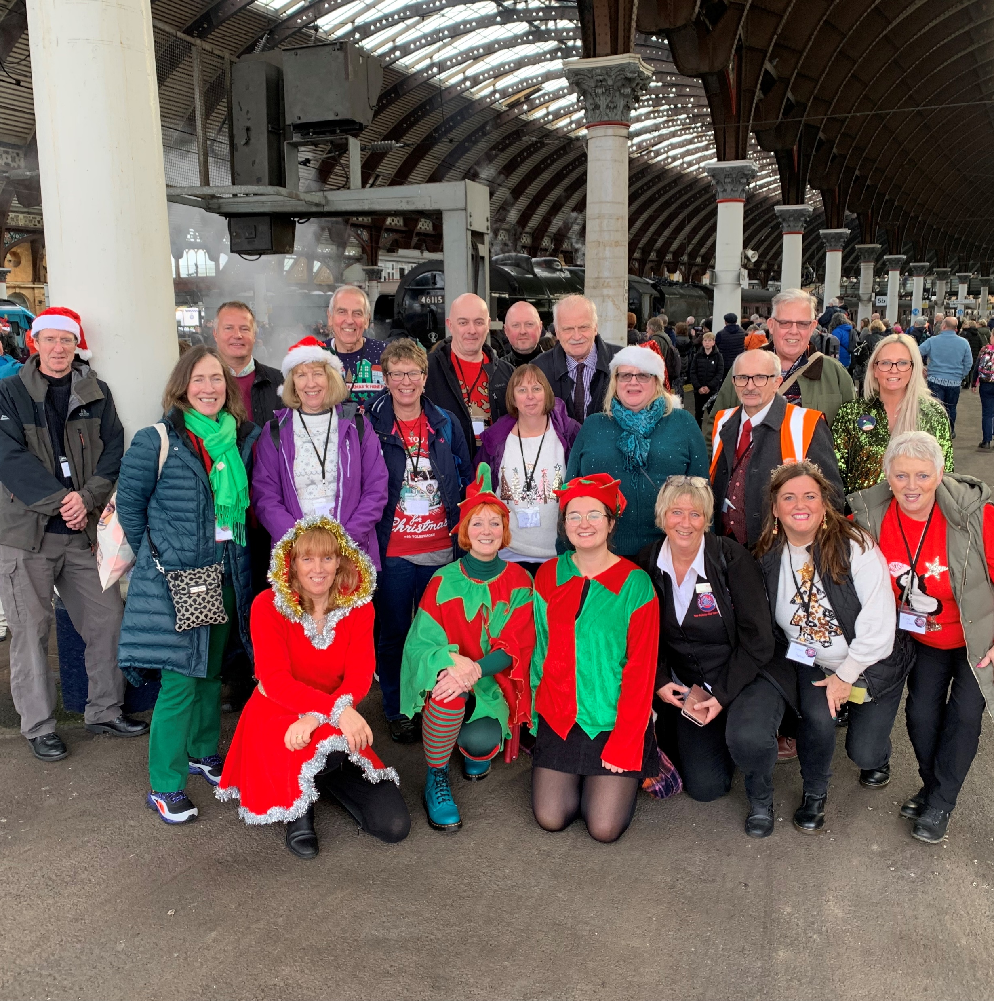
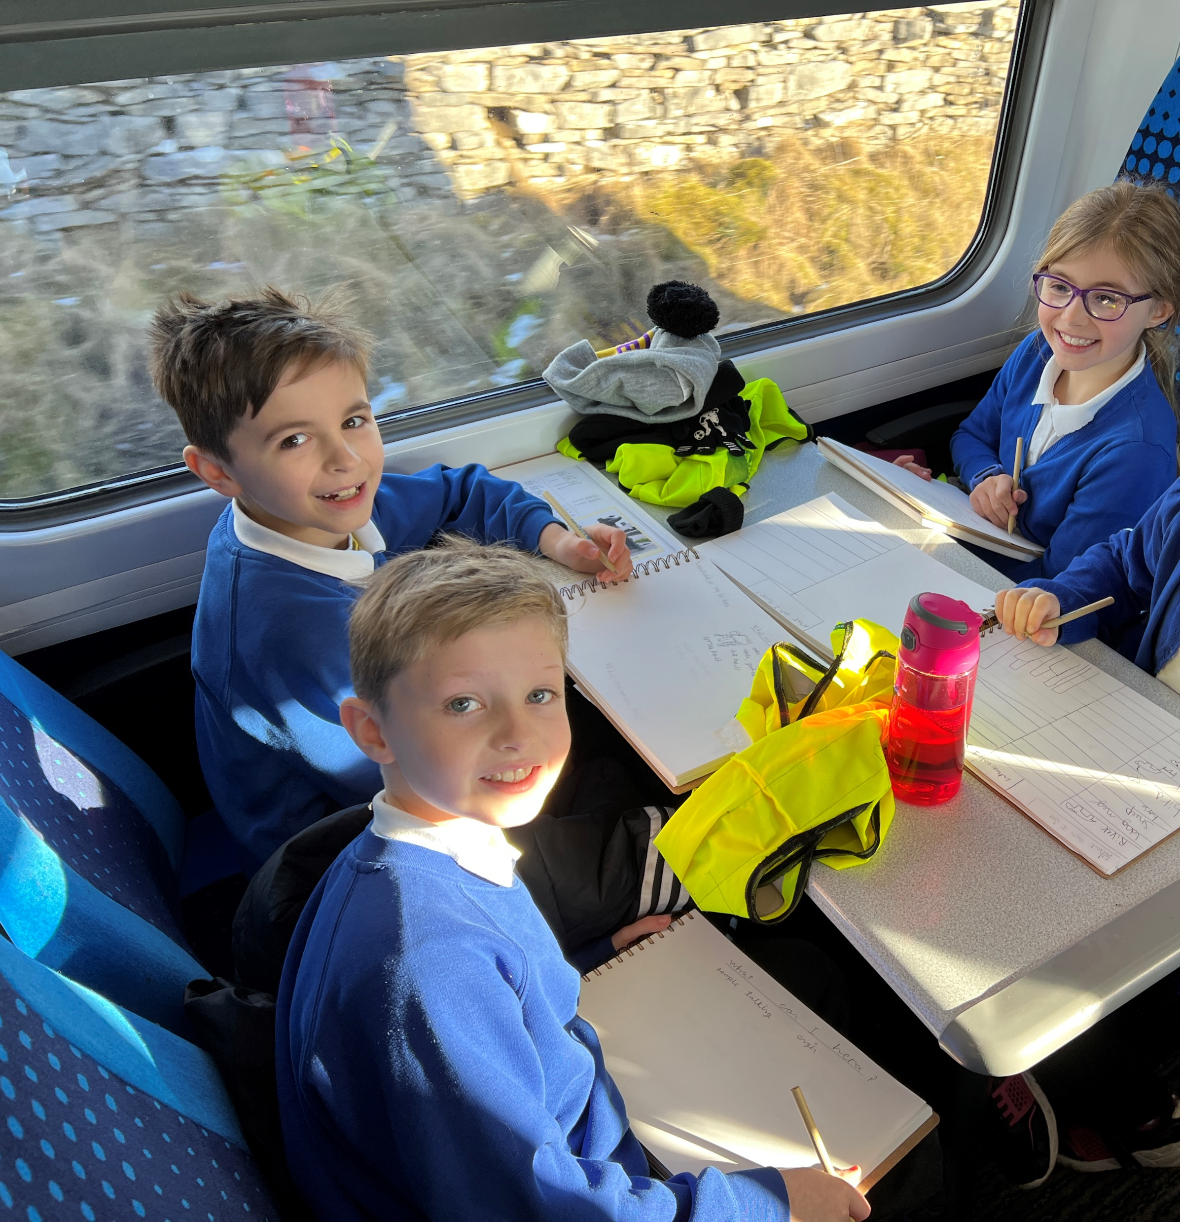
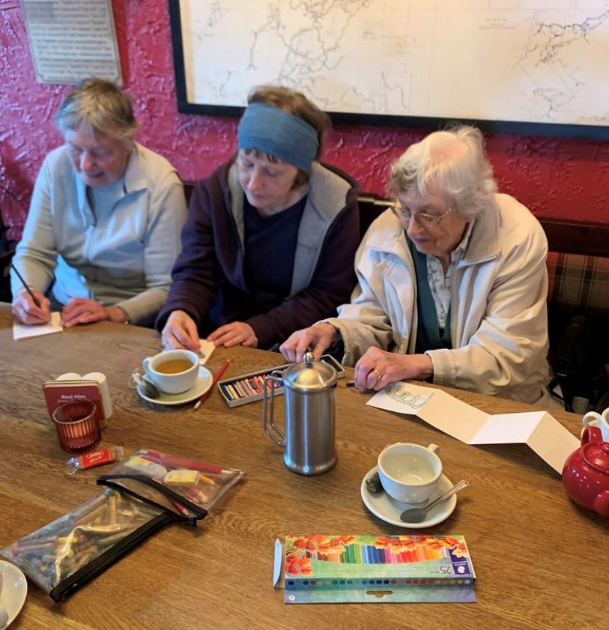
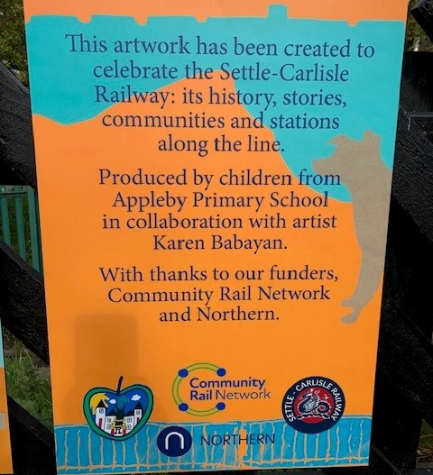
THE VIRTUOUS CIRCLE
Earns Income
Supports CRP Capacity
Enables Community Activity
Connects More People With Rail
Builds Passenger & Community Engagement
A STRONGER RAILWAY
Notes:
This is the model we're trying to create.
Commercial activity isn't the destination. It is part of a virtuous circle.
Income strengthens our capacity.
That capacity allows us to do more community work.
Community work introduces new people to rail, builds relationships with communities and makes stations and journeys more welcoming.
That helps create passengers and advocates for the railway.
Which in turn creates more opportunity.
Commercial success and community success don't have to compete. They can reinforce one another.
Current CRP projects demonstrate that breadth, from schools and Girlguiding to refugee support, sustainable tourism and community station activity.

Slide 11
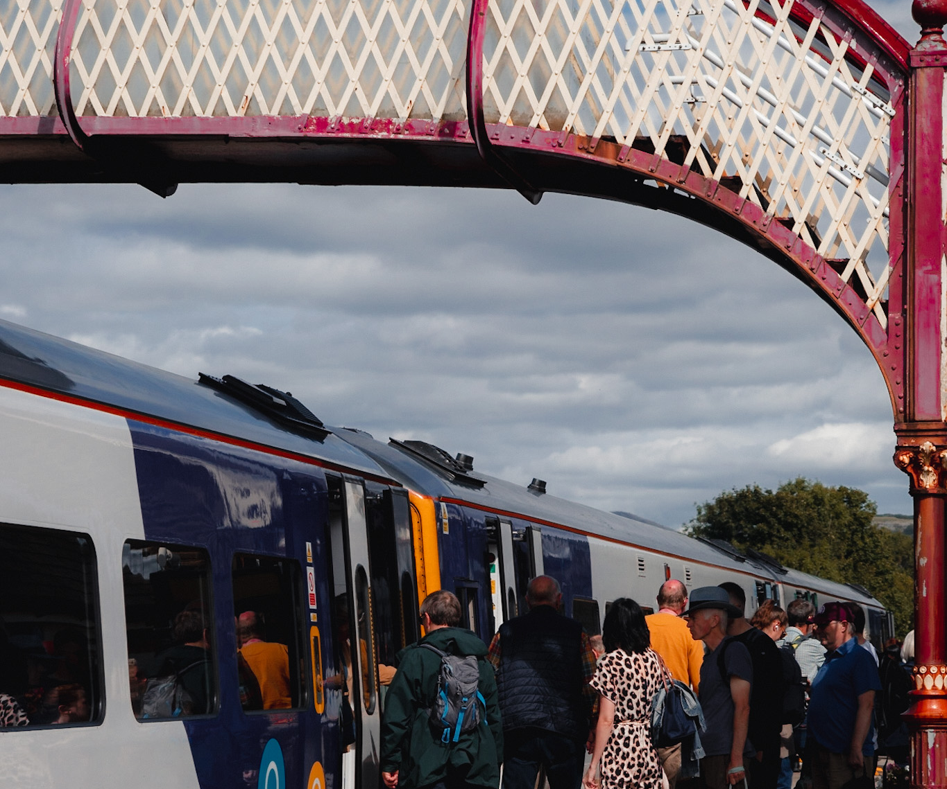
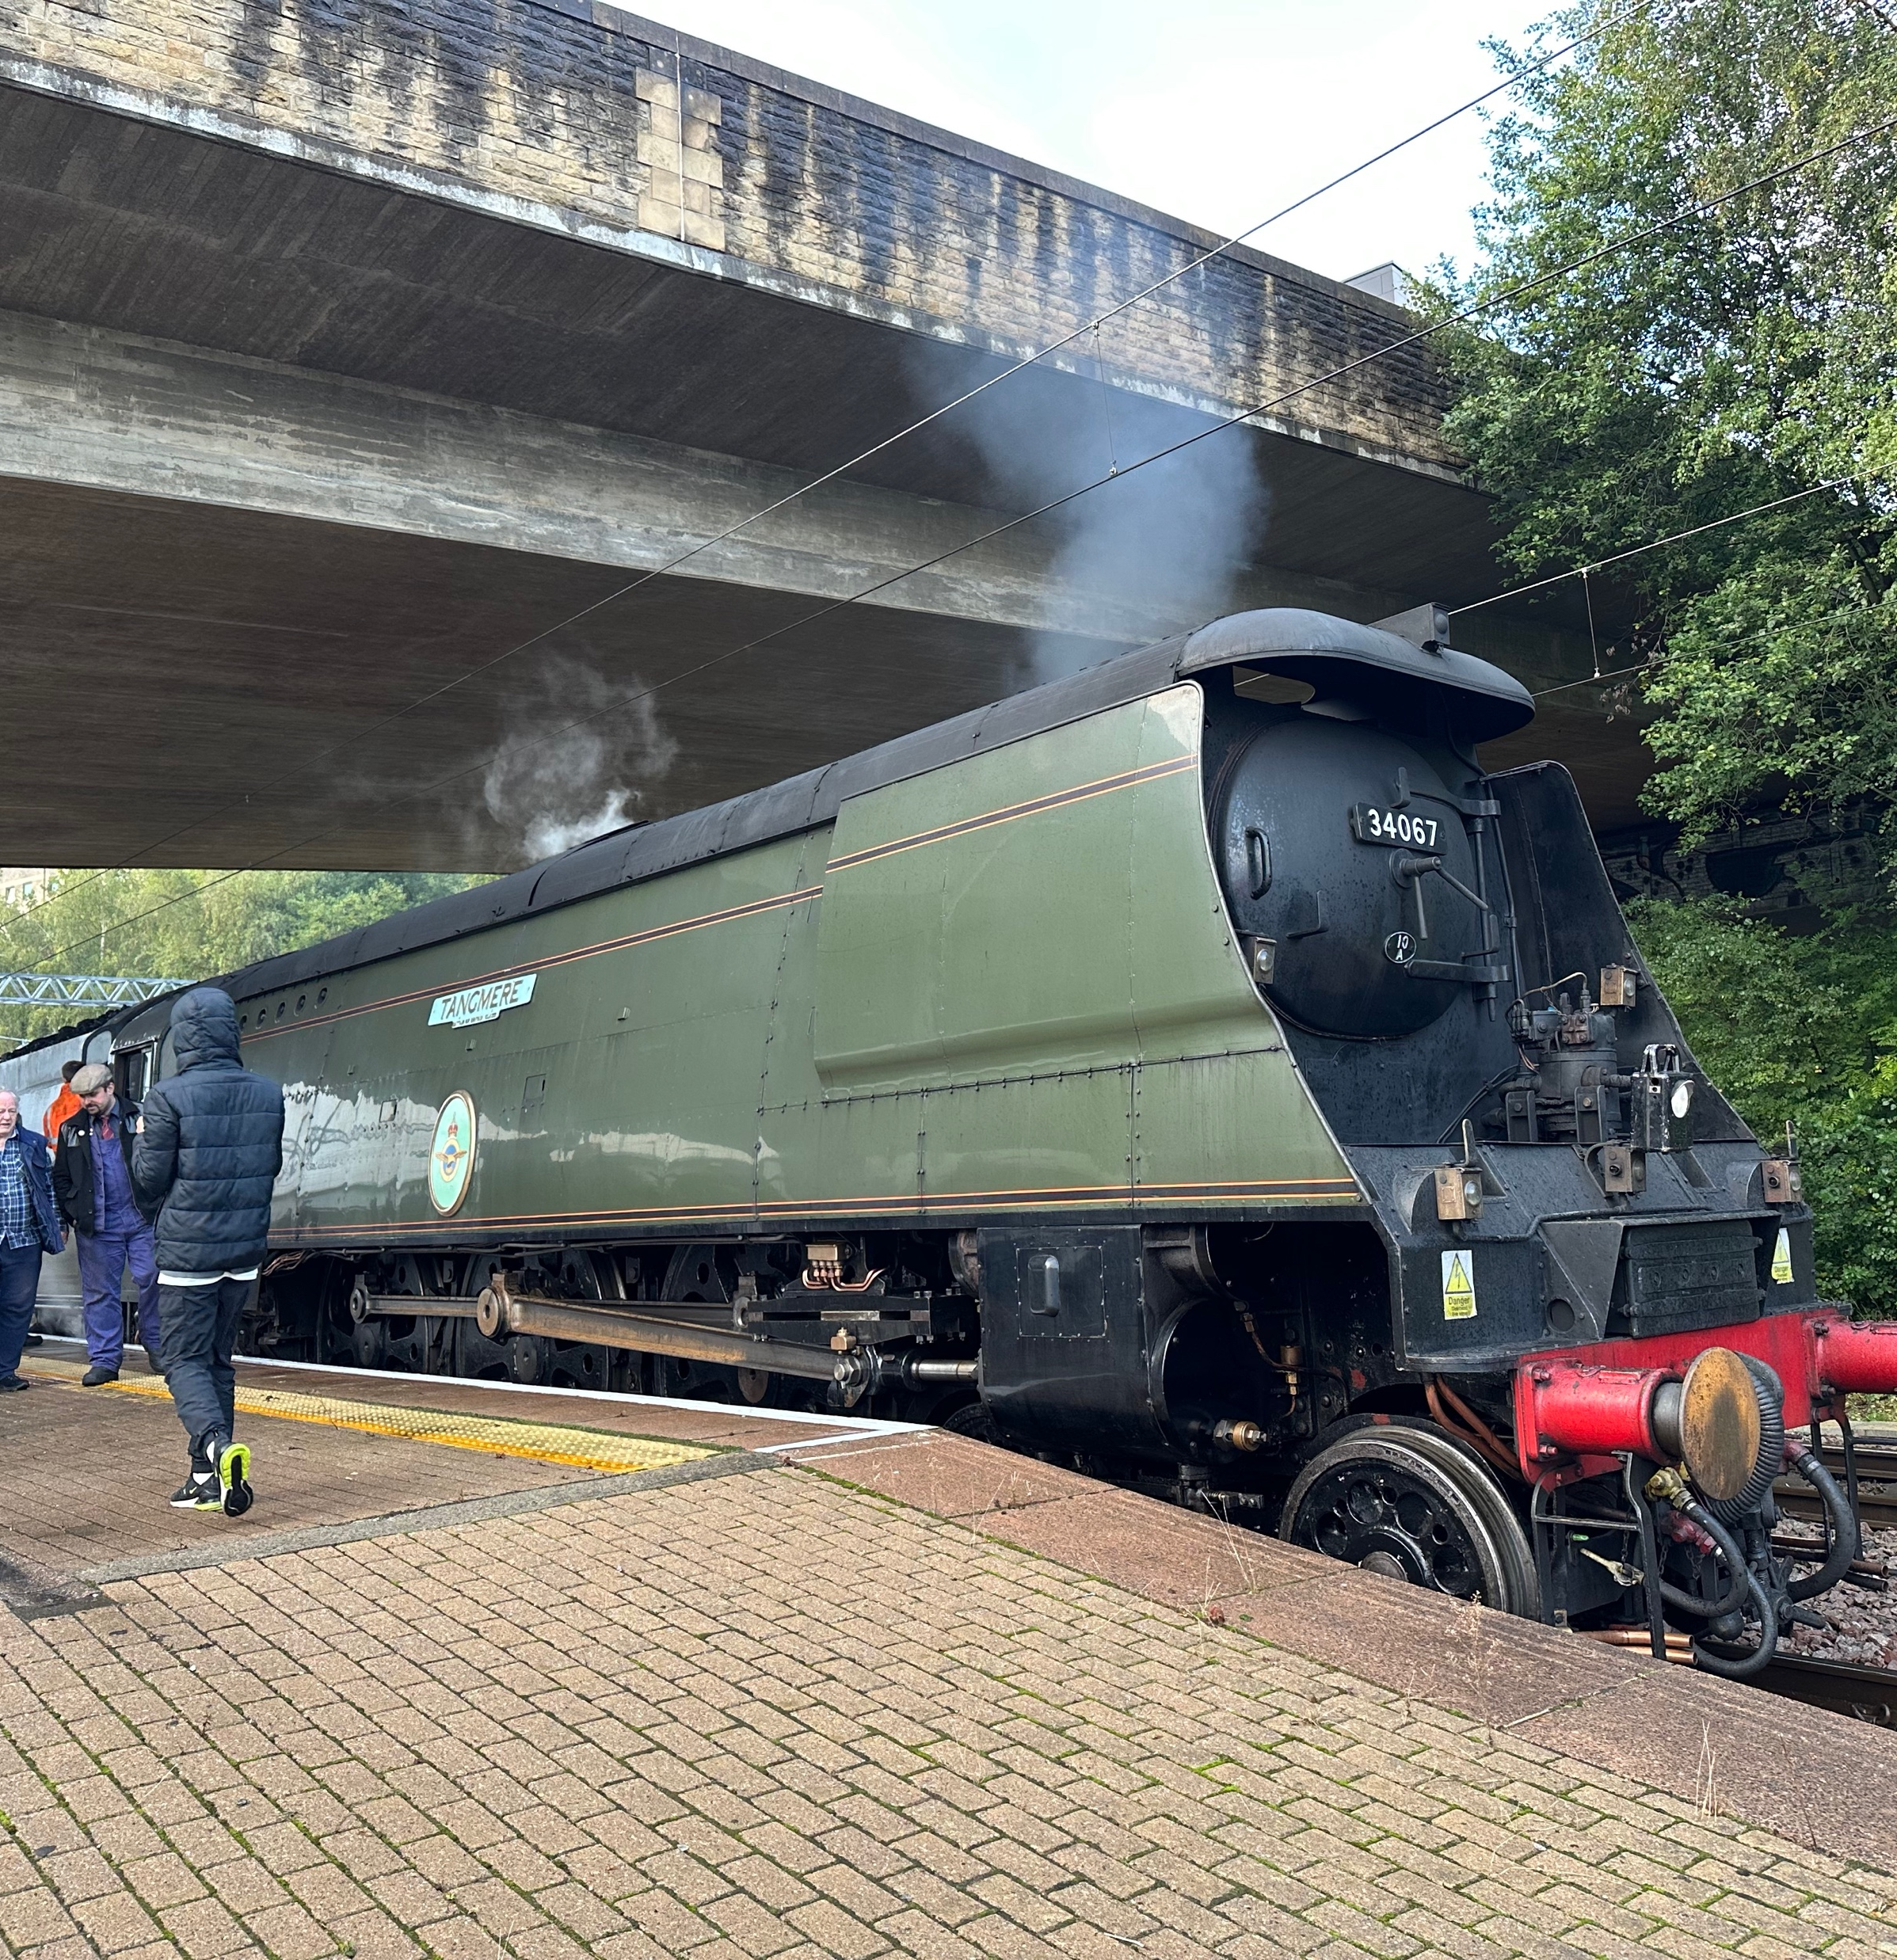
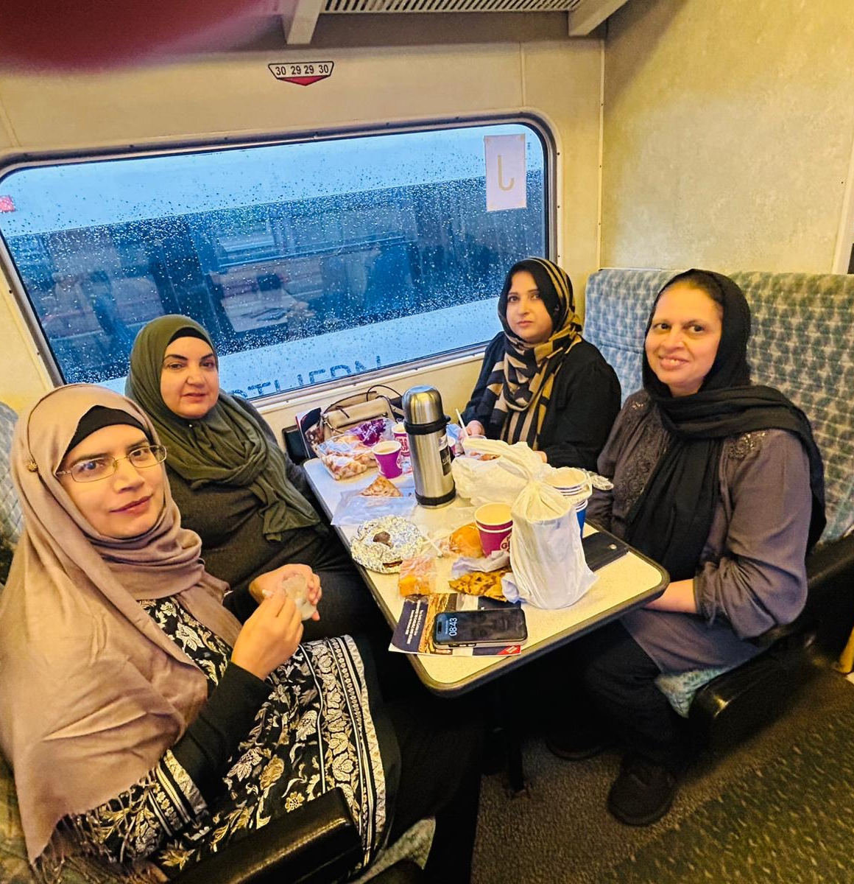

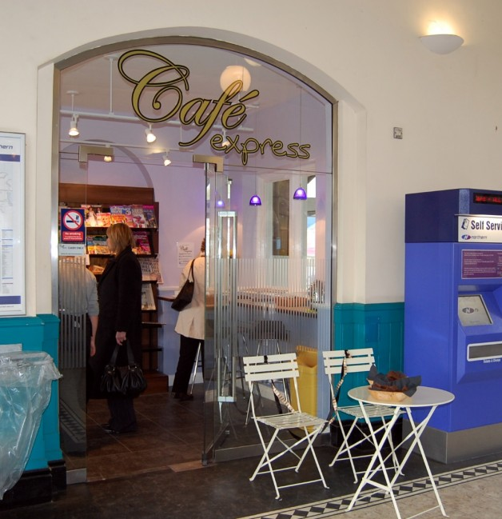
THIS ISN'T JUST ABOUT
SETTLE CARLISLE RAILWAY
STATION SPACE
Caffes - retail
SERVICES
Contracts – group travel
Think social enterprise – not simply fundraising.
EXPERIENCES
events - heritage
LOCAL PRODUCTS
Food - gifts
TOURISM
trips - packages
YOUR BRAND
merchandise - partnerships
Notes:
We’re not suggesting everybody leaves this conference and buys a trolley.
Our model works because it fits our railway.
The question is what fits yours.
Do you have an unused station building? A strong tourism offer? Local producers looking for customers? Events? Guided experiences? Retail opportunities? A recognisable railway brand?
Instead of asking only, ‘Where can we find another grant?’ perhaps we should sometimes also ask:
‘What value can we create ourselves?’

Slide 12
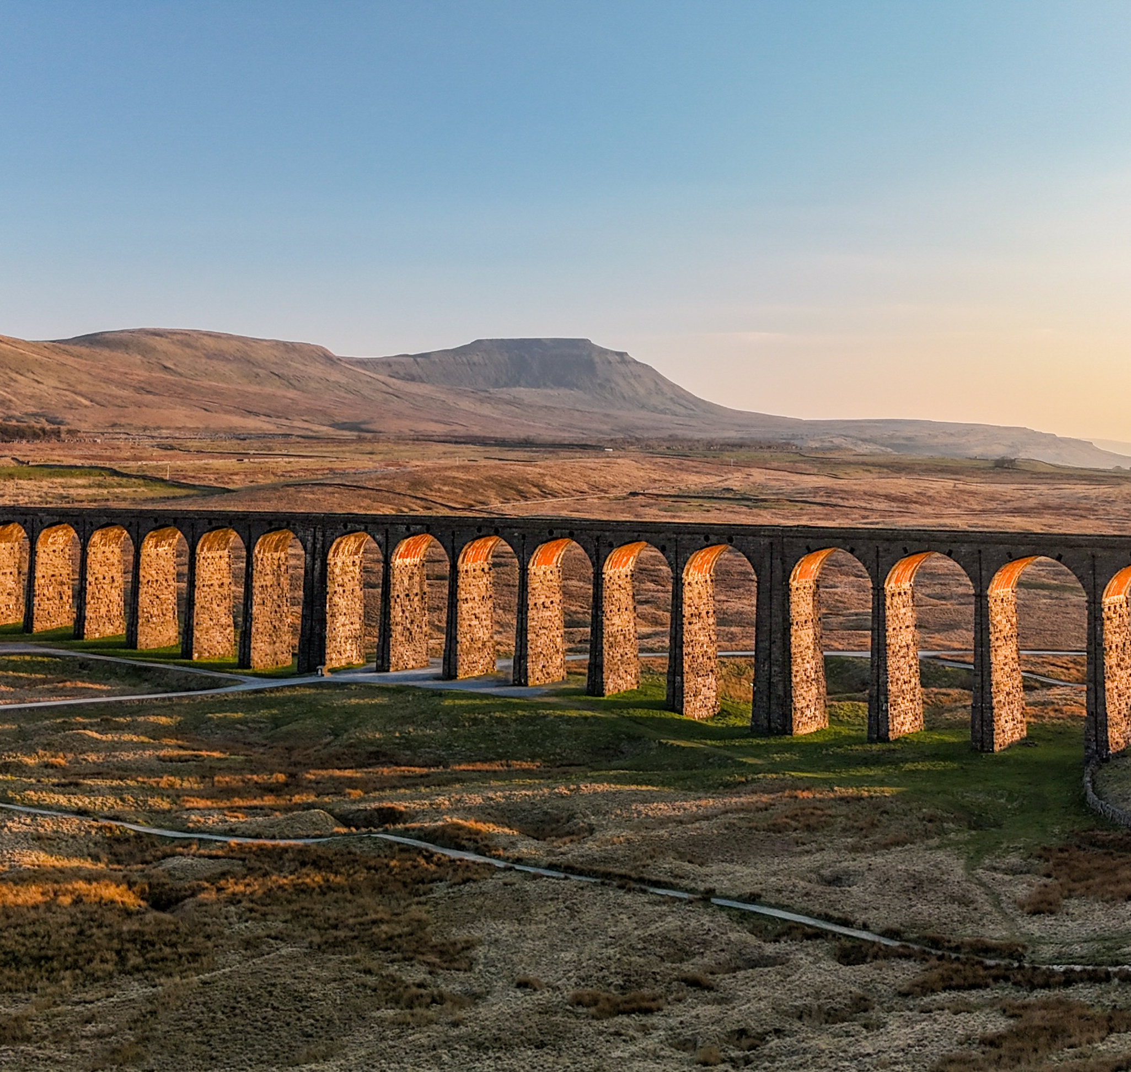
OUR DESTINATION
A railway that supports its communities.
Communities that support their railway.
A CRP equipped for the future.
Notes:
The Settle–Carlisle Railway was nearly lost once.
Its survival taught us something important: never take the future for granted.
I think the same applies to Community Rail.
We should celebrate the support we have today – and continue working closely with the train operators, Community Rail Network and organisations that make our projects possible.
But alongside that, we should build our own resilience.
On the Settle–Carlisle, that can start with something as simple as a cup of tea bought from a trolley.
That cup of tea supports a job. It supports suppliers. It promotes our area. It enhances someone's journey. And it generates income.
Multiply that thinking across everything we do and we start creating something much bigger:
a sustainable future for Community Rail.”
Then click to reveal one final line:
What could your CRP do today to help fund its tomorrow?
That is where I would stop. It leaves delegates thinking about their own CRP, rather than simply applauding what Settle–Carlisle has done.
The factual foundation for this argument is particularly strong because your own 2026 accreditation announcement explicitly connects the two sides of the organisation: Operations Manager Susie Smith states that the commercial operations, including the trolley and Skipton café, support Community Rail projects while providing passenger benefits, local employment and opportunities for local

Slide 13
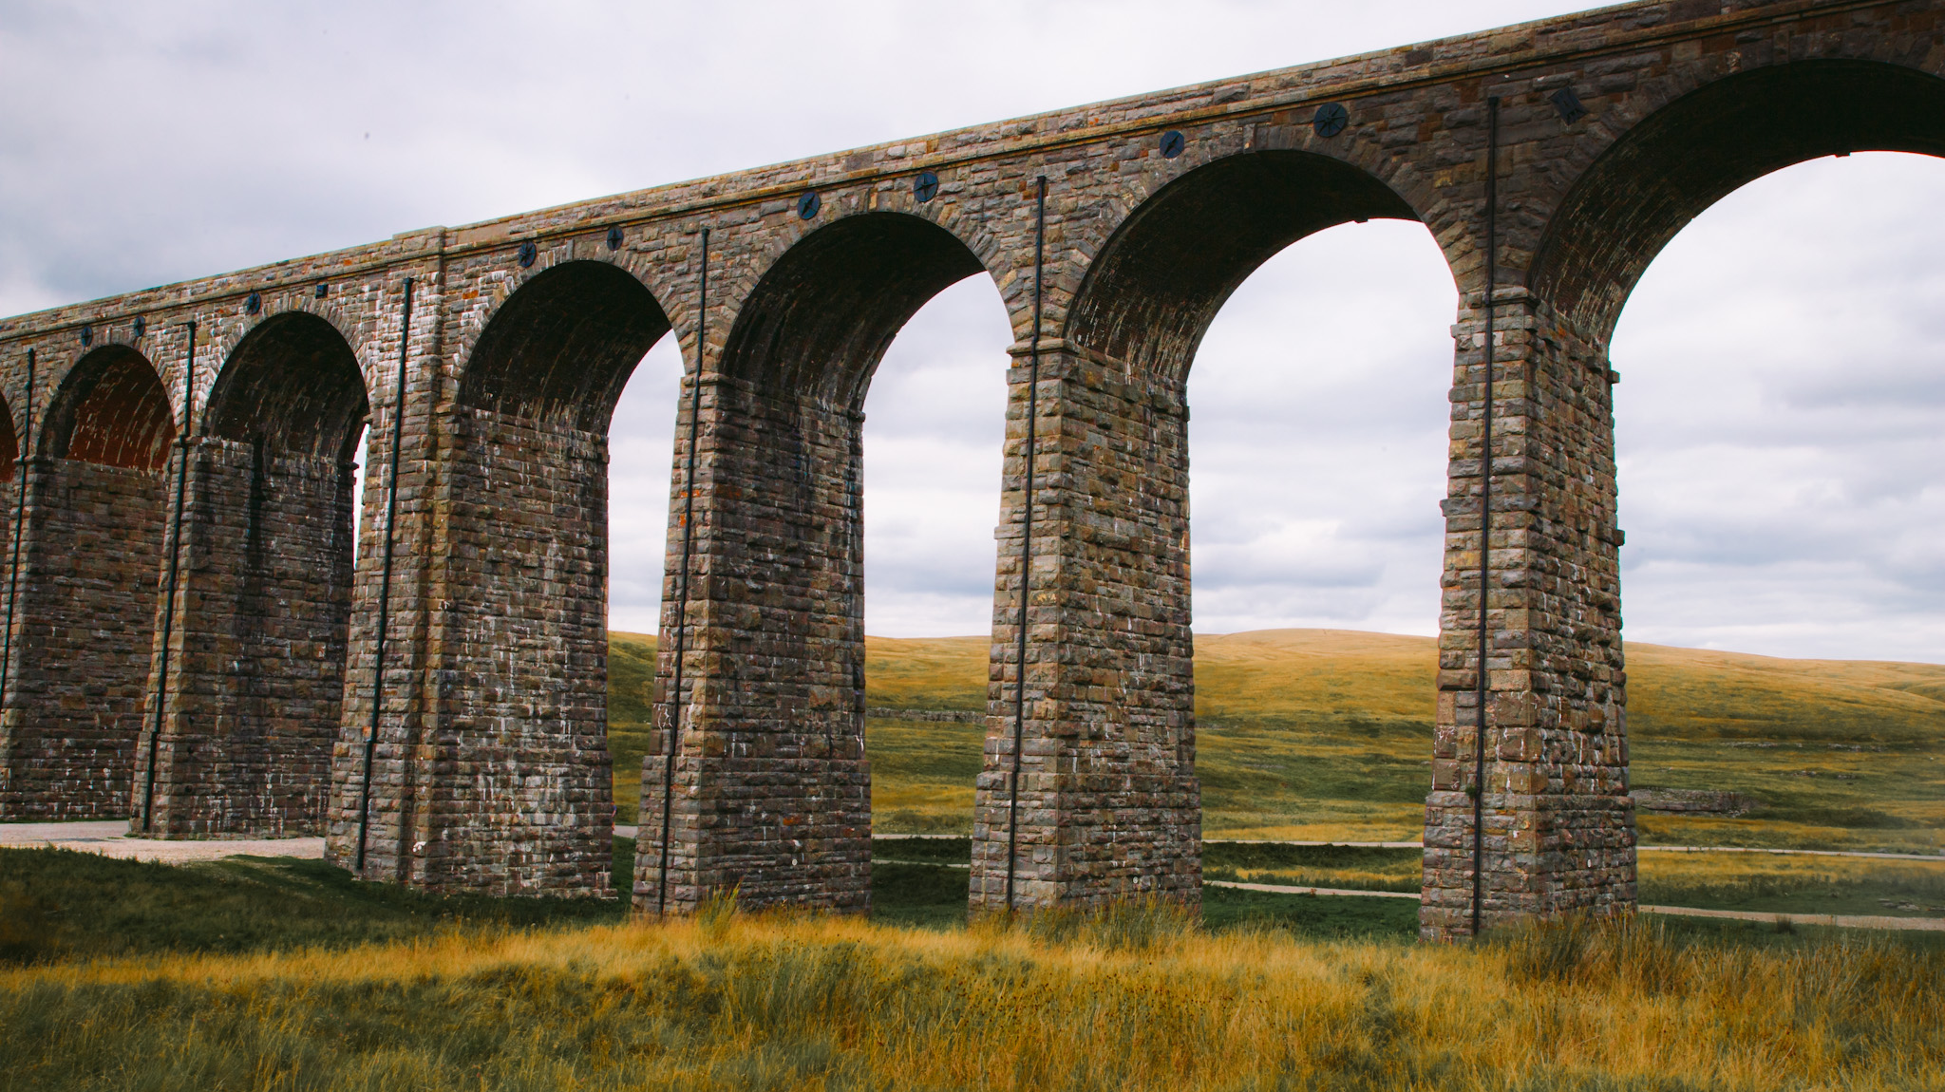
Settle-Carlisle.co.uk
Any questions?

