Slide 1

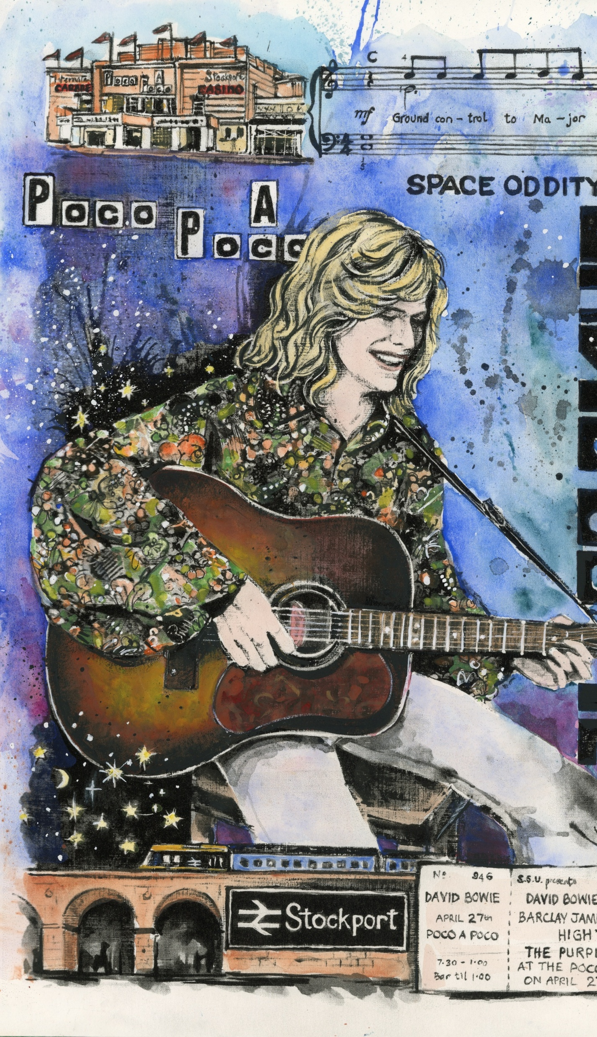


Stockport
Music Story

Slide 2
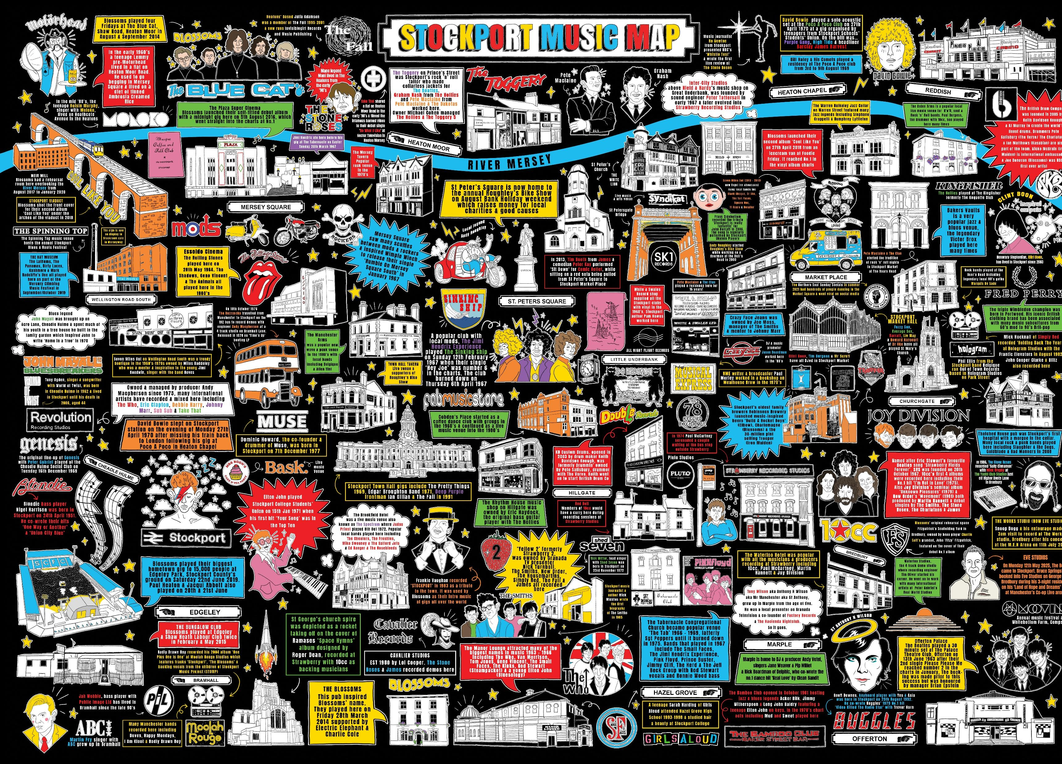
Why
Improve customer journey
Reduce anti-social behaviour
Celebrate Stockport’s heritage
and What
100+ people consulted
Over 40 pieces of Art
6 local artists

Slide 3
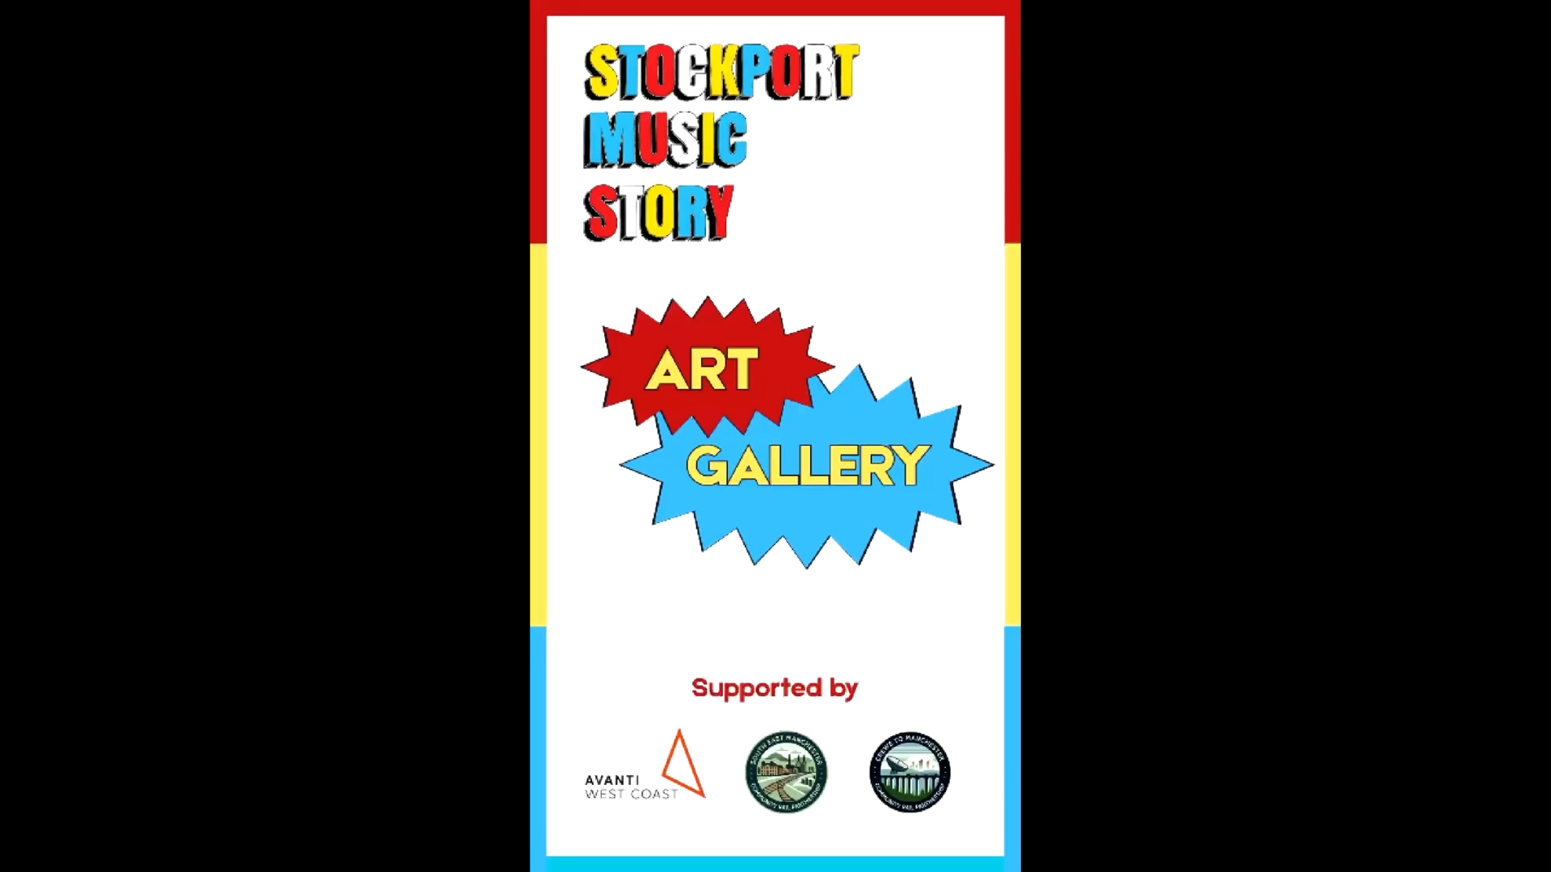

Slide 4


Slide 5
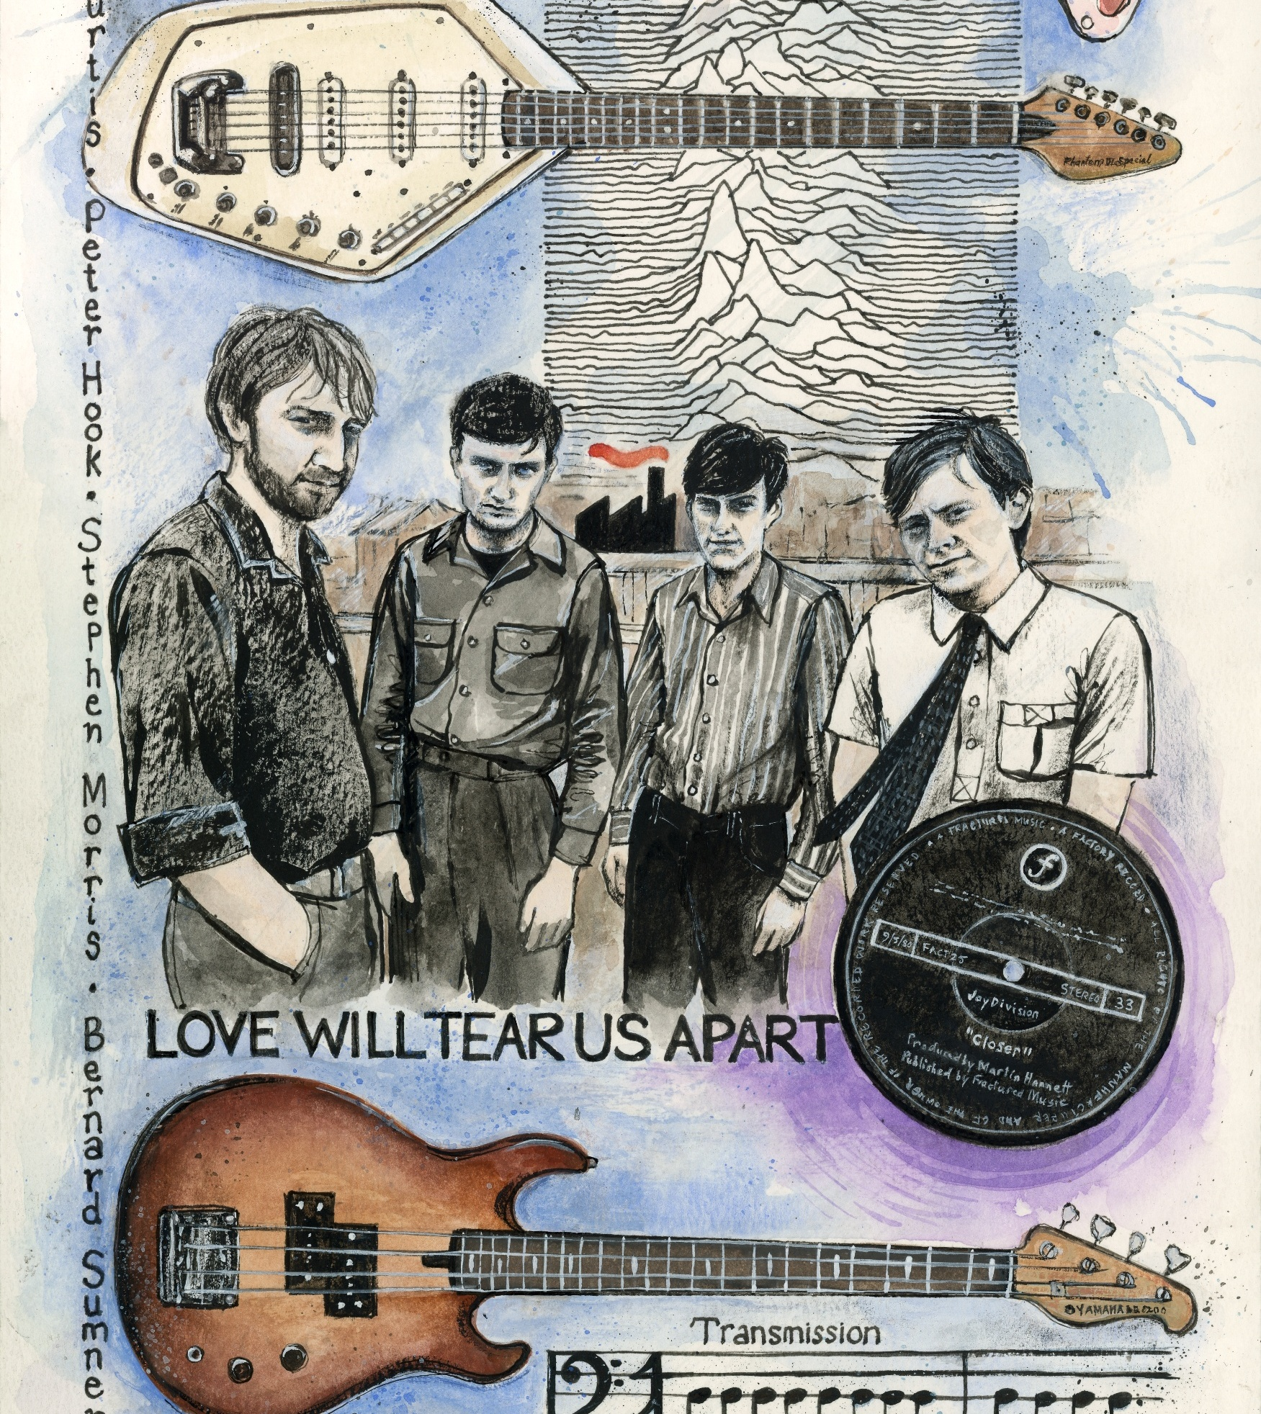
Impact
Almost 5 million visitors per year
400+ people engaged in tours / walks
100+ people attended launch event
Starred on ITV News
5,600 unique QR clicks (896 in just one day)
3,000 unique visitors to the project website
Social value = £2,879,584.82
Economic value = £177,447.92 to the town

Slide 6
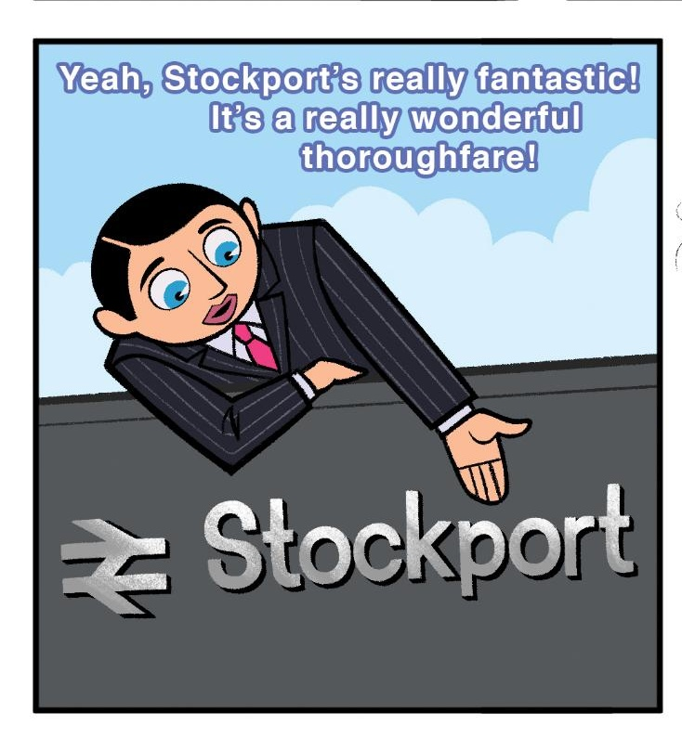
Questions?

