Slide 1







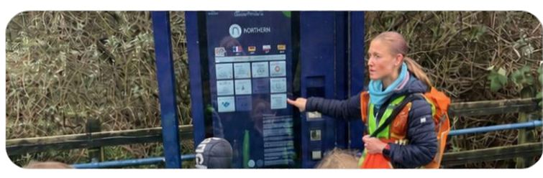
RAIL
SAFETY AND STANDARDS BOARD
Social value in community rail
MEASURING WHAT MATTERS
Community
rail social value
A guide to measuring, monetising and reporting the social value created for community rail partnerships and groups.
Rachael Everard | RSSB

Slide 2

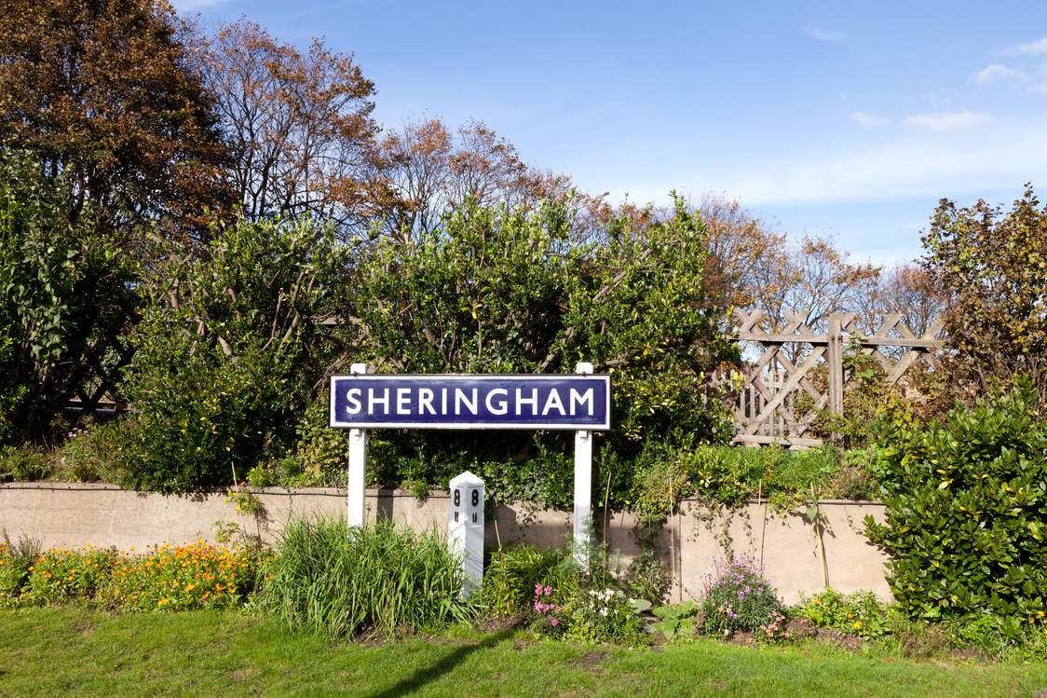
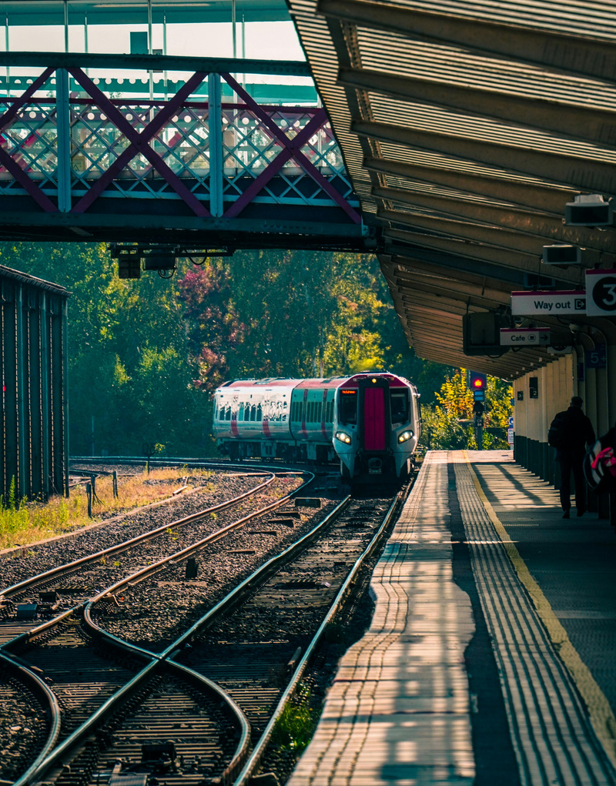
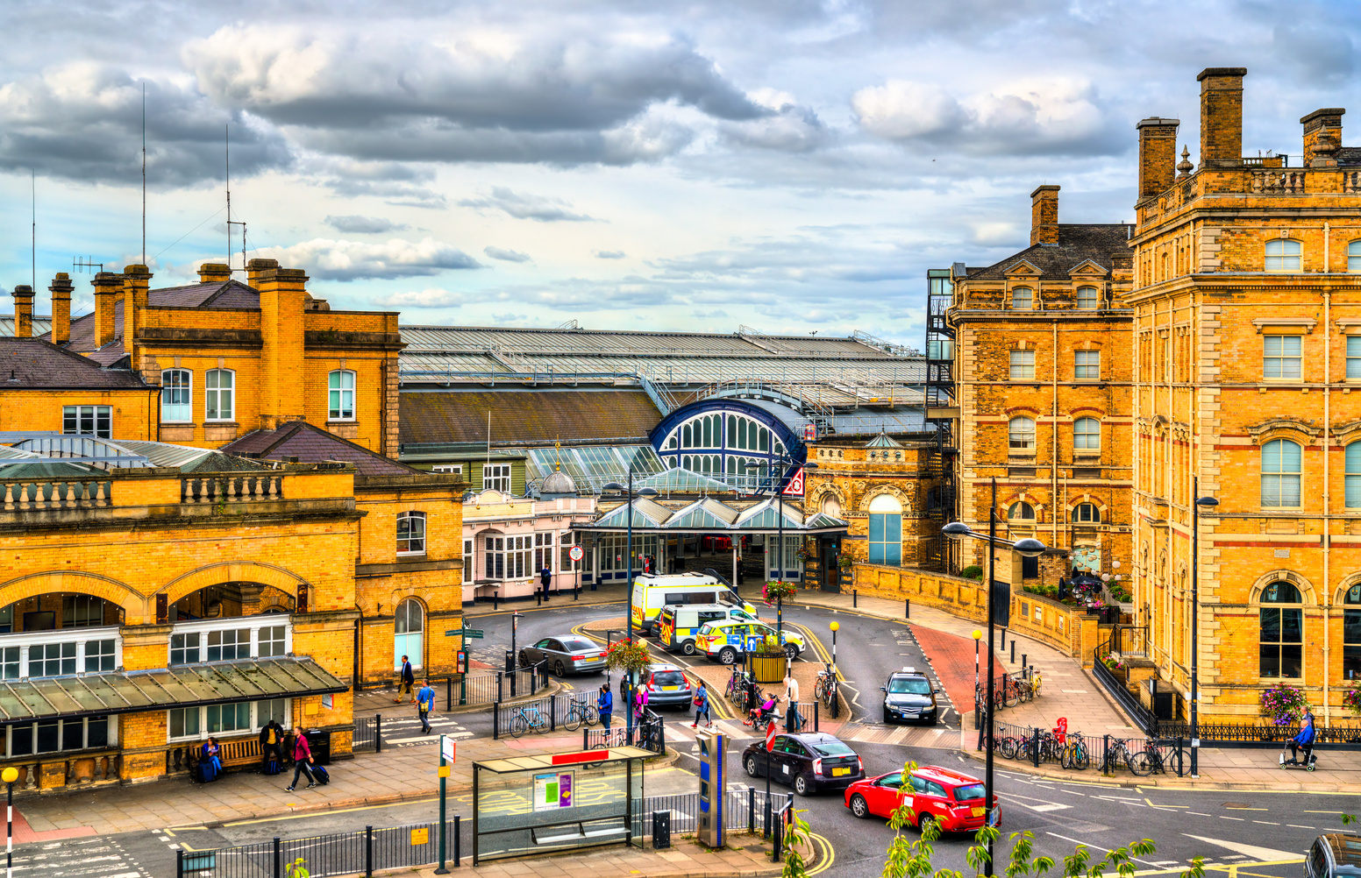
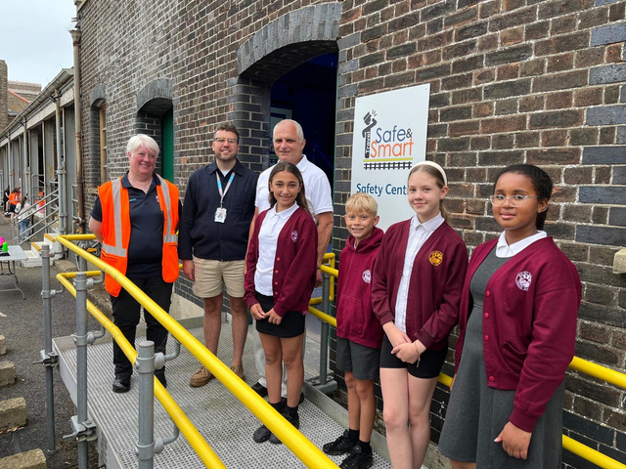
Look beyond the timetable
The things that matter do not always appear in passenger counts.
Flowerbeds
Care for place
A friendly hello
Belonging
A first train trip
Confidence
A local mural
Pride

Slide 3
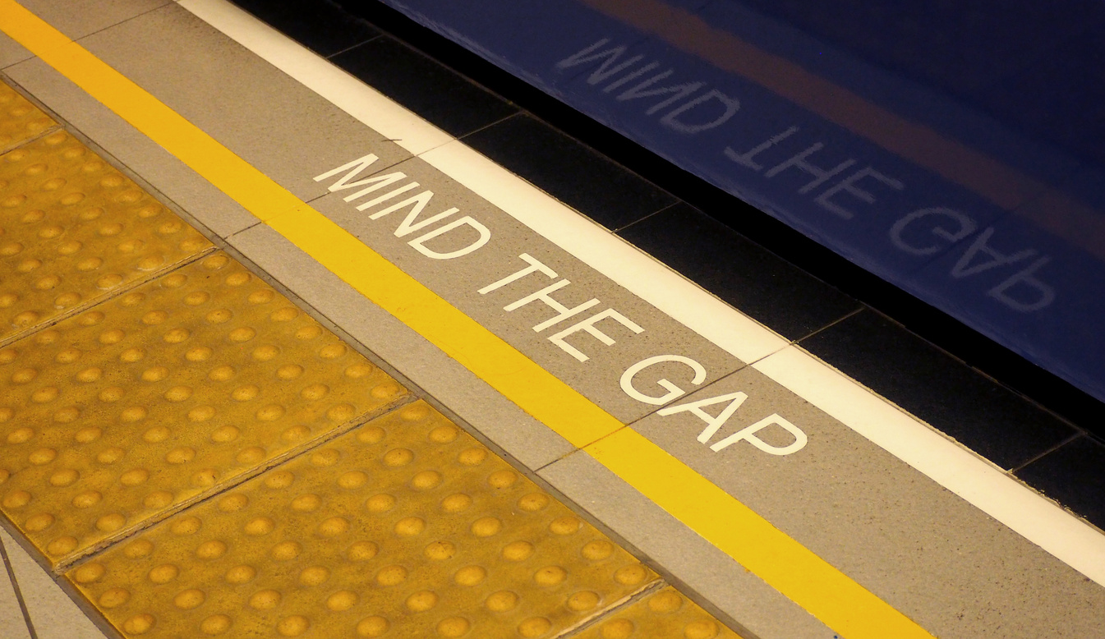
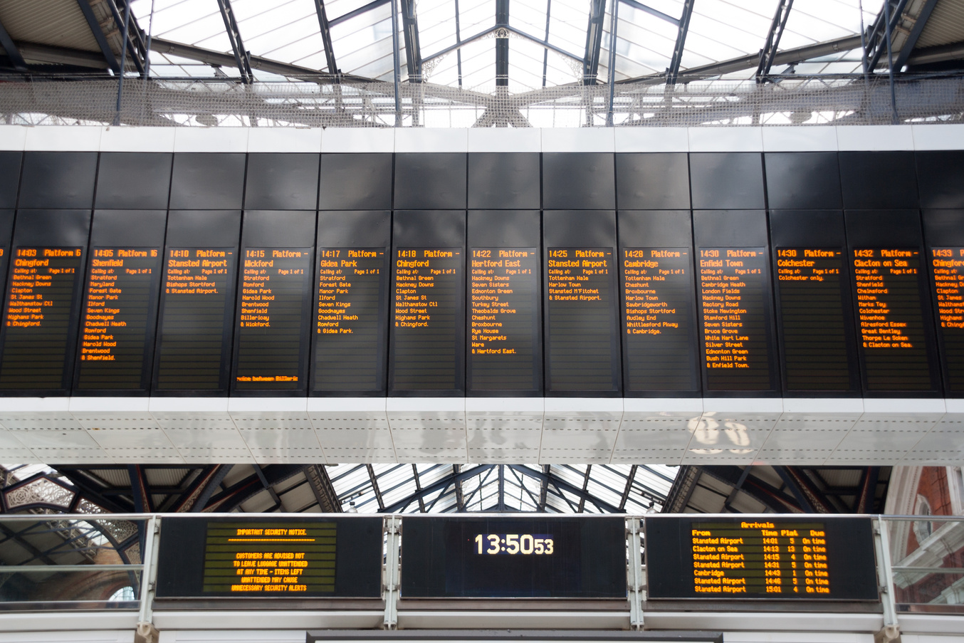
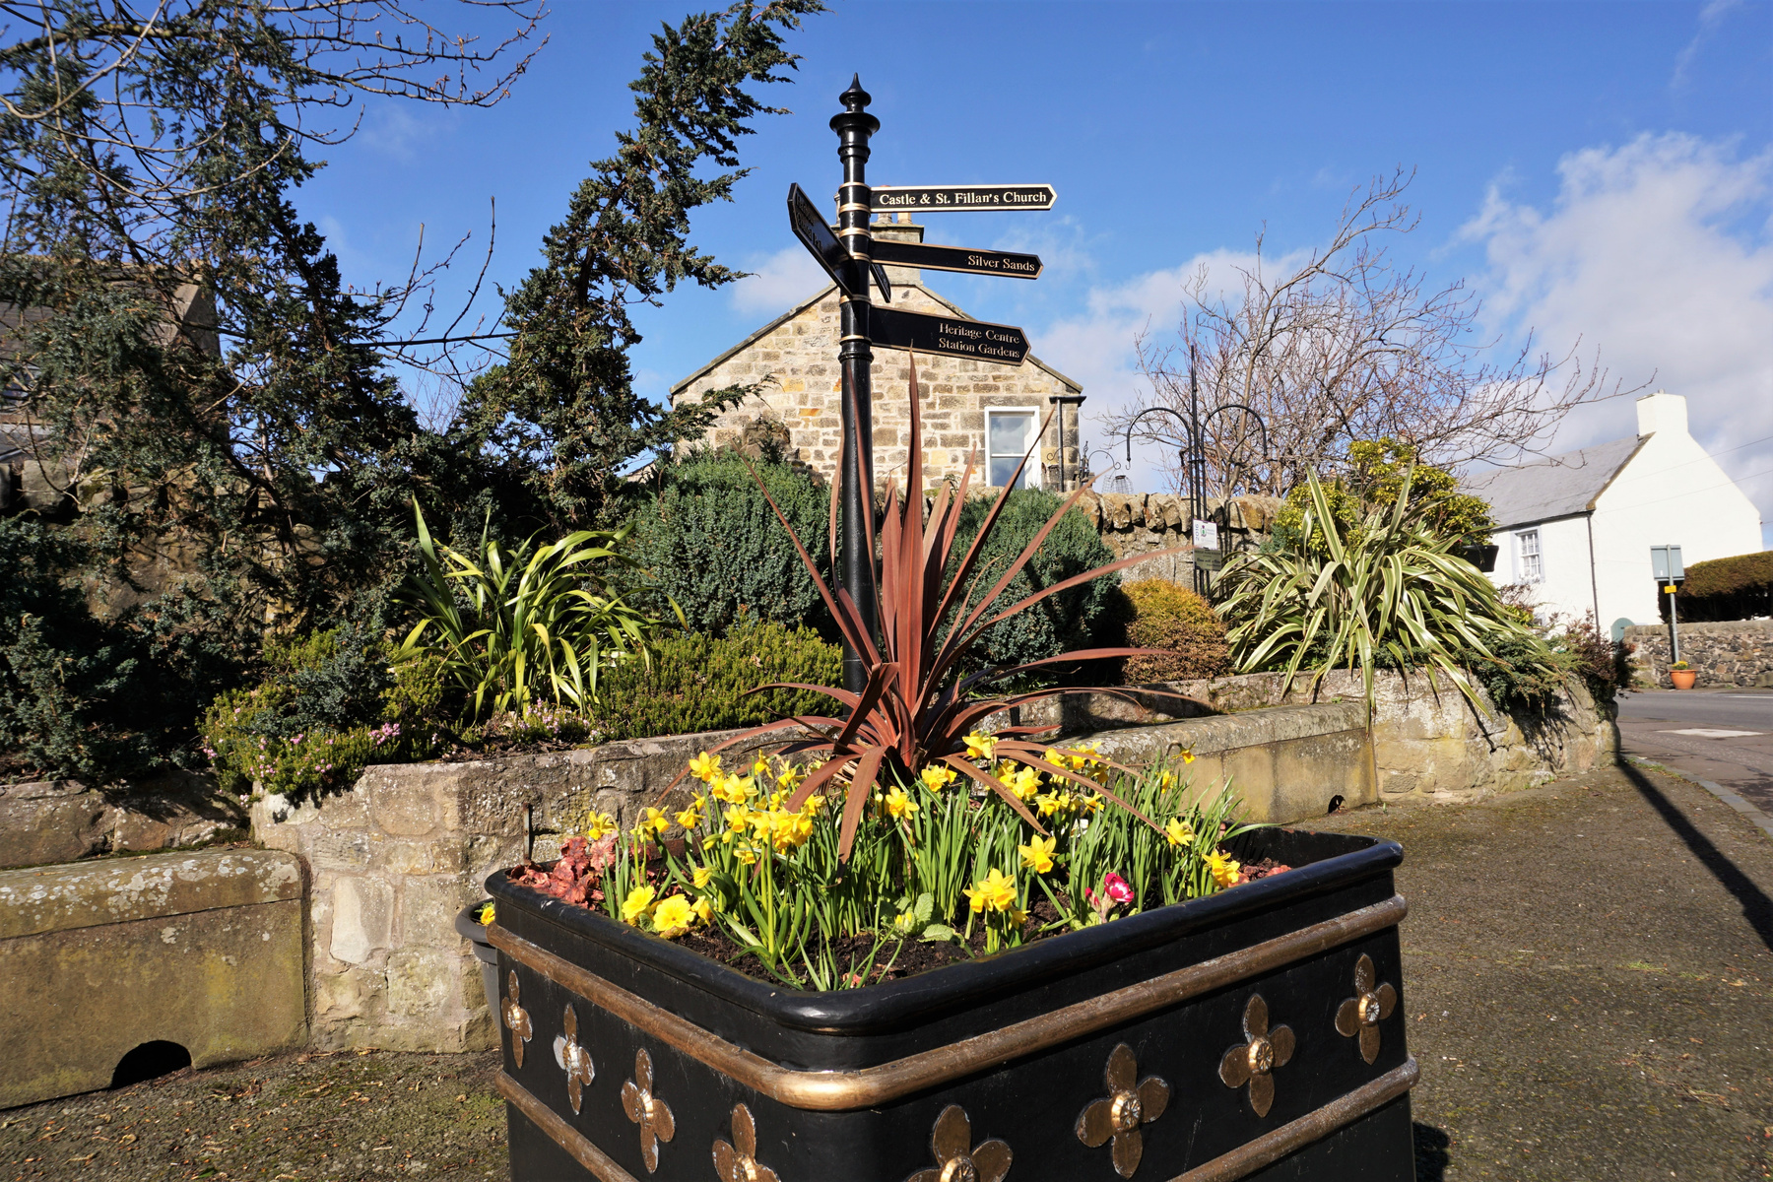
RSSB: neutral ground for the railway
We help the whole railway work together
Safer
More efficient
More sustainable
Independent • Not for profit • Owned by the rail industry

Slide 4
Social value is the difference we make to people’s lives
Health & wellbeing
Access & inclusion
Jobs & skills
Connection & belonging
Local economy
Beyond the journey itself

Slide 5
Why measure it?
1
Be heard
Make a stronger case for investment
2
Make better choices
Learn what creates the biggest difference
3
Tell the story
Combine evidence with human experience
What gets measured gets noticed. What gets noticed gets funded.

Slide 6
A shared language for social value
The Rail Social Value Framework helps the industry compare like with like.
It aims to help organisations measure and communicate the positive impacts they create beyond the railway.
Different measures
Shared framework
Clearer decisions
Not a rulebook
Built together
Designed for action

Slide 7
Community rail already creates social value
125,000
£129m
Nearly £18
people reached each year
social value for communities
returned for every £1 spent
8,000+
380,000
65,000
volunteers
volunteer hours
children and young people
Data source: Community Rail Network, The Value of Community Rail Report 2024

Slide 8
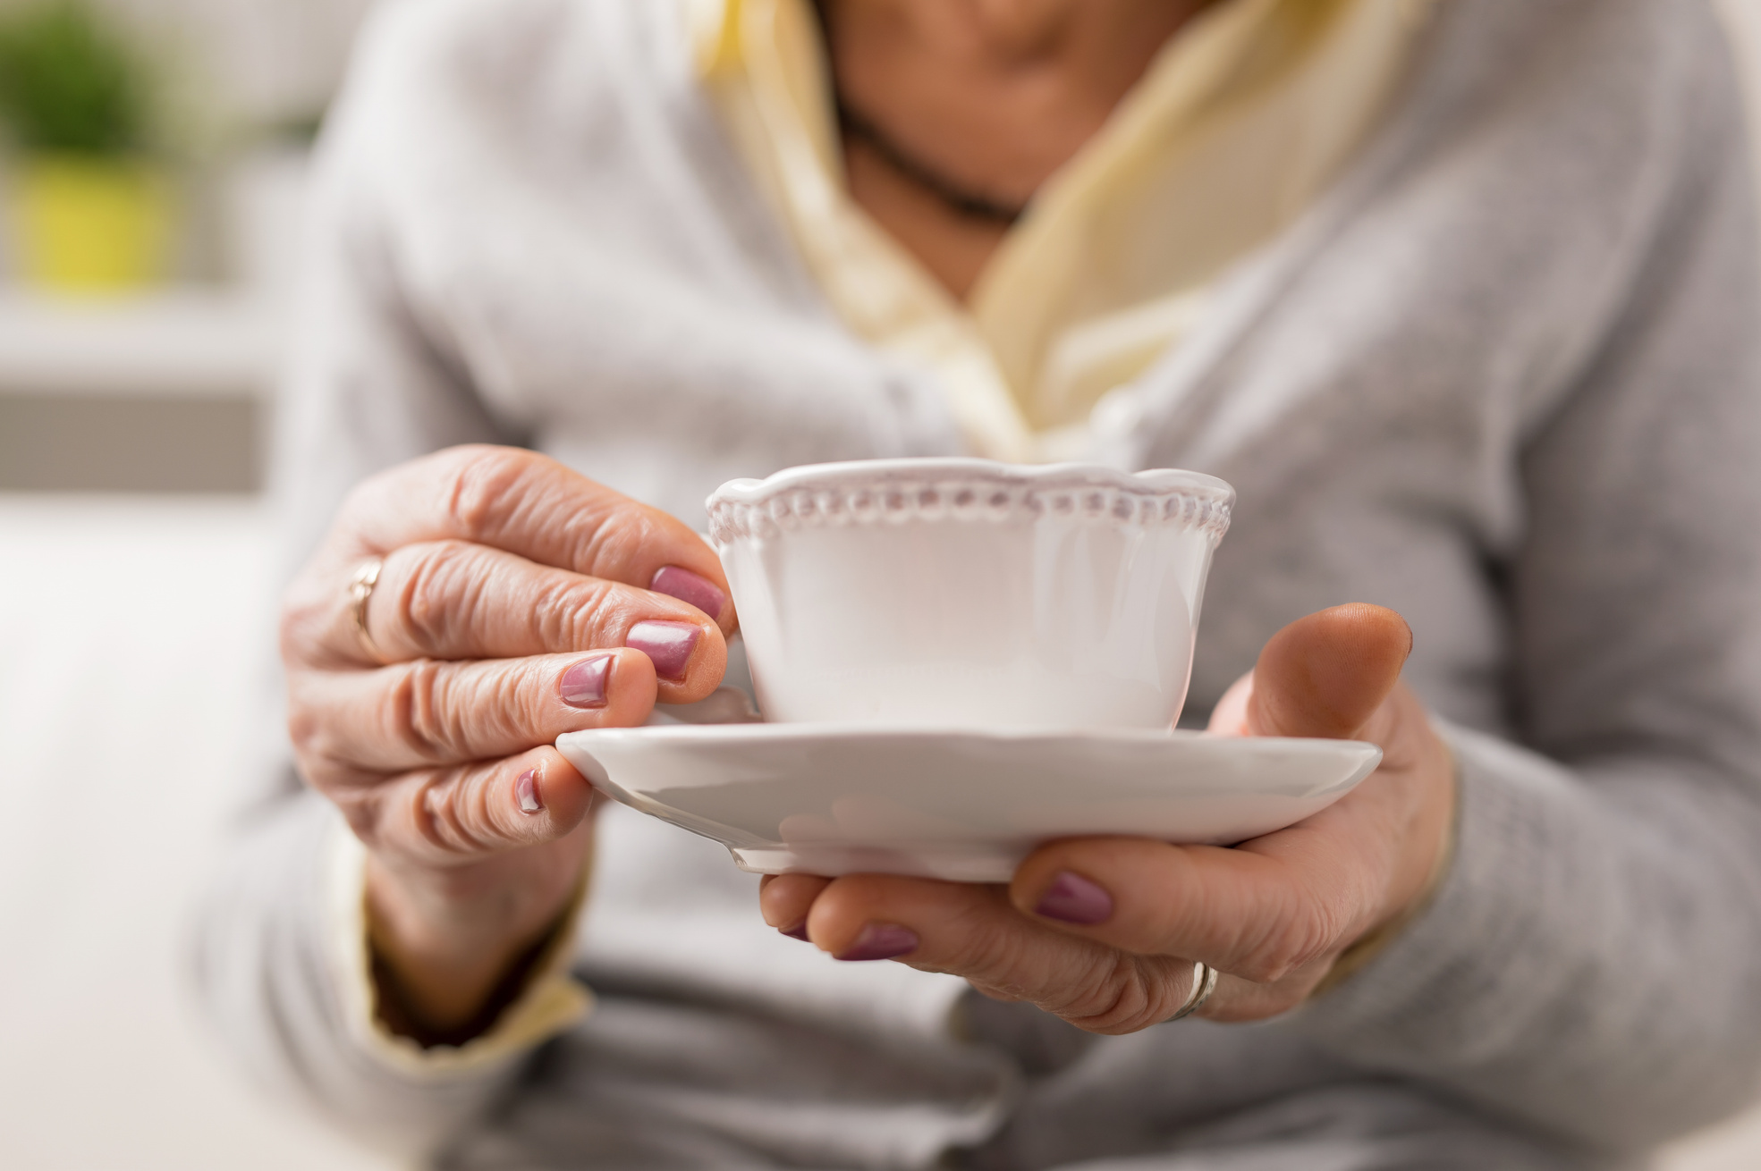
Confidence changes what becomes possible
One supported journey can unlock many more.
Cambridge
A familiar first trip
London
A theatre visit
King’s Lynn
Lunch with a friend
Cambridge South
A medical appointment
(Karen is my real neighbour. This is not Karen.)

Slide 9
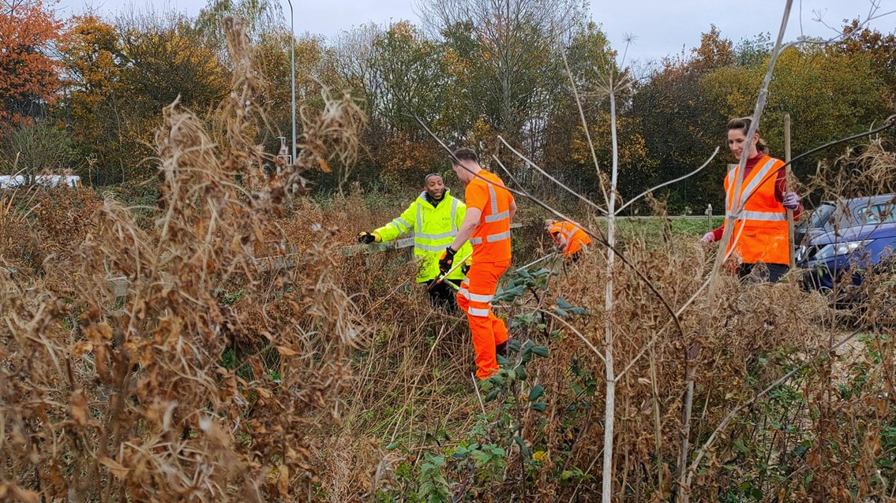
From Rails to Roots
Community activity can connect wellbeing, nature, volunteering and rail travel.
Safe, non-judgemental space
The community activity gives people somewhere welcoming to participate without pressure.
Nature and wellbeing
Gardening and spending time outdoors can support social contact and general wellbeing.
Rail staff volunteering
Volunteering days allow railway employees to contribute directly to the communities served by the railway.
Try the Train trips
Supported journeys can help people become more familiar with rail travel and build confidence to travel independently.
Community rail lives the framework every day.

Slide 10
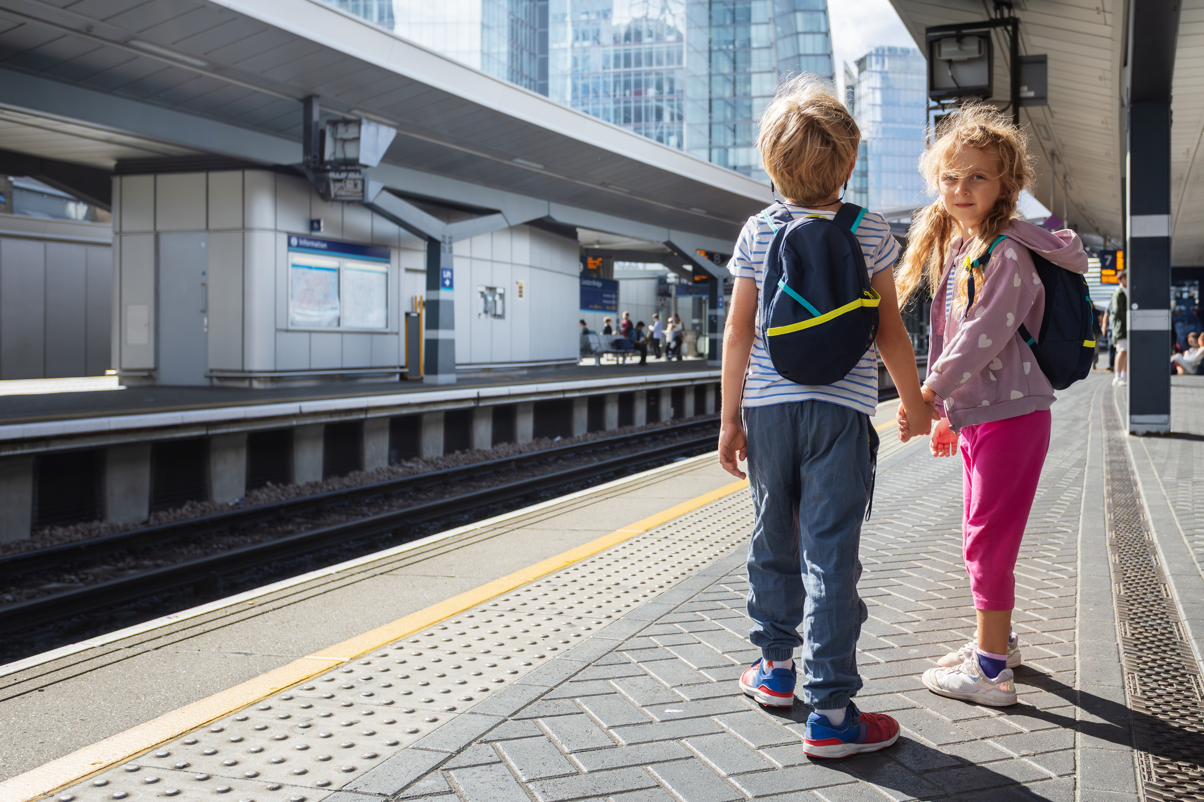
Keep doing.
Keep telling.
Keep capturing.
The railway isn’t just tracks and trains.
It’s people.

