Slide 1
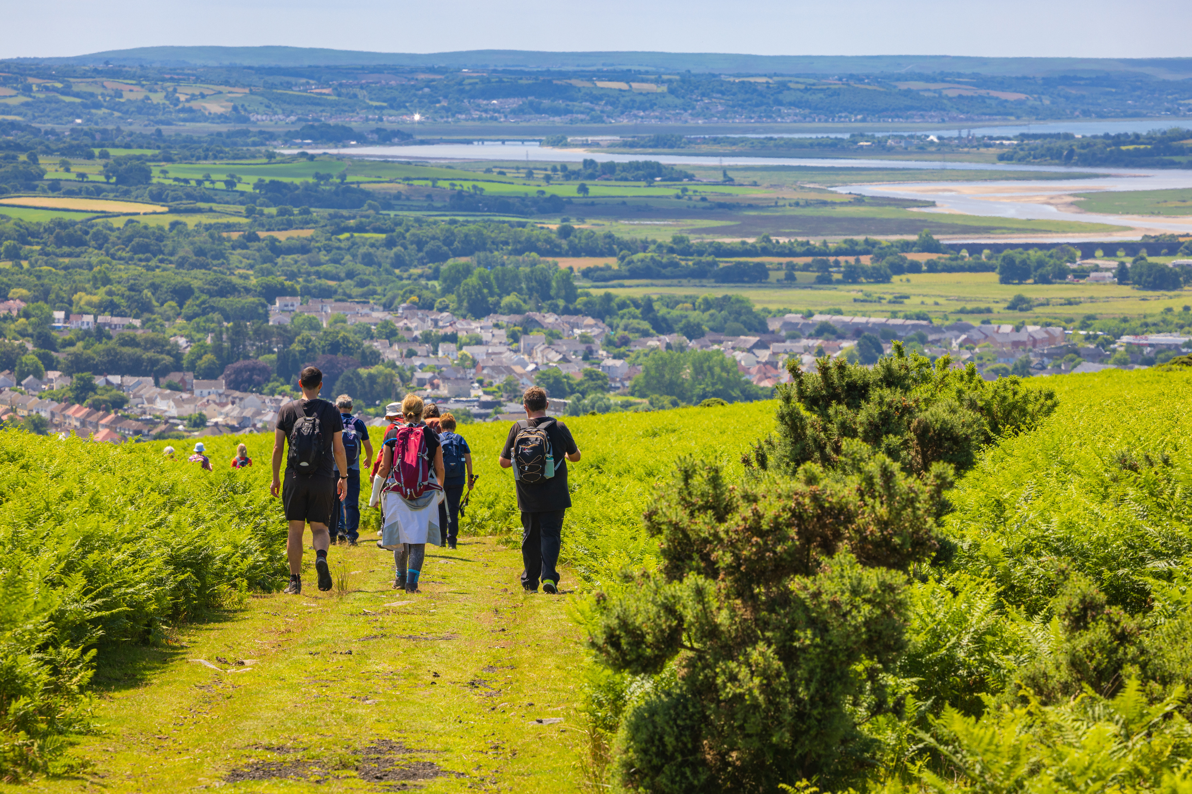





HEART OF WALES LINE TRAIL PASSPORT

Slide 2

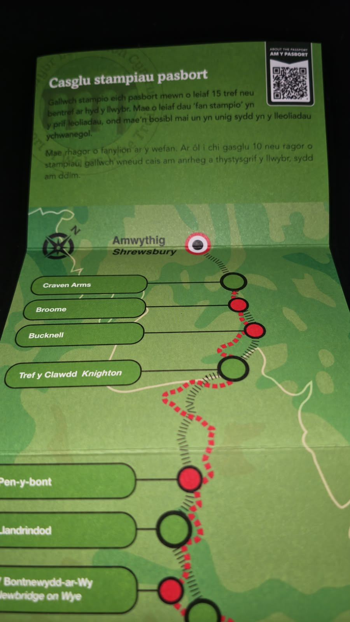
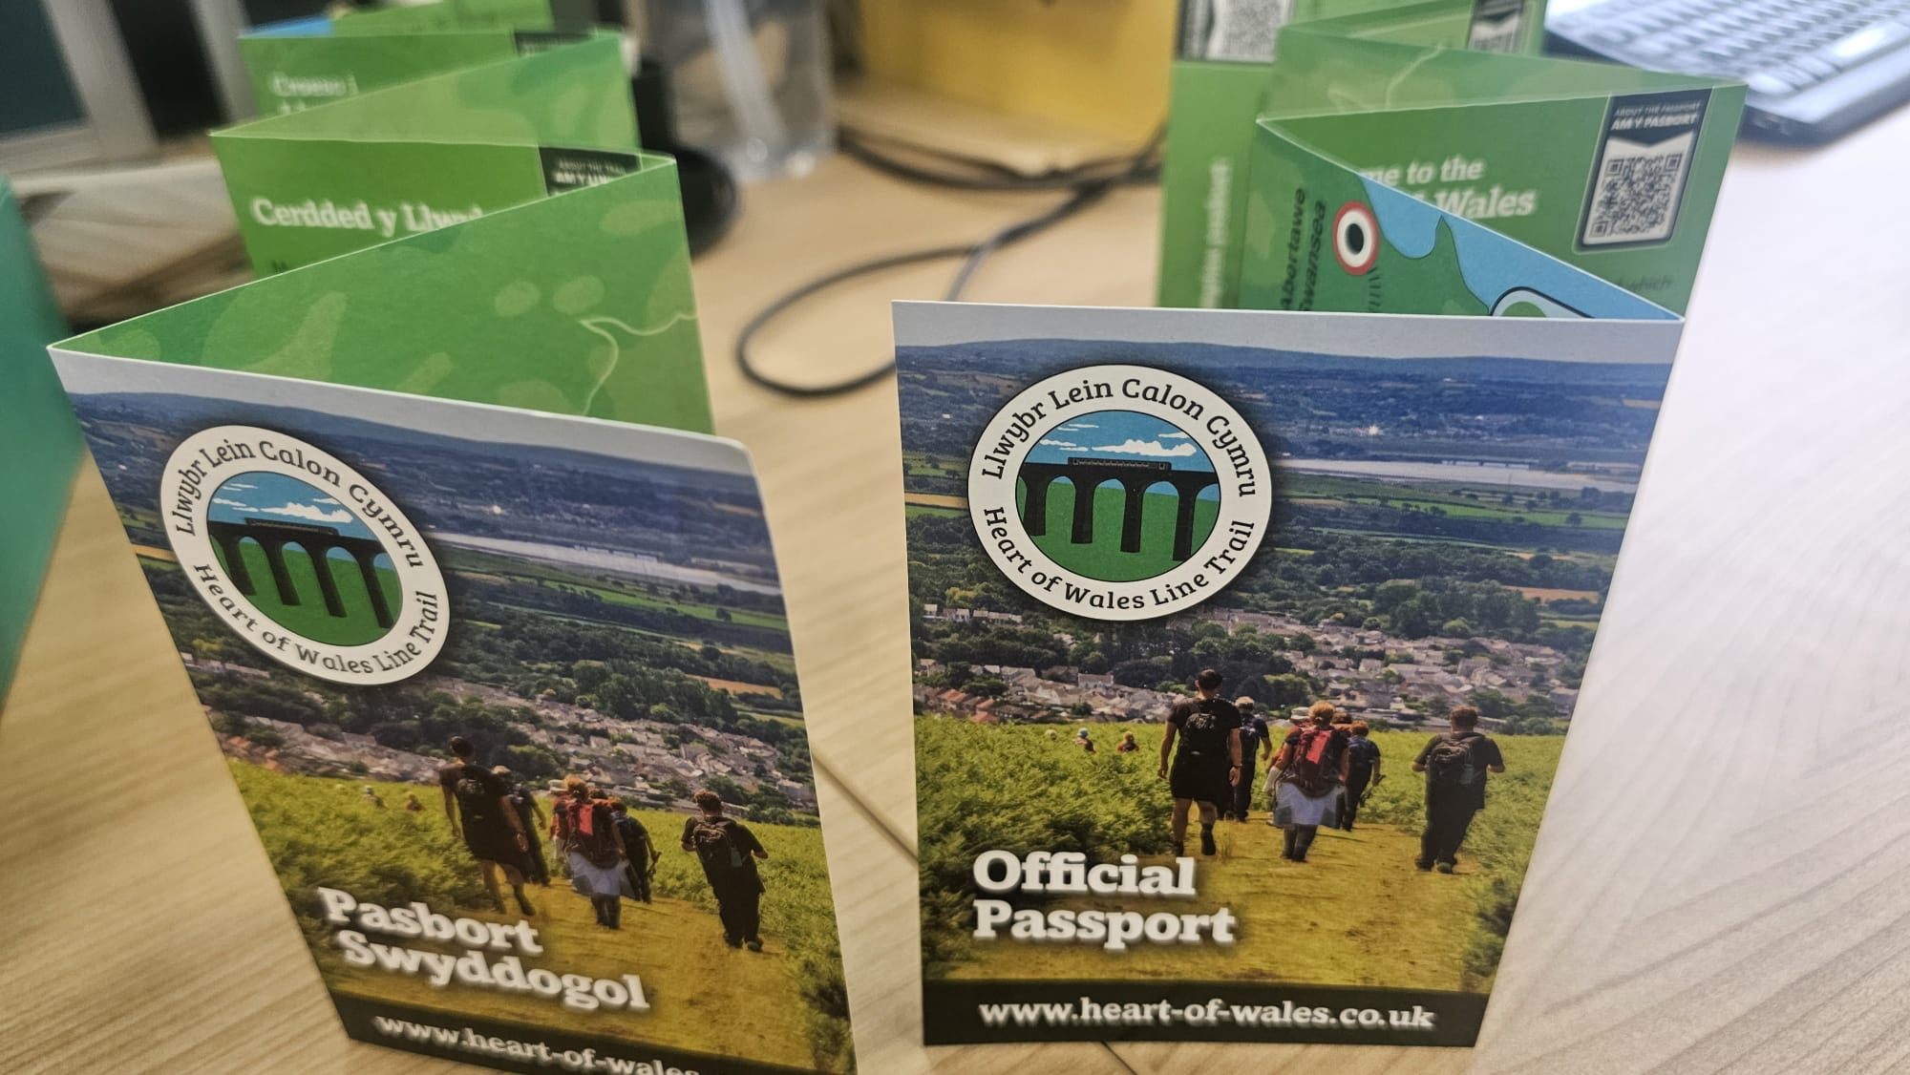
HEART OF WALES LINE PASSPORT
PHYSICAL PASSPORT
COLLECT STAMPS
GET PATCH

Slide 3
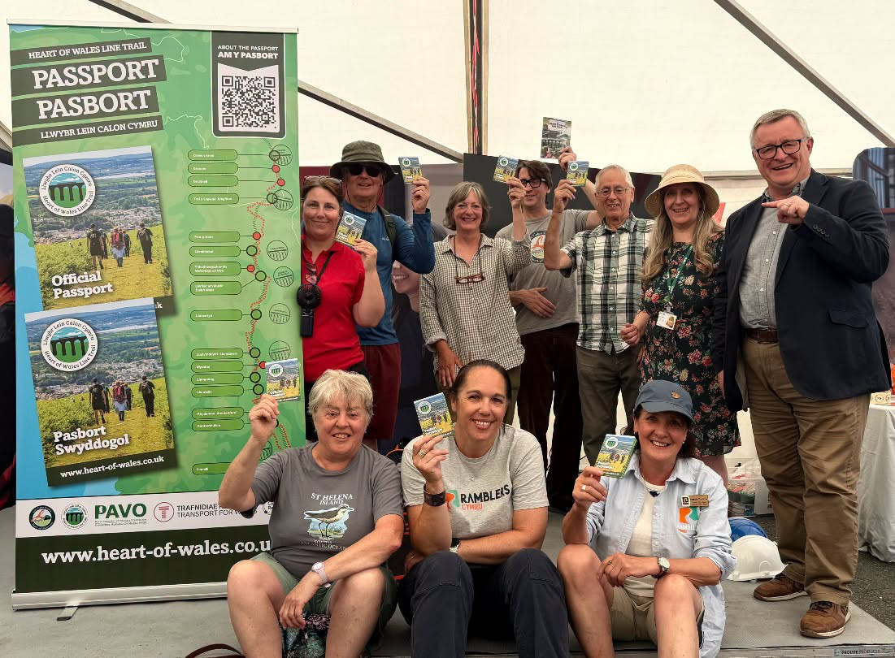
WHAT WE DID?
-DESIGN AND PRINT PASSPORTS
-STAMPING STOPS
-STAMPING PACKS CREATED
-PRESS RELEASE
-LAUNCH EVENT
-WEBSITE AND MAP

Slide 4
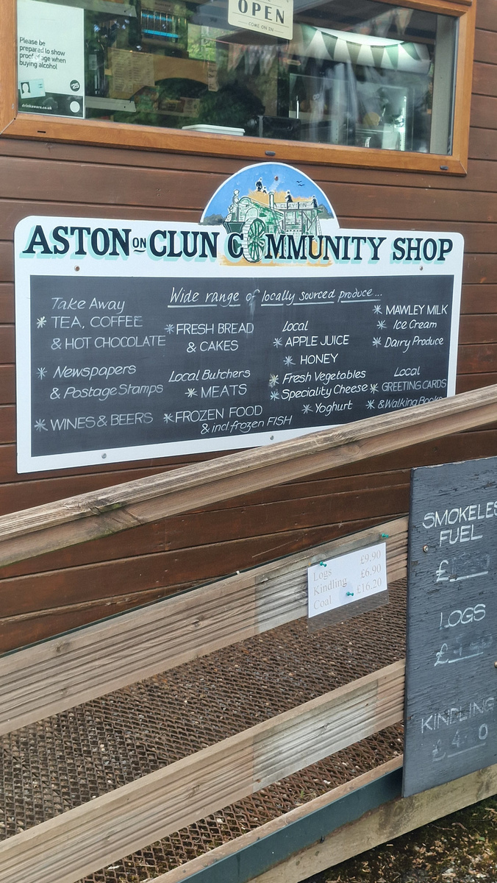
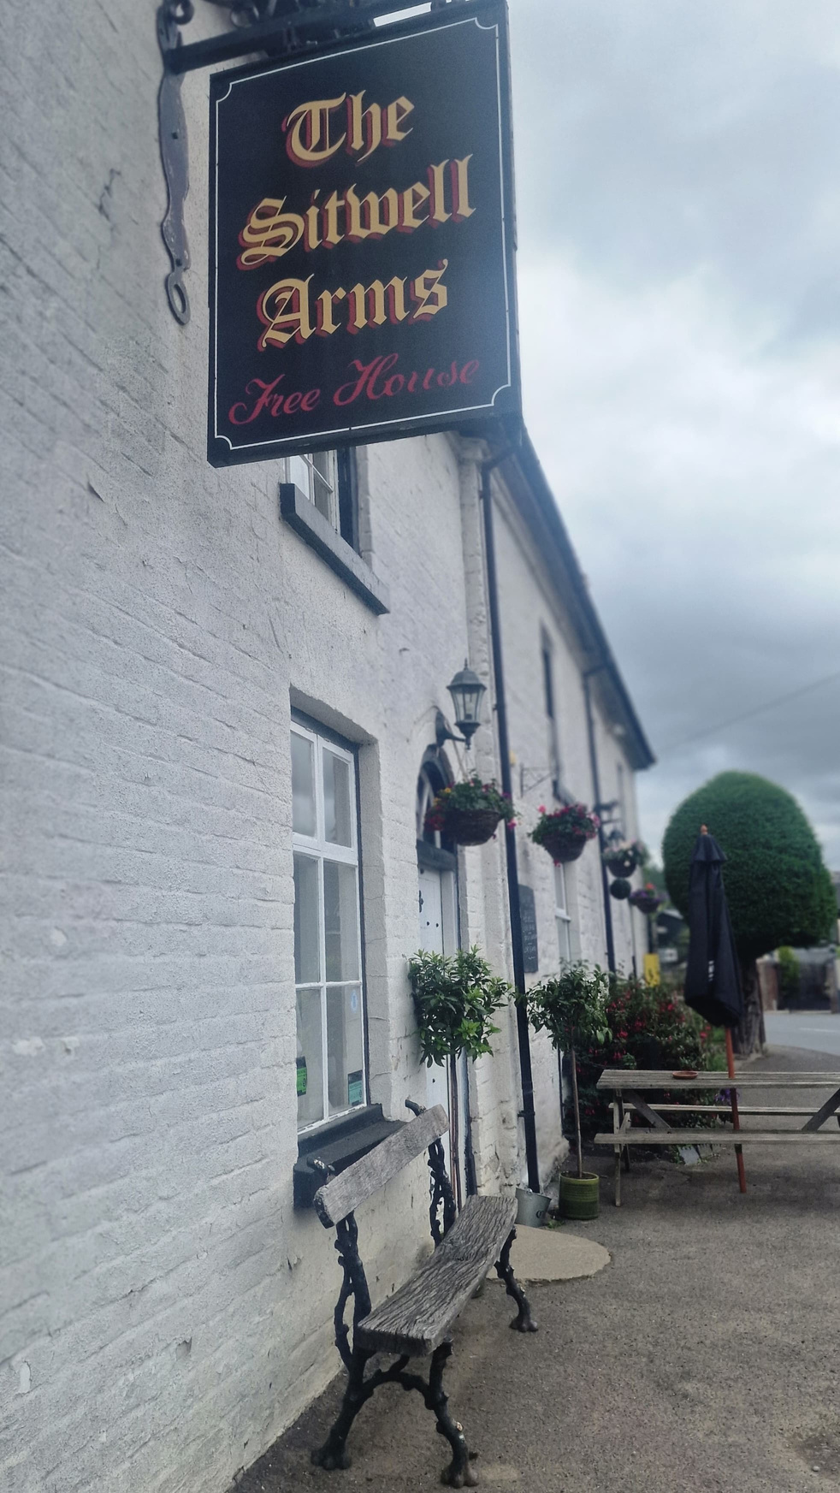
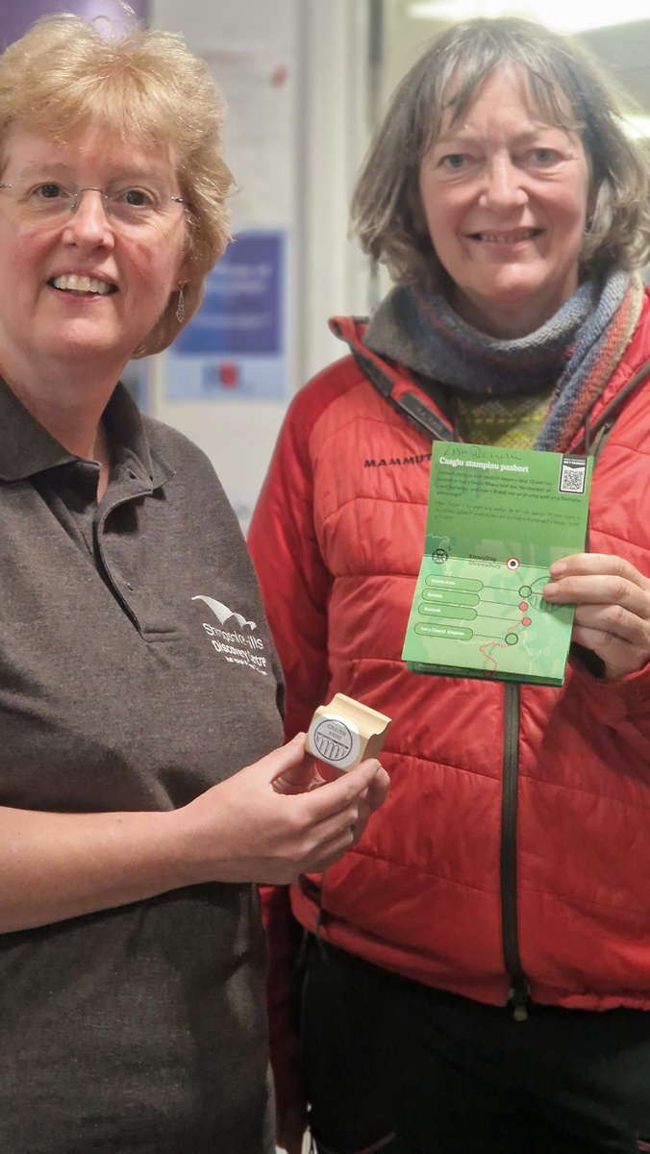
WHAT HAPPENED?
42 PASSPORTS SOLD
£420 RAISED FOR ‘FHWLT’
52,000 VIEWS ON SOCIAL MEDIA

Slide 5
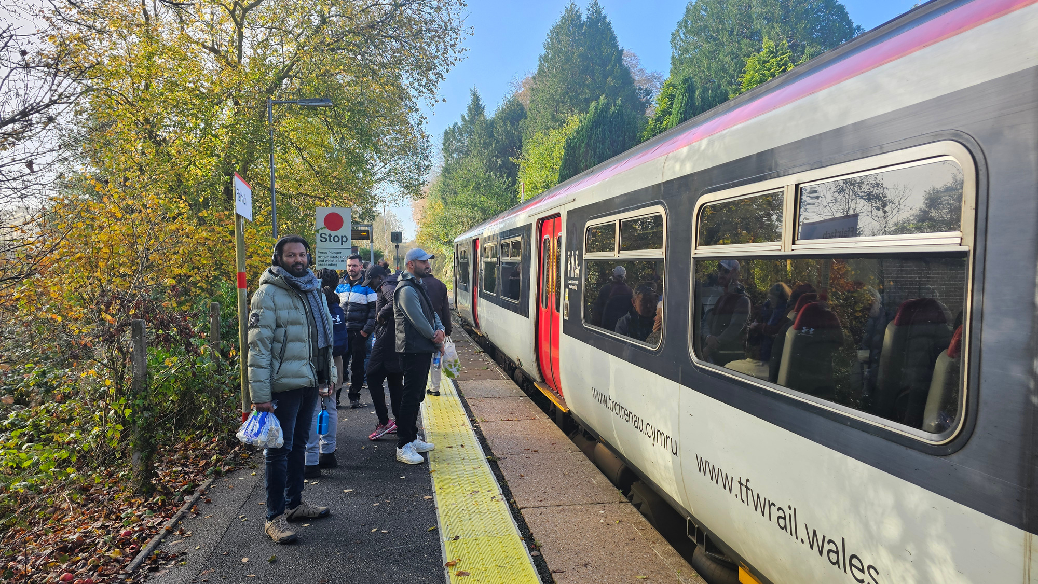
LEGACY
REPEAT JOURNEYS AND SUSTAINABLE TOURISM
NEW MEMBERS FOR FHWLT
NEW CONNECTIONS IN COMMUNITY
IMPROVED TRAIL

Slide 6
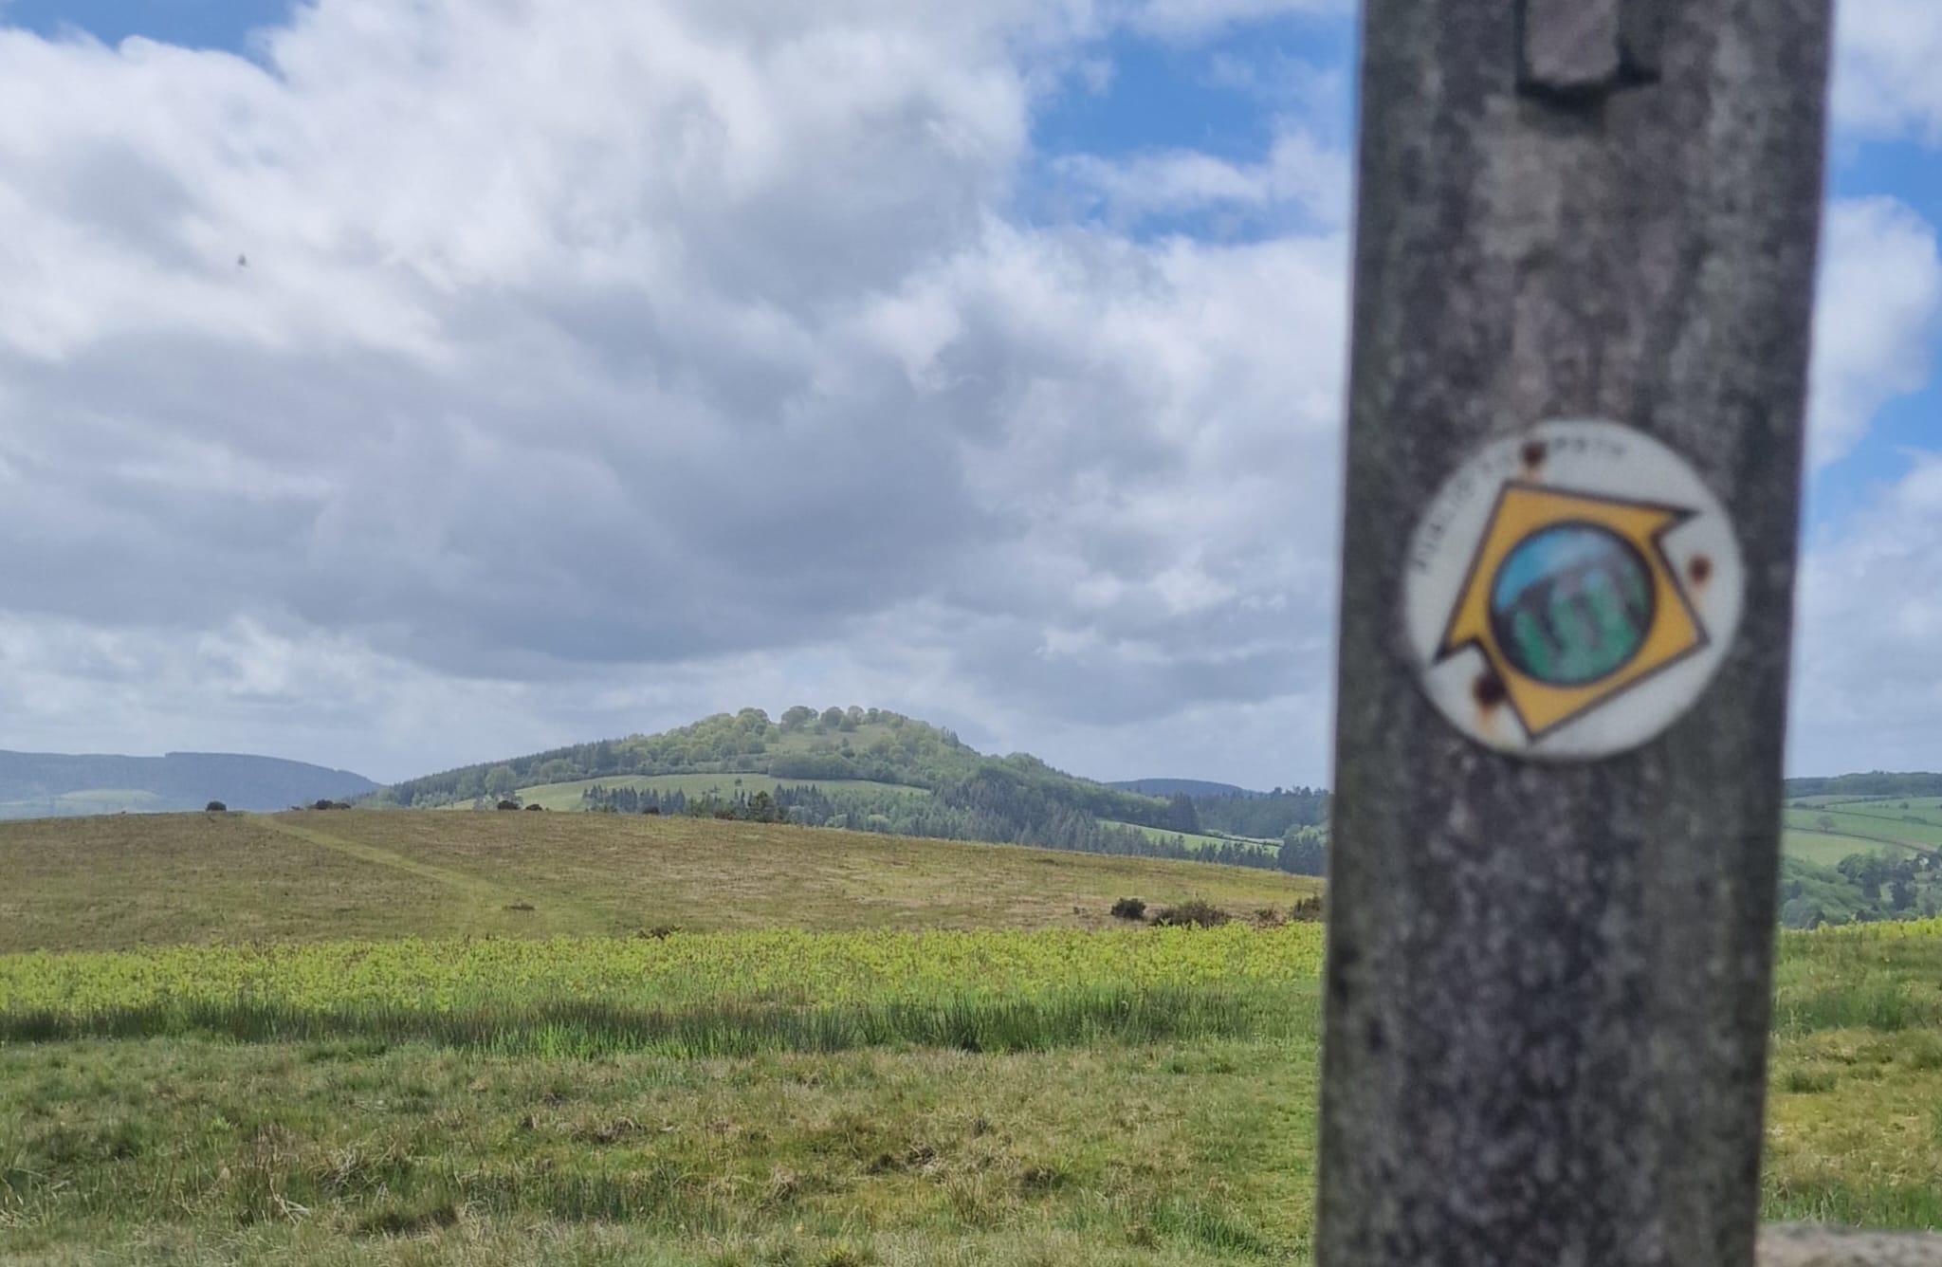

@heartwalesline
@heartwalestrail

