Slide 1
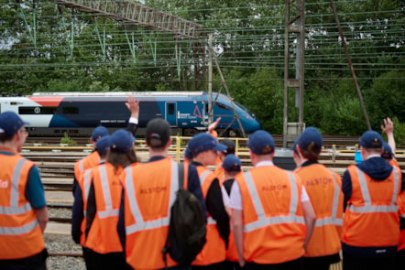
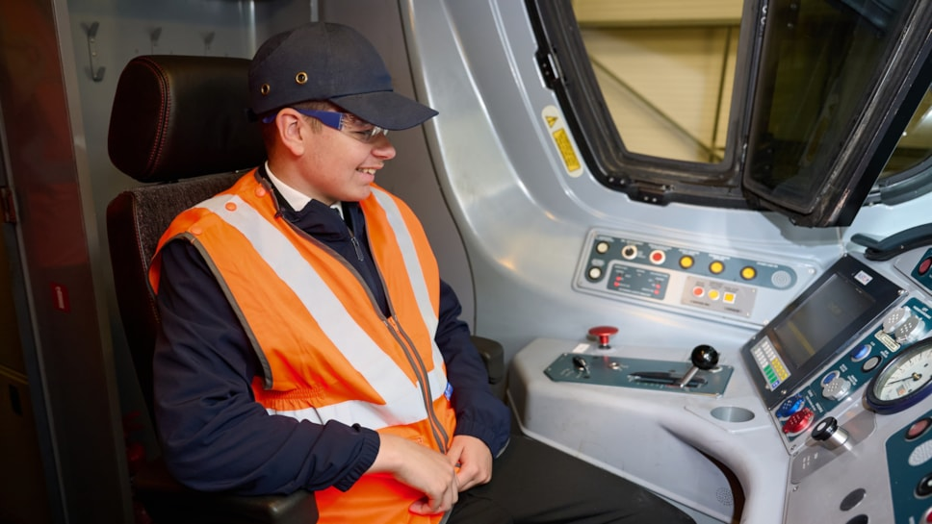
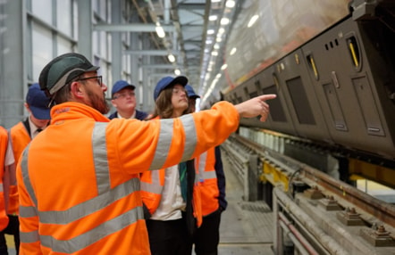
Feel Good Futures
Inspiring the next generation of railway professionals
Feel Good Futures provides local school students aged between 14 and 18 with unique learning opportunities that may otherwise be inaccessible to them.
Each trip is focused on highlighting the role of STEM in rail, as well as showcasing the diverse career opportunities available in the industry.
The program is funded by Avanti West Coast and delivered by Community Rail Lancashire.
Each trip involves return travel on an Avanti West Coast service, a Feel Good Future Booklet and pen.

Slide 2
Collaboration is Key
A partnership model that connects young people with real railway careers
Avanti West Coast
Provides funding and travel
Community Rail Partners
Helps provides the schools and program delivery
Feel Good Futures
Industry Partners
Network Rail, Alstom, London Transport Museum
Schools and Colleges
Teachers, students, career advisors

Slide 3
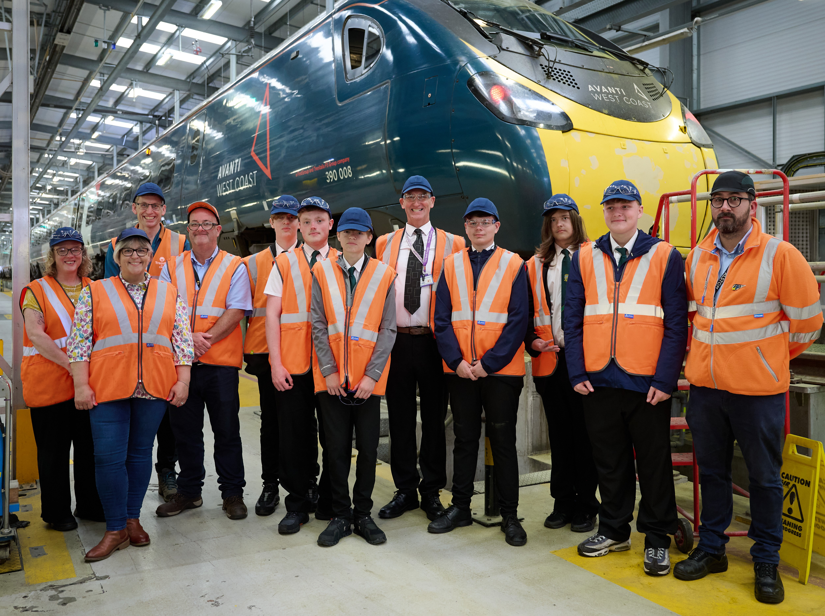
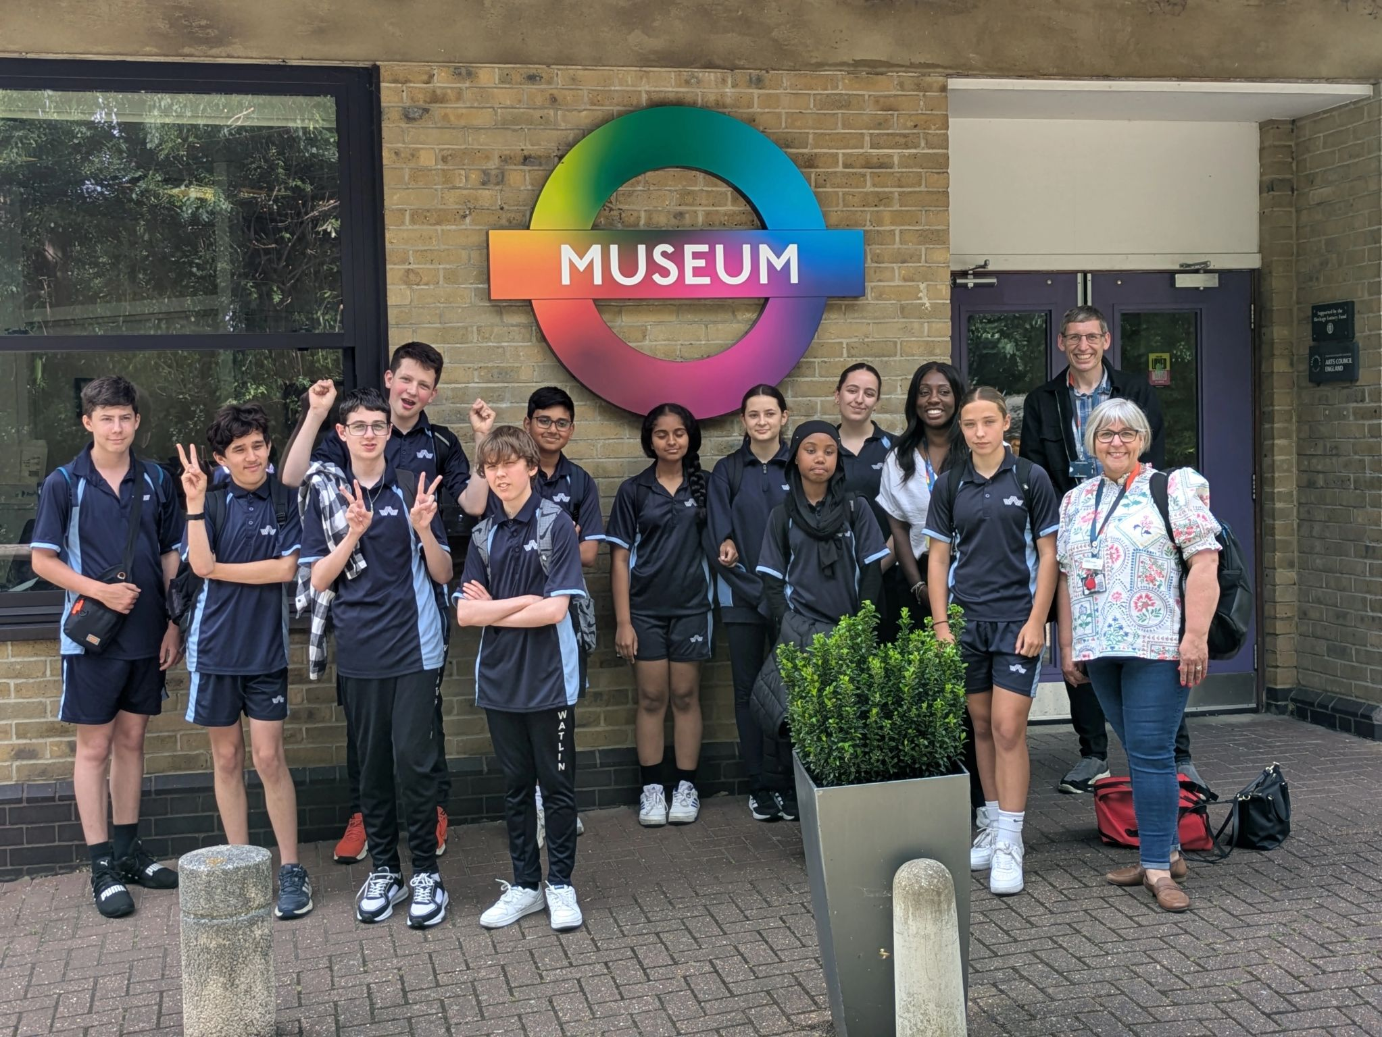
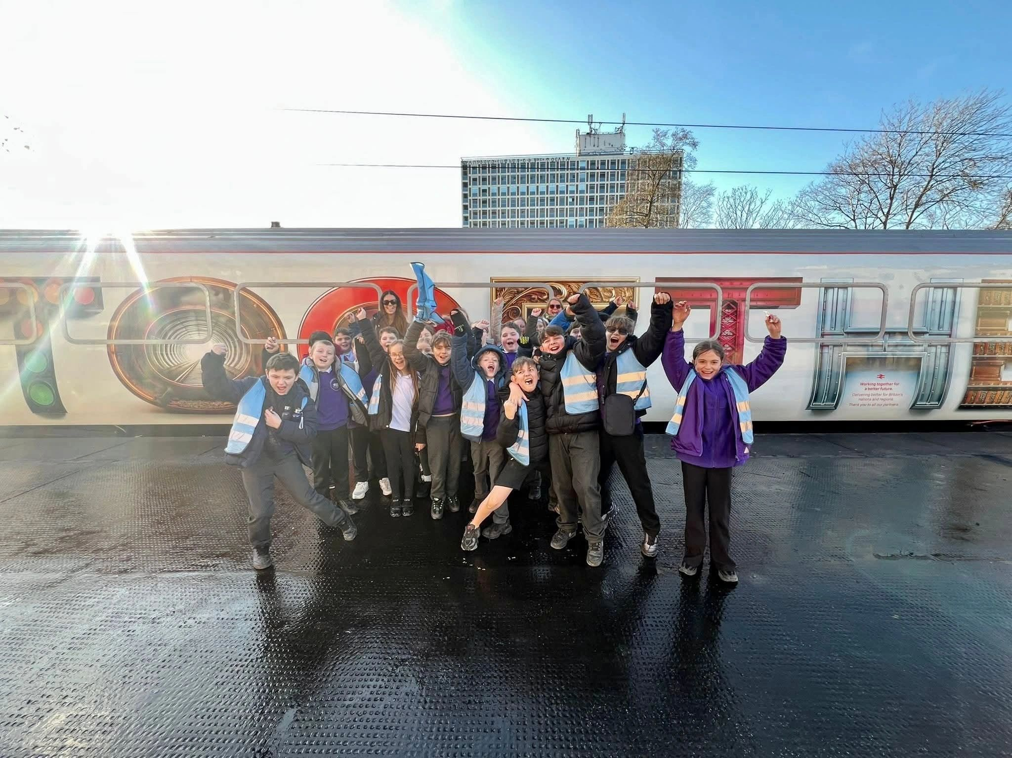
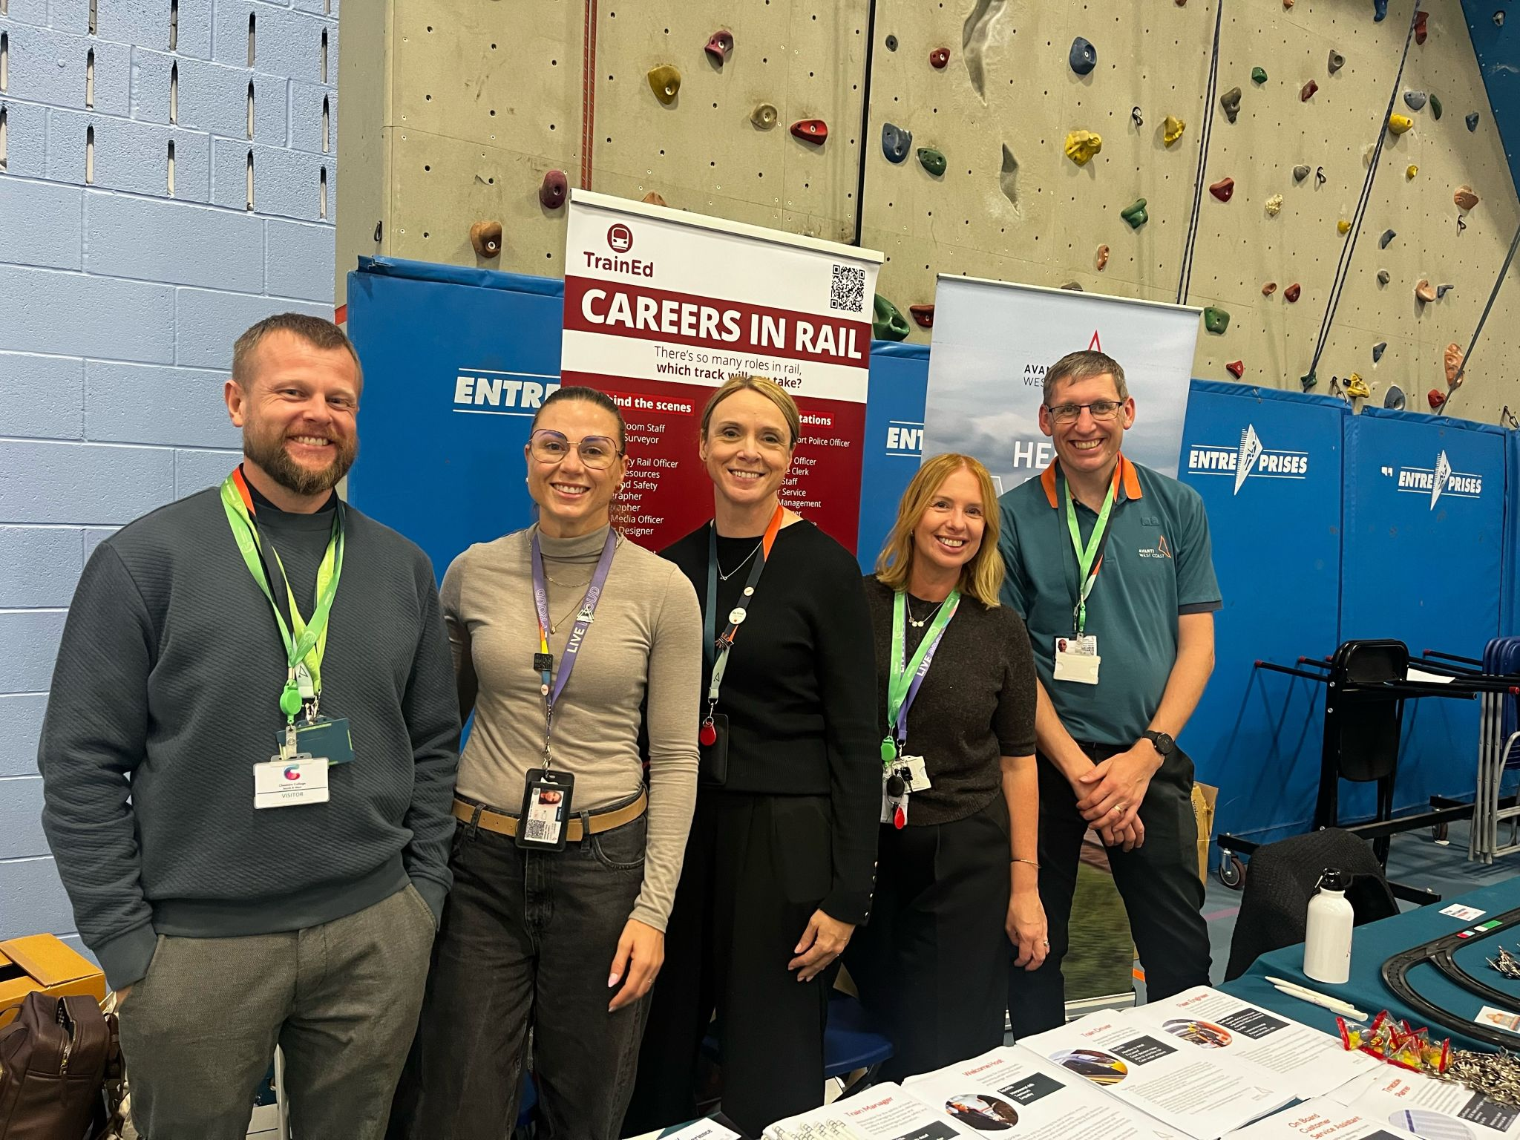
What we have done so far
1,100+ students directly reached
2,500+ students reached through careers fairs
Alstom
Polmadie, Glasgow
Edge Hill, Liverpool
Oxley, Wolverhampton
Wembley, London.
London Transport Museum
Inspire Engineering Days at Acton Depot.
Inspiration Train
School engagement at Crewe, London Euston, Edinburgh, Llandudno and Stockport.
Career Fairs
Crewe, Rugby, Coventry, Stafford and Manchester.

Slide 4
What students said
The impact: meeting people, seeing behind the scenes and trying things out
MEET PEOPLE
SEE BEHIND THE SCENES
HAVE A GO
“The interviewing part was the best because I learnt the most about the jobs there and it piqued my interest.”
“It opened my eyes to the railway industry. I could actually join this industry”
“It was amazing, I enjoyed going on the simulator and signalling trains.”
A TEACHER’S REFLECTION
“One child who can be challenging to say the least stated he wanted to go into coding on trains as a career.”

Slide 5
Successes and challenges
What’s working — and what we need to navigate
✓ WHAT’S WORKING
⚠ CHALLENGES
• Real workplaces
• Industry professionals
• Apprentices as role models
• Fully funded travel
• STEM + careers combined
• Strong industry partnerships
• Secondary school timetables
• Exams and curriculum pressures
• Supply-cover costs
• Finding suitable venues
• Operational restrictions
• Limited availability at specialist sites
05 / 06

Slide 6
What’s Next?
Building the next generation of railway talent
🚆 More industry visits
Longsight • Merseyrail Stadler • Hesk Bank Signal Box
🛠️ More STEM and engineering
London Transport Museum • Stemovators
🎓 More careers engagement
Continue attending careers fairs and showcase the wide range of roles within rail
🌍 More opportunities
Safeside Birmingham • Big Bang Fair 2027
👥 More diverse role models
Asquith Xavier • Women in STEM

