Slide 1

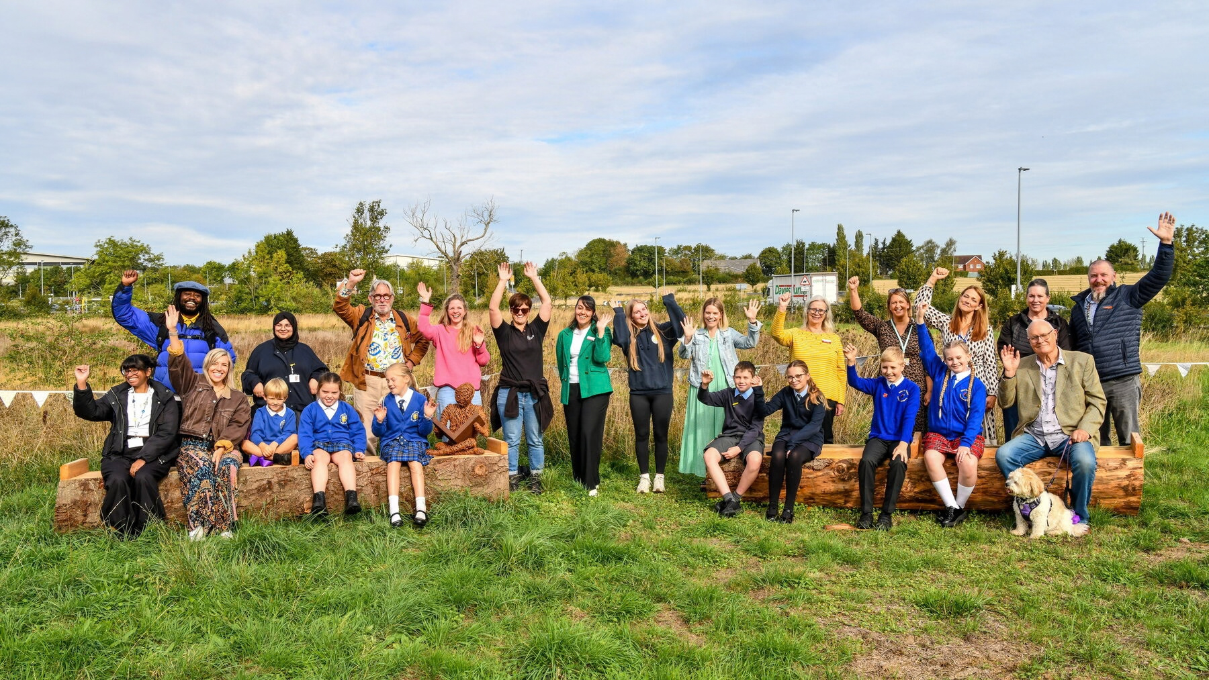
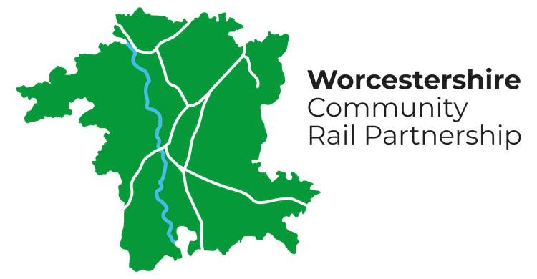
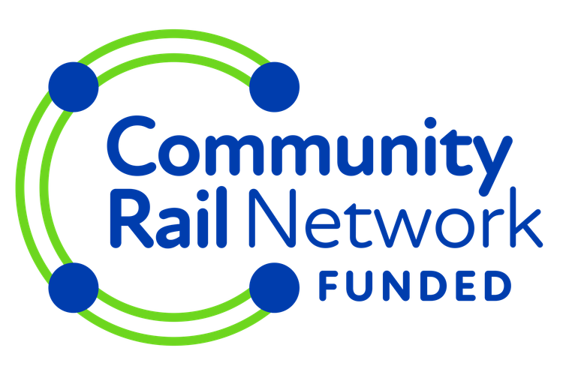



The Eco Area
Worcestershire Parkway
Notes:
Welcome — my name is Hayley, and I am the Senior CRP Officer for Worcestershire Community Rail Partnership. Hook the room: 'What if the land beside your station could become a nature reserve designed by local children?' That's what we've built at Worcestershire Parkway, in partnership with the Bee Friendly Trust. Worcestershire Parkway is a relatively new interchange station, and passenger numbers have far exceeded expectations. But as it got busier, something was missing: nowhere to sit outside, no sense of community, and no invitation to explore the land right next to the station. That's the story I want to take you through in the next six minutes — What began as overlooked land is becoming a place of wildlife, creativity, learning and community. The project shows what can happen when community rail looks beyond the platform and asks not just where people are going, but what kind of place they want to leave behind. 1

Slide 2
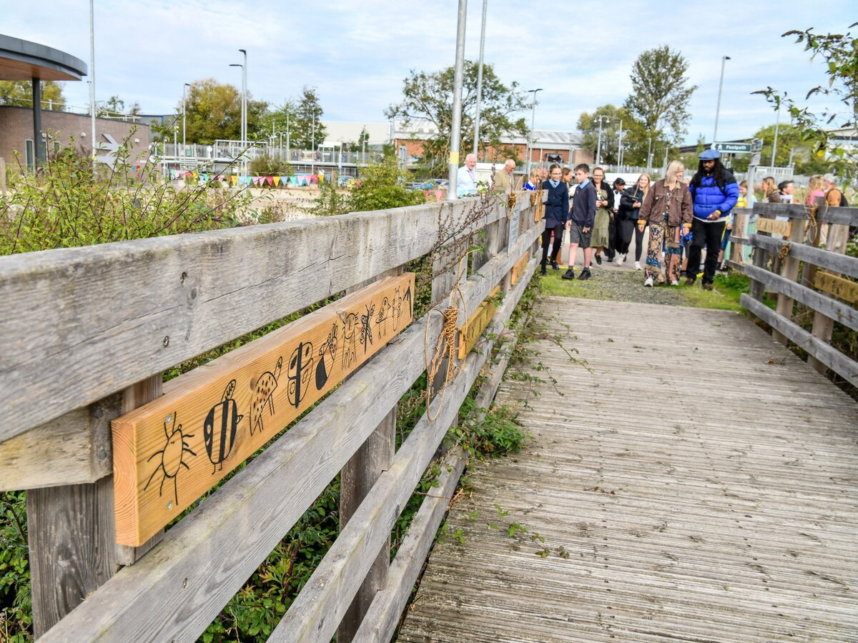
Why we started
1
An interchange, not a place
2
Land hiding in plain sight
3
A partnership forms
Worcestershire Community Rail Partnership — CRP Showcase
Notes:
Right next to the station sits land owned by Worcestershire County Council — it's crossed by a public right of way, it has a bat house, real biodiversity. But nothing at the station told you it was there. No signage, no obvious path, no invitation. Worcestershire Community Rail Partnership and the Bee Friendly Trust looked at that gap and saw an opportunity rather than a problem. Bee Friendly Trust became project manager and lead delivery partner, building on an earlier station project that had shown what the site could be. We managed the funding and brought together the railway, local authority and community relationships needed to make it happen.
2

Slide 3
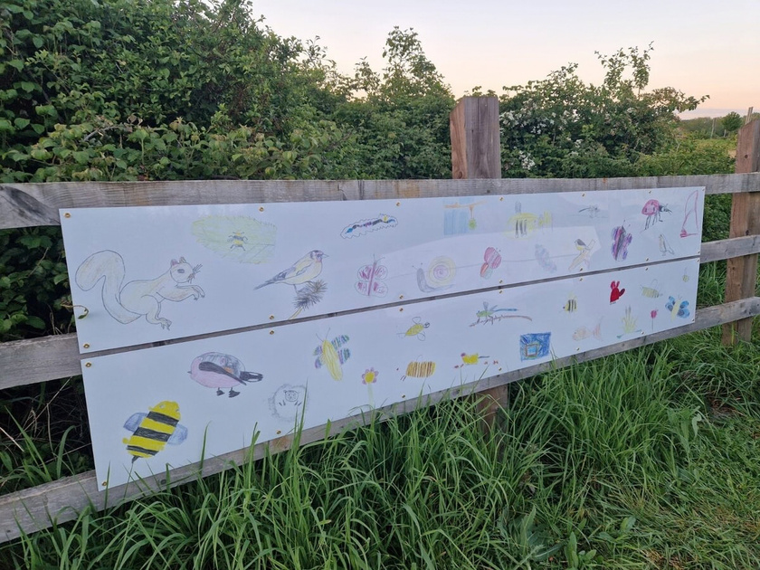
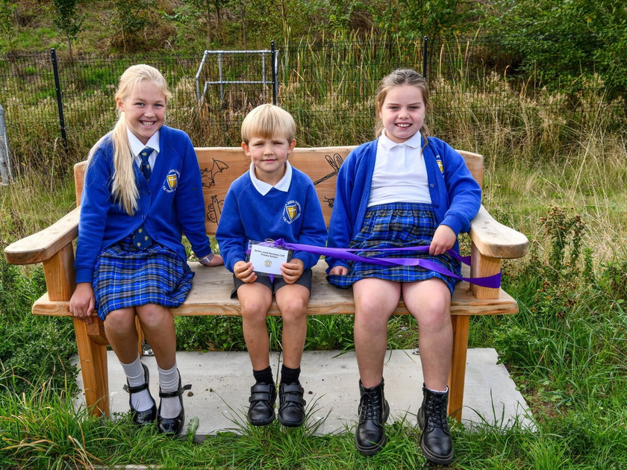
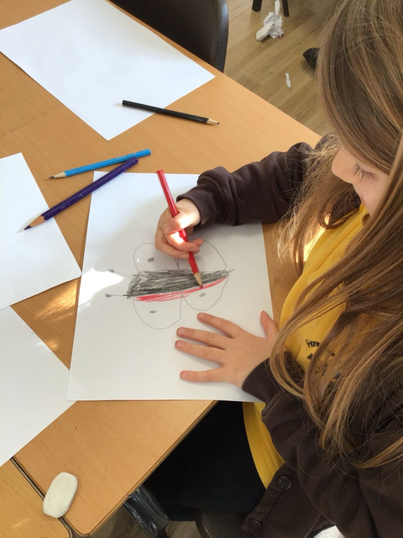
We asked the children first
100
pupils, 4 schools
4
wildlife workshops
Worcestershire Community Rail Partnership — CRP Showcase
Notes:
This is the heart of the project. We didn't commission an illustrator to design the site — we asked children what nature meant to them. Around 100 pupils from 4 local schools took part in 4 wildlife workshops. They talked about the creatures they'd seen, or hoped to see, and then chose which animals they wanted to draw. Nothing was redrawn or tidied up by an adult afterwards — what you see on this board is exactly what the children produced. That mattered to us, because the next step was making sure those drawings didn't stay on classroom paper.
3

Slide 4
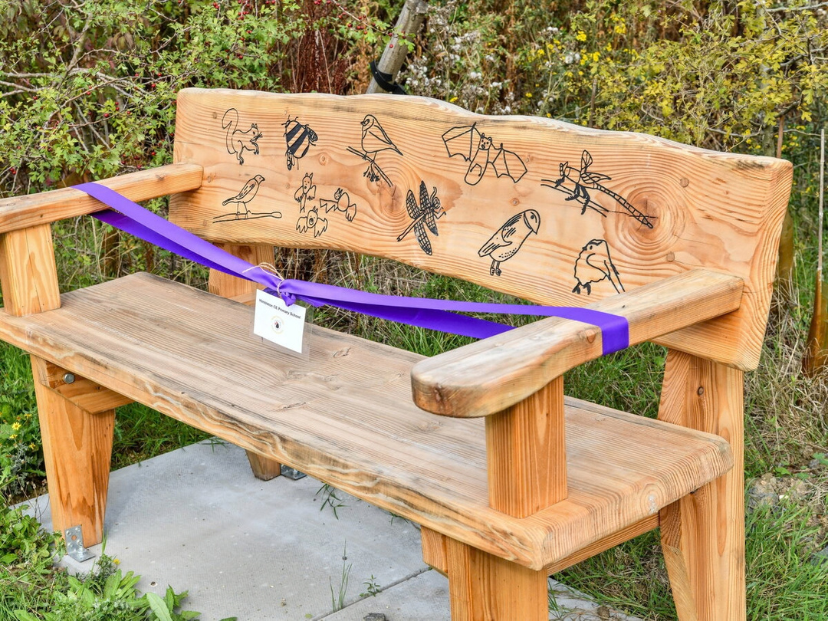
From paper to permanent
£32,000
Phase 1 funding
Benches · Footbridges · Signage · Outdoor classroom
Worcestershire Community Rail Partnership — CRP Showcase
Notes:
The drawings were pyrographed — burned — into solid wood, so they'd last. We now have four solid-wood benches, four updated information boards, a finger sign, footbridges and interpretation boards carrying children's artwork, willow-woven wildlife, and natural log seating forming an outdoor classroom. Men's Shed has designed and will build the classroom's chalkboard and storage. Phase 1 was made possible by £32,000 of funding from Community Rail Network, CrossCountry, GWR and Worcestershire Community Rail Partnership, with Network Rail, Worcestershire Wildlife and the County Council giving time and expertise alongside it. This is a genuine partnership project — no single organisation could have delivered this alone.

Slide 5
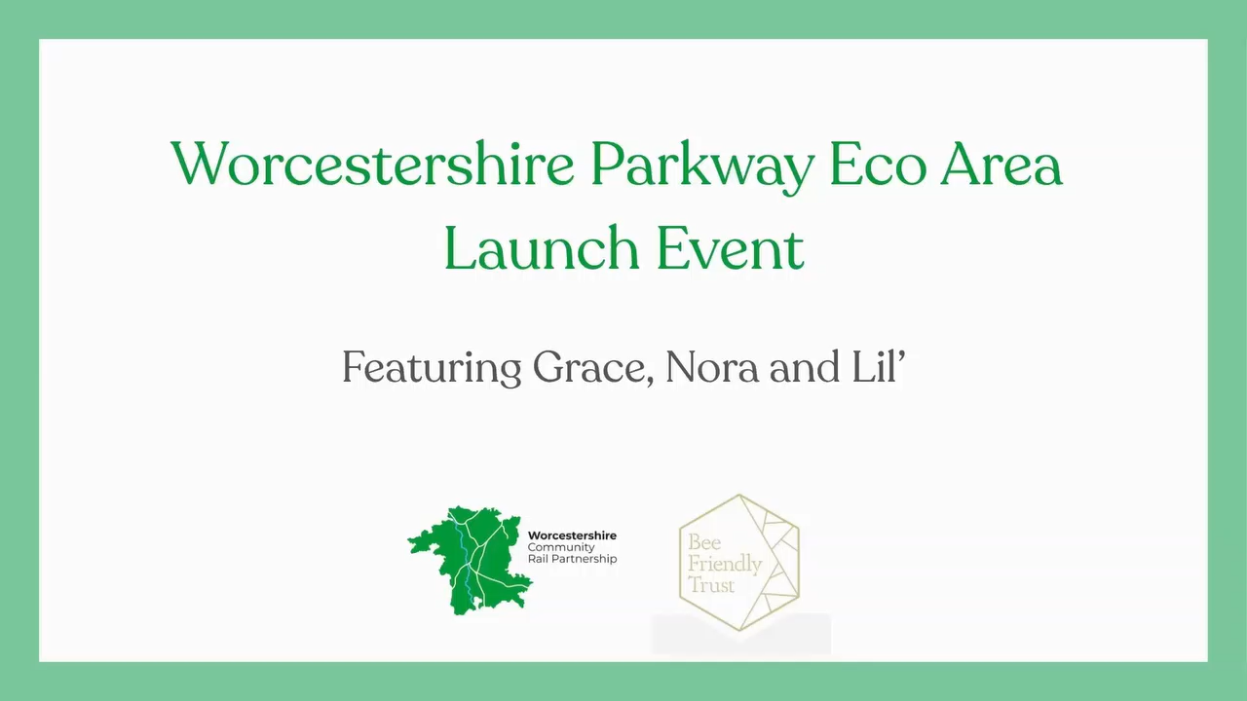
Notes:
On 24 September, three of our four schools came back to the site — eight pupils, six teachers, plus partners and stakeholders, and together they cut the ribbon. For the children, this wasn't someone else's project. They were standing at a working railway station, looking at their own ideas made permanent. They told us they were proud to see their drawings there, and that being in nature made them happy — those two lines are exactly why we did this. Teachers were just as enthusiastic, and are already planning to bring classes back for outdoor lessons and art.

Slide 6
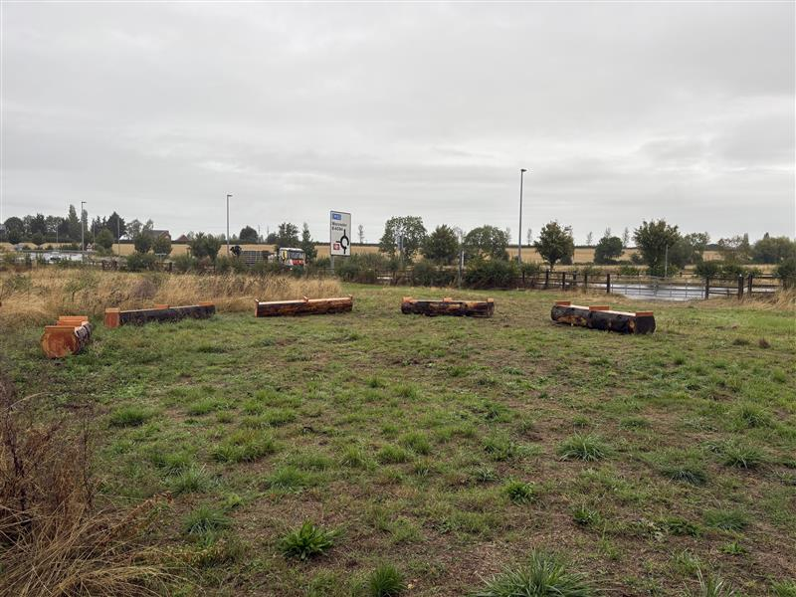
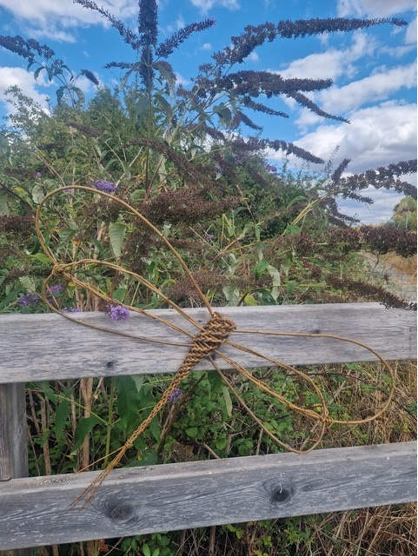
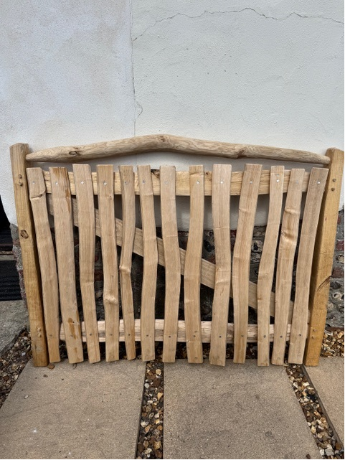
What's next
Trees · Hedgerows · Willow · Insect sculptures . Bug hotel . Chalkboard . Interactive artwork
Thank you — questions welcome.
Notes:
Phase 2 is already planned: tree, hedgerow and willow planting, plus interactive art sculptures with homes for insects built in. Worcestershire County Council owns and maintains the land, so this has secure, long-term care. The space is open to schools, community groups, passengers, the public, and other community rail partnerships who want to have a destination at the station. We are excited to continue to develop this space, with the community at its heart. Thank you for listening.

