Slide 1


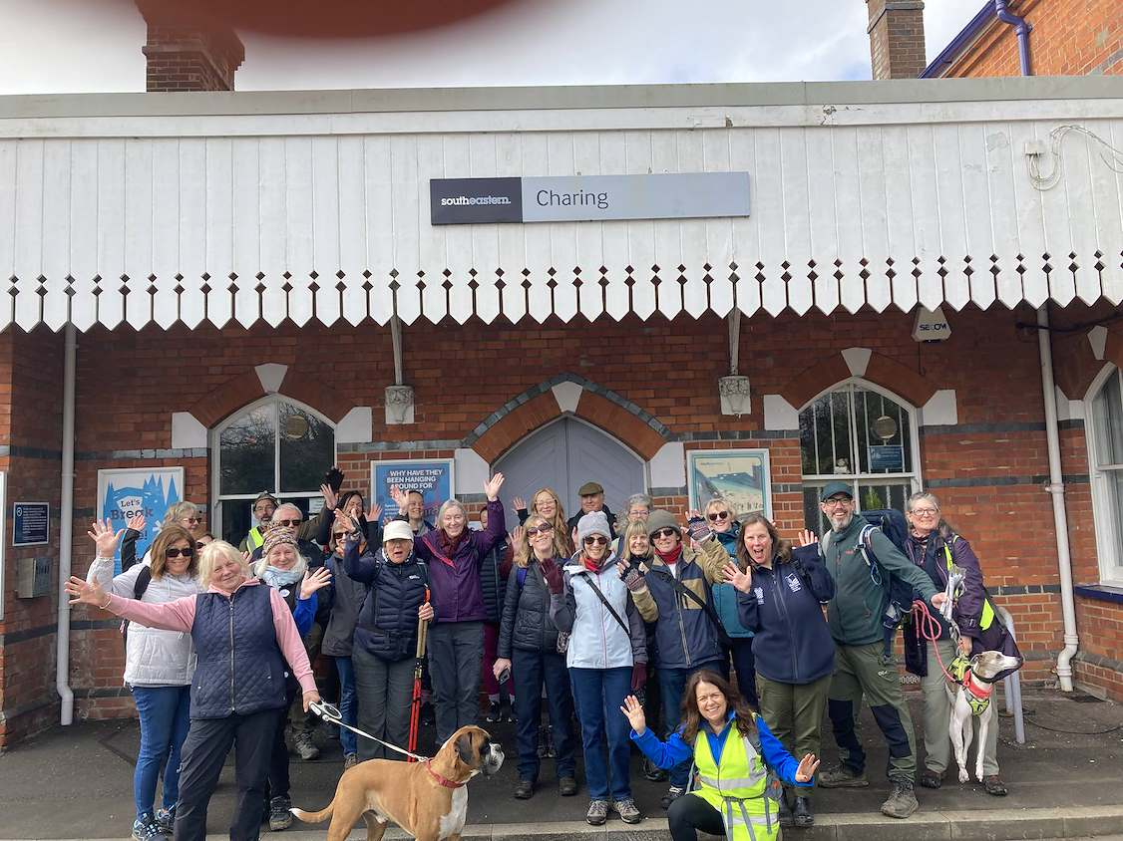
Delivering Successful Large Group
Rail to Trail Guided Walks
Thérèse Hammond
Project Officer Kent CRP
CRN Walks and Trails skill share
Sept 2026
Charing Station
Walk open to the public

Slide 2
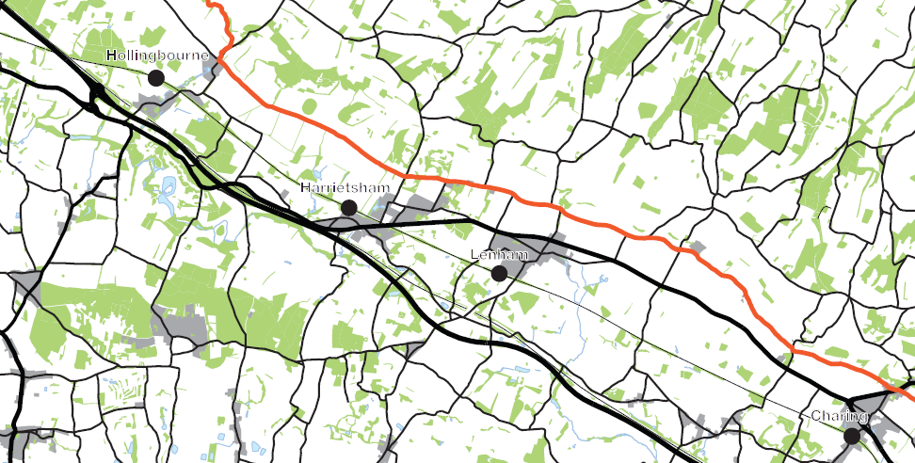
Rail to Trail – Kent CRP
Background to chosen routes
There are 4 stations along the Kent Downs Line which have easy access to the North Downs Way (NDW) and so this is where I concentrate my rail to trail walks – between Charing, Lenham, Harrietsham and Hollingbourne
Aims and Objectives
Provide ‘taster’ guided walks along the NDW trail for those who may be unfamiliar with it
Promote sustainable travel and active lifestyles to local and geographically distant communities
Increase accessibility by connecting people with rail, walking and local destinations
Increase sustainable tourism within the area all year around promoting inclusion and diversity
Map of the 4 stations
showing their proximity to the
North Downs Way (marked in orange)

Slide 3
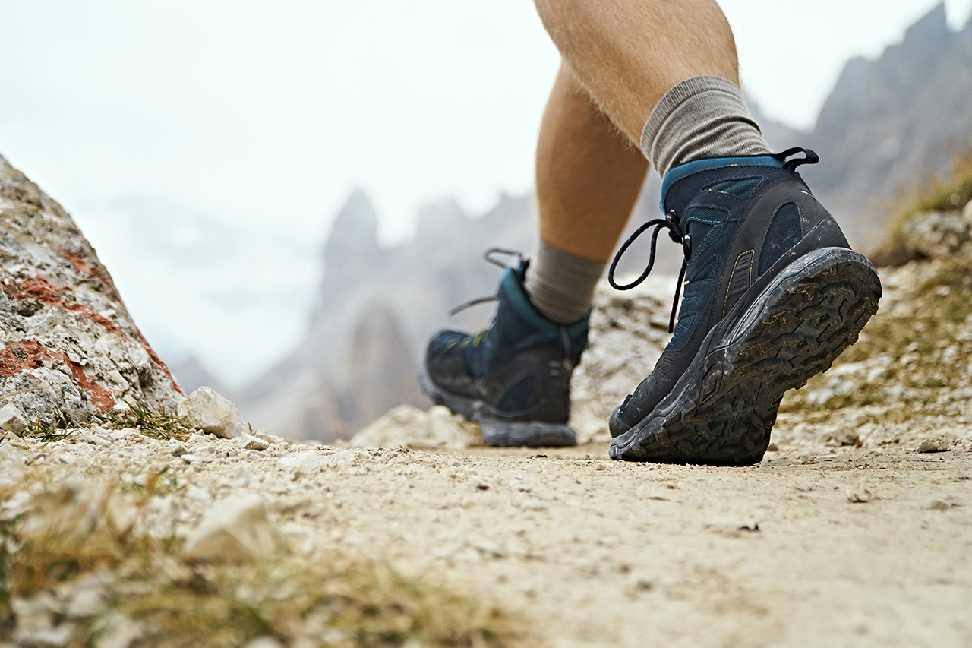
Rail to Trail – Planning for Success
Arrange an advance booking system e.g., Eventbrite or Beyonk
Clear participant communication
Communication on the day e.g., swap phone numbers or set up a specific WhatApp group for the event
Route risk assessment
Recruit walk assistants
Consider the different walking paces of the participants
Promotion of the event – this should be carefully considered as it can make or break an event
Emails to members and those on your data base
Social media channels
Partner networks and other community groups channels
Local press
Station notice boards

Slide 4
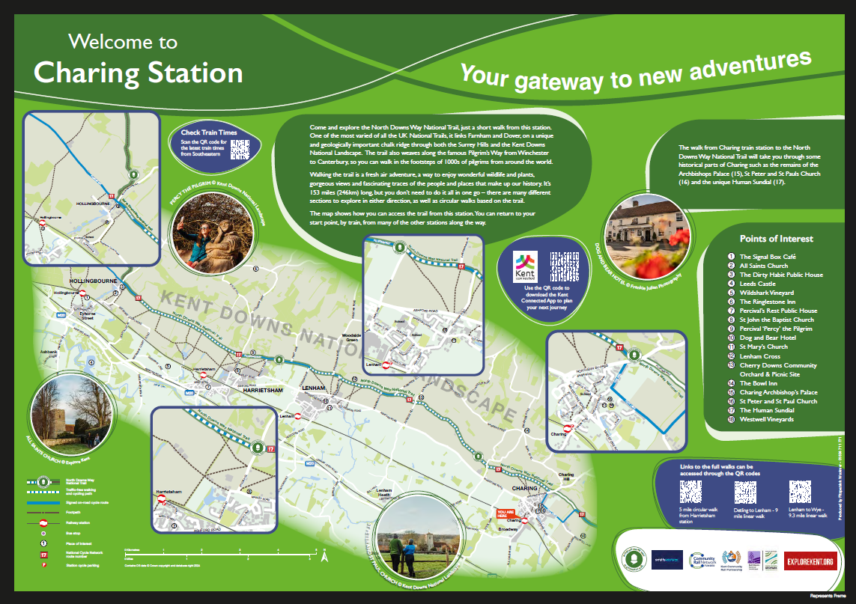
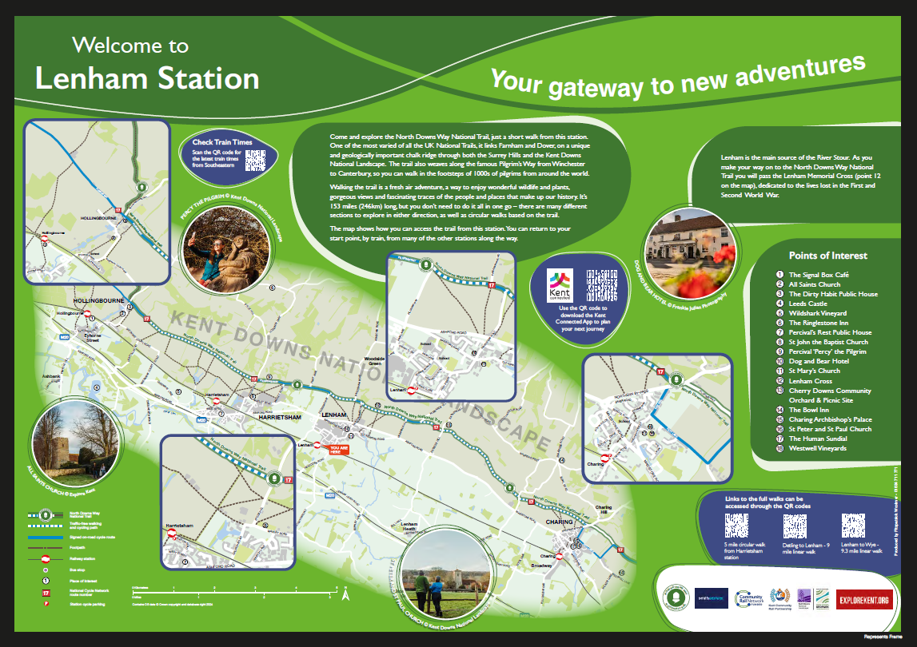
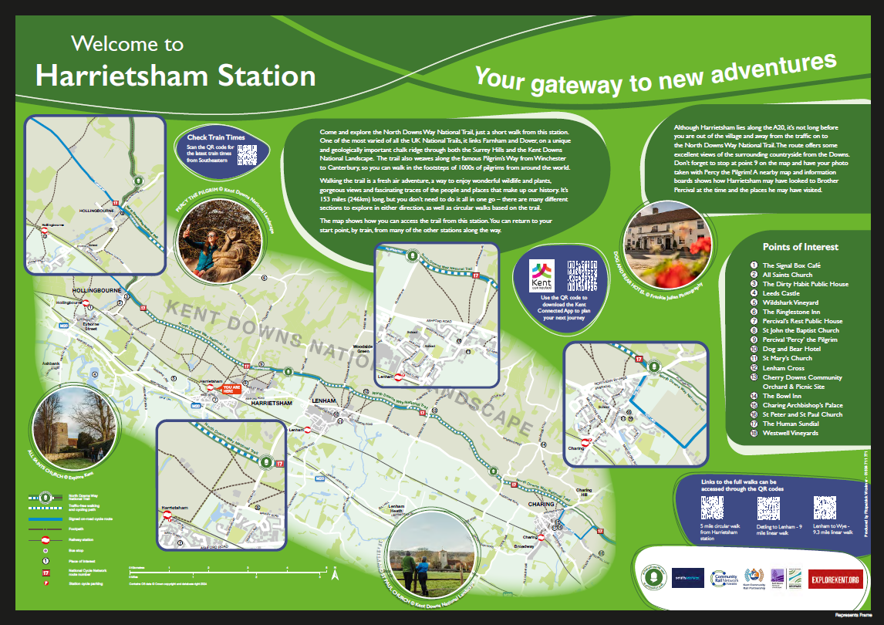

Rail to Trail – Working in Partnership
Establish partnerships with local organisations who have the same or similar aims e.g., to extend the summer season of walking to all year long or making the area more accessible and inclusive etc.
I regularly work in partnership with NDW National Trail, Kent Downs National Landscape, Explore Kent and Visit Maidstone
These highly successful partnerships have provided over the years – funding for officer's time to plan and deliver the walks, promotion of the walks via numerous social media channels and walk assistants - often qualified NDW Ambassadors
Partnerships can also provide credibility, additional resources and reach a wider demographic
In partnership Kent CRP produced the station map boards below now installed at each of the 4 stations promoting the route/s along the NDW
4 Station Map Boards Funded by CRN

Slide 5
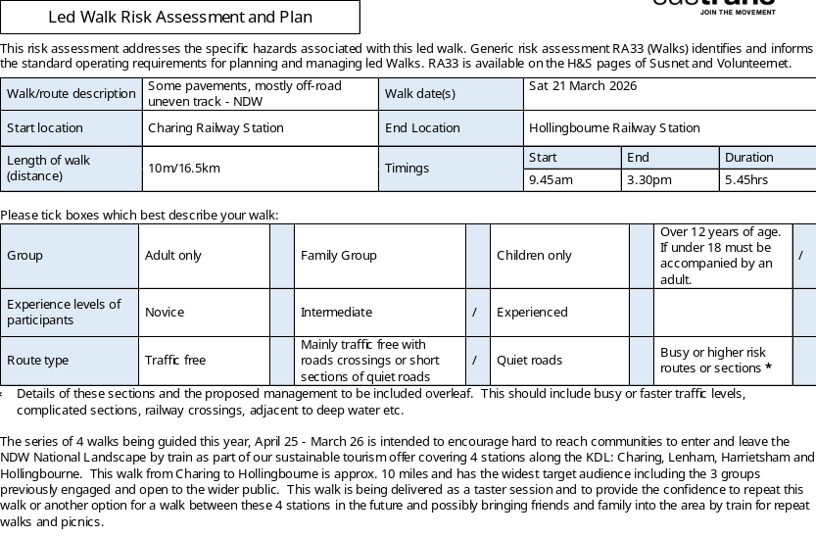
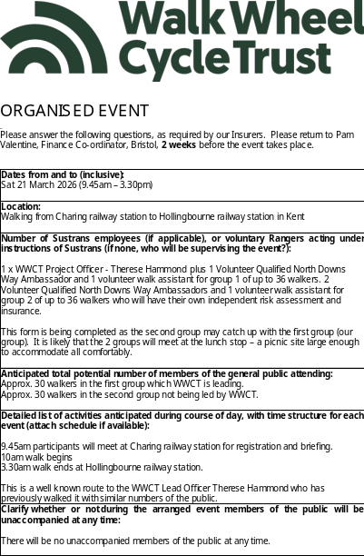

Rail to Trail - Risk Assessment and Permission Forms
Complete the risk assessment walk - preferably with your walk assistants, practice ‘what if’ scenarios
Write up the risk assessment (including refreshment and welfare planning) and have it signed off
If over 50 participants anticipated - complete a large event form
Prepare photo/video/audio/quote form
Promote the walk – preferably also via Partnership socials

Slide 6
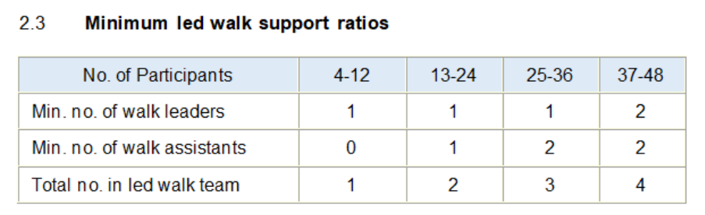
Rail to Trail - Ratio of Walk Leaders to Walkers
I prefer to work in multiples of 30
If there are likely to be 30 walkers, I would be the walk leader leading from the front with a mid marker walk assistant and a back marker walk assistant
If there are likely to be 31- 60 walkers 2 such groupings would be established
If there are likely to be 61- 90 walkers 3 such groupings would be established
Each walk leader would trained and experienced, know the route, have a map, be first aid trained, have an appropriate DBS and be confident to manage any emergency

Slide 7
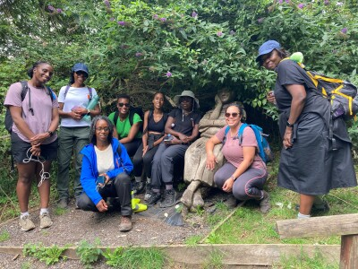
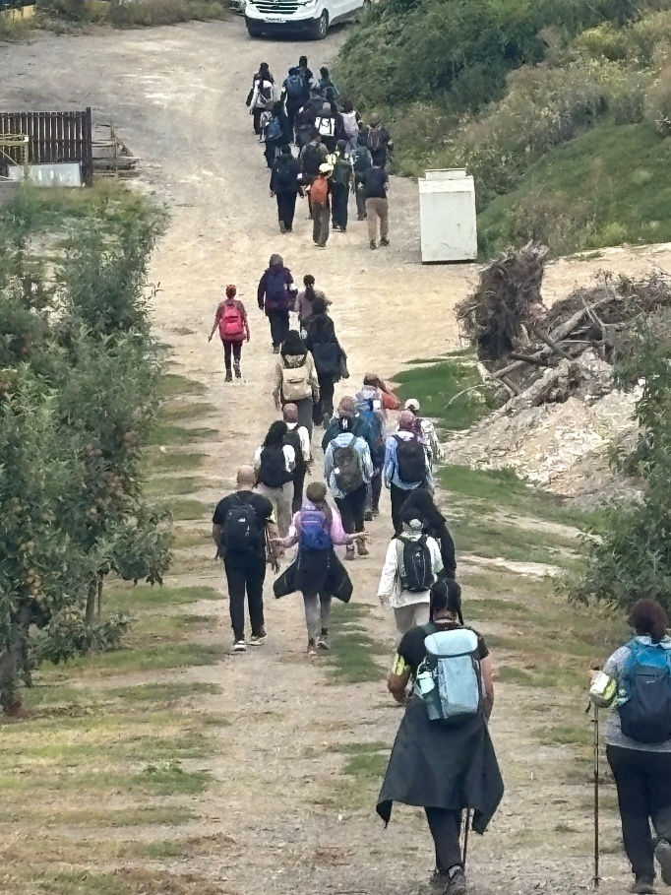
Rail to Trail – Managing Safety at Scale
Registration of all attendees – this can be undertaken per group of 30 or so participants
In Case of Emergency (ICE) details
Walk assistant briefing
Walk participant briefing, distance, rest stops and how road crossing will be managed etc.
Emergency procedures – e.g. identify first aiders
Weather contingencies
Accessibility considerations
Black Girls Hike – London Branch
“This has been a great day, so much shared and learned”
10 miles Charing to Hollingbourne
101 Muslim Hikers – London Branch
“I didn’t know this (the trail) was so close to London.”
14 miles Wye to Canterbury Cathedral

Slide 8
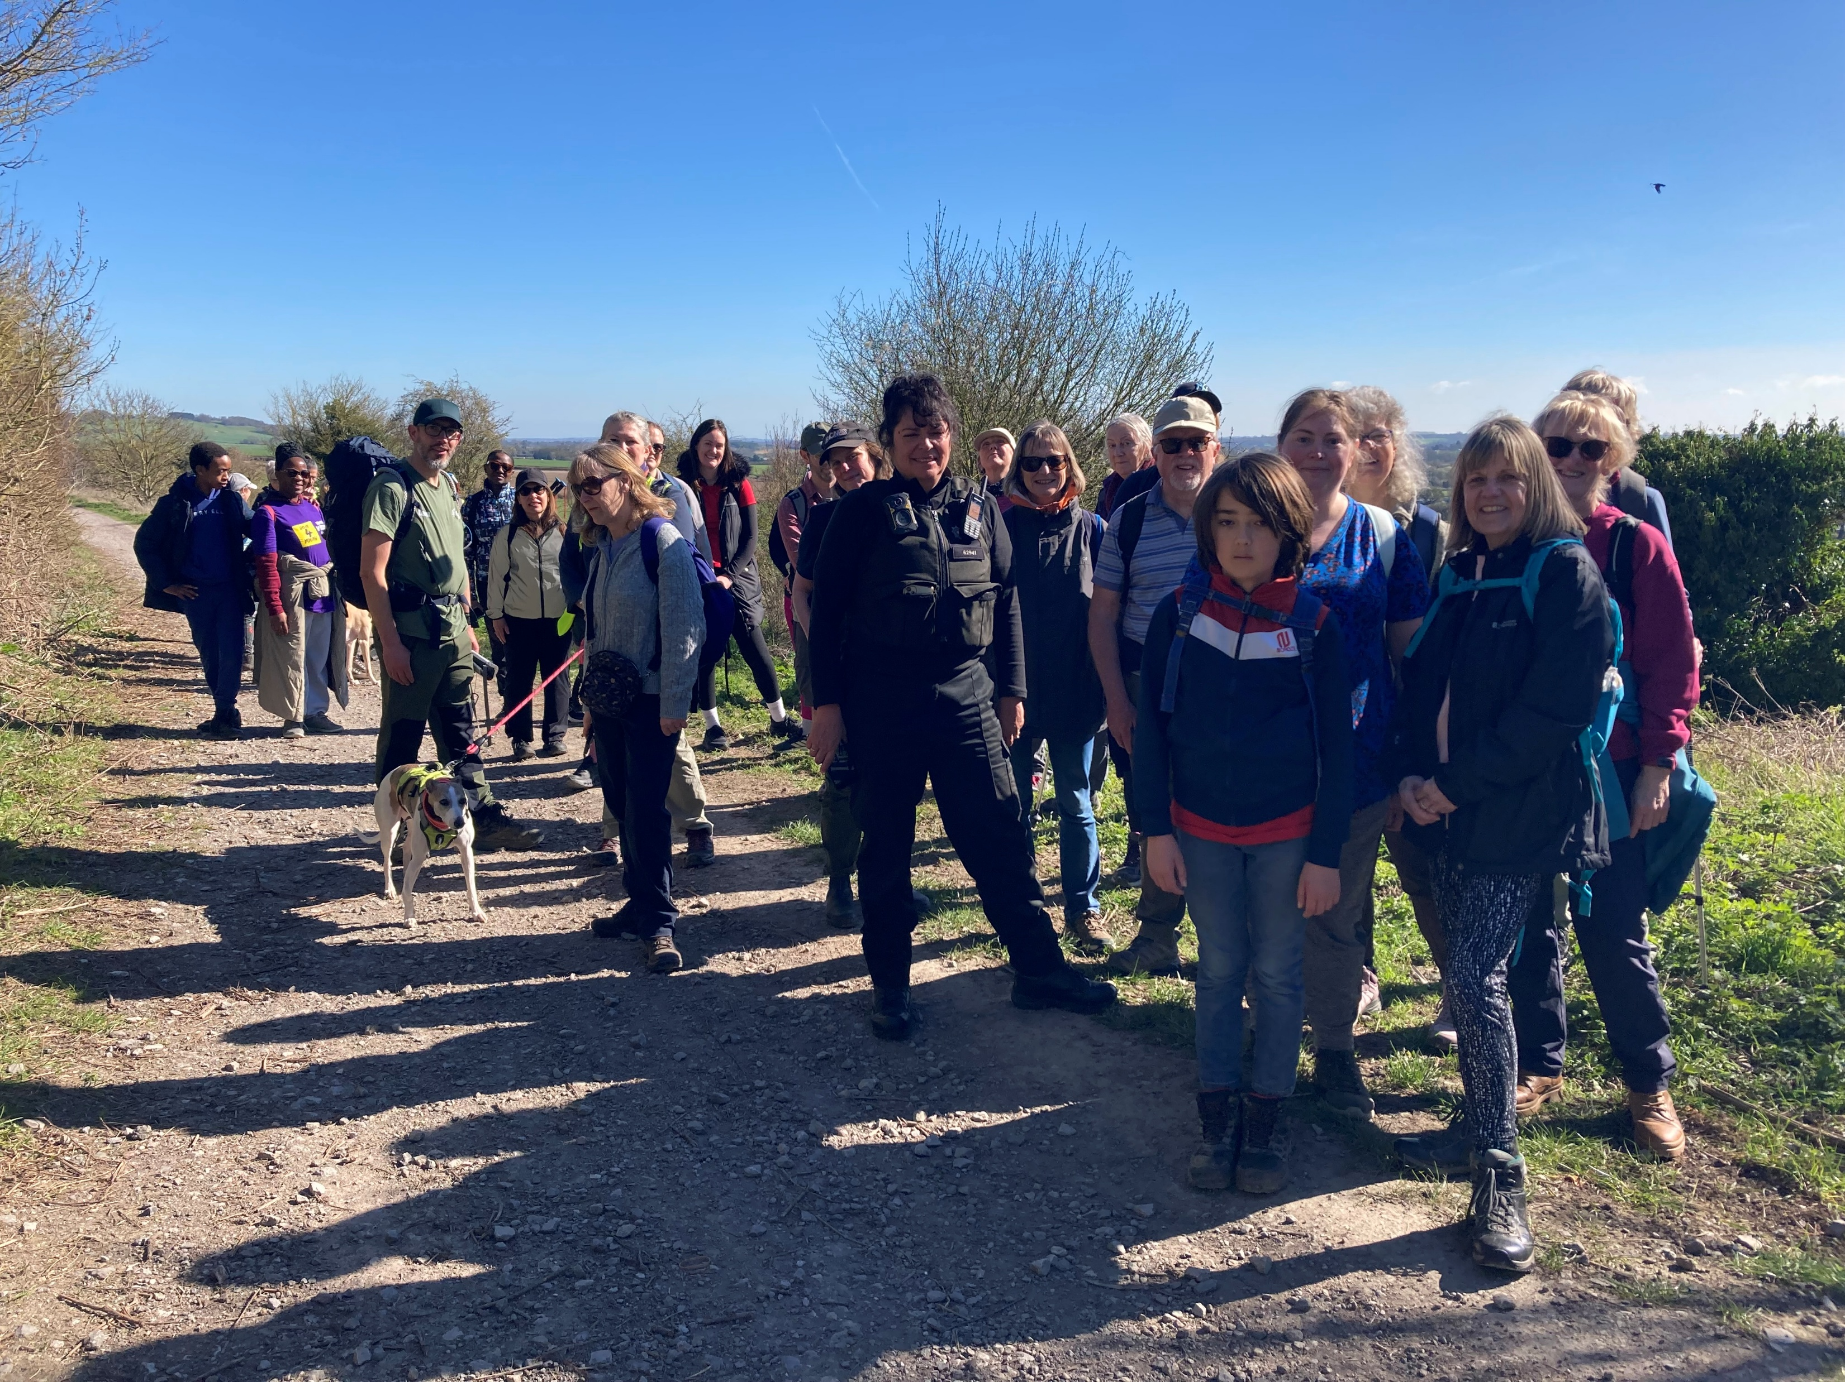

Rail to Trail - When Things Don’t Go to Plan!
10-mile guided walk Charing to Hollingbourne along North Downs Way
100 places made available on Beyonk booking system - 80 walkers signed up to attend
37 participated on the day!
Expect at least a 25% drop out rate if the walk is free - % will be higher if inclement weather
A poorly train traveler was taken ill on the train, ambulance was awaited at Borough Green & Wrotham which delayed the train, so train traveled nonstop apart from Maidstone East to Ashford International therefore not stopping at Charing our guided walk start station!
Walk open to the public
Group permission Form

Slide 9
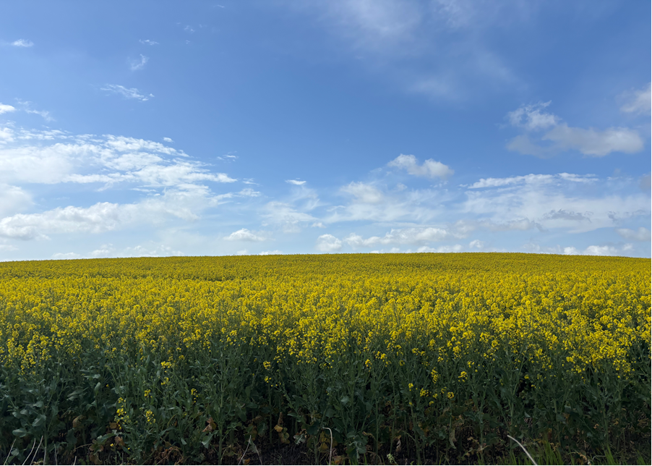
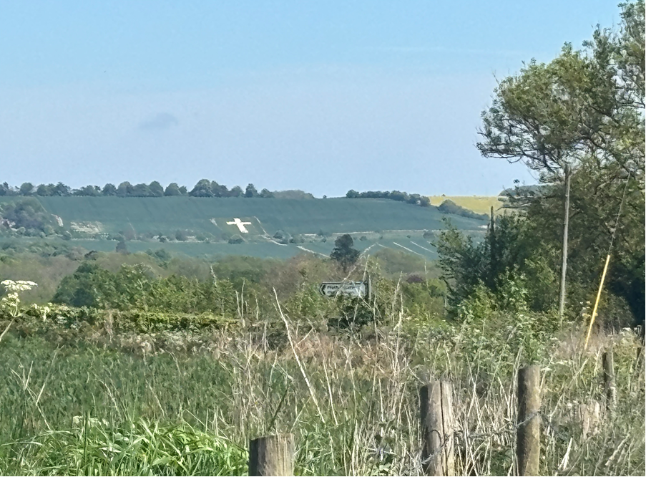
Rail to Trail – What Success Looks Like
Reasonable number of participants
Positive participant feedback – via surveys etc
Increased awareness of rail to trail routes
New partnerships formed
Repeat visits to the area planned by confident participants
Community is engaged with community rail, possible volunteer recruitment for future walks, station adoptions etc
Possible
Participant quotes
Participant feedback
Photos of the event
Rail to Trail – Top Tips
Start planning early
Build a strong walk assistant team
Communicate often
Work with partners
Keep the participant experience at the centre of the event
Have fun!

Slide 10
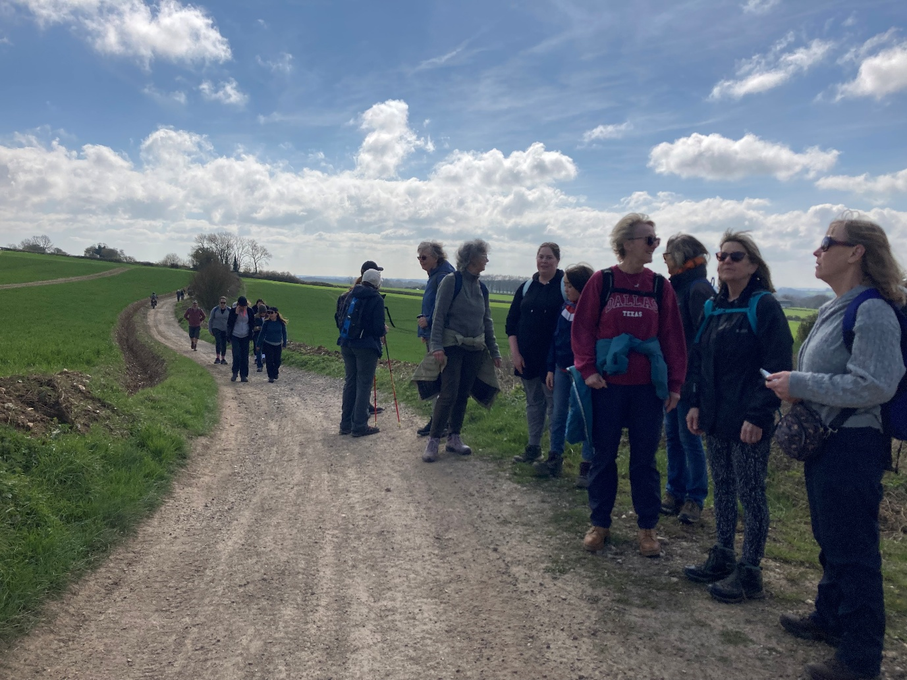
Rail to Trail - Participant Quote
A typical quote
“Hi Therese,
Just to say we really loved this event. Yourself and all the ambassadors were outstanding in your knowledge and engaging with presenting information on the route.
Due to going to this event, we are hoping to walk more sections of the North downs via train, but we would also love to attend any more events you organise in the future.
We really liked the Signal box cafe and would definitely plan a walk to end or start there!
Charli & Alex Stockdale”
Walk Participants

Slide 11
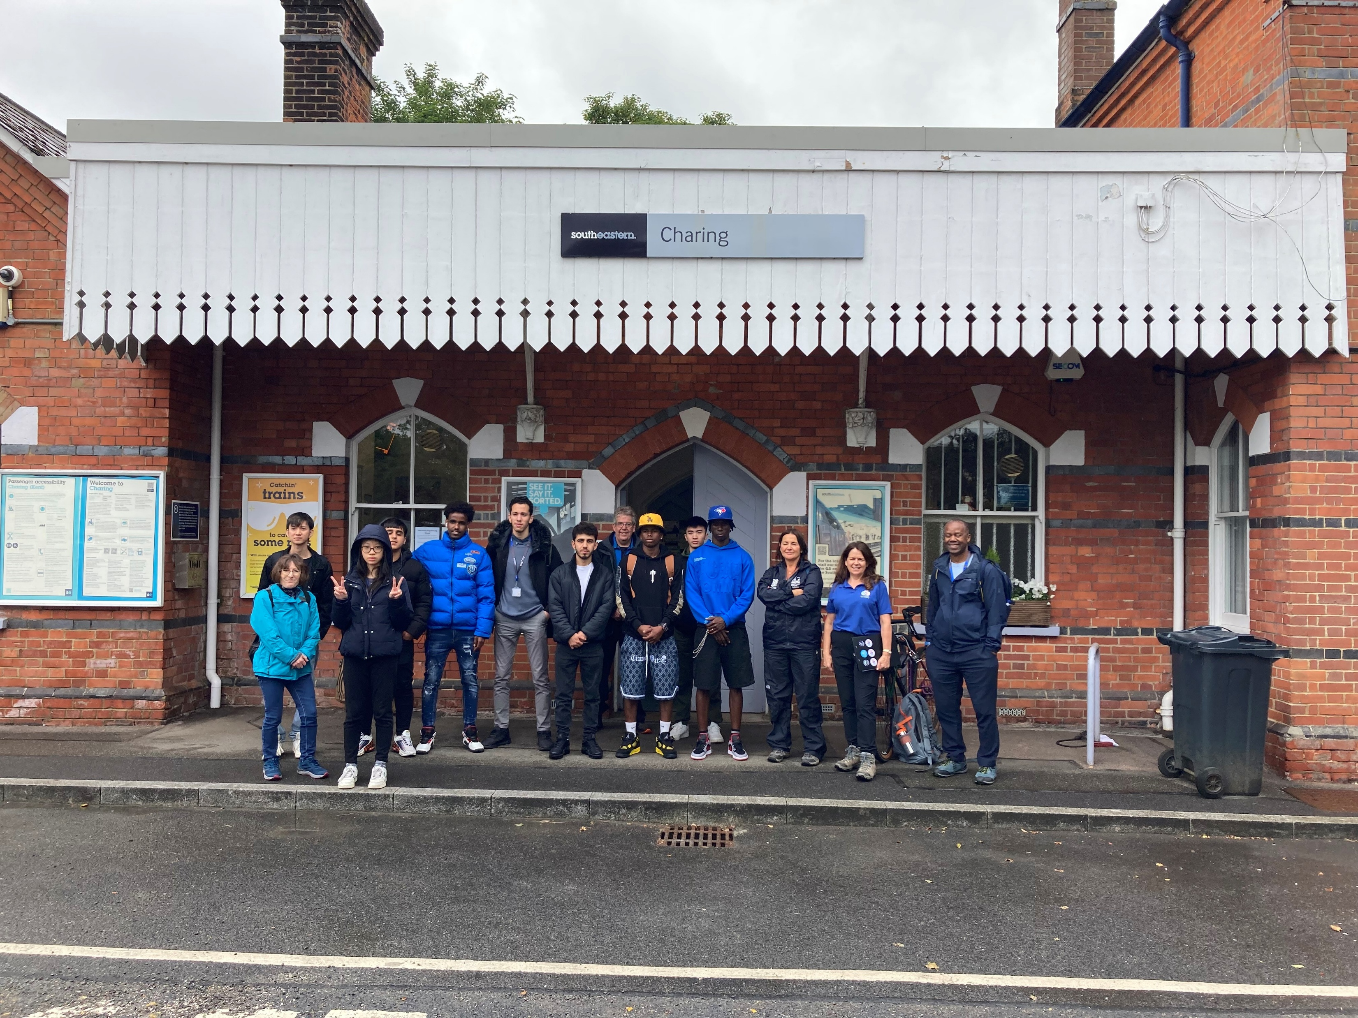
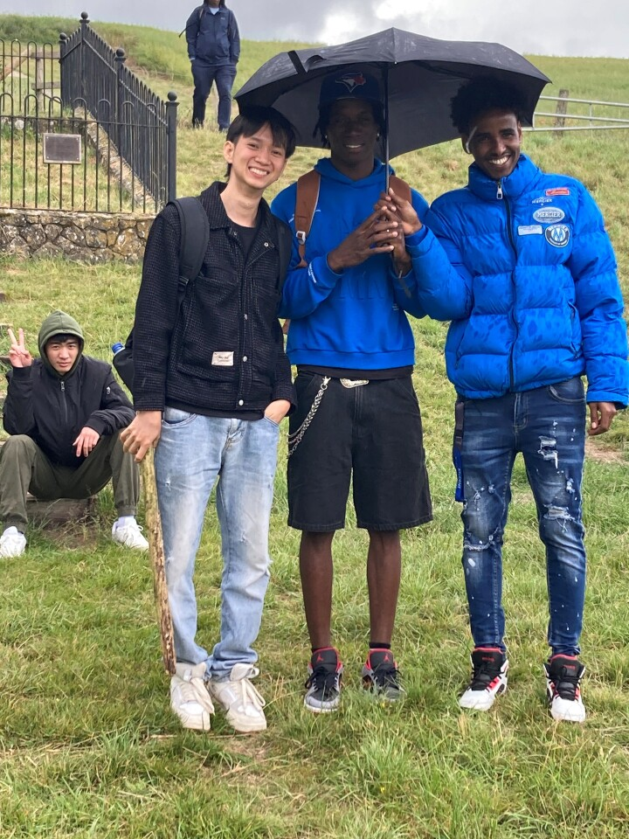
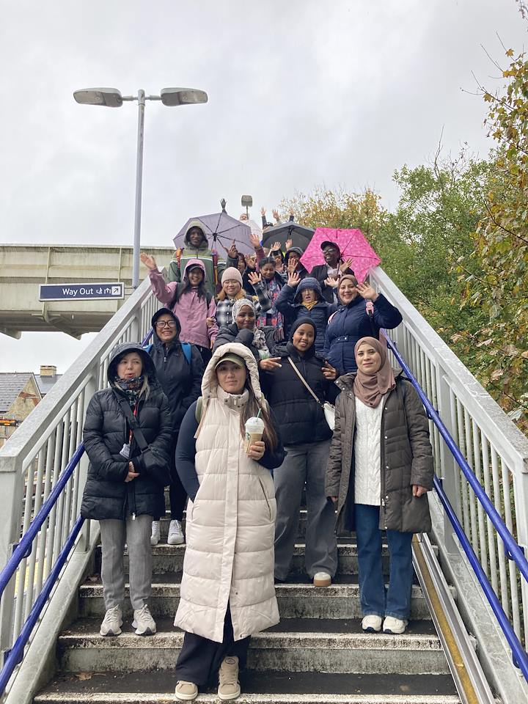
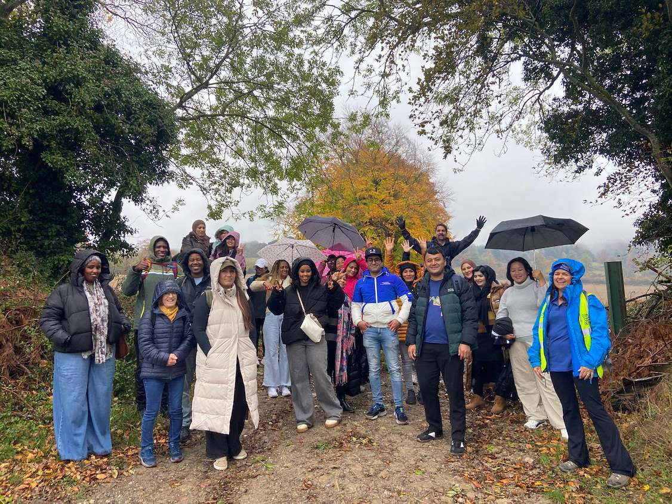
Rail to Trail – Q&A
Ashford College ESOL students
(Train travel training is combined within ESOL events)
Ashford College ESOL adult learners

