Slide 1
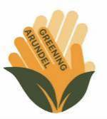
Greening Arundel’s Poetry Trail
Walks & Talks Skill Share
Katrina Murray
15 September 2026

Slide 2

Greening Arundel (2023 to date)
Local greening groups
Arundel Agenda 21
Arundel Bee Project
Arundel Castle Gardens
Arundel Community Apiary
Arundel Community Orchard
Arundel Gardens Association
Arundel Tree Wardens
Friends of Priory Pocket Park
Other local groups
Arundel Chamber of Commerce
Arundel Community Partnership
Governmental bodies
Town, District and County Councils
South Downs National Park Authority

Slide 3
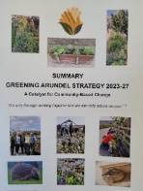
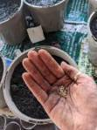
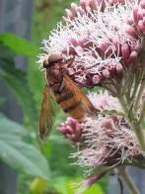
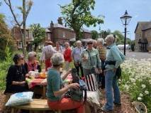
Nature Recovery through Community Engagement
Increasing biodiversity and bio-abundance
Enhancing green spaces
Protecting and nurturing wildlife
Reducing environmental harm
Engaging the community
Becoming sustainable

Slide 4

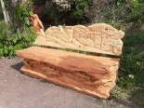
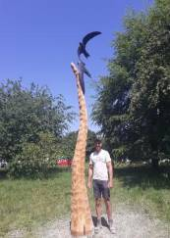
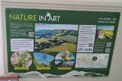
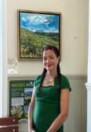
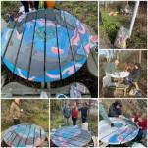
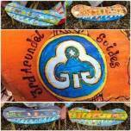
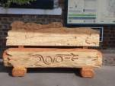
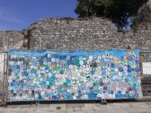
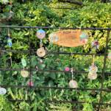
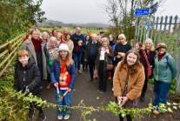
Nature in Art: Art in Nature
Multi-media
– Sunflower Parade, Nature Notes, Disc Display
Sculptures – benches and Screaming Swifts
Paintings – waiting room and picnic table

Slide 5

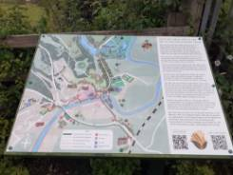
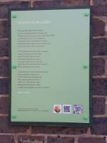
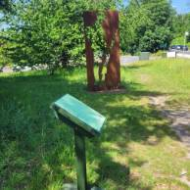
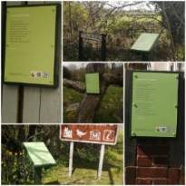
Creating the Poetry Trail
Funding obtained from GTR and CRN
Two local poetry groups
– 16 original poems inspired by nature/history
Recordings made by each poet
– NaviLens codes for those with visual impairment
Locations selected with landowner approval
Plaques and hand drawn map designed and installed

Slide 6
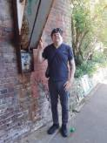
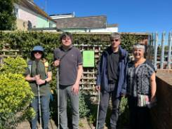
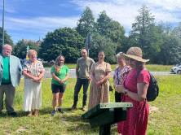
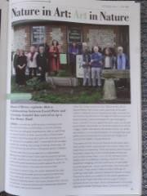
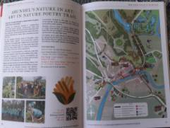
Testing and Promoting the Trail
Pocklington Trust – consultation and visit
Launch during Great Big Green Week
Arun District Council Reel on FB
Featured in Arundel’s Arts Festival programme

Slide 7
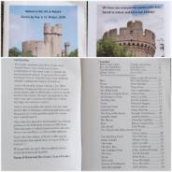

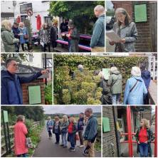
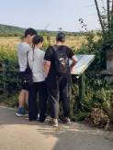
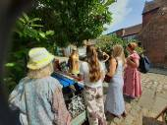
Hazards & Happy Days
Pocklington Trust collaboration
– hazard awareness and training guides
Attracting groups and individuals to visit
Inspiring young poets

Slide 8
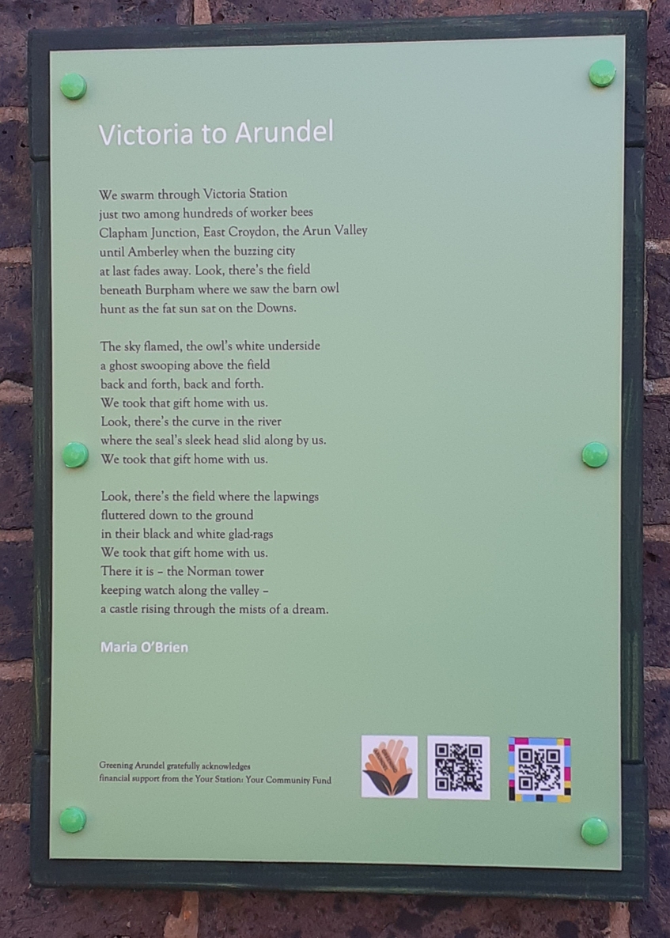

Check it out!
https://www.arundeltowncouncil.gov.uk/about-arundel/poetry-trail/
https://www.visitarundel.co.uk/discover-arundels-nature-in-art-poetry-trail/
https://www.arundeltowncouncil.gov.uk/victoria-to-arundel/
https://www.facebook.com/reel/1345183694440865
https://www.instagram.com/reels/DbTXX7fIa2c/
Follow - www.greeningarundel.com www.facebook.com/ArundelGreenTeam/

