Slide 1
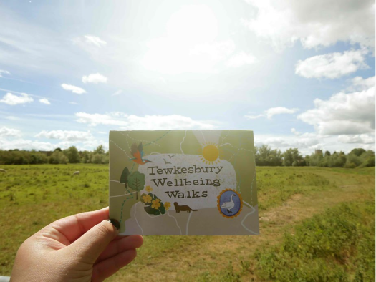

Walking with Communities
Co-designing the Tewkesbury Wellbeing Walks map
Notes:
Hi Everyone
My name is Faatimah, I'm the community rail development officer at glos crp
today i'm going to talk to you about Getaway, a project under our youth and education programmes.

Slide 2
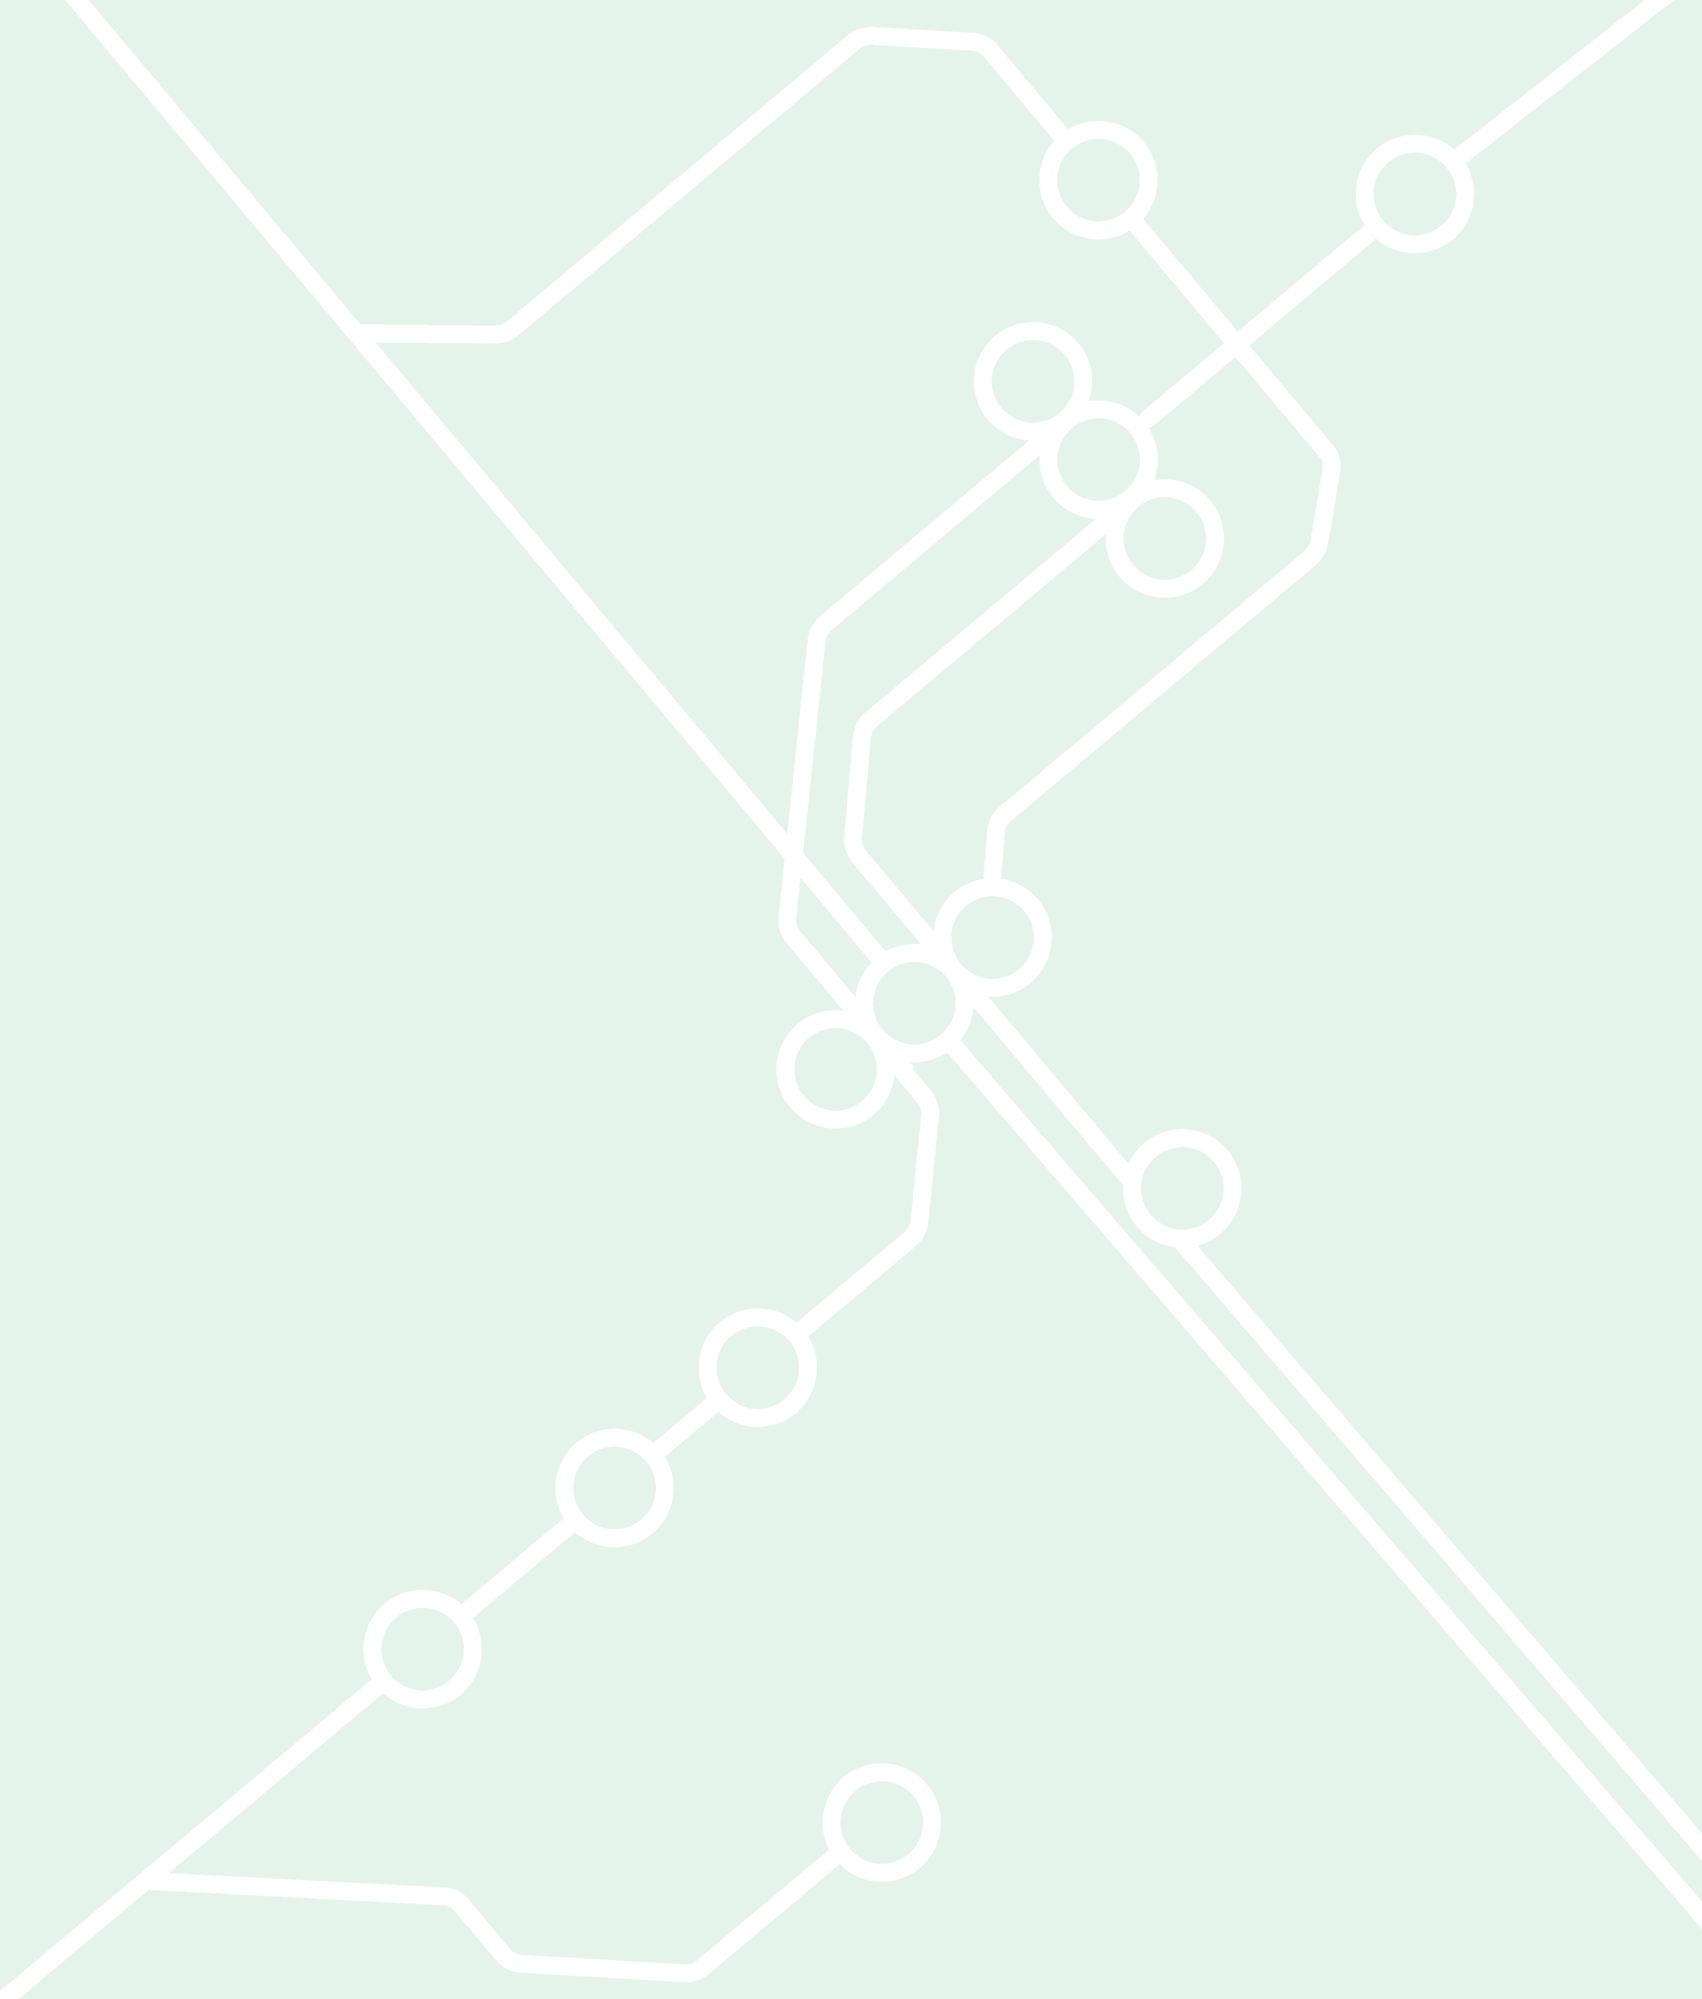
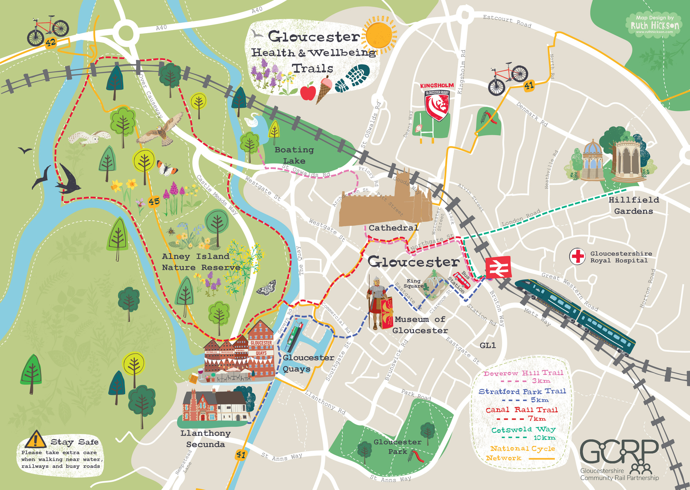

Why Codesign?
  We did not hold the local knowledge
  Local people shaped the map from the start
  Co-design was the foundation, not an add-on
Notes:
As GCRP, our vision is:
Our mission is:
So what does this mean?
We are talking about inclusion - across the board - an equal playing field for individuals and communities We are talking about equity - Acknowledging that different people have different needs.
We are talking about
sustainability - in the long term we are trying to influence change in behaviour that will be good for the reducing carbon and also connecting people better and people and places better.
SO to approach my project i'm considering these points.
But what do i mean by easier?
This is in terms of mental, physical and social.
When I say 'easier' -
- I am thinking about "specific requirements" for people and for communities.
in terms of mental wellbeing eg anxiety around rail travel, physical eg accessibility, linking to services available from train operating companies and onward travel from stations
and social - station as places - how do you feel? places influence how you feel and people's attitudes towards you may or may not make it easier to be in that environment.
where are you and what change takes place
to be inclusive you have to be exclusive

Slide 3




Collaboration
Who Was Involved?
CO-OWNERS
boardmembers & steering group
members
  Finding the right partners: - values and Trust
  Local Groups to involve: - Who is your audience?
  GCRP
  Art Shape
  Walking and wellbeing groups
  Nature reserve volunteers and staff
  Local residents and organisations
  Train station staff
INFLUENCERS
people engaged in volunteering, forums & panels
INCREASING DEPTH OF PARTICIPATION
ACTIVE
PARTICIPANTS
peopleengaged in events, trips
& training
FOLLOWERS
engagements on social media
& website
Notes:
To set the scene - i'm introducing you to Gloucester train station and where we focused our project, and how our organisation mission and vision link to this.
2 minutes walk from glos train station is barton and tredworth.
Barton and Tredworth is the most ethnically diverse ward in Gloucestershire, is classified as a highly deprived area nationally
and 41.4% of Barton and Tredworth's population are from a diverse ethnic group

Slide 4

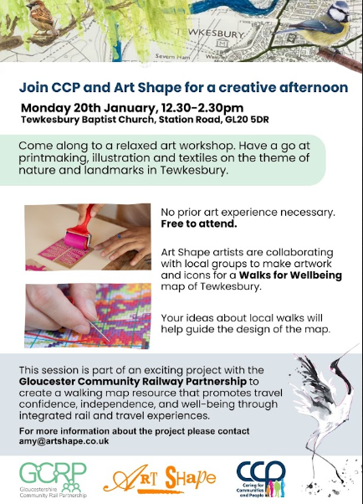
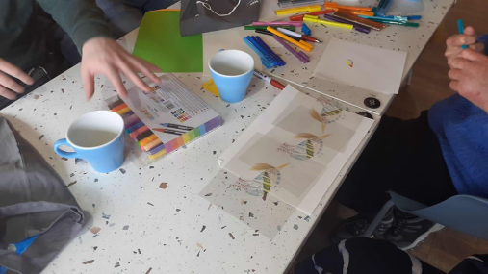
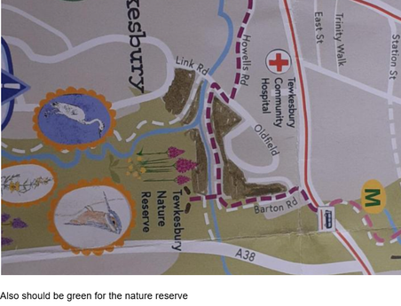
From local knowledge to routes
  Workshops gathered routes, places and stories
  Preparing partners re travel info
  Community insight identified hidden spaces
  Example: the 80-metre Secret Garden route
Notes:
For almost all diverse ethnic groups health related quality of life is worse compared to
white British people, in some cases being equivalent to being 20 years older than your actual age.
We know the benefits of being in the outdoors but
In the 2011 census, 13% of the UK population identified as black, Asian or minority ethnic but a 2017 Natural England study found 26.2% of black people spent time in the countryside, compared with 44.2% white people.
Separate report from Natural England estimated that people from BAME backgrounds account for just 1% of visitors to national parks despite making up about 14% of the general population.
this leads to Safety concerns and racial discrimination concerns.
Actually a 2021 study by uni of surrey found that this is thefundamental constraint on the choices of British Black and Asian travellers.
British Black and Asian survey respondents said word of mouth and online information were their leading sources of travel information, Focus groups delving into these answers revealed that they are largely driven by the need to identify how safe a destination is for Black and Asian travellers and to explore the prevalence of racism.
A good case study is the 'Muslim Hikers' group who have faced a lot of abuse, just recently actually on Countryfile...
between 2015-2019, an average of 19% of people lived in a household with no access to a car or van compared with 40 % of Black people and 33% of people from the Other ethnic groups.
Actually a more updated local stat from 2020 is - in B&T, 39% of households have no car in Barton and Tredworth compared with 26% across England
So how do we bring together these points..
Underpinned by the belief that the countryside is for everyone, and that young people should feel confident and independent whilst travelling by rail, we set out to develop opportunities for young people from diverse backgrounds to access the health and wellbeing benefits of being out in Gloucestershire’s rural spaces

Slide 5

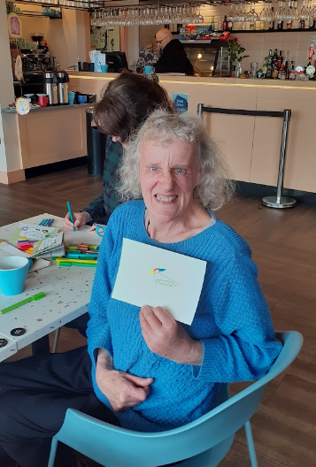
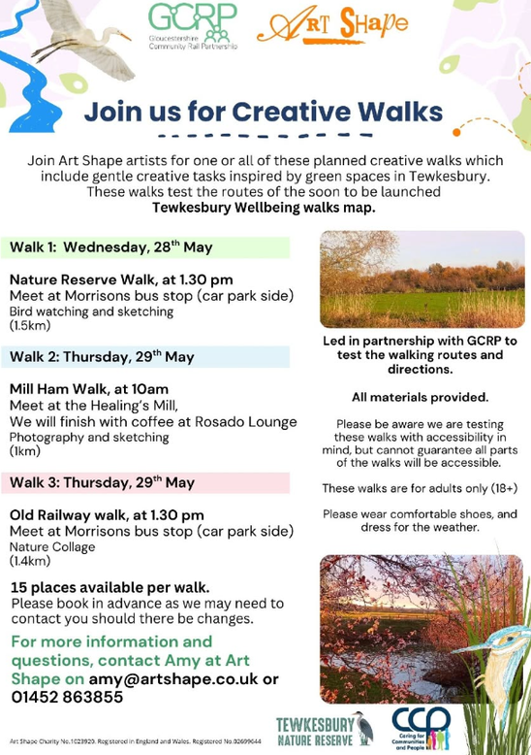

Testing the map
Following a soft launch to celebrate the work of participants who contributed the map, we tested the map with users:
  Phase 2 extra funding
  Checked clarity and usability
  Refined wording, icons and design
  Considering the testing group and location
Notes:
1st - asked older cohort to name project - it was explore and experience! named it getaway - gives them ownership.
the group leader that they trusted & felt safe with did workshops with them before/after trips so their voices were heard & plan where they wanted to go next.
So the org and yp wanted to bring in a creative element - & so they filmed vlogs on the trips and learnt to film and edit on the trips. - we put that into our funding application
Im there to facilitate
With younger group - important to listen to the youth leaders
Eg We took a refugee group on a trip - the leader asked if parents could come along because parents were unsure abt sending kids on their own - if it was just me...
This is all about building trust so im going to try make it easy for them, especially ont he back of my own experiences and also the research ive done. i have the experience of being stared at too in rural spaces and being uncomfortable or having racist things said to me. and i feel the impact of being used as a tick box exercise to meet diversity and inclusion agenda. People really feel that and i don’t eant to do it to someone else so
although im not black i am able to empathise and that helps with building that relationship.
So i did things like
Eg scope out area beforehand if possible, is it safe?
cultural appropriate clothes etc / not scared to ask questions eg croft farm appropriate swimwear
Station staff were engaged to ensure there were no public event clashes.
1leader had concerns abt his own exp in racial discrimination as a child &not wanting to go.
-trip to forst of dean. one yp has a perception of everyone is racist in the forest and when we got on the train...drunk rugby fans. leader there to diffuse the tension made it easier then me doing the same thing
I always made sure there was culturally appropriate food or ask group to organise and invoice us
photo permissions - not overusing as org or back of head to be sensitive to vulnerable grp

Slide 6

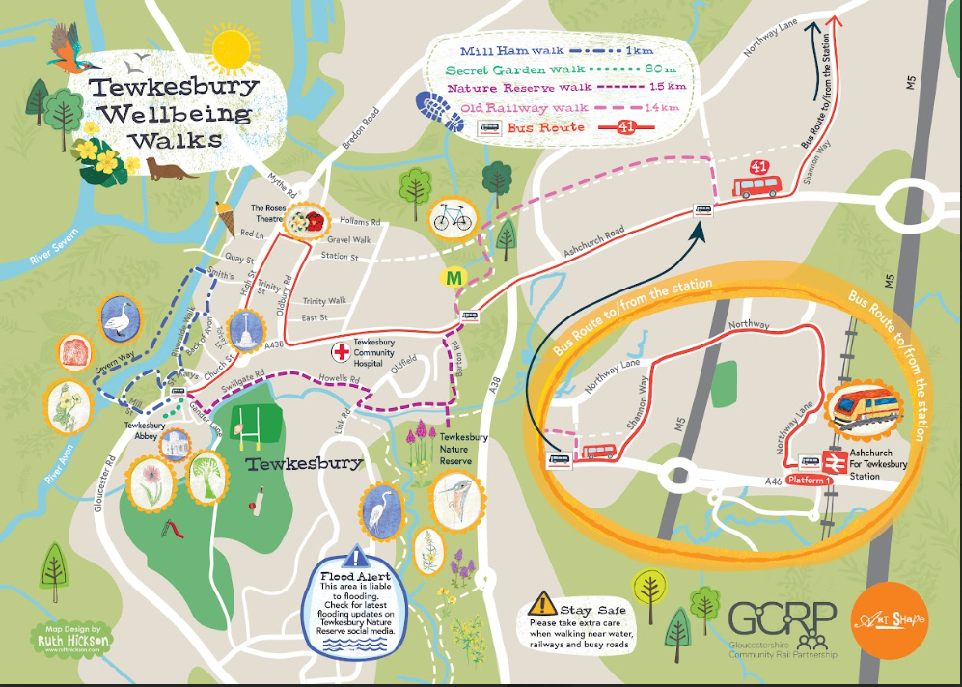
What we learned
  Start with a clear brief
  Give people a useful starting point
  Build accessibility in throughout - But what is accessibility?
  A beautiful map must also be usable
Notes:
so to finish up .
we are trying to make it easier for people to use public tranposrt - are we doing that - i'd like to think so from the comments that we are going in the right direction.

Slide 7

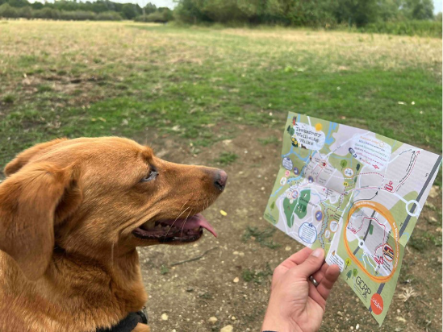
What worked well?
  Trusted local partners
  Creative facilitation
  Community-created artwork
  Local detail that gave the map character
Setting clear boundaries
  Not every suggested route fitted the brief
  Accessibility and route length mattered
  Routes needed public transport connections
  Co-design still requires decisions
  Building Trust
Notes:
How did we engage and empower?
1st The research matches our idea...but what does the community want?
We started by building on personal relationships we had in the community and through that, approached oranisations that are trusted in the black and brown community in glos.
We met them where they were rather than expecting them to approach us and made sure that we were meeting the goals of comm organisation so that we could build a collaborative partnership.
We wanted to make sure we weren't doing the project to them - it had to be through the community group not the other way around as we didn't want to create any type of power dynamic or a top down approach-
so for example the music works, one of the community groups, is all about music. how can we input that into our project? (more about that on the next slide!)
We communicated exactly what we were offering in terms of the project ( that was one day trips out the rural spaces) and what resources we have (eg through train travel and TOCs and also funding for the day trips but also asking what resources the community group has, for example do they have staff, do we need to fundraise for that) - presuming what resources they have could have backfired if we hadn't planned in advance.
- so we werent prescriptive - the initial premise is there but the ideas had to come from them

Slide 8

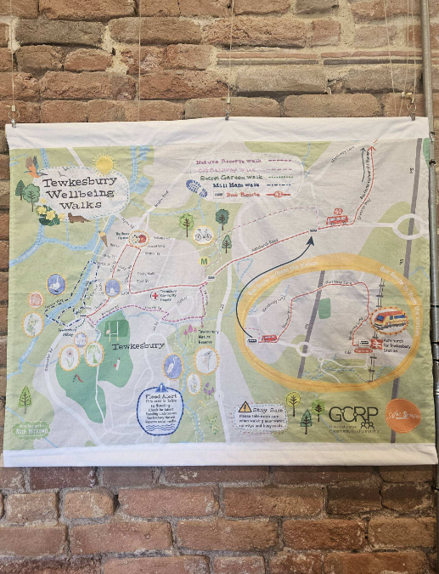
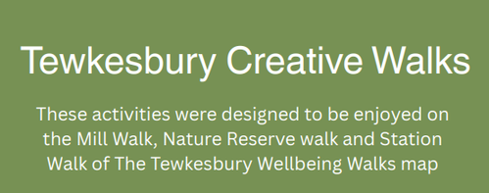
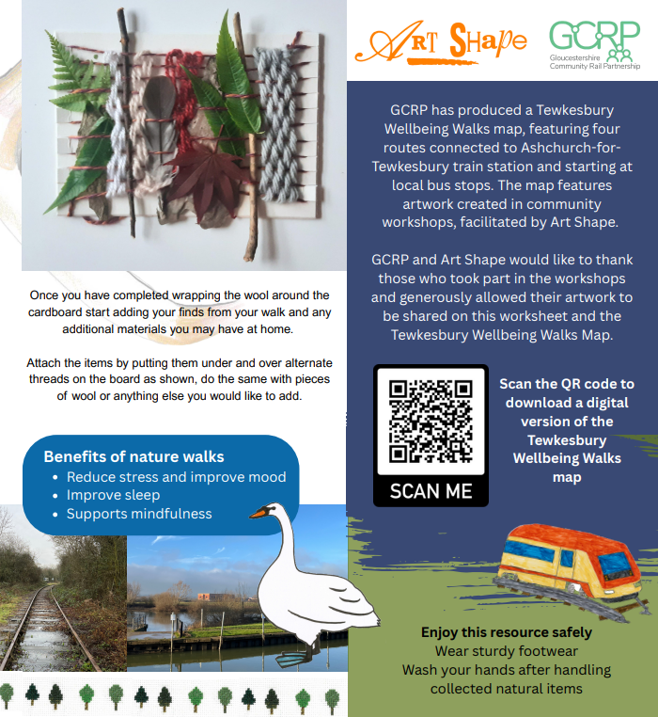
The Value of Building Trust
Notes:
year 1 38 new experiences...
Expanding horizons,
learning new skills,
building rail confidence.
year 2
5 trips for 121 young people
why has this happened?
confidence in us built and trust in us built
explaining basketball trip - came from a young person -
his idea. 33 young people turned up - i usually take 12 .
they trusted that i would deliver.
would we have such a big uptake from our own ideas?
already thinking about year 3 plans, with comm groups
who wants to build on more rail education and independent travel aspect,
more trips, longer residential trips
and as gcrp we are thinking about strategic partnerships as an organisation -
aspire to be chosen partner on reducing carbon- climate agenda
its something to be discussed further!

Slide 9
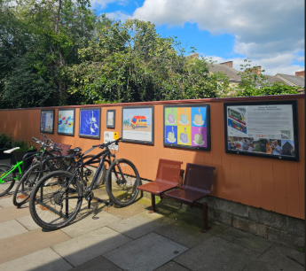
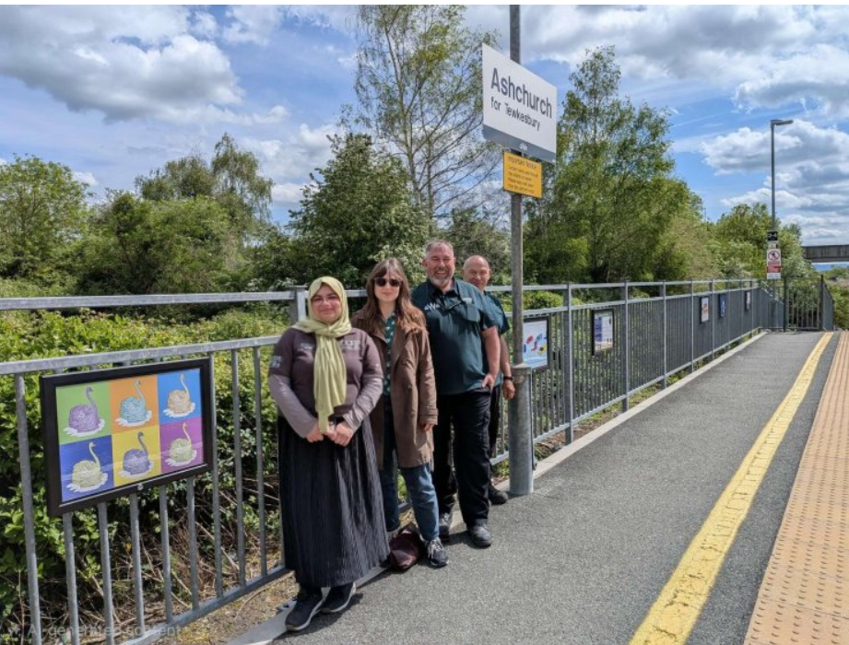
Ashchurch for Tewkesbury Community Gallery
Notes:
Video

Slide 10
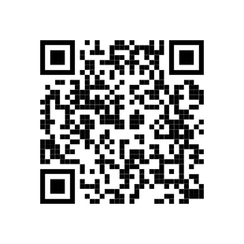
Thank you for listening!
www.gcrp.org.uk
faatimah@gcrp.org.uk

